Slide 1
Overview
See Dropbox link on http://april2017.mcstas.org and the Friday material
http://docs.mantidproject.org/nightly/algorithms/LoadMcStas-v1.html

Slide 2
Future: Multiple Scattering
https://github.com/mantidproject/mantid/issues/11945
http://media.mcstas.org/ESS_DMSC_20161117/DMSC_talk_MBertelsen_McStas_Union.mp4
Worked examples where best to put?
(in multiple-scattering concept page, in working-with-McStas concept page? …
need to include McStas version)
Enough test coverage?
Anything else?

Slide 3
Other
Take instrument design one step further (is used)
Pre sample analysis
Post sample analysis
https://arxiv.org/abs/1607.02498

Slide 4
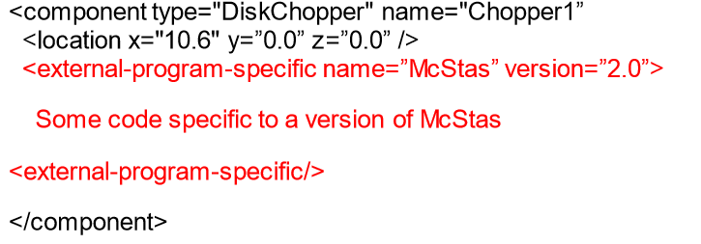
Mantid -> McStas?

Slide 5
Mantid -> McStas?
User could modify Mantid IDF and run McStas simulations on such
Where we have monitor data
Anything else where McStas/Mantid might be useful?

