Slide 1
How I use Mantid - and how I would like to use it
Doug Abernathy
ARCS Lead Instrument Scientist
Spallation Neutron Source
Oak Ridge National Laboratory
Mantid Users Workshop
June 12 - 13, 2017
Abingdon, UK

Slide 2
How I use Mantid
Data reduction at ARCS
Autoreduction
XML/python user controlled (legacy)
Instrument investigations using MantidPlot
User issues (history)
Detectors
Adding functionality
Fit function: Ikeda-Carpenter monitor
Algorithm: GetPhononDOS (legacy)
… and how I’d like to use it
Science directed, community driven
Visualization for 4-D S(Q,E) using event data, easy model inclusion, resolution convolution
Powder inelastic with community accepted corrections, resolution, phonon DOS

Slide 3
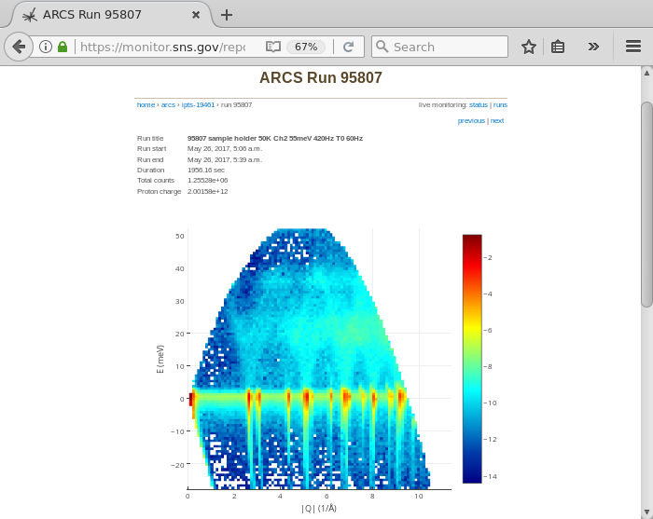
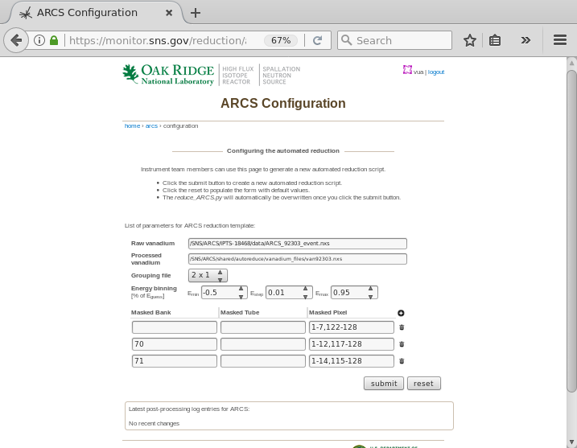
ARCS reduction
Autoreduction: monitor.sns.gov
Extension: multi-run reduction
Legacy XML controlled script (replaced DANSE methods with Mantid functions)

Slide 4
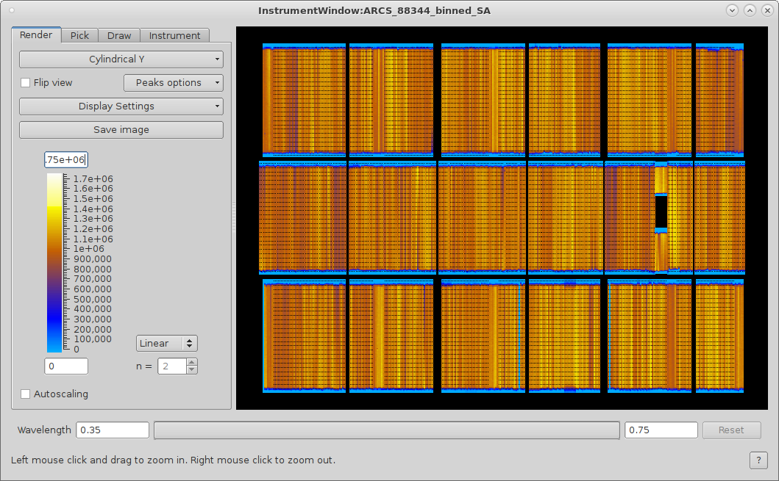
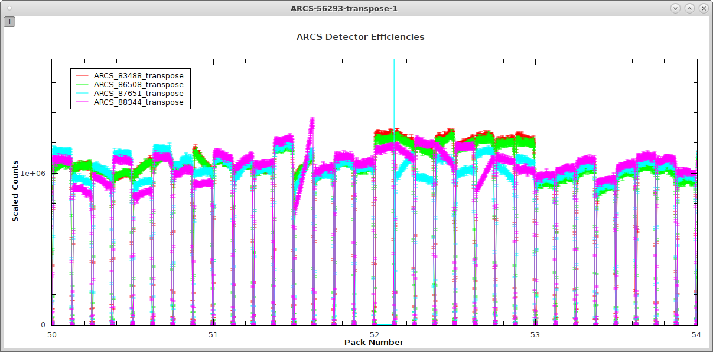
Investigations using MantidPlot
Example: detector efficiencies
Use history and python scripts to help users understand possible problems, find fixes (which vanadium run, combining data with different masks, etc.)

Slide 5
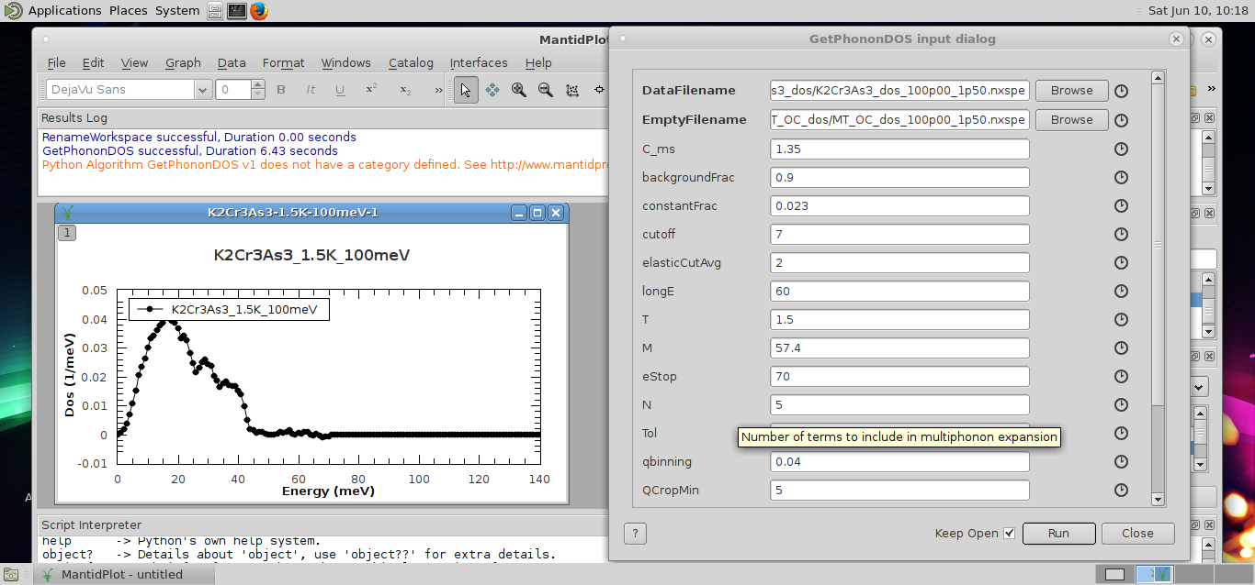
Adding functionality
Fitting: ICmonitor.py
Ikeda-Carpenter source term used to fit downstream monitor data
Algorithm: GetPhononDOS (J. Niedziela, Fultz group)

Slide 6
… and how I’d like to use it
Mantid as a base for science-directed, community-driven analysis software, e.g.
Visualization for 4-D S(Q,E) using event data, easy model inclusion, resolution convolution
Need to demonstrate current capabilities are covered and some additional features provided (speed, resolution corrections, model fitting)
Powder inelastic with community accepted corrections, resolution, phonon DOS
Incorporate best practices for powder corrections (absorption, multiple scattering, multiphonon scattering, etc.) with documentation
Use multiple incident energy data from a single scatterer (resolution corrections)
Compare to other calculations, e.g. DFT codes (e.g. O’Climax)
What can we learn from other community projects (e.g. PDFGui)

