Slide 1
Diffraction report

Slide 2

Started by looking at last year list.
Pleased to see that some items are now done.
Some are still there (and been there for a long time eg. clever absorption algorithms) and
Some have seen some progress being made.
Mantid4 : feel is that it has to be done. Assurance that this should not take much time of
The developers who are dedicated to some of the current things being worked on.
Interaction : much better. Need to keep this kind of approach with more “on the ground”
Approach.
Renaming : need to be careful! Naming police ? How do we make sure algorithms are used
By others when it is a quick hack. COMMUNICATION.

Slide 3
Powder
Calibration and Data Reduction : use corrected values for unit conversion.
Compare how calibrations are done at both facilities to try and get the best of the data:
Peter/David to talk and get examples and validate with Helen (+someone from SNS)?
Absorption and multiple scattering : validate various algorithms. Check against existing
code (see eg PEARL). How do we define complex shapes easily….. CAD drawing. Pulgins,
3rd party software to make hull shape. Does it work
Total Scattering : Alan retires next year but should be Ok for a while
Mutidasets Fitting

Slide 4
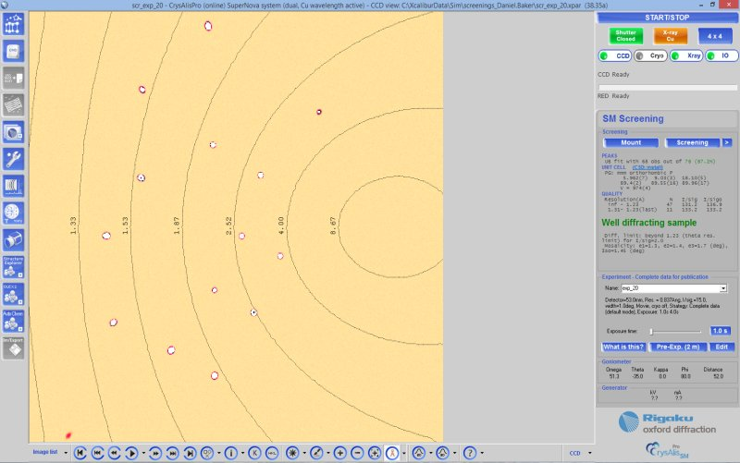
Single crystal
Progress noted but still a lot to be done to be on par with modern Xray software where
within minutes you have integrated peaks, a suggested structure, proposed strategy…
Automatic and Concurrent Data Reduction
intelligent routines tuning the parameters for best data quality.
Processed data always available and real time on-screen feedback of data quality and completeness. Full Complement of Crystallographic Tools
Tools and functions for dealing with non-standard and problematic data. These tools are available through the GUI or from a command line interface, and niclude advanced unit cell finding :
Ewald^{Pro} — Reciprocal lattice viewer, Twin data processing, Incommensurate data processing
Automated high pressure data collection and reduction, Face-indexing — with automated shape generation

Slide 5
Single crystal
Sort out calibration : need to include small detector offsets. Need to work for non-rectangular
Detector (keep promising this would not happen but it always happens….). It is essential that we
get a good UB for all the other algorithms to work properly. Porting UB to other datasets.
Interactive 3D GUI for rapid look at data “a la ISAW”. There has been some work on the VSI but
It is still very clunky. Simple output by clicking. At the moment, you have to be very familiar
with visualization filters to be able to operate it. It does not speak the language fit for purpose.
A lot of the users in this area are chemists who are used to software such as that just presented.
CrystalPlan to work for everyone !
Still issues with finding weak peaks. Look at what is done elsewhere (nsxtools at ILL). Machine
Learning.
Inherently, neutron scattering has more noise. Need a range of methods for integration.
Detector space, bayesian methods.
A long standing item : shape dependent absorption correction. This exists in nsxtools, TOPAZ
sometimes uses another program which could also be converted. CAD drawing, scanner.
Incommensurate structures.
3D Δ-PDF ? Needs much faster processing.

Slide 6
Engineering / imaging
Finish work in progress for imaging GUI.
Finish work in progress for fitting interface
IMAT : diffraction working when modules are all here(should be OK).
Bragg edge next. Flag up muons when this work is being done, lots of commonalities
Dynamic groupworkspace concept
Getting in and out of 3rd party software should be better handled (eg. GSAS). At the moment
We can read resolution function, cif file, etc… but we still make EXP or pcr files by hand.
Why ???
Nothing for texture yet. Needs something a la MTEX. Pole and inverse pole figures. Requires
Graphics so can wait till Mantid4 is up and running.

