Slide 1
Mantid Users Meeting Welcome Debbie Greenfield

Slide 2
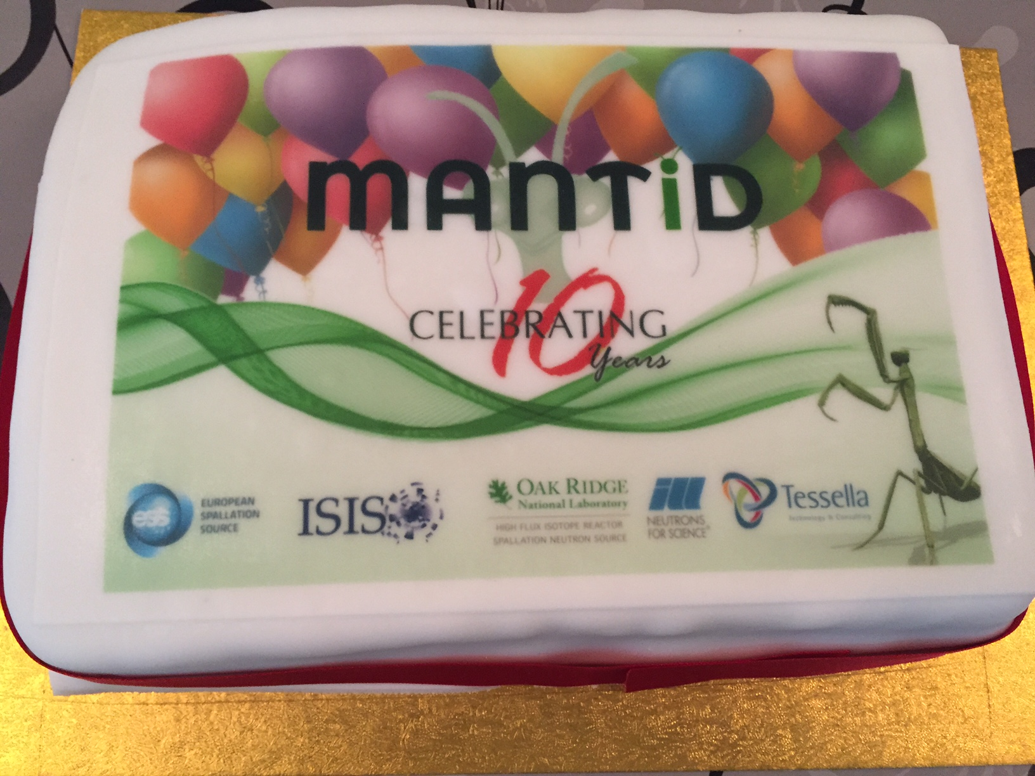
109 contributors
Over 71,000 code commits.
Over 1.5 million lines of code
Change - new collaborators – new challenges and opportunities

Slide 3
Users Workshop?
Previously ‘Scientific Steering Committee’
New format: ideally pre-meetings should enable more focussed input
Please feedback after the meeting
Please take the opportunity to challenge ‘requirements’ that limit sharing of code

