Slide 1
Technical Steering Committee
Peter Peterson
Chair

Slide 2
The Mantid Technical Steering Committee is responsible for providing recommendation for the technical direction of Mantid
To come up with the best technical solutions for a given major and submitted problems.
Provides answers to technical questions posed by the Project Management Board.
Provides recommendations on infrastructure and processes.
Deals with pull requests from entities that are outside the Mantid partnership.
Reviews and approves all Design Documents before implementation of proposed features.
Approves changes to the 3rd Party dependencies of Mantid, and makes recommendations for changes / updates.

Slide 3
5-year plan
Reliable and Stable
Separating user interface from core functionality
Mantid as SciPy styled libraries
User centric documentation
Extensible and flexible instrument geometry and units
Workspace types need to more efficiently reflect the science
Experiment steering
Advanced visualization
Mantid connecting to advanced analysis and modeling
Utilizing distributed and heterogenous computing environments

Slide 4
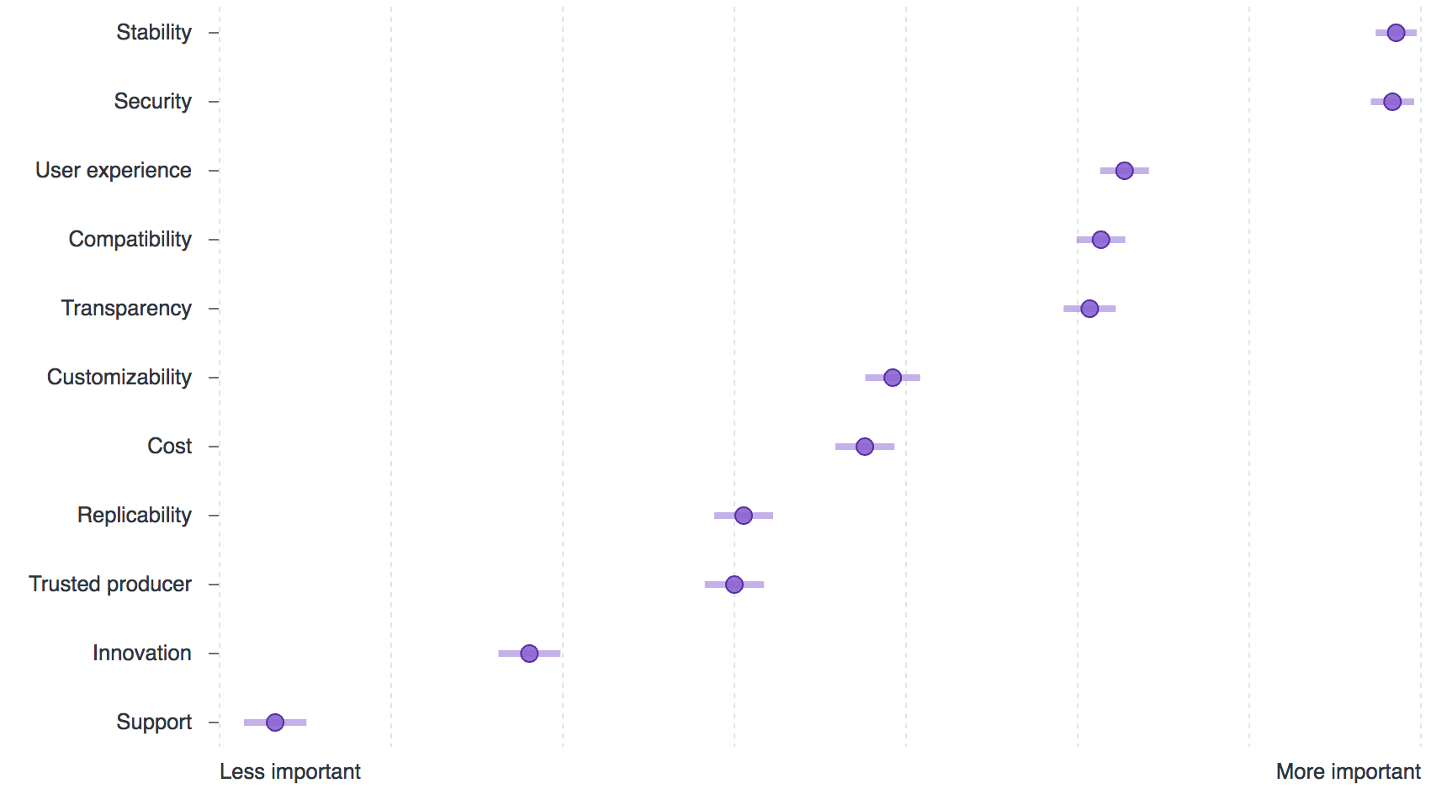
GitHub’s 2017 Open Source Survey
http://opensourcesurvey.org/2017/

Slide 5
Mantid 4 is a step towards the 5-year plan
User centric documentation
Mantid as SciPy styled libraries

Slide 6
Move from Qt4 and Qwt5
Qt4 has been unsupported since December 2015
Qwt5 requires Qt4
TechnicalSteeringCommittee/reports/MantidQt5.md

Slide 7
Supporting python3
Python2 is end of life in 2020
IPython will stop supporting python2 in 2019
matplotlib will stop supporting python2 in 2018
RHEL7 is python2.7 only
RHEL8 release date has not been announced
TechnicalSteeringCommittee/reports/MantidPython3.md

Slide 8
Package manager installs software into a user environment and allows for easy dependency management
Currently have mantid for python2 on linux64

