Slide 1
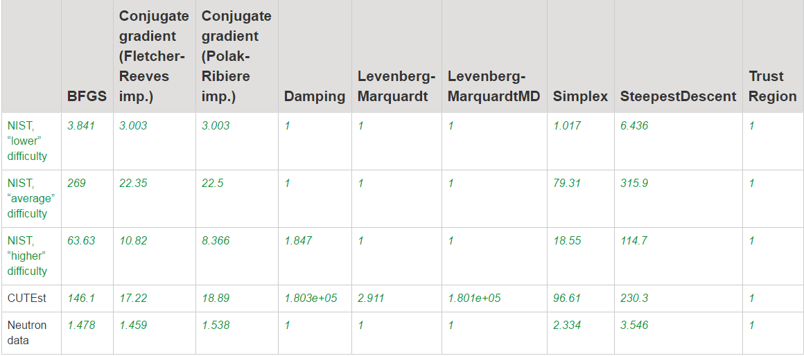
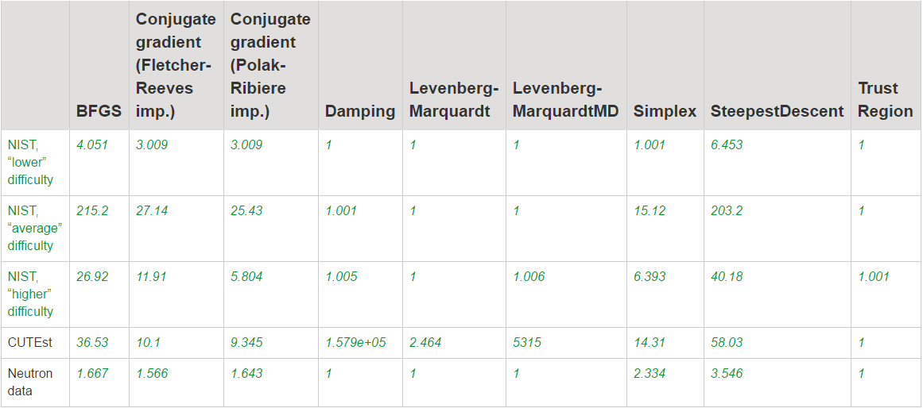
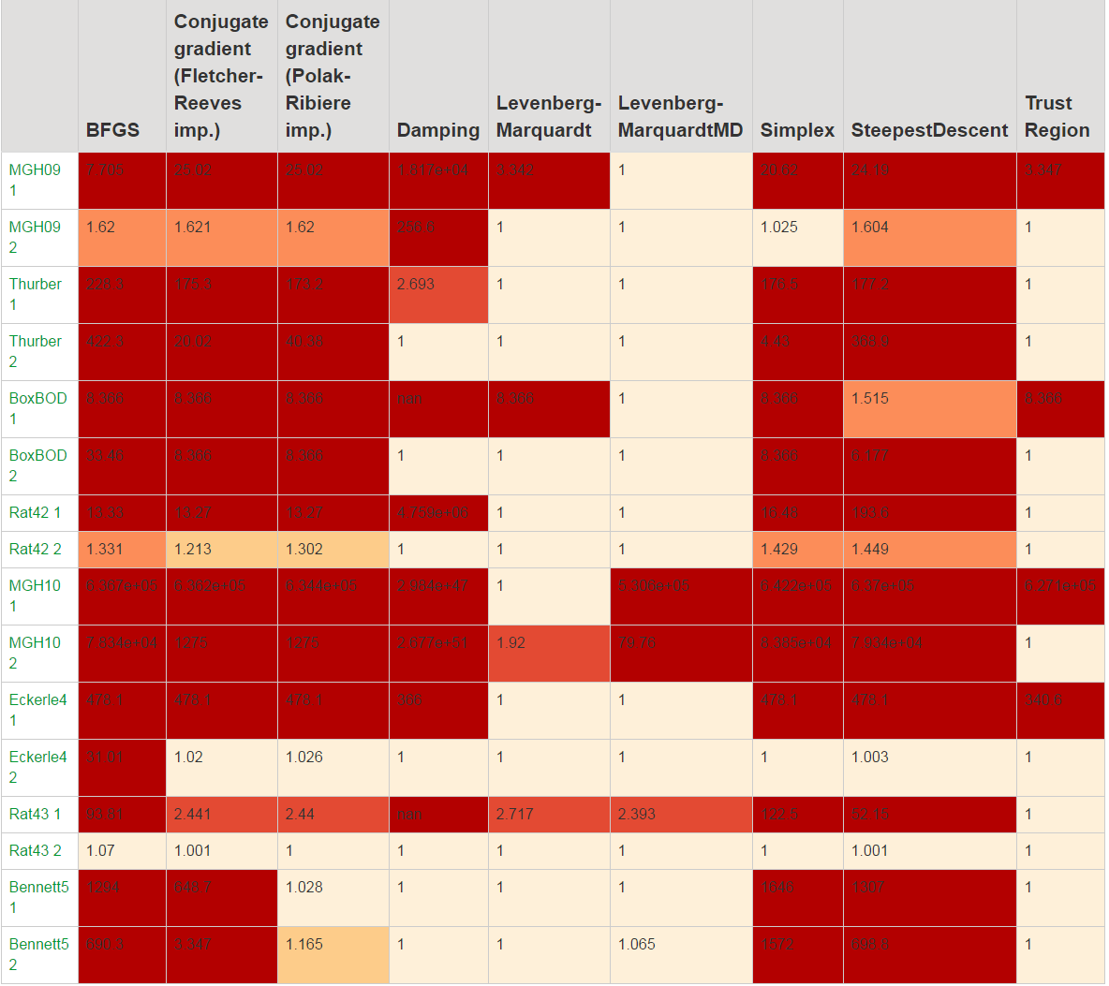
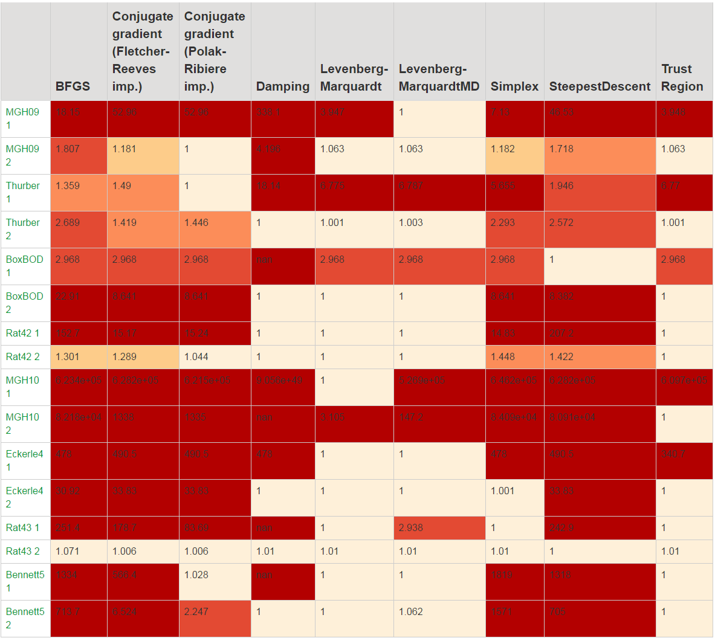
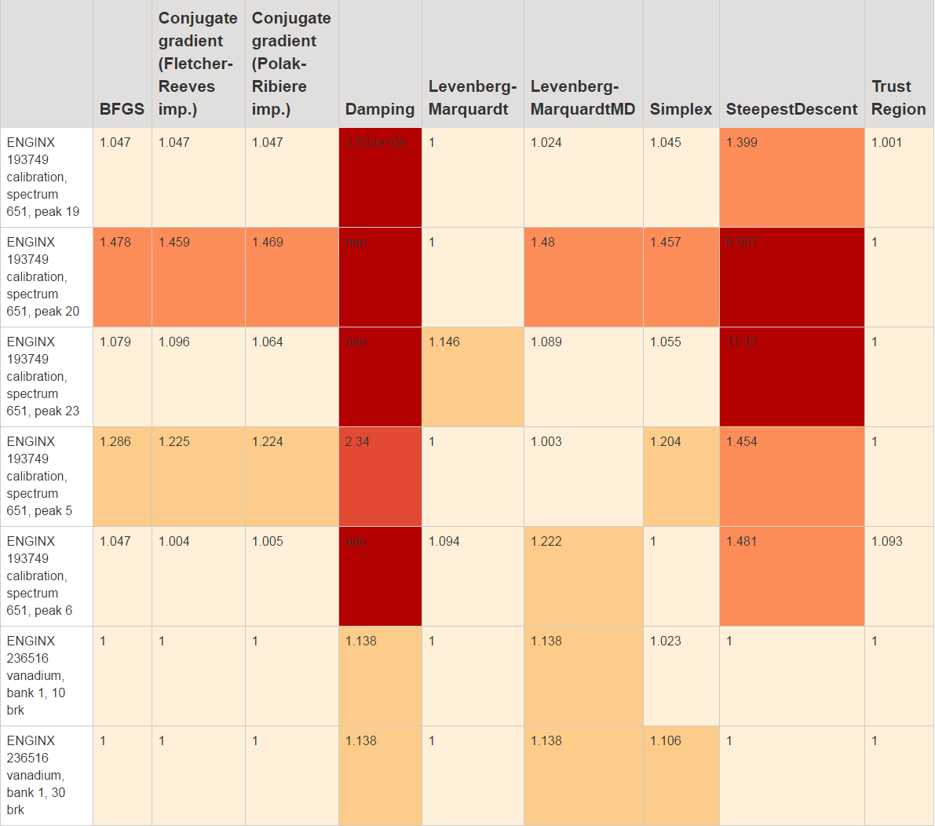
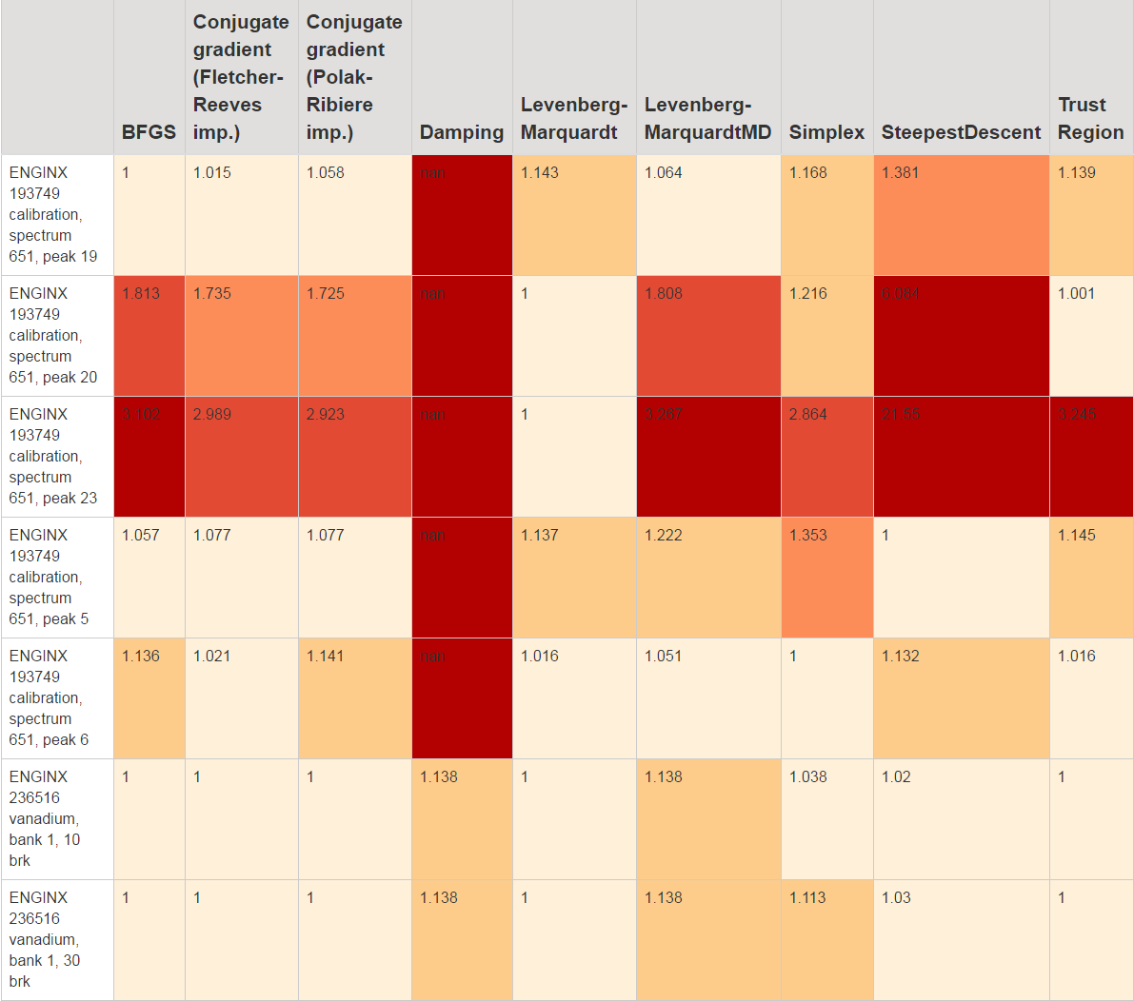
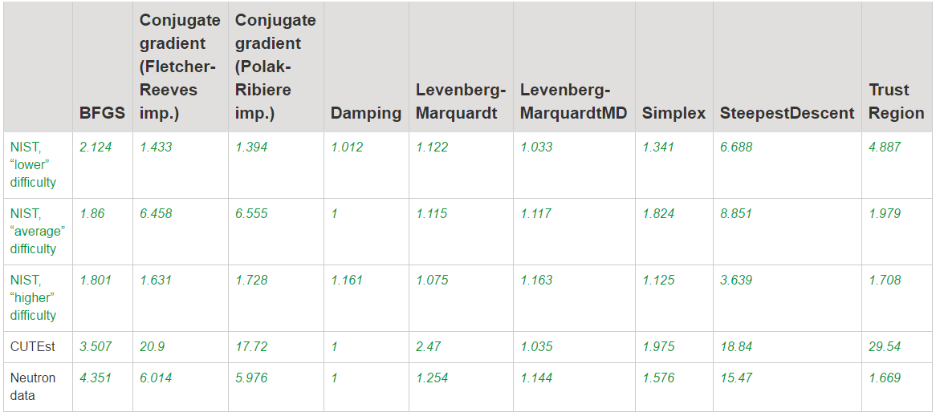
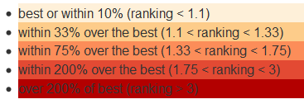






Comparing local minimizers for fitting neutron and muon data with the Mantid framework
Anders Markvardsen¹, Federico Montesino Pouzols¹, Roman Tolchenov², Thomas Perkins¹, Nicholas Draper², Tyrone Rees³, Nicholas Gould³, Jonathan Hogg³, Jennifer Scott³
¹ ISIS Pulsed Neutron and Muon Source, Rutherford Appleton Laboratory, Science & Technology Facilities Council – STFC, Harwell Oxford, OX11 0QX, UK
² Tessella, Abingdon, Oxfordshire, OX14 3YS, UK
³ Numerical Analysis Group, Scientific Computing Department, Science & Technology Facilities Council - STFC, Harwell Oxford, OX11 0QX, UK
Nonlinear regression benchmarks
Overview and aim We present a comparison of local minimizers for fitting a variety of datasets using the Mantid¹ framework. As well as mathematical test problems, tests have been performed using real neutron data. A new, flexible Trust Region⁴ minimizer has been incorporated into Mantid, and is included in the test results. The most used algorithm in Mantid is ‘Fit’ and the primary aim of this work is to improve this algorithm and thereby fitting in Mantid. Further, this framework for objectively comparing minimizers can be used by anyone to compare any new minimizer against the already compared minimizers. Currently, the best bet for a candidate to beat the default minimizer in Mantid is a new Trust Region minimizer. Also, as the neutron test suite is extended it may reveal certain best minimizers for sub-set of neutron fitting problems. Background Fitting is a core functionality in neutron, muon and x-ray data reduction and analysis software packages. It is required in tasks as diverse as instrument calibration, refinement of structures, and various data analysis methods specific to different scientific techniques. One such software is the Mantid software¹: an extensible framework that supports high-performance computing for data manipulation and visualisation of scientific data. It is used at several neutron and muon facilities worldwide. The Mantid fitting system offers the flexibility to add and combine different functions, minimizers, constraints, and cost functions as plug-ins. Users can apply different combinations of these elements either via scripting or graphical user interfaces. Minimizers When fitting a function to experimental or simulated data, the minimizer is the method that adjusts the function parameters so that the model fits the data as closely as possible. The concept of how close a fit is to the data is defined by the cost function. Several local minimizers are supported in Mantid (as in other software packages used in the neutron, muon and x-rays community). However, there is a lack of openly available comparisons between them. Trust region minimizer A new Trust region minimizer has been developed at RAL⁴, and preliminary results are included in the comparisons here. At each iteration, it calculates and returns the step that reduces the cost function by an acceptable amount by solving, or approximating a solution to, the trust-region subproblem. Neutron and other datasets As well as the NIST⁵ and CUTEst⁶ datasets, we present preliminary results for neutron data from different instruments at the ISIS facility. These datasets have observational errors, unlike the NIST and CUTEst problems and so, for a fair comparison, we present two sets of results: Unweighted (no errors) 2) Weighted least squares, using real errors for neutron data and simulated errors (square root of y) for other datasets Comparison For each test problem, the best possible results are given a score of 1. The relative score of a minimizer is the ratio between its performance and the performance of the best. We compare accuracy (sum of squared fitting errors) and run time. For example, a ranking of 1.25 for a given problem means: (for accuracy) The minimizer produced a solution with squared residuals 25% larger than the best solution in Mantid. (for run time) The minimizer took 25% more time than the fastest minimizer. The color coding used is shown on the right. | Run time | Future We plan to extend the comparison with more test problems from neutron and muon data, considering different science areas. Furthermore, on the basis of our comparisons, we intend to further develop and characterize the new, flexible Trust region minimizer, RAL-NLLS, whose aim is to improve the reliability and broaden the functionality of the Mantid fitting system. References [1] www.mantidproject.org [2] Kelley C.T. (1999). Iterative Methods for Optimization. SIAM series in Applied Mathematics. Frontiers in Applied Mathematics, vol. 18. ISBN: 978-0-898714-33-3. [3] Nocedal J, Wright S. (2006). Numerical Optimization, 2nd edition. Springer Series in Operations Research and Financial Engineering. DOI: 10.1007/978-0-387-40065-5. [4] RAL-NLLS: https://ccpforge.cse.rl.ac.uk/gf/project/ral_nlls [5] http://www.itl.nist.gov/div898/strd/nls/nls_main.shtml [6] https://ccpforge.cse.rl.ac.uk/gf/project/cutest/wiki/ This project has received funding from the European Union’s Horizon 2020 research and innovation programme under grant agreement No 654000
Unweighted data
Weighted with observational errors
Median accuracy, unweighted.
Median accuracy, weighted with observational errors.
Accuracy (median). NIST “higher difficulty” problems. Unweighted.
Accuracy (median). NIST “higher difficulty” problems. Weighted with observational errors.
Accuracy (median). Some neutron data test problems. Unweighted.
Accuracy (median). Some neutron data test problems. Weighted.
Median run-time Unweighted

