Slide 1
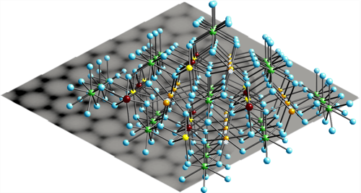
SetSampleMaterial + Absorption Corrections
ACS award winning image NaLaF4
Credit: Tara Michels-Clark

Slide 2
SetSampleMaterial
Material info from WS->sample().getMaterial()
AttenuationXSection
ScatteringXSection
SampleNumberDensity
Used by all absorption algorithms:
AbsorptionCorrection
AnvredCorrection
CuboidGaugeVolumeAbsorption
CylinderAbsorption
FlatPlaneAbsorption
HRPDSlabCanAbsorption
MonteCarloAbsorption
MultipleScatteringCylinderAbsorption
PearlMCAbsorption
SphericalAbsorption

Slide 3
SetSampleMaterial
Can input information directly:
AttenuationXSection
ScatteringXSection
SampleNumberDensity
One atom only requires ChemicalSymbol or Atomic number
Add MassNumber for ion
Compounds require ChemicalFormula, UnitCellVolume and ZParameter

Slide 4
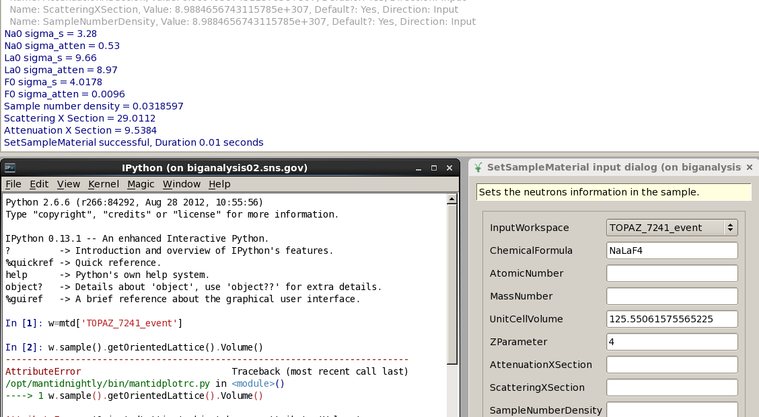
Example of Input

Slide 5
Material Class
Moved to Kernel
String parsing in Material Class
NeutronAtom::ReferenceLambda is used as default value
ChemicalFormula is a struct
Vector of Chemical symbol of each atom
Vector of number of each atom
Vector of Atomic number of each atom

Slide 6
Future Work
Tables from Atom and NeutronAtom should be in xml file
More options for entering molecules
General Molecule parser available?
Get UnitCellVolume from OrientedLattice.volume()
Fractional number of atoms

