Slide 1
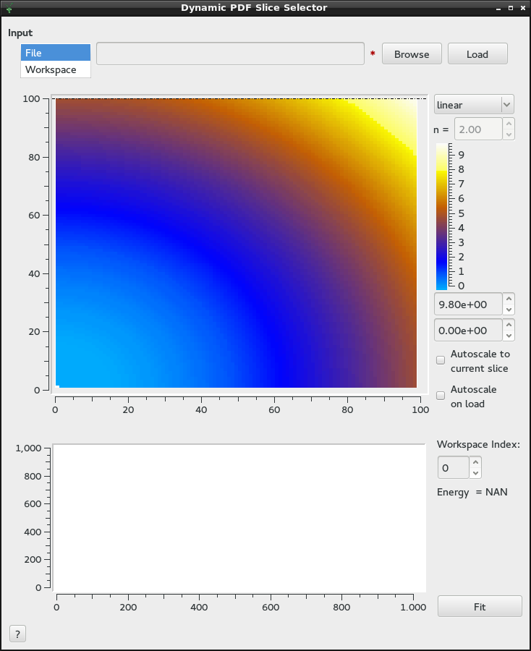
Data Loader
S(Q,E) Intensity Map
E (meV)
Intensities
Selector
Q (Å⁻¹)
Single Spectrum View
Intensity
Spectrum Selector
Q (Å⁻¹)

Slide 2
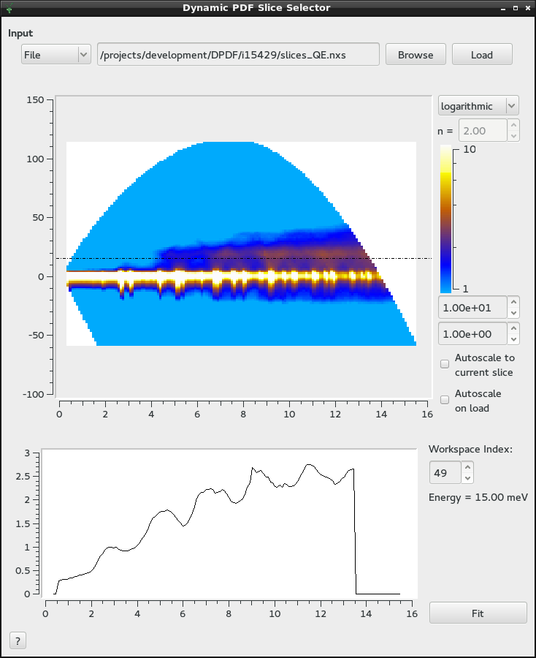
Slice Indicator
E (meV)
Q (Å⁻¹)
Intensity
Q (Å⁻¹)

