Slide 1
Possible ways to improve the stability of the nightly build

Slide 2
Reasons to improve mantidnightly
“Friendly” users
Basis for new features
Less spam email
Some instruments are under active development and need new features/fixes daily
Level playing field as more institutions join the collaboration
Division directors don’t ask why mantid is broken for an instrument
Patches don’t come out often/fast enough

Slide 3
3 versions installed at SNS
mantid – latest stable release
mantidnightly – latest successful system tested build of master
mantidunstable – latest successful clean build of master

Slide 4
The Joel Test
Do you use source control?
Can you make a build in one step?
Do you make daily builds?
Do you have a bug database?
Do you fix bugs before writing new code?
Do you have an up-to-date-schedule?
Do you have a spec?
Do programmers have quiet working conditions?
Do you use the best tools money can buy?
Do you have testers?
Do new candidates write code during their interview?
Do you do hallway usability testing?
http://www.joelonsoftware.com/articles/fog0000000043.html

Slide 5

Code Smells
I'm often asked why the book Refactoring isn't included in my recommended developer reading list. Although I own the book, and I've read it twice, I felt it was too prescriptive-- if you see (x), then you must do (y). Any programmer worth his or her salt should already be refactoring aggressively. It's so essential to the craft that if you have to read a book to understand how it works, you probably shouldn't be a programmer in the first place.
There's nothing wrong with codifying refactoring guidelines in a book. But the most important guideline is to watch for warning signs in your own code-- so called "code smells".
Developing your "code nose" is something that happens early in your programming career, if it's going to happen at all. I combined all the documented code smells I could find into this reference; most of these smells should be familiar to you.
http://www.codinghorror.com/blog/2006/05/code-smells.html

Slide 6
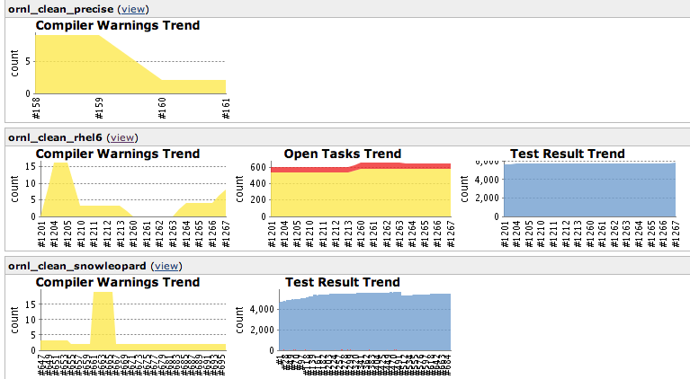
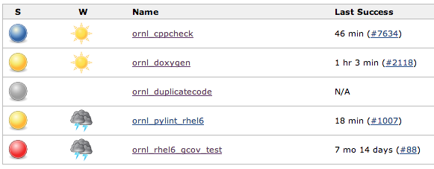
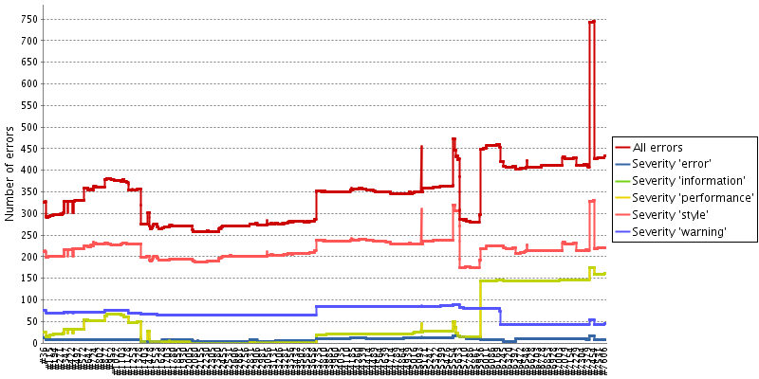
Static analysis
Traditionally:
Compiler warnings – supported compilers
Unit tests
System tests
Should:
Compiler warnings – any compiler
Missing api docs –doxygen
cppcheck
Consider:
pylint
cpd – duplicate code
gcov – test coverage
clang tools

Slide 7
A Note
External people consider all code in https://github/mantidproject as “Mantid”

Slide 8
Current Mantid Rebase Workflow
Write a testable ticket
Accept the ticket
Do stuff
Rebase/merge to prepare to integrate
Merge to master
Fix build servers
Close ticket
Wait a month and Stuart verifies the ticket

Slide 9
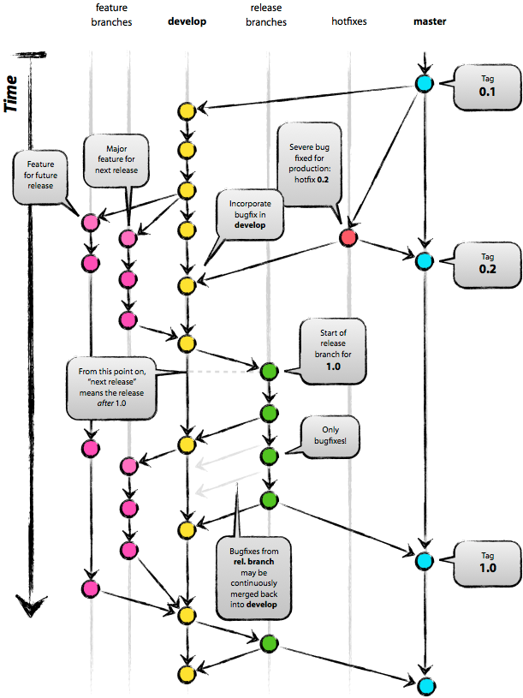
GitHub workflow
Fork on GitHub (click Fork button)
Clone to computer ($ git clone git@github.com:you/diaspora.git)
Don't forget to cd into your repo: ($ cd diaspora/)
Set up remote upstream ($ git remote add upstream git://github.com/diaspora/diaspora.git)
If you use git-flow initialize it: git checkout master && git flow init -d && git checkout develop
Start working on a new issue or feature ($ git flow feature start 100-description, naming convention is issuenumber-description, if you don't have a bug report no worries just skip the number)
Develop on feature. ($ git add . ; git commit -m 'commit message')
Push branch to GitHub ($ git flow feature publish 100-description, just to stop you losing local changes on the event of hardware failure)
Fetch upstream ($ git fetch upstream)
Update local develop ($ git checkout develop; git pull --rebase upstream develop)
Switch back to feature ($ git flow feature checkout 100-new-feature ; git rebase develop)
Repeat steps 8-11 till dev is complete
Rebase develop in to feature branch ($ git flow feature rebase 100-description)
Publish feature branch to Github ($ git flow feature publish 100-description)
Issue pull request for develop branch (Click Pull Request button)
https://github.com/diaspora/diaspora/wiki/Git-Workflow

Slide 10
ParaView workflow
Create a feature branch and “checkout”
Do stuff (resist “urge to merge”)
Merge into “next” and push to origin
Fix issues (from build server) on feature branch and re-merge into “next”
Stuart verifies the work
Merge topic onto “master”
Delete the branch
http://www.mantidproject.org/Git_Workflow

Slide 11
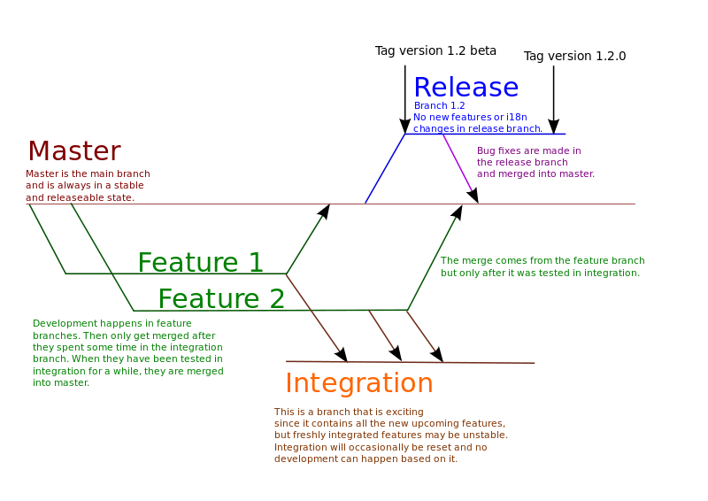
KDE workflow
http://community.kde.org/Frameworks/Git_Workflow

Slide 12
Changes to build servers
Duplicate incremental (and clean?) builds for integration branch
mantidunstable is the result of successful integration
mantidnightly is the result of successful “master” build

Slide 13
Verification throughout dev cycle
Currently:
7 weeks development
2 days testing
3 days hoping nobody notices you aren’t testing
Future:
8 weeks development with verification throughout

Slide 14
Possibilities for testing
Close a ticket, verify a ticket
Testing Fridays (5 days of testing increases to 8 days)
Look for testing tickets first/last thing every day
Change the development culture to test more often
Things merged into master by the tester

Slide 15
Extra benefits
All builds of “master” are releasable – just add unscripted testing and a version number
Patch releases require (almost) no extra review
Only “fully baked” features are in a release

Slide 16
Problems
Ticket cruft in trac
Merge emails
Broken change set links in tickets
Difficult to see what is going on
Educating people in new workflow
Is code merged into master only after verification by the tester or gatekeepers?

Slide 17
Recommendations
Turn all warnings back on
Warnings day
Explore additional static analysis results
“Own” all code in mantidproject/mantid
Verify tickets during release cycle

Slide 18
