Slide 1



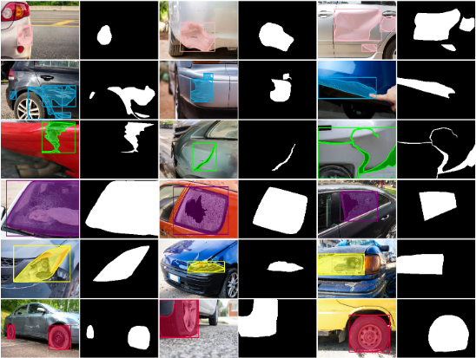
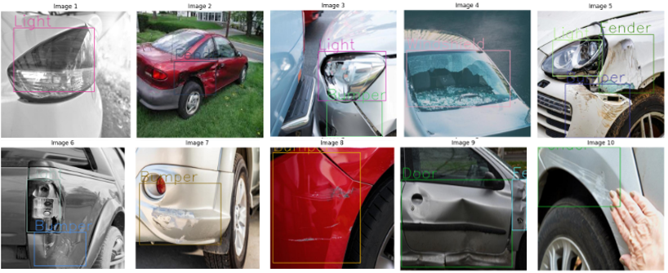
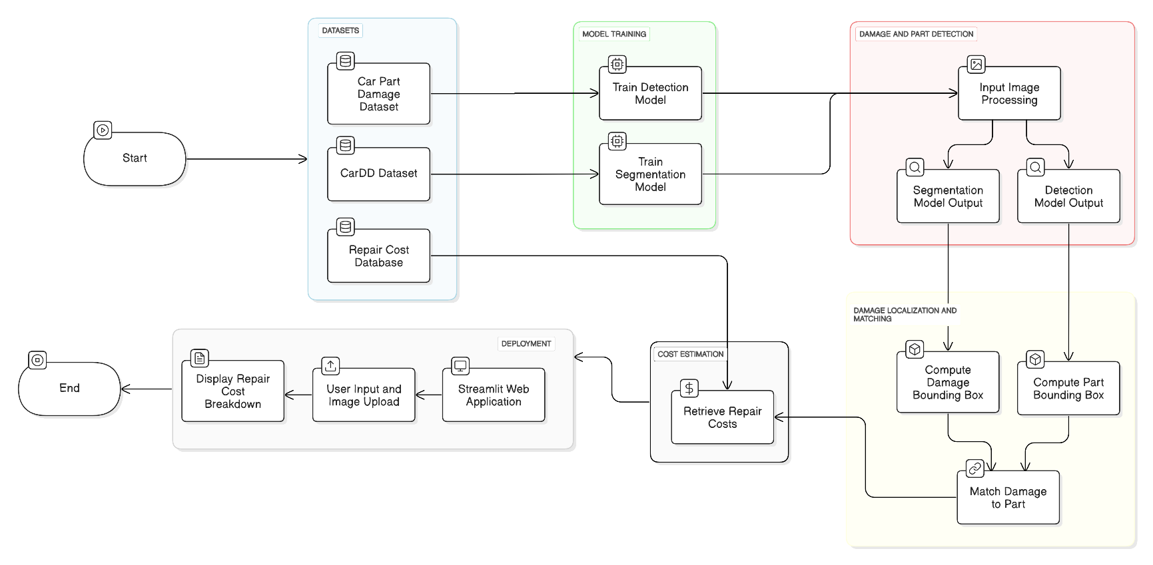
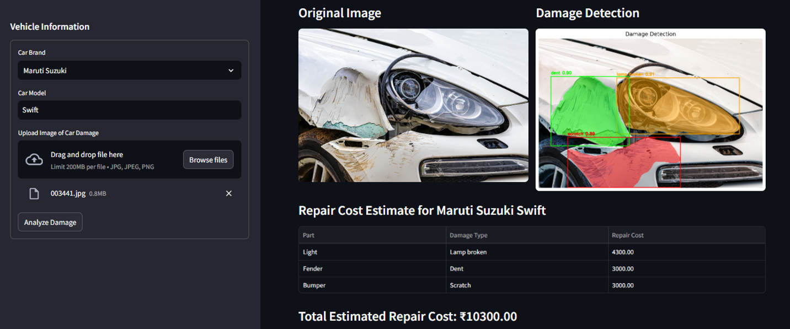
Automated Vehicle Damage Detection and Cost Analysis using Computer Vision
Bhuvan Kapoor
Dr. Amrit Pal
Motivation/ Introduction
School of Advanced Sciences
Results
School of Computer Science and Engineering
Manual vehicle damage assessment is often slow, subjective, and error-prone, leading to delays in insurance claims and repair processes. This project proposes an automated system for vehicle damage detection and cost estimation using deep learning. By applying object detection and segmentation models, the system identifies damage types—such as dents, scratches, and cracks—and maps them to specific car parts. It then estimates repair costs based on the car's brand and model using a predefined cost database. This approach enhances accuracy, speeds up assessments, and ensures consistency, offering a scalable solution for modernizing vehicle inspection and repair workflows.
Scope of the Project
This project focuses on developing an automated system for vehicle damage detection and cost estimation using computer vision and deep learning techniques. The system detects and segments damages such as dents, scratches, and cracks from vehicle images, identifies the affected car parts, and matches them to a repair cost database based on the vehicle’s brand and model. It covers the complete workflow from image input to final cost output, designed for integration into insurance, service center, or customer-facing applications. The project is scalable, supports multiple damage types and vehicle models, and aims to reduce manual effort and improve accuracy in damage assessment.
Fig 1: Results for YOLOv11- Segmentation Model
Methodology
Fig 2:Results for YOLOv11- Detection Model
The proposed system for Vehicle Damage Detection and Cost Analysis follows a structured, multi-stage pipeline designed for accurate and efficient assessment of vehicle damage and estimation of repair costs. The process begins with user input through a Streamlit web interface, where the user selects the vehicle’s brand and model and uploads an image of the damaged vehicle.
The uploaded image first undergoes damage detection and segmentation using a YOLOv11-based segmentation model. This model is trained to recognize common damage types such as dents, scratches, and cracks. It outputs a segmented image highlighting damaged areas along with the coordinates of each damage center. This step isolates different damage types present on the vehicle’s surface.
Following damage detection, the original image is passed through a second YOLOv11 object detection model trained to identify and locate vehicle parts such as bumpers, doors, hoods, and fenders. Each detected part is assigned a center coordinate.
To associate detected damages with specific parts, the system computes the Euclidean distance between the centers of damaged regions and vehicle parts. The damage is mapped to the nearest vehicle part, assuming it is the most likely affected component.
After mapping, the system refers to a predefined CSV database that contains repair costs categorized by car brand, model, damage type, and part. The corresponding cost is retrieved for each identified damage-part pair.
Finally, the individual repair costs are aggregated and displayed to the user along with the damage visualization, offering a complete and transparent cost breakdown. This fully automated approach minimizes manual intervention, reduces processing time, and improves the reliability and scalability of vehicle damage assessment systems. It can be effectively integrated into insurance platforms, car service centers, and customer-facing mobile applications.
Fig 3: Final Streamlit Output
Conclusion/ Summary
This project offers an automated solution for Vehicle Damage Detection and Cost Analysis using computer vision. Traditional damage assessment methods are manual and often unreliable. To address this, the system uses a YOLOv11 segmentation model to detect and classify damage types—such as dents, scratches, and cracks—and a YOLOv11 detection model to identify affected vehicle parts.
By mapping damage to parts using Euclidean distance, and referencing a predefined cost database based on vehicle brand and model, the system delivers fast, accurate, and transparent repair cost estimates. A user-friendly Streamlit interface enables seamless input and output interaction.
This automated pipeline significantly reduces assessment time, minimizes human error, and enhances reliability. It holds practical value for insurance platforms, vehicle service centers, and end-users. Future enhancements could include expanding vehicle coverage, real-time analysis, and integration with insurance systems for end-to-end claim automation.
Contact Details
bhuvan.kapoor2023@vitstudent.ac.in amrit.pal@vit.ac.in
Acknowledgments/ References
Wang, X., Li, W., andWu, Z.(2023). Cardd: Anewdatasetforvision-based car damage detection. IEEE Transactions on Intelligent Transportation Systems, 24(7):7202 7214.
Reddy, D. A., Shambharkar, S., Jyothsna, K., Kumar, V. M., Bhoyar, C. N., and Somkunwar, R. K. (2022). Automatic vehicle damage detection classification frame work using fast and mask deep learning. In 2022 Second International Conference on Computer Science, Engineering and Applications (ICCSEA), pages 1–6. IEEE.
Kyu, P. M. and Woraratpanya, K. (2020). Car damage detection and classification. In Proceedings of the 11th international conference on advances in information tech nology, pages 1–6.
Mohammed, N.A., Potrus, M. Y., and Ali, A. M. (2023). Deep learning based car dam age classification and cost estimation. Zanco Journal of Pure and Applied Sciences, 35(1):1–9.

