Slide 1
Employee Data Analysis using Excel
STUDENT NAME: BHUVANA.S
REGISTER NO: 312211018/NM ID: asunm1423312211018
DEPARTMENT:B.COM GENERAL
COLLEGE: DR.MGR.JANAKI COLLEGE

Slide 2
PROJECT TITLE
Employee Score Analysis using Excel

Slide 3


AGENDA
Problem Statement
Project Overview
End Users
Our Solution and Proposition
Dataset Description
Modelling Approach
Results and Discussion
Conclusion
3/21/2024 Annual Review

Slide 4

PROBLEM STATEMENT
To find the specific area of performance that is problematic, such as low productivity, high absenteeism, or poor quality of work.

Slide 5

PROJECT OVERVIEW
An employee score analysis is a supervising method management professionals use to review an employee’s performance.
Usually consisting of a list of important qualities, skills and daily tasks, employee scorecards can help motivate employees to improve their production.
A employee score analysis is a management tool used to monitor an employee’s performance.

Slide 6

WHO ARE THE END USERS?
The end users of an employee score analysis typically include:
Human Resource Department
Department Managers
Senior Executive Managers
Performance Review Committees

Slide 7

OUR SOLUTION AND ITS VALUE PROPOSITION
The project involves the creation of an excel based performance analysis tool that will:
Integrate data
Analyze Performances
Visualize data
Facilitate Reporting

Slide 8
Dataset Description
Employee ID – Example 101,202,305
Employee Name – Example Alice Johnson, David Miller
Employee Age- 29,45
Department- Finance, Marketing, IT
Attendance rate- 95%, 88%
Training hours- 20,35
Date of joining- Example 02/11/2019

Slide 9

THE "WOW" IN OUR SOLUTION
The axes in chart line shows of the highest and lowest score analysis of the employees
It shows how trends and scores analyzes data changes over time.
3/21/2024 Annual Review
9

Slide 10
MODELLING
Tools and techniques in excel:
The Pivot table is used for summarising and data analysing data across different dimensions such as department, job title or performance ratings.
Charts and Graphs is used to visualise trends, distributions and correlations within the dataset.
Formulas are used in excel functions for calculations and derive additional insights from the data.
10

Slide 11
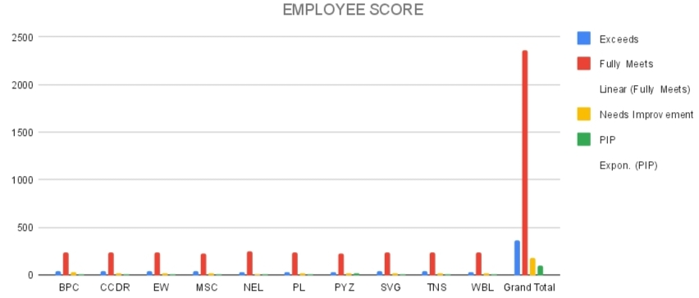
RESULTS
‹#›

Slide 12
conclusion
Thus the Pivot table summarizes the employee score analysis in a clear way, determining the highest and lowest points.

