Slide 1
SQL DATA TYPES
Bhuvana Pravallika

Slide 2


In today's world, everywhere u see data. Every thing is connected with data.
Analyzing Data
Searching Data

Slide 3


Data became confidential. Now to store this data we are using Databases. Since this databases stores tones of data.
Databases
Connected Databases

Slide 4

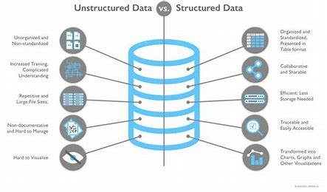
Data may be in any format. To maintain a structure and to categorize we use Data types in SQL.
Different kinds of Data
Data with SQL

Slide 5
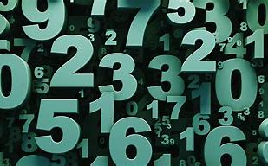
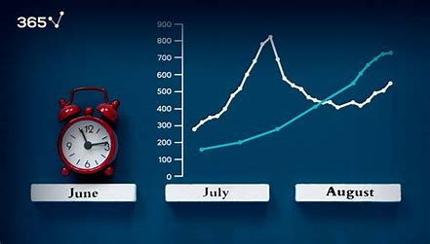



In SQL, data types specify the type of data that can be stored in a column. Here are some of the most common types:
Numeric
Dae and Time
Binary
Boolean
String

Slide 6

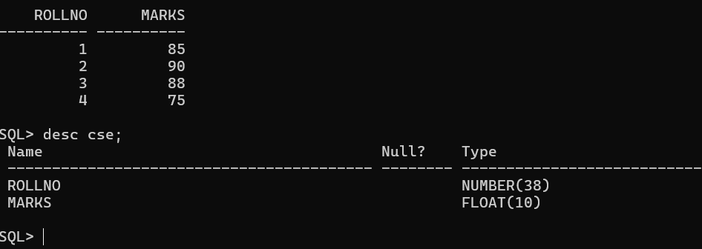
Numeric Data TypeS
INT: Used for whole numbers. Example: 123
FLOAT: Used for floating-point numbers, which are numbers with decimals.
Example: 123.45
Query: CREATE TABLE CSE(ROLLNO INT(5), MARKS FLOAT(10));

Slide 7
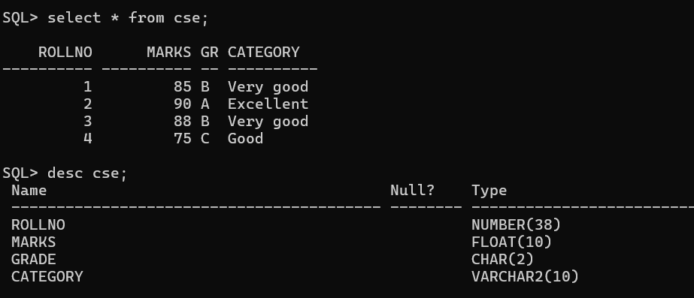
Character Data Types:
CHAR: Fixed-length character data. Example: CHAR(10) reserves 10 characters.
VARCHAR: Variable-length character data.
Example: VARCHAR(50) can store up to 50 characters.

Slide 8
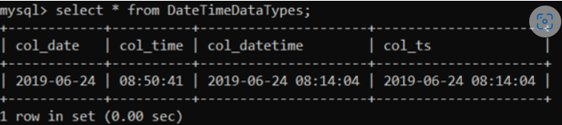
Date and time data types
DATE: Stores date values. Example: 2023-06-13
TIME: Stores time values. Example: 10:55:30
DATETIME: Stores both date and time values. Example: 2023-06-13 15:30:00
TIMESTAMP: The timestamp used to mark timestamp whenever a row is updated or entered in the table.

Slide 9
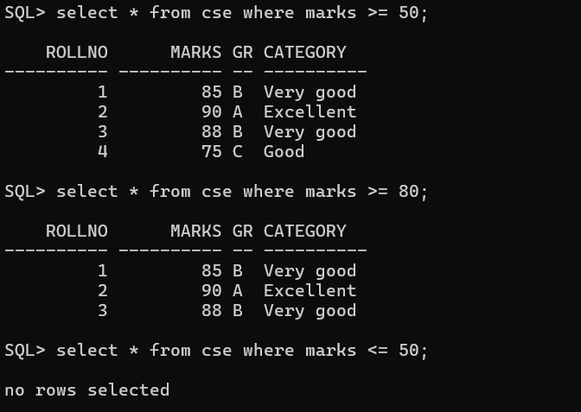
Boolean Data Type:
BOOLEAN: Stores TRUE or FALSE values.
It’s often represented as 0 (false) or 1 (true) in databases.

Slide 10
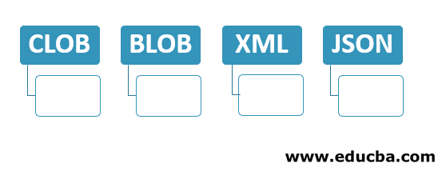
Miscellaneous Data Types
CLOB: CLOB stands for Character Large Objects. They can hold character data for up to 2GB. Not supported by MySQL, though. MySQL uses Text to achieve the same.
BLOB: BLOB stands for Binary Large Objects. They are used for storing binary objects of size up to 2GB. Usually, images are converted into binary objects and stored in BLOB columns.
XML: Used for storing XML data.
JSON: Used for storing JSON data. Not supported by MySQL.

Slide 11
THANK YOU

