Slide 1

CMR College of Engineering & Technology
(UGC Autonomous)
Accredited by NAAC with “A” Grade
Kandlakoya, Medchal Road, Hyderabad-501401
MAJOR PROJECT TITLE
ACADEMIC PERFORMANCE PREDICTION USING MULTI SOURCE MULTI FEATURE BEHAVIOURAL DATA
Our Esteemed Guide:
Mr. G Saidulu Assistant Professor
BATCH 10
Team members:
Iffat Maria 19H51A05A2
Yellaram Archana 19H51A05C1
Bhuvana Vangari 19H51A05J2

Slide 2
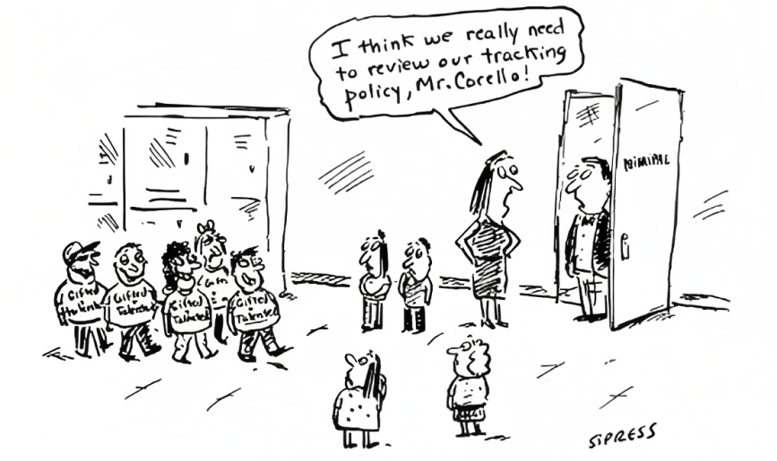
Outline
Abstract
Introduction
Literature Review
Existing works
Research Objective
Problem Definition
Proposed System
Implementation
Results
Conclusion
Future Scope
References

Slide 3
Abstract
Online education is becoming increasingly popular, and it is frequently combined with traditional on-campus study to improve learning efficiency for university students.
Since students have access to a wealth of online learning data, it offers a useful way to forecast students' academic performance and facilitates pre-intervention for at-risk students.
Current data sources for predicting student performance are limited to data from the corresponding learning platform, where only learning behaviours from that course can be observed.
However, students’ academic performance will be related to other behavioral factors. A popular supervised machine learning algorithm, random forests (RF) has been used for predicting students’ performances.

Slide 4

Introduction
Due to various reasons, students’ performance tends to fluctuate.
If the major factors are identified and monitored, it will give the administration an opportunity to improve the environment.
At college:
At home:
Fig. Comical illustration to depict the differences in student behaviour at college and at home.

Slide 5
Literature Review
In the paper,”Predicting student performance using decision tree classifiers and information gain” by Guleria et al. [5] class performance is predicted using Decision tree ML algorithm.
Used a dataset of 120 entities, inefficient as it cannot predict well with huge data.
“Data mining approach for predicting student performance” by Edin Ozmanbag et al. [3] predicts students’ success using data dimensionality problem
ML classifiers used: MLP, j48, NB
Used Naive Bayes with accuracy up to 78%. Cannot handle class imbalance issue.

Slide 6
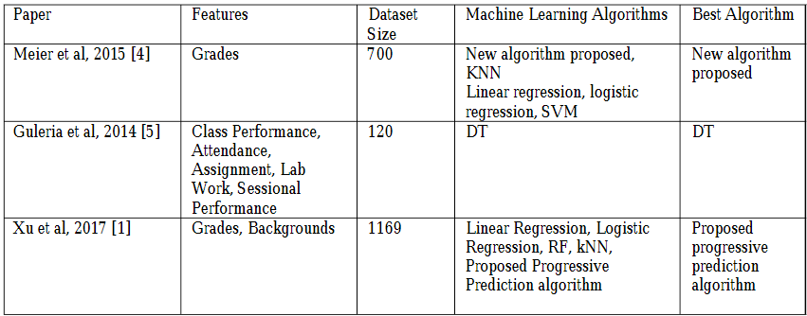
Summary of related research papers

Slide 7

Existing Works
LOGISTIC REGRESSION MODEL:
Logistic regression predicts the output of a categorical dependent variable. Therefore the outcome must be a categorical or discrete value. Instead of giving the exact value as 0 and 1, it gives the probabilistic values which lie between 0 and 1.
In Logistic regression, instead of fitting a regression line, we fit an "S" shaped logistic function, which predicts two maximum values (0 or 1).
The value of the logistic regression must be between 0 and 1, which cannot go beyond this limit, so it forms a curve like the "S" form. The S-form curve is called the Sigmoid function or the logistic function.

Slide 8
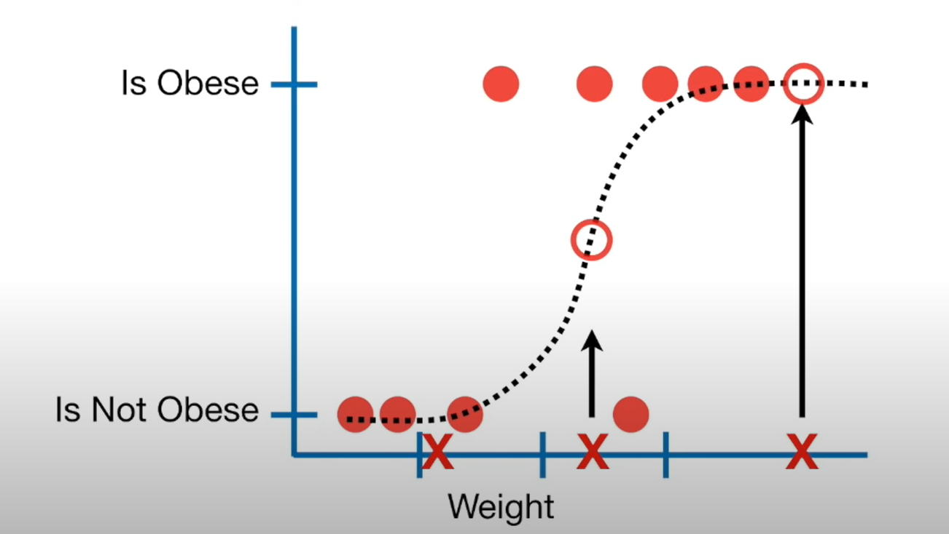
Logistic Function (Sigmoid Function), example

Slide 9
Existing Works
NAÏVE BAYES MODEL:
The Naïve Bayes algorithm is comprised of two words Naïve and Bayes, Which can be described as:
Naïve: It is called Naïve because it assumes that the occurrence of a certain feature is independent of the occurrence of other features. Such as if the fruit is identified on the bases of color, shape, and taste, then red, spherical, and sweet fruit is recognized as an apple. Hence each feature individually contributes to identify that it is an apple without depending on each other.
Bayes: It is called Bayes because it depends on the principle of Bayes' Theorem.

Slide 10
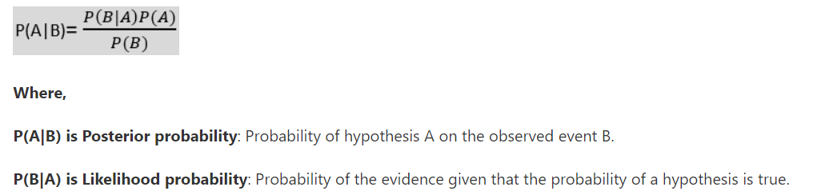
Naive Bayes

Slide 11
Existing Works
DECISION TREE MODEL:
In a decision tree model, each internal node represents a test on an attribute of the dataset, each tree branch reflects the test result, and each leaf node represents a target feature label.
They don't require extensive classification parameter configuration or prior knowledge of the problem domain.
The approach utilises an attribute or feature selection measure to choose the attribute or feature that best separates the dataset instances into discrete target classes.

Slide 12
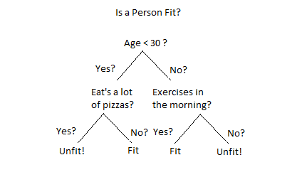
Decision tree example

Slide 13
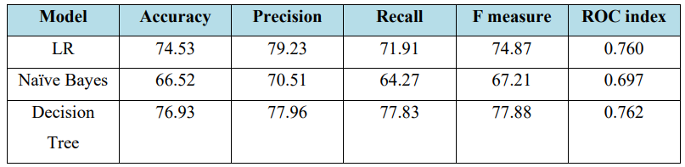
Results of Existing Solutions
Fig. Performance Metrics of Existing Solutions
Notes:
Accuracy is how many we got right: tp+tn/tp+tn+fp+fn
Precision is the number of predictions that were right : tp/tp+fp Recall: how many positive lavesl u found out of the total ones: tp/tp+fn F1 score: how good the predictions r: harmonic men pf precision n recall

Slide 14
Research Objective
Our project aims to design, develop and implement a performance prediction platform, that performs the following tasks:
Capturing a sufficiently rich profile of a student and integrating these data to obtain a holistic view
Exploring the factors affecting students’ academic performance and using this information to develop a robust prediction model with high accuracy

Slide 15
Problem Definition
Existing models use ML to predict student performance.
As a result, educators could not monitor the real-time students learning curve. Hence in the proposed model, multidimensional student data is utilised to predict student outcome.
A supervised machine learning method is utilized to predict long-term student performance. The proposed models offer new insight into determining the most critical learning activity and assist the educators in keeping track of student performance.

Slide 16
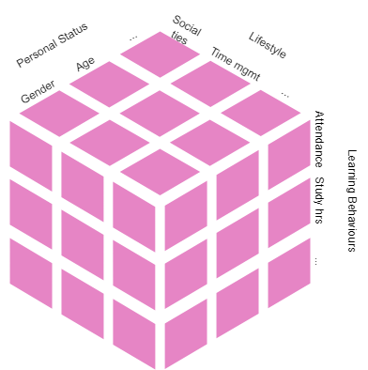
What makes data multidimensional?
The student dataset displays attributes related to the following categories:
• Personal Status(e.g., gender, age, etc) • Lifestyle Behaviors(e.g., social tie, time management, etc) • Learning Behaviors (e.g., class attendance, study duration, etc)
Representation of the Dataset

Slide 17
Proposed Algorithm
Based on the performance of existing models, LSTM is chosen.
It belongs to the complex areas of Deep Learning.
It is a variety of recurrent neural networks (RNNs) that are capable of learning long-term dependencies, especially in sequence prediction problems.
LSTM has feedback connections, i.e., it is capable of processing the entire sequence of data, apart from single data points such as images.
It can be implemented using the Keras Library.
Notes:
UNSUPERVISED???----So unlike supervised learning, here we will not provide any supervision to the model. We will just provide the input dataset to the model and allow the model to find the patterns from the data. With the help of a suitable algorithm, the model will train itself and divide the fruits into different groups according to the most similar features between them.

Slide 18
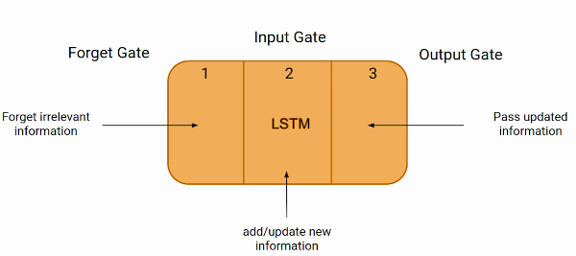
LSTM Architecture
These three parts of an LSTM unit are known as gates.
The first gate is called Forget gate, the second gate is known as the Input gate, and the last one is the Output gate.
Fig. LSTM Cell

Slide 19
Working of the Algorithm
Firstly, at a basic level, the output of an LSTM at a particular point in time is dependant on three things:
The current long-term memory of the network — known as the cell state
The output at the previous point in time — known as the previous hidden state
The input data at the current time step

Slide 20
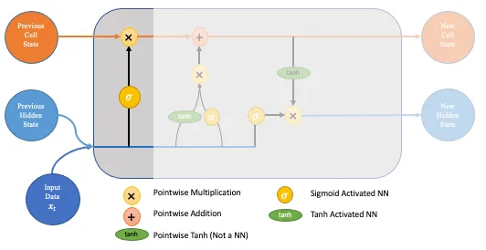
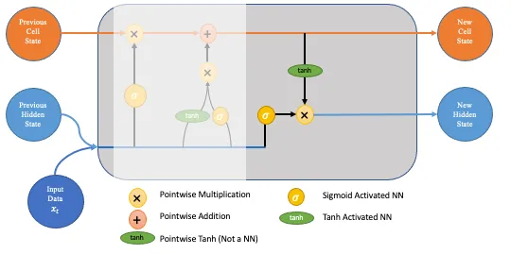
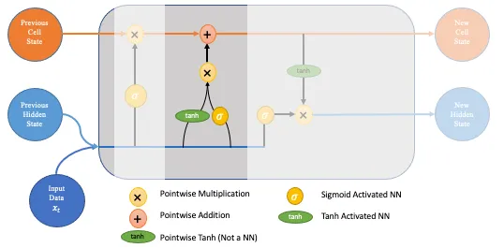
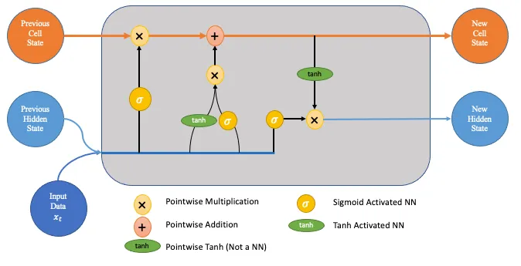
Working of LSTM

Slide 21
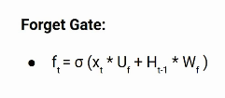
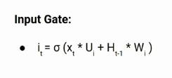

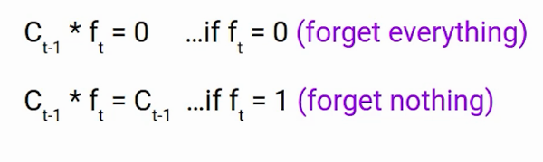
Important Formulae

Slide 22
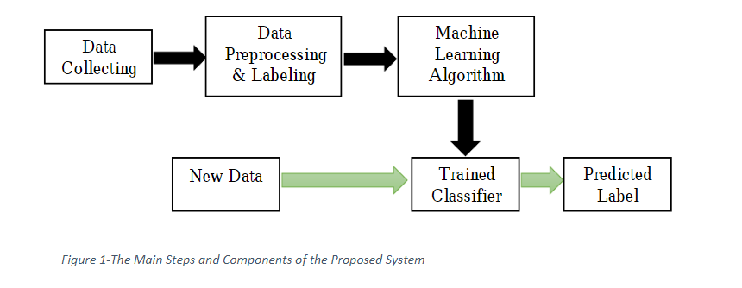
Block Diagram
Fig. The Main Steps and Components of the Proposed system

Slide 23
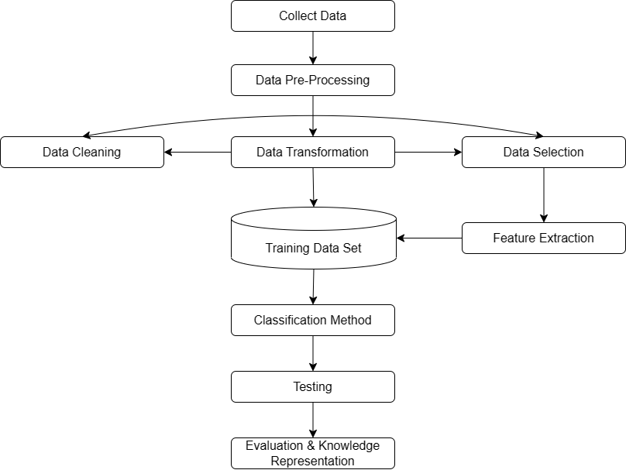
Flow Chart

Slide 24
Modules in Proposed Model
From the Architecture diagram, we can see that there are 3 important modules in the proposed model. They are:
Service Provider
Admin
Remote User

Slide 25
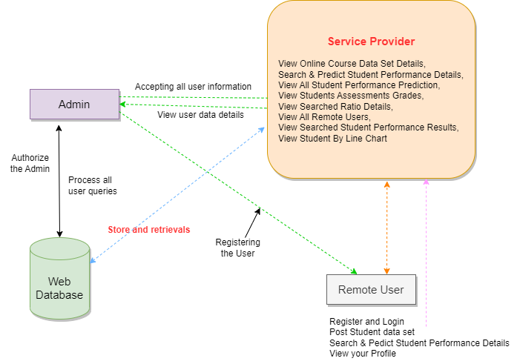
Architecture

Slide 26
Operations of Service Provider
Stores and retrieves data from the database
Can view:
> Student performance details
> All remote users
> Student performance results
> Student assessment details
> Dataset details
Search and predict student performance
View performance by line chart

Slide 27
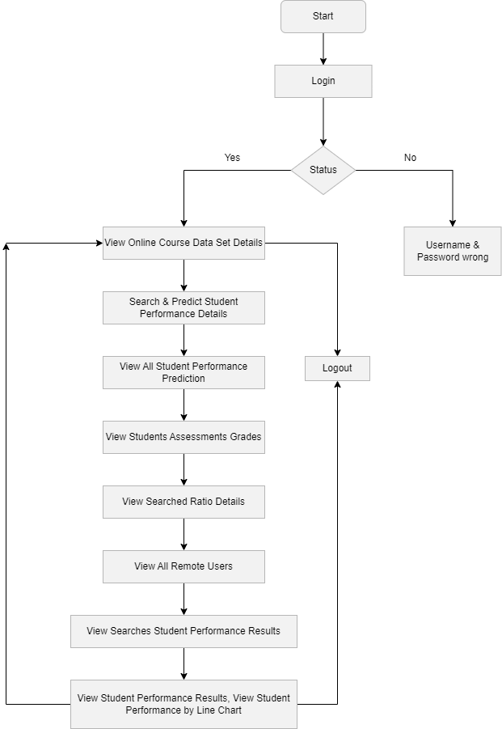
Flow Chart:
Service Provider

Slide 28
Operations of Admin
Concerned with the database
Web database queries processing,
Web database is authorised by the admin.
Accepts all the user information
View user details

Slide 29
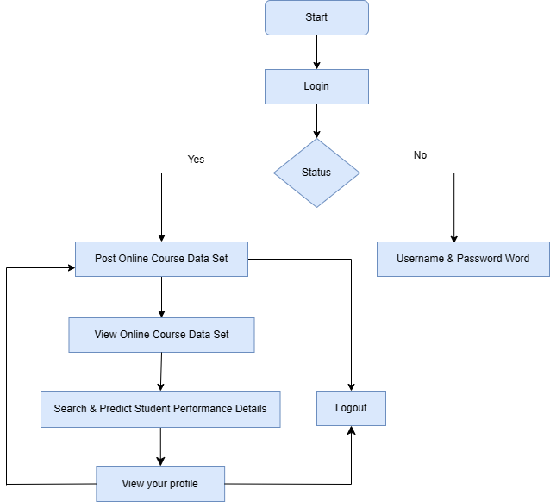
Flow Chart: Remote User
Operations:
Can be class teacher, any authorised person
Register/login
Post student data
View profiles to track their progress
Search and Predict performance results
Fig. Flowchart of Remote User

Slide 30
Dataset Attribute List (21):
Id | Cardio Fitness | Gender | Age | Height | Weight | Physical Fitness
Aerobic Fitness | Stress | Mental Health | Intelligent | Executive Fun | Eating | Physical Activity
Sleep Pattern | Social tie | Time Management | Course | Library Entry | Online Learning | Attendance

Slide 31
Dataset Information
The data attributes include general health, social and school related features.
It was collected by using reports and questionnaires.

Slide 32
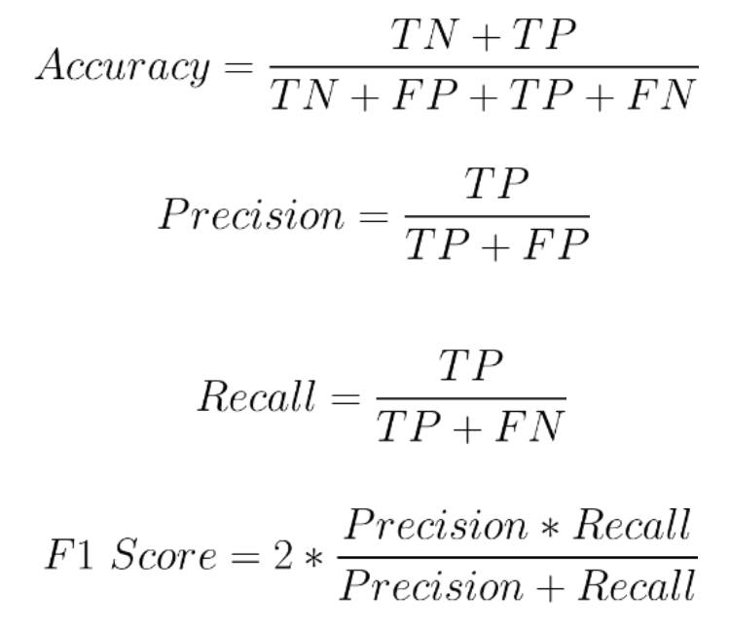
Performance Metrics
The following Performance Metrics are calculated on the dataset[8]:
Accuracy
Precision
Recall
F1 Score
ROC Index
They are calculated using the following formulae:

Slide 33
Results
The following factors are important to predict the results in our project:
Stress
Mental Health
Physical Activity
Sleep pattern

Slide 34
Conclusion
Artificial Intelligence performs a significant role in the educational field.
The study achieved highly accurate prediction results.
The presented research will be beneficial for educational institutions to predict students’ works at an early stage so that special attention can be given to weak students from the start of the session.

Slide 35
Future Scope
For future work, students’ performance predictor in individual courses is an open research idea to recommend courses/fields where students can outperform.
A students’ academic performance prediction model followed by university and course recommendation systems will be very helpful for students and institutes as well.

Slide 36
References
[1] J. Xu, K. H. Moon, and M. Van Der Schaar, “A Machine Learning Approach for Tracking and Predicting Student Performance in Degree Programs,” IEEE J. Sel. Top. Signal Process., vol. 11, no. 5, pp. 742–753, 2017.
[2] P. Cortez and A. Silva. Using Data Mining to Predict Secondary School Student Performance. In A. Brito and J. Teixeira Eds., Proceedings of 5th FUture BUsiness TEChnology Conference (FUBUTEC 2008) pp. 5-12, Porto, Portugal, April, 2008, EUROSIS, ISBN 978-9077381-39-7
[3] Edin Osmanbegovic and Mirza Suljic. (2012). Data mining approach for predicting student performance. Journal of Economics and Business, vol. X, Issue 1.
[4] Y. Meier, J. Xu, O. Atan, and M. Van Der Schaar, “Predicting grades,” IEEE Trans. Signal Process., vol. 64, no. 4, pp. 959–972, 2016.
[5] P. Guleria, N. Thakur, and M. Sood, “Predicting student performance using decision tree classifiers and information gain,” Proc. 2014 3rd Int. Conf. Parallel, Distrib. Grid Comput. PDGC 2014, pp. 126–129, 2015. [6] J. D. Kelleher, B. Mac Namee, and A. D’Arcy, Fundamentals of Machine Learning for Predictive Data Analytics. Algorithms, Worked Examples, and Case Studies. 2015.
[7] P. Cortez and A. Silva. Using Data Mining to Predict Secondary School Student Performance. In A. Brito and J. Teixeira Eds., Proceedings of 5th FUture BUsiness TEChnology Conference (FUBUTEC 2008) pp. 5-12, Porto, Portugal, April, 2008, EUROSIS, ISBN 978-9077381-39-7
[8] https://medium.com/analytics-vidhya/confusion-matrix-accuracy-precision-recall-f1-score-ade299cf63cd

Slide 37

Thank you.
Mercury is the closest planet to the Sun and the smallest one in our Solar System—it’s only a bit larger than our Moon. The planet’s name has nothing to do with the liquid metal, since it was named after the Roman messenger god

