Slide 1
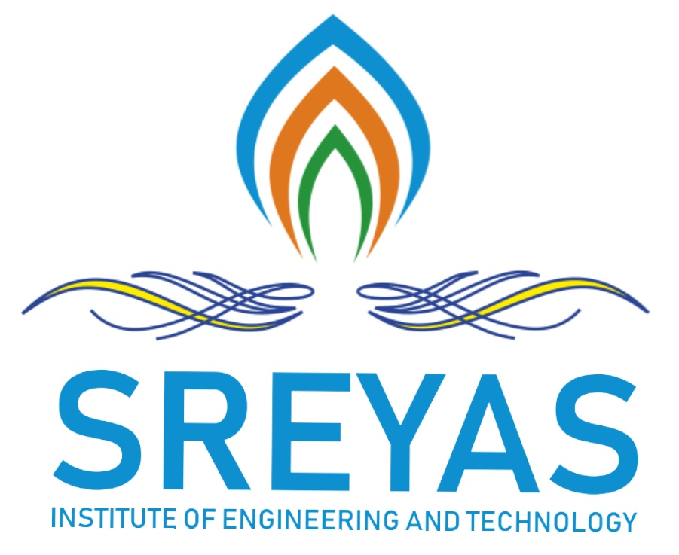
Sreyas Institute of Engineering and Technology
An Autonomous Institution
Approved by AICTE, Affiliated to JNTUH
Accredited by NAAC-A Grade, NBA (CSE, ECE & ME) & ISO 9001:2015 Certified
A
MINI PROJECT
On
Predictive Resource Allocation for Disaster Management Using AI
BACHELOR OF TECHNOLOGY
IN
COMPUTER SCIENCE AND ENGINEERING
BY
BIRRU BHUVANESHWARI DEVI 22VE1A0570
BOYAPALLY ROHITH GOUD 22VE1A0571
PAGILLA UDAYA SRI 22VE1A05A6
RAYUDU VEERA SAI KIRAN 22VE1A05B2
ACADEMIC BATCH: (2022-2026)
Under the Guidance of
Dr.T.SWARNA LATHA ( Assistant Professor)

Slide 2
PROJECT MODULES
1. Admin Module
Manages system users and disaster records.
Uploads real-time or historical disaster data.
Views predictions and manually triggers resource deployment if needed.
2. User Module (Rescue Teams / General Public)
Affected users can report incidents.
Rescue teams receive assigned resources.
Track live updates and request supplies.
3. Data Ingestion Module
Collects real-time data from:
Social media (e.g., Twitter)
IoT sensors
Satellite imagery
Weather APIs
Cleans and preprocesses the data for ML.

Slide 3
4. Prediction Module
Uses NLP and ML to:
Predict disaster severity
Classify urgency
Forecast resource demand
5. Resource Allocation Module
Applies optimization algorithms to allocate:
Rescue teams
Medical supplies
Transportation & food
Ensures fair, fast, and efficient delivery.
6. Visualization & Dashboard Module
Interactive admin dashboard:
Displays predictions and reports
Resource maps and deployment history
Charts and real-time updates

Slide 4
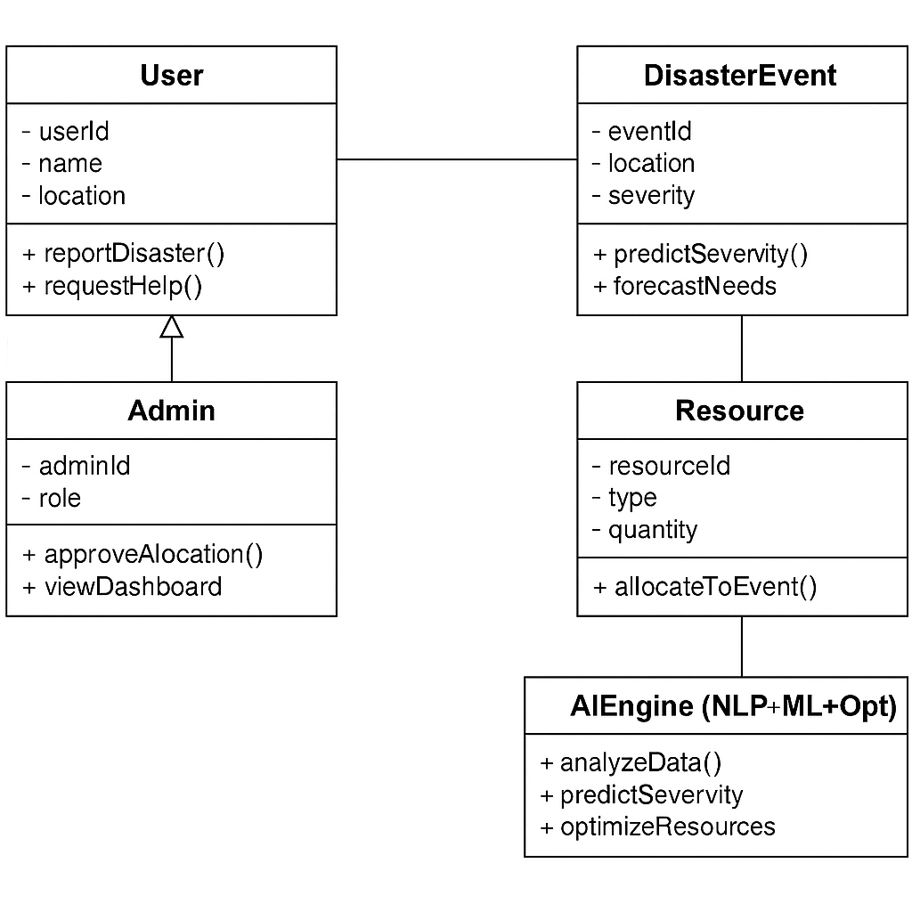
CLASS DIAGRAM

Slide 5
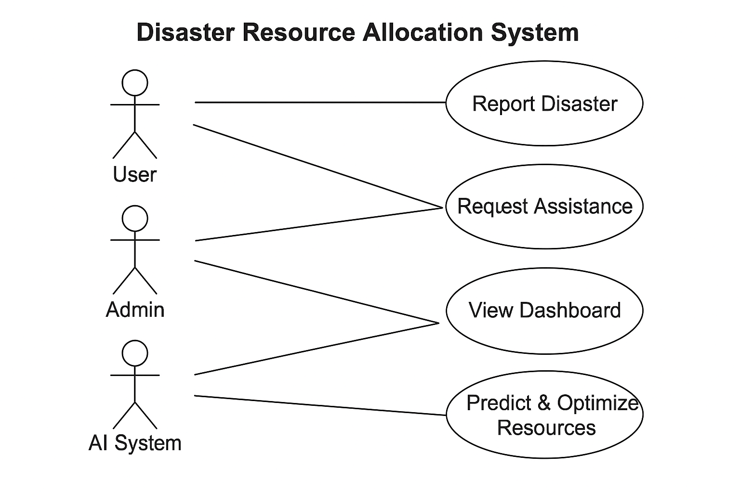
USE-CASE DIAGRAM

Slide 6
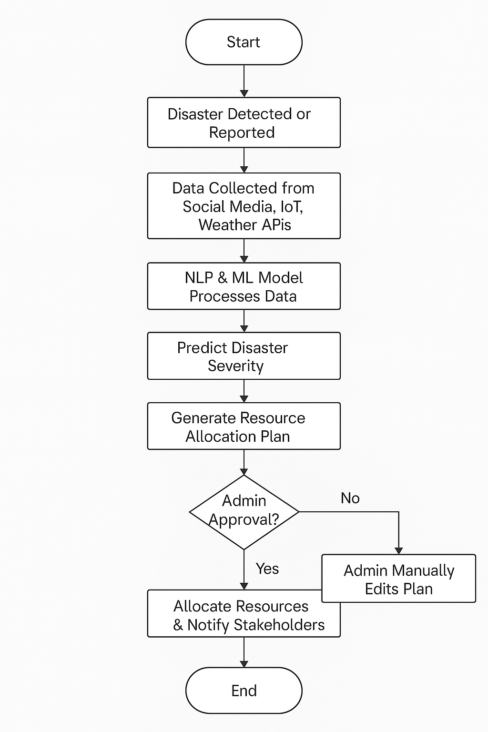
ACTIVITY DIAGRAM

