Slide 1
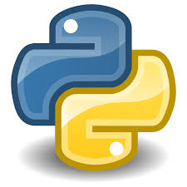

Introduction to python
tutorials

Slide 2
What will we be seeing today
Different languages
Difference between interpreted and compiled language
Why python
History
Where is python used
Advantages and disadvantages of python
What do you need to do when you are struck
How will the course move on
Basics of python(jupyter notebook)

Slide 3
languages
machine level language – basic building block
Fortran – basic and one of the first programming language
C / C++ - used in computer applications building
MATLAB - used for data handling in labs, robotics etc
Html, CSS, JavaScript – web development
Java – useful to create games, apps
R – big data handling

Slide 4
Difference between Interpreter and complied languages
Compiler
Interpreter
Compiler transforms code written in a high-level programming language into the machine code, at once, before program runs
Ex : C and C++
Interpreter coverts each high-level program statement, one by one, into the machine code, during program run.
Ex : Python

Slide 5
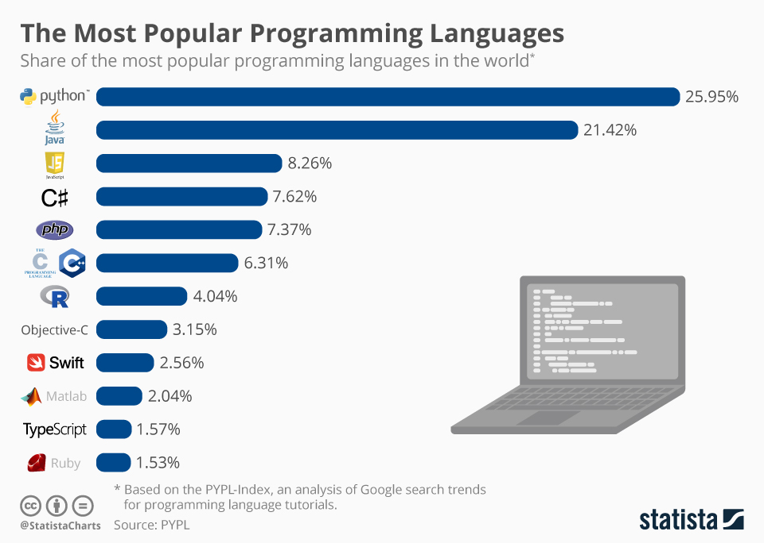
Why python ??
User friendly
Easy syntax
Runs on any platform
Built in packages
Most used language
Notes:
User friendly, easy syntax - example for loop

Slide 6
history
designed by Guido van Rossum in 1989
developed by Python Software Foundation, pypi, github, stx next, softkraft, octobot
Object oriented programming
U can create your own datatypes using classes
It is a way to structure various properties and behavior
Notes:
Compare between java and python

Slide 7
Where is python used ?
Machine learning and deep learning
Web development
Building apps
Image analysis
Building software

Slide 8
Disadvantages
As it is a interpreter language and as everything is treated as objects it is slow(use packages)
As every variable is a type of object it leads problems
advantages
Lot of built in packages that can be used
Easy programming
Type conversion

Slide 9
Where do u need to go when u have any trouble
Stack overflow
Github
kaggle
How to install different packages
Built by pypi
Pip install libraryname==version

Slide 10
How will this tutorials continue
There will be no ppts from next.
We will be using jupyter notebook from the next lectures, in we can run python programs.
The notebooks will be shared half an hour through mail before so that you can practice with us.
There will be assignments at the end of each lecture(there is no need to send us the assignments if u want to discuss we can discuss in next session).
This tutorials will be for 4 days (can be extended).

