Slide 1

Participant Details
Participant Name: Bhuvanani Vattikonda
Project Title: SomnoCare — Simplified AI CPAP Adherence, Sleep Apnea Screening & Lifestyle Coach
Problem Statement: Build an intelligent, accessible healthcare & wellness agent using Google ADK, Gemini 2.5 Flash, Cloud Run & Firestore that empowers everyday patients to screen for Obstructive Sleep Apnea (OSA), maintain CPAP insurance compliance, and improve airway health.
Live Prototype: https://somnocare-ai.netlify.app | GitHub: https://github.com/Bhuvanani14/somnocare

Slide 2
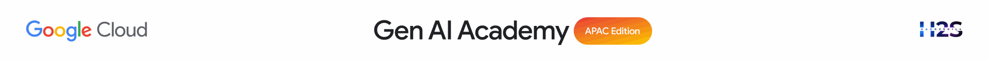
Brief about the idea
Project Vision: Make clinical-grade Sleep Apnea (OSA) screening, CPAP therapy adherence, and daily airway exercise effortless for any layperson.
The Core Problem: Nearly 1 billion adults suffer from Obstructive Sleep Apnea, and up to 50% of prescribed CPAP users abandon therapy within Year 1 due to mask leaks, nasal dryness, complex medical jargon, and disconnected lifestyle habits (weight, smoking, posture).
Our Solution — SomnoCare v2.0: A simplified, 5-step Light & Dark Mode companion built on Google ADK, Gemini 2.5 Flash, Cloud Firestore, and Cloud Run.
1. Everyday Simplicity & Security: Jargon-free Daily Summary cards (Light Mode default + Dark Mode toggle), PBKDF2-SHA256 login, personalized onboarding, and a 4-digit Privacy PIN lock screen.
2. Clinical Risk & Lifestyle Layer: Tracks Age, BMI trend, Smoking Quit Streak, official 8-item STOP-BANG & Epworth Sleepiness Scale (ESS), and correlates Weight/BMI & Snoring directly with AHI reduction.
3. Edge AI Multimodal Coaching: On-device WebAudio FFT Snore Detector (80–350 Hz), MediaPipe/OpenCV 2D Pose Skeleton Coach for Squats, Yoga & Oropharyngeal Throat Exercises, Multilingual Voice Logging (EN/HI/KN/TE), Open-Meteo CPAP Humidifier tuning, and 1-Click Physician PDF Report.

Slide 3
Your solution should be able to explain the following:
How did you approach the common problem statement and translate it into a working solution using ADK, MCP/AlloyDB AI while ensuring Hackathon’s core requirements are met?
What real-world problem does your solution address, and what practical impact does it create for users?
What is the core approach or workflow behind your solution?
Real-World Clinical Impact: Prevents CPAP therapy dropout (saving CMS 4h/70% insurance coverage) while addressing root-cause OSA risk factors (BMI, smoking inflammation, supine sleeping, and upper-airway muscle tone).
Translating into a Working Solution with Google ADK & Gemini 2.5 Flash:
• Agentic Tool Orchestration: Built `somnocare_agent` in Google ADK (`app/agent.py`) equipped with 12 deterministic clinical tools (`get_profile`, `update_profile`, `evaluate_osa_risk_and_screening`, `calculate_cms_adherence_compliance`, `log_sleep_therapy_entry`, `log_exercise_or_yoga_session`, `get_local_weather_for_humidifier`, etc.).
• Statistical Correlation Engine: Computes live Pearson correlation (r) linking Weight change -> AHI (r = +0.94) and Snoring -> AHI (r = +0.97).
• Deterministic Red-Flag Safety Guard: Intercepts chest pain, syncope, drowsy driving, or AHI >= 30 before coaching and escalates to emergency/physician care.

Slide 4
Opportunities
How different is it from any of the other existing ideas?
USP of the proposed solution
How SomnoCare Differs from Existing CPAP Manufacturer Apps (myAir / DreamMapper):
• Holistic OSA Risk + Therapy (Not Just Machine Data): Manufacturer apps only show basic machine hours. SomnoCare unifies STOP-BANG & ESS clinical screening, BMI/Weight trends, Smoke-Free airway recovery, and positional therapy in one place.
• Built for a Basic Layperson (Light & Dark Mode): Replaces confusing clinical tables with 5 plain-English steps, traffic-light status badges, and hands-free voice logging in English, Hindi, Kannada, and Telugu.
• On-Device Computer Vision & Acoustic Privacy: Runs MediaPipe/OpenCV Pose rep-counting (Squats, Yoga Bridge, Cat-Cow, Oropharyngeal Throat exercises) and WebAudio FFT Snoring detection 100% locally in the browser—zero raw video or bedroom audio is ever uploaded.
• Environmental CPAP Auto-Tuning: Uses live Open-Meteo temperature, humidity & PM2.5 AQI to recommend exact CPAP humidifier levels (1–8) and heated-tube temperatures to stop rainout and dry mouth.
• Enterprise Security & Doctor Handoff: PBKDF2-SHA256 authentication, 4-digit PIN privacy lock, granular camera/mic consent toggles, Firestore audit logs, and 1-click ReportLab Physician PDF export.

Slide 5
List of features offered by the solution
1. Simplified 5-Step UI (Light & Dark Mode): Clean layperson cards for Insurance Status, AHI, BMI, STOP-BANG & Smoke-Free Streak.
2. Login, Personalization & Security Center: PBKDF2-HMAC-SHA256 login, account registration, 4-digit PIN lock screen, and Security Audit Log.
3. Profile, BMI & Smoke-Free Streak: Tracks Age, Height, Weight, BMI category, Neck circumference, and days smoke-free.
4. Clinical OSA Screening (STOP-BANG + ESS): Official Chung et al. 8-item STOP-BANG & Johns 8-item Epworth Sleepiness Scale with drowsy-driving alert.
5. On-Device Acoustic Snore Detector & Voice Logging: 80–350 Hz WebAudio FFT snore classifier + Multilingual voice parser (EN/HI/KN/TE).
6. OpenCV / MediaPipe Pose & Throat Exercise Coach: Live 2D skeleton & joint-angle rep counter for Squats, Push-ups, Yoga Bridge, Cat-Cow & Oropharyngeal tongue slides.
7. Guided 4-7-8 Pranayama & Late-Meal Logger: Animated nasal breathing pacer and dinner-to-bedtime reflux risk tracker.
8. Live Weather/AQI CPAP Humidifier Tuner: Open-Meteo telemetry prescribes CPAP humidifier level & heated tube temp.
9. Sleep Study PDF Extractor & 1-Click Doctor PDF Report: Extracts Diagnostic AHI/SpO2 from PSG reports and exports a 30-day Physician PDF.
10. Conversational Gemini 2.5 Flash Coach + A2UI v0.8 Cards: Interactive clinical chat with Red-Flag emergency safety escalation.

Slide 6
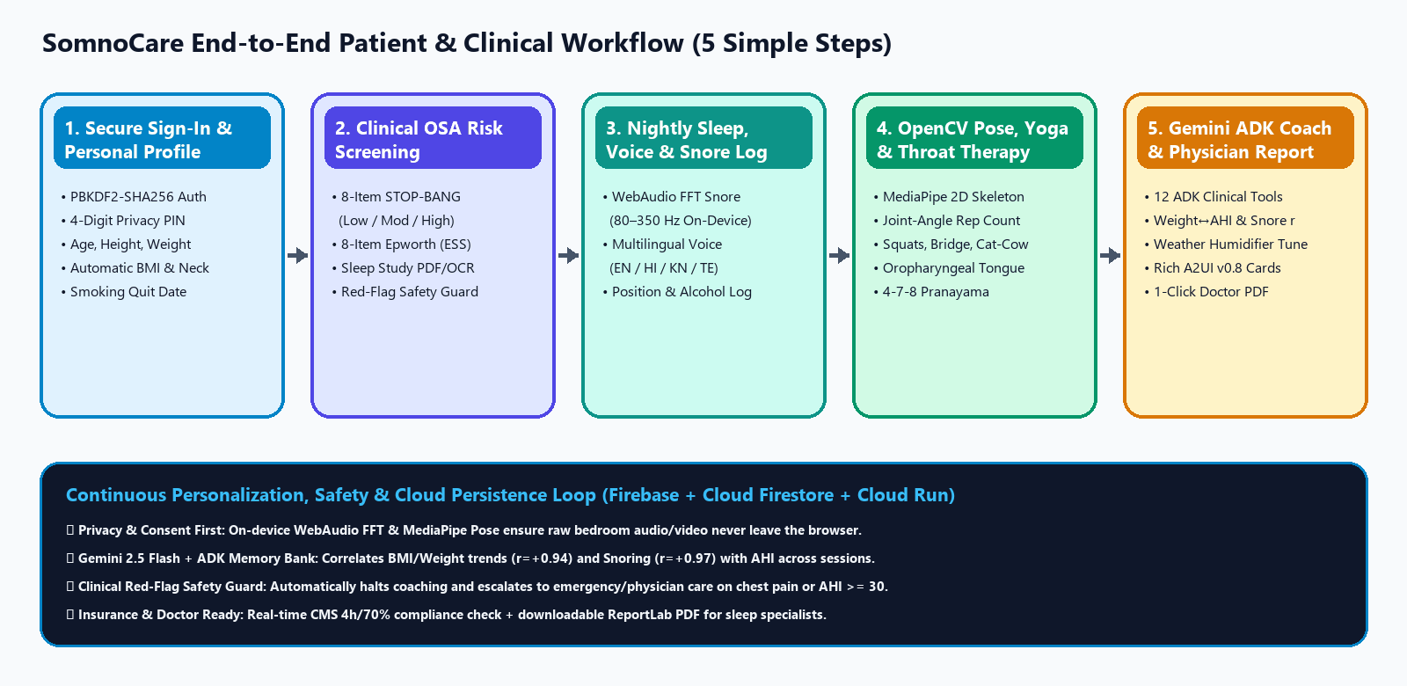
Process flow diagram or Use-case diagram
End-to-End Patient Journey — From Secure Onboarding & Screening to Daily Coaching & Physician PDF Handoff:

Slide 7
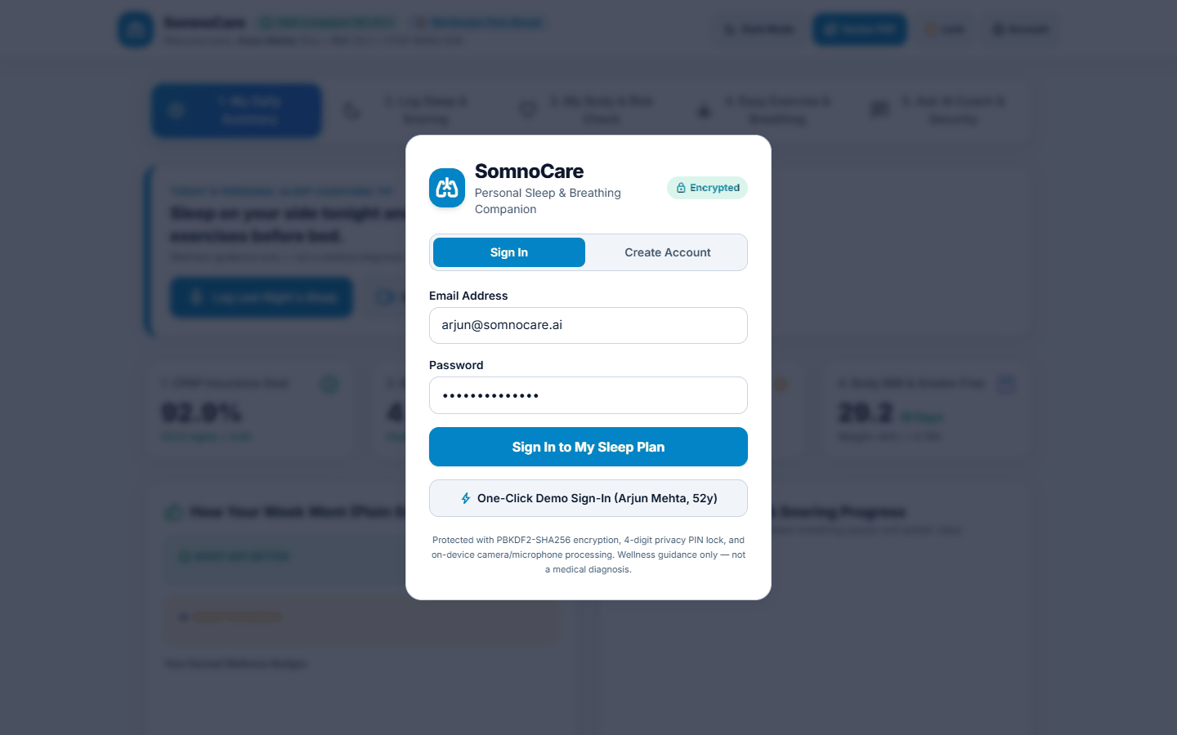
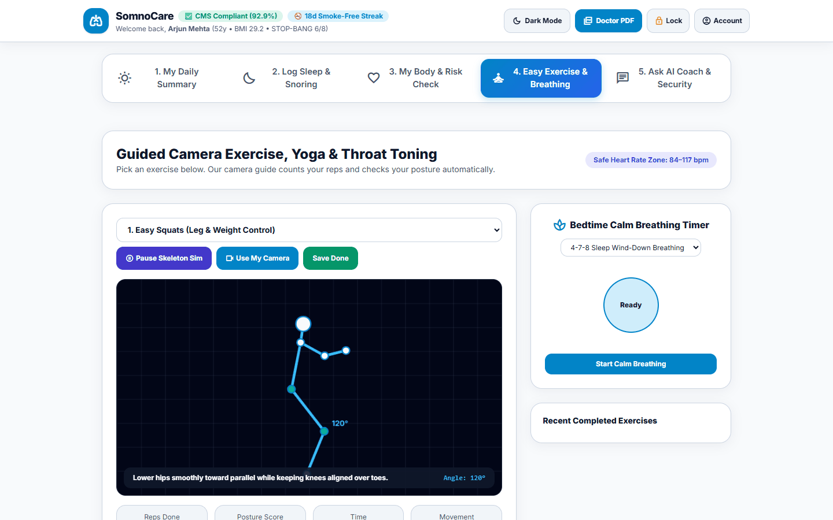
Wireframes/Mock diagrams of the proposed solution
Simplified 5-Step Interface Wireframe Layout (Designed for Zero Cognitive Overload):
• Top Bar: Brand Status Pill (Insurance Compliant) + Patient Summary + [Light/Dark Mode] + [Doctor PDF] + [PIN Lock] + [Account]
• Step 1 (My Daily Summary): 5 Plain-Language KPI Cards + 14-Day CPAP/AHI/Snoring Chart + Weight/BMI vs. AHI Chart + Badges
• Step 2 (Log Sleep & Snoring): [Left] WebAudio FFT Snore Microphone + Multilingual Voice Logger | [Right] Simple Nightly Sleep Form
• Step 3 (My Body & Risk Check): [Left] Age, Height, Weight, Neck Size & Smoking Tracker | [Right] 8-Item STOP-BANG & Epworth Check
• Step 4 (Easy Exercise & Breathing): OpenCV/MediaPipe Pose Canvas (Joint Angle + Rep Counter) + 4-7-8 Breathing Pacer + Weather Tuner
• Step 5 (Ask AI Coach & Security): Gemini 2.5 Flash Chat with A2UI Cards + Privacy Consent Toggles + Security Audit Log + PSG Upload

Slide 8
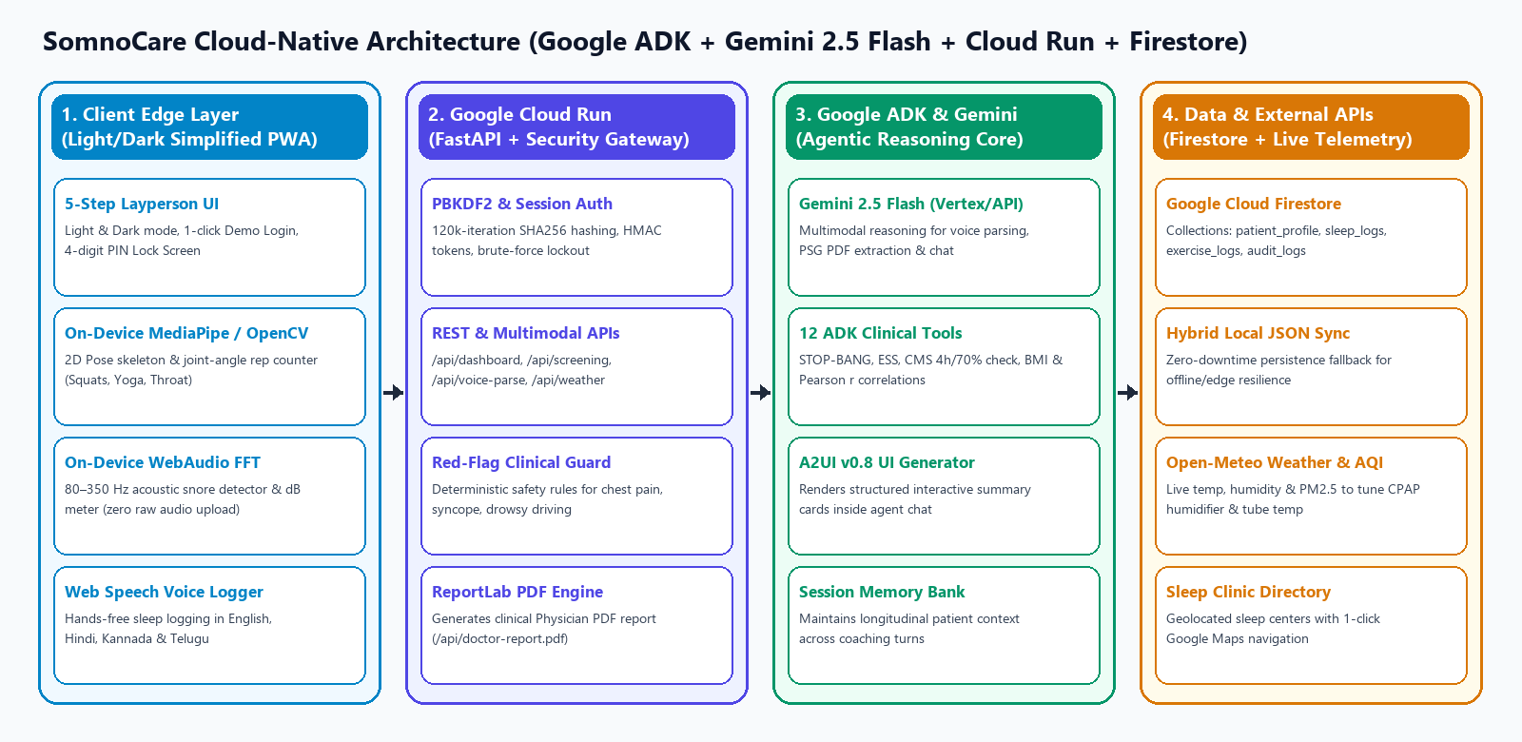
Architecture diagram of the proposed solution:
Layered Cloud-Native Architecture combining Edge Privacy (WebAudio/MediaPipe) with Google Cloud Run, ADK, Gemini 2.5 Flash & Firestore:

Slide 9
Technologies/Google Services used in the solution
(Why did you choose your specific AI stack and system design, and how does it support scalability and real-world deployment?)
1. Google Agent Development Kit (ADK) & Gemini 2.5 Flash (`google-adk`, `google-genai`):
• Powers `somnocare_agent` with 12 strongly-typed clinical tools, Session Memory Bank, multimodal sleep-study PDF parsing, multilingual voice extraction, and A2UI v0.8 structured card generation.
2. Google Cloud Firestore & Firebase Ecosystem (`google-cloud-firestore`):
• Stores real-time document collections (`patient_profile`, `sleep_logs`, `exercise_logs`, `meal_logs`, `partner_observations`, `users_auth`, `security_audit_logs`) with hybrid local JSON fallback for 100% uptime.
3. Google Cloud Run & Cloud Build (`Dockerfile`, `deploy_cloud_run.sh`, FastAPI/Uvicorn):
• Stateless, autoscaling container serving both the REST/Agent API and static SPA with strict HTTP security headers (`CSP`, `X-Frame-Options`, `X-Content-Type-Options`).
4. Edge Computer Vision & Signal Processing (MediaPipe Pose / OpenCV Geometry + WebAudio API):
• Executes 30 FPS skeletal joint-angle rep counting and 80–350 Hz acoustic snore detection on-device for zero-latency feedback and total patient privacy.
5. ReportLab Clinical PDF Engine & Open-Meteo Telemetry API:
• Generates physician-ready 30-day compliance reports and live weather/AQI CPAP humidifier prescriptions.

Slide 10
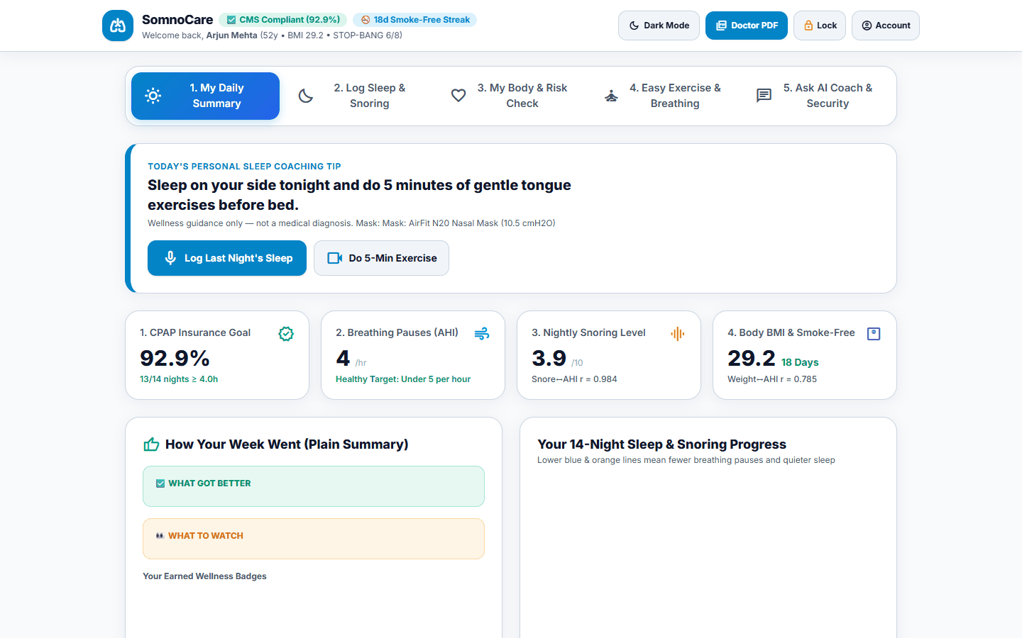
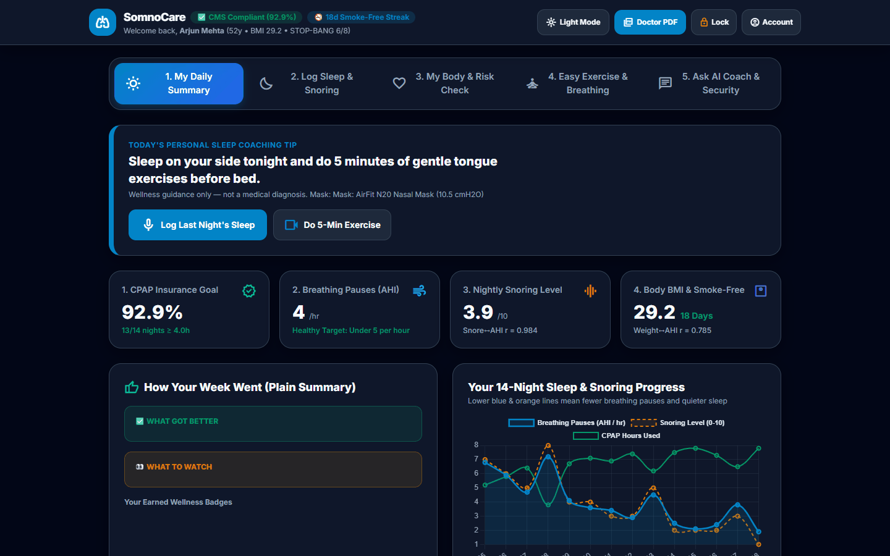
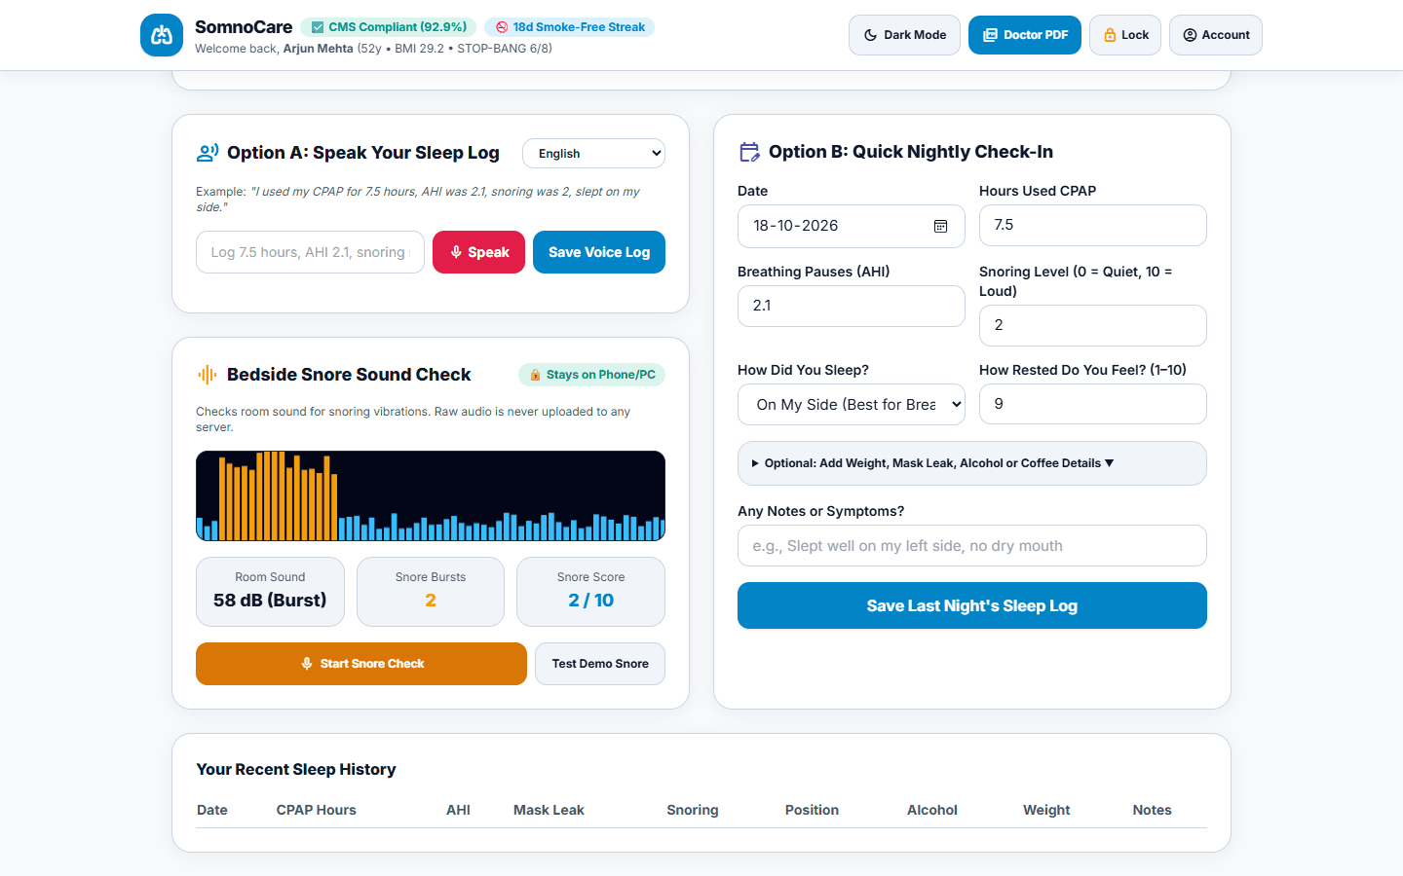
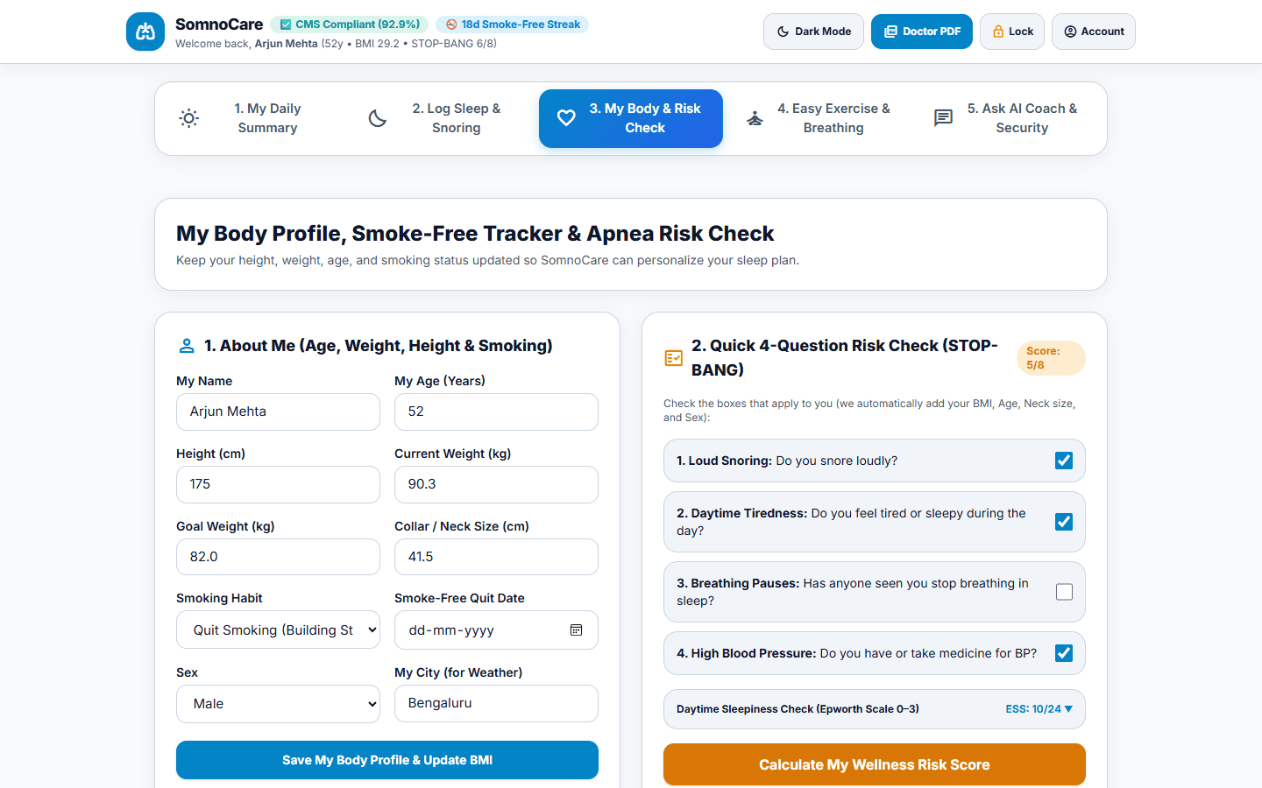
Snapshots of the prototype
Live Working Prototype Snapshots — Light Mode, Dark Mode, Snoring & Voice Log, and STOP-BANG/BMI Screening:

Slide 11
