Slide 1

ONTOLOGY-GUIDED HYPOTHESIS GENRATION USING LLMs AND TOPIC MODELING IN MHEALTH RESEARCH
TEAM MEMBERS
G. Bhuvanasri (B23AI098)
Mohammed Shahbaaz (B23AI121)
G. Prudhvi Narayan (B23AI088)
V. Anusha (B23AI114)
SUPERVISOR
K. Snehaja, Assistant Professor
Department of CSE (AI & ML) • KITS Warangal
Academic Year: 2026–27
01

Slide 2

1. PROJECT CONTEXT & OBJECTIVE
BASE PAPER OBJECTIVE
OUR OBJECTIVE
Generate research hypotheses from mHealth literature by combining topic modeling, semantic relationships, ontology concepts, and LLM reasoning.
Build the initial literature-processing layer by finalizing the mHealth dataset, performing basic NLP preprocessing, and discovering initial topics.
Key distinction
Later stages are outside the current implementation scope.
• Our phase: gap discovery and evidence assembly are the current implementation boundary.
• LLM hypothesis generation and validation remain further.
02

Slide 3
2. BASE PAPER — END-TO-END METHODOLOGY
Scopus
mHealth corpus
Text
preprocessing
TF-IDF +
word embeddings
Embedded Topic
Model (ETM)
Topic
terms
AQA + PMI
relationships
Ontology
mapping
Topic–concept
association
Semantic
augmentation
Gemini
hypotheses
LLM validation
/ refinement
TF-IDF cosine
similarity
Expert
evaluation
The base paper moves from literature → semantic structure → ontology grounding → LLM generation → validation.
03

Slide 4
3. WHAT THE AUTHORS IMPLEMENTED
Scopus corpus
Ontology mapping
429 mHealth documents focused on mHealth applications in India; manual relevance verification.
Map extracted terms to domain concepts; build topic–concept associations and semantic augmentation.
Text representation
Gemini
Use ontology-enriched topic context to prompt Gemini for research hypotheses.
Abstract-focused analysis; TF-IDF plus word embeddings support semantic representation.
ETM
Validation + evaluation
LLM refinement, TF-IDF cosine similarity for redundancy/diversity, and expert evaluation.
Embedded Topic Model discovers latent topics and produces topic terms.
AQA + PMI
Extract structured Aspect–Qualifier–Action relationships and statistically associated term pairs.
04

Slide 5
4. BASE PAPER vs OUR CURRENT IMPLEMENTATION
Stage
Base paper
Current implementation
Literature
Scopus; 429 documents
PubMed; 14,905 raw records
Representation
TF-IDF + word embeddings
SPECTER2; 768-D document embeddings
Topic model
Embedded Topic Model (ETM)
Official BERTopic 0.17.4
Relationships
AQA + PMI
Semantic similarity + Jaccard co-occurrence
Ontology / concepts
Domain ontology mapping
MeSH normalization + concept layer
Temporal analysis
Not central
2015–2025 topic/concept growth
Gap detection
Not the same mechanism
GapScore + synonym filtering
LLM generation
Gemini + validation
Not implemented yet
Final evaluation
Similarity + experts
Evidence traceability
05

Slide 6
5. CURRENT IMPLEMENTATION — THREE TOPICS
01 FINALIZE mHEALTH DATASET
02 BASIC NLP PREPROCESSING
03 INITIAL TOPIC MODELING
PubMed literature corpus
14,905 raw records → 14,881 cleaned → 12,642 retained for downstream processing.
Scientific text cleaning
HTML/XML and boilerplate removal, DOI/URL cleanup, Unicode normalization, biomedical symbol handling and whitespace normalization.
BERTopic-based topic discovery
Preprocessed documents are clustered to obtain initial mHealth research topics and representative terms.
Only these three implementation areas are presented in this version of the project.
06

Slide 7
6. FINALIZE mHEALTH DATASET
14,905
14,881
12,642
raw PubMed records
cleaned records
retained records
DATASET SCOPE
SCREENING RESULT
Publication period: 2015–2025
PubMed mHealth literature
0 duplicate PMIDs
24 records removed during cleaning
9,279 relevant + 3,363 borderline = 12,642 retained records.
This retained corpus is the input to preprocessing.
07

Slide 8
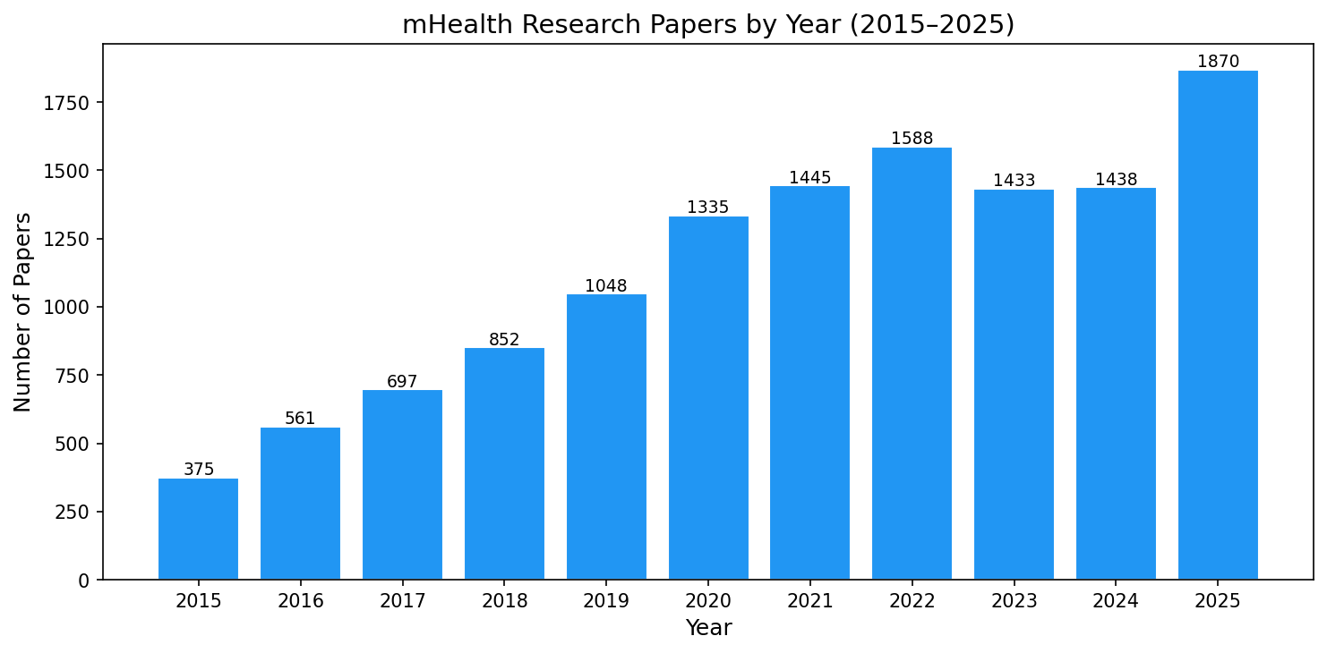
DATASET OUTPUT — PAPERS BY YEAR
08

Slide 9
7. BASIC NLP PREPROCESSING
01
02
03
HTML/XML and publisher boilerplate removal
DOI, URL and copyright artifact removal
Unicode normalization
04
05
06
Biomedical symbol handling
Whitespace normalization
clean_document = clean_title + clean_abstract
12,642
preprocessed documents
Biomedical forms such as “m-health”, “anti-HIV”, and “Option B+” are preserved where meaningful.
09

Slide 10
8. INITIAL TOPIC MODELING — BERTOPIC
SPECTER2
UMAP
HDBSCAN
BERTopic
TOPICS
document representations
→
5D reduction
→
density clustering
→
topic representation
→
initial topic set
63
7,927
genuine topics
documents assigned to genuine topics
4,715 documents (37.3%) are assigned to the HDBSCAN outlier class.
10

Slide 11
STAGE 4 & 5 — BIOMEDICAL CONCEPTS & MeSH NORMALIZATION
Extracting Granular Medical Ideas from Literature and Standardizing Terminology for Gap Detection
STAGE 4 — BIOMEDICAL CONCEPT EXTRACTION
Extract specific clinical and technical ideas inside discovered topics
Extraction Sources across 12,642 Corpus Papers:
• PubMed MeSH terms • Author keywords • Medical noun phrases
Concept Filtering Funnel:
19,689 raw concepts → Frequency ≥ 5 → 2,790 concepts
• Topics identify broad research themes (e.g., HIV Care).
• Concepts identify concrete clinical facts (e.g., medication adherence).
STAGE 5 — MeSH NORMALIZATION & GROUNDING
Standardize concept names and map structured topic-concept pairs
Purpose: Term Consistency & Duplicate Merging
• Merges morphological variations into canonical MeSH descriptors.
Normalization & Relational Scale:
2,790 concepts → 2,786 (4 merged) → 21,439
• Eliminates synonym fragmentation: e.g., 'smart phone' → 'smartphone'.
• Connects concepts with topics: builds 21,439 topic-concept associations.
EASY MEMORY HOOK:
★ TOPICS = Research Area (The broad cluster)
★ CONCEPTS = Important Medical Ideas (Inside that area)
PIPELINE BRIDGE TO RESEARCH GAPS:
Papers ◄────────► Discovered Topics ◄────────► MeSH Concepts
Structured input ready for semantic relationship and gap detection.
10b

Slide 12
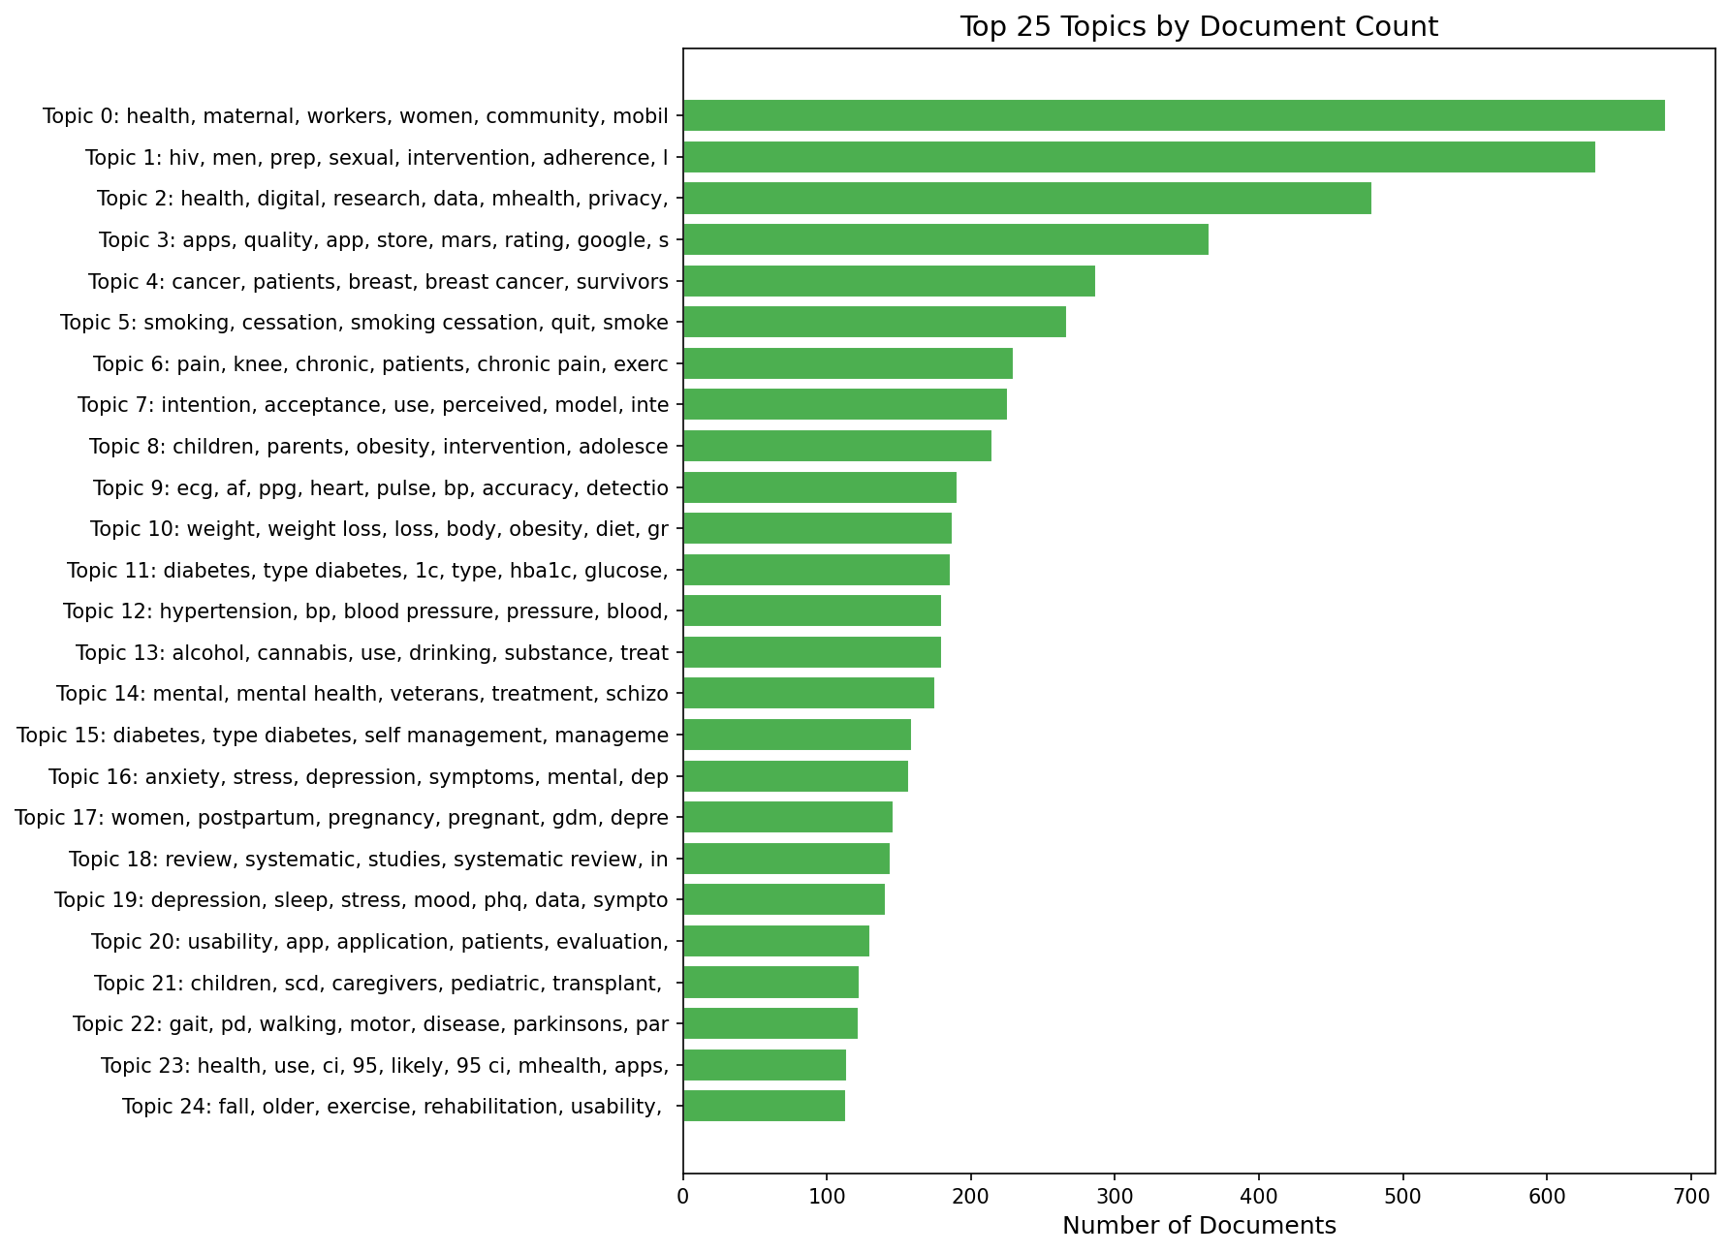
TOPIC MODELING OUTPUT — TOPIC FREQUENCY
11

Slide 13
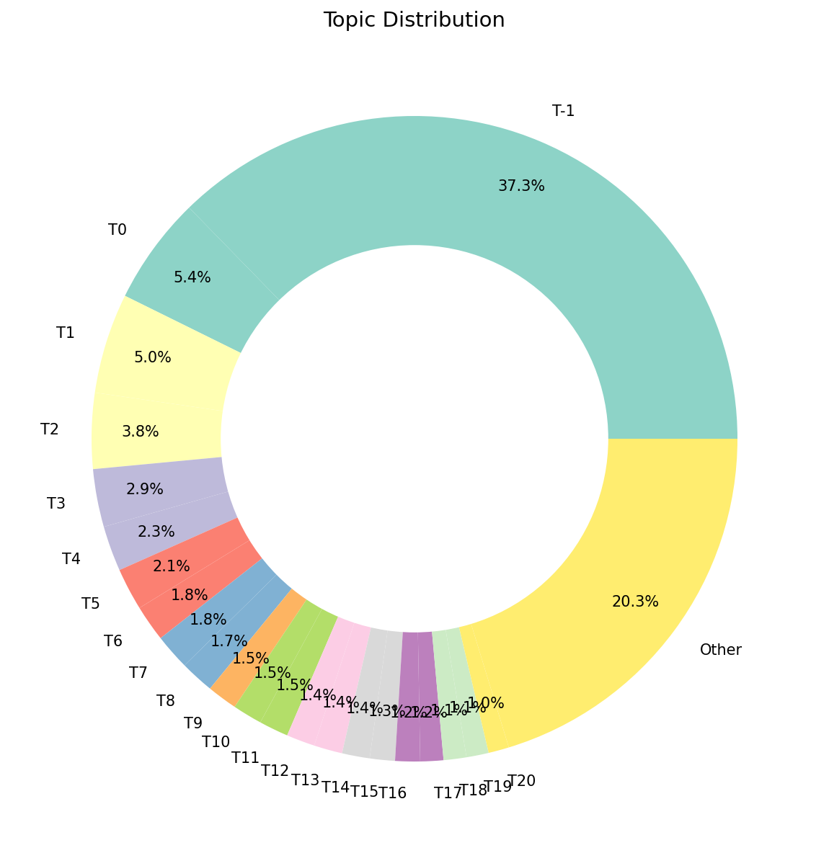
TOPIC MODELING OUTPUT — TOPIC DISTRIBUTION
12

Slide 14
TOPIC MODELING OUTPUT — REPRESENTATIVE TERMS
TOPIC | DOCUMENTS | REPRESENTATIVE TERMS
Topic 0 | 683 | health, maternal, workers, women, community, mobile, care, services, mhealth, health workers
Topic 1 | 634 | hiv, men, prep, sexual, intervention, adherence, living hiv, sex, art, testing
Topic 2 | 479 | health, digital, research, data, mhealth, privacy, digital health, apps, design, technologies
Topic 3 | 366 | apps, quality, app, store, mars, rating, google, stores, available, google play
Topic 4 | 287 | cancer, patients, breast, breast cancer, survivors, cancer patients, app, symptom, patient, cancer survivors
Topic 5 | 267 | smoking, cessation, smoking cessation, quit, smokers, tobacco, abstinence, participants, quitting, quit smoking
Topic 6 | 230 | pain, knee, chronic, patients, chronic pain, exercise, app, low pain, osteoarthritis, management
Topic 7 | 226 | intention, acceptance, use, perceived, model, intention use, mhealth, health, adoption, factors
Topic 8 | 215 | children, parents, obesity, intervention, adolescents, healthy, child, app, school, physical
Topic 9 | 191 | ecg, af, ppg, heart, pulse, bp, accuracy, detection, heart rate, rate
13

Slide 15
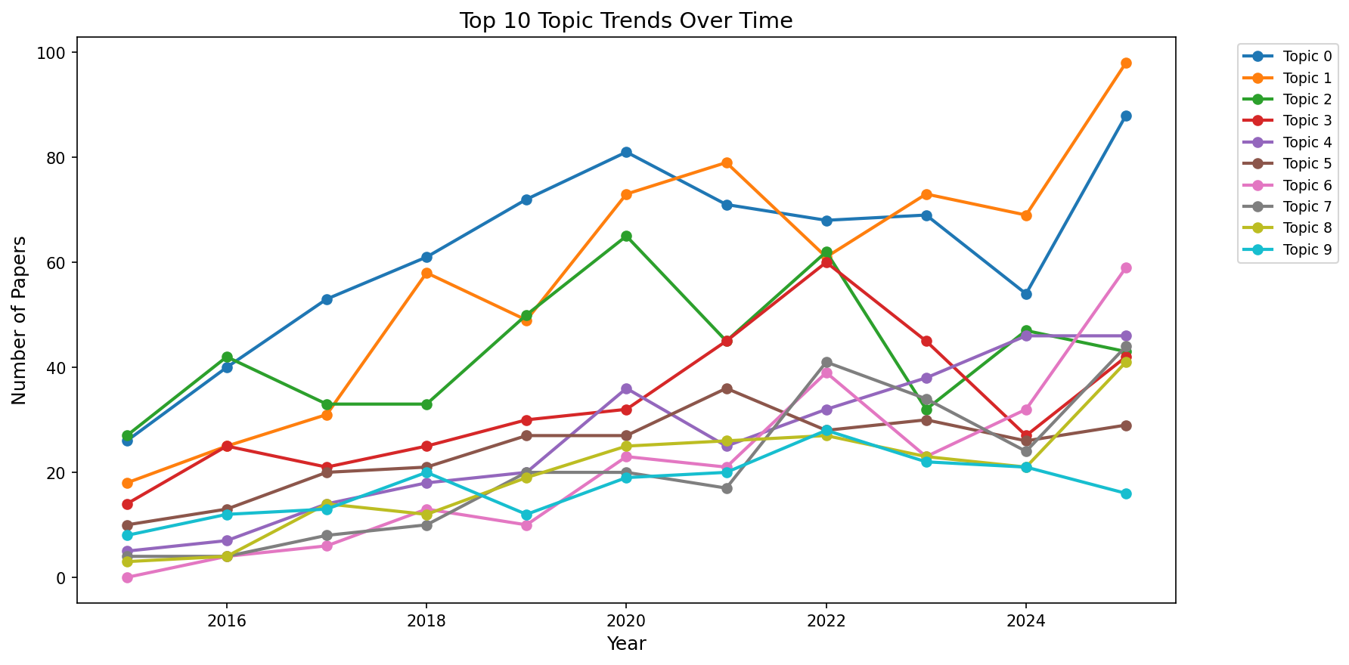
TOPIC MODELING OUTPUT — TOPIC TRENDS
The chart shows how the leading discovered topics vary across the 2015–2025 corpus.
14

Slide 16
9. IMPLEMENTATION BOUNDARY — FINAL
IMPLEMENTED 01
IMPLEMENTED 02
IMPLEMENTED 03
Finalize mHealth dataset
14,905 raw → 14,881 cleaned → 12,642 retained.
Basic NLP preprocessing
12,642 scientific documents prepared for topic discovery.
Initial topic modeling
BERTopic produced 63 genuine topics and 4,715 outliers.
NOT INCLUDED IN THIS VERSION
Biomedical concept extraction • MeSH normalization • temporal/semantic gap analysis • research-gap scoring • LLM hypothesis generation • LLM validation
15

Slide 17
10. KEY TAKEAWAYS FOR PRESENTATION
DATASET IS READY
TEXT IS STANDARDIZED
A validated PubMed corpus gives us a reliable
Starting point for downstream mHealth analysis.
Preprocessing converts the retained literature into
consistent scientific text while preserving important
biomedical expressions.
TOPICS ARE DISCOVERED
OUTPUTS ARE TRACEABLE
BERTopic groups semantically related papers and
exposes recurring themes in mHealth literature.
Each stage produces outputs, allowing the
Processing Pipeline, topic results to be demonstrated
NEXT STEP IS WELL DEFINED
The present phase establishes the literature-analysis
foundation; hypothesis generation and LLM-based
stages follow as future work.

Slide 18
11. REFERENCES & SOURCE BASIS
• Vibha, Rajesh R. Pai, N. Sumith. “Ontology-Guided Hypothesis Generation Using LLMs and Topic Modeling in mHealth Research.” IEEE Access, 2025, 13, 200725–200736.
• Current project source: Phase 1 Final End-to-End Validation, Cleanup, and Completion Report (audit date: 26 September 2026).
• Current project repository artifacts: notebooks 00–06, src modules, BERTopic model, outputs/, figures/.
• Base-paper presentation notes: methodology summary prepared from the supplied base-paper discussion.

Slide 19
THANK YOU

