Slide 1
Cardio Good Fitness Retail
Case Study
Bhuvaneswari Suriyanarayanan

Slide 2
Background
Cardio Good Fitness is a Retail store that sells fitness equipments.
We have the sample customer data for its treadmill products which we will be using for our data analysis , conclusion and recommendations

Slide 3
Objective
Come up with a Customer Profile of the different treadmill products from the sample data
Perform Univariate, Bivariate and Multivariate analysis on the sample data
Generate a set of insights and recommendations that will help the company in targeting new customers

Slide 4
Sample Data Information
Variable | Description
Product | The model no. of the treadmill
Age | In no.of years of the customer
Gender | of the customer
Education | in no.of years of the customer
Marital Status | of the Customer
Usage | Avg no.of times the Customer wants to use the product every week
Fitness | Self rated fitness score of the Customer(5 - Very fit, 1- very unfit)
Income | of the Customer
Miles | Expected to run every week
Observation | Variables
180 | 9
Note:
I have grouped the Age to AgeRange categorical bucket and have added a new column
I have also grouped the data Productwise and further genderwise and used for my analysis

Slide 5
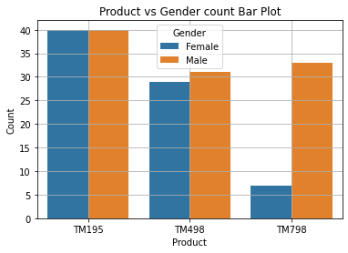
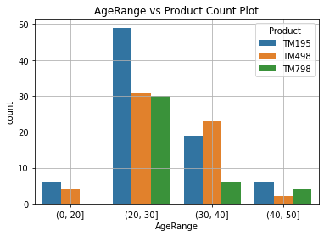
EDA - Univariate Analysis - Highlights
TM195 is equally liked by men and women
TM498 and TM798 is more preferred by men than women
For all the three Products the maximum customers are in the Age group 20-35 years of Age

Slide 6
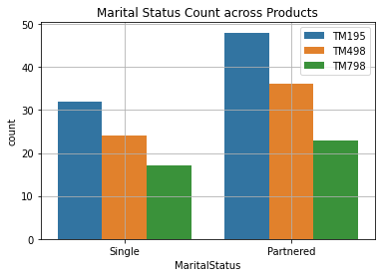
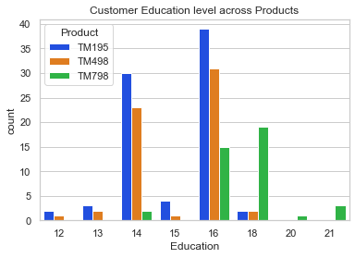
EDA - Univariate Analysis - Highlights
Customers with Education level of 16(Undergraduates) are the major contributors in all the three Product Category
Partnered Customers are more than Single in all the three Product Category

Slide 7
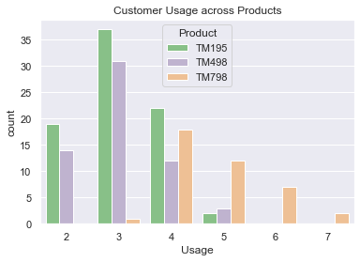
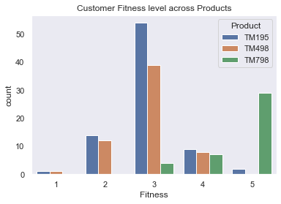
EDA - Univariate Analysis - Highlights
The average usage for TM195 and TM498 is 3 times a week whereas
TM798 has an average usage of 4 times a week which is more compared to the other products
Customer using TM195 and TM498 have an average fitness rating of 3( mediocre)
Customer using TM798 has a fitness rating of 4 that is higher than the other two Products

Slide 8
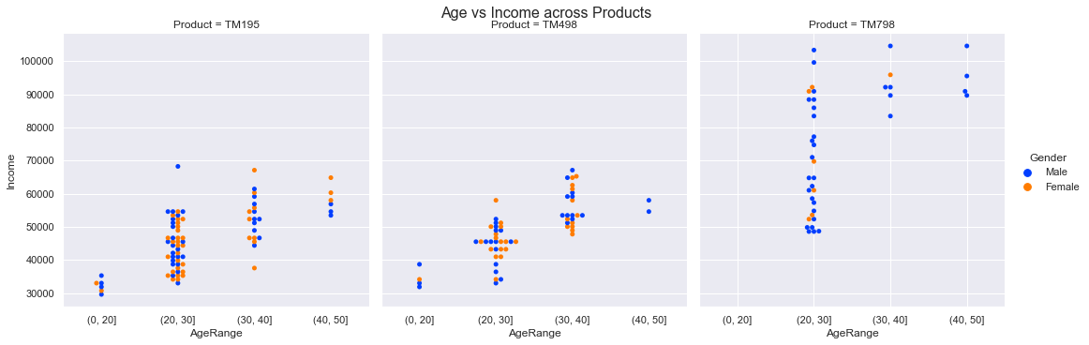
EDA - Multivariate Analysis - Age vs Income across Products
TM195:Maximum Customers are in the Age group 20-30 years with an income range between 30-55k.Both Men and female customers are equally distributed
TM498:Maximum Customers are in the Age group 20-30 years with an income range between 30-50k.Male customers are more than Female
TM798:Maximum Customers are in the Age group 20-30 years with an income range between 50-90k.Both Male customers are the maximum.

Slide 9
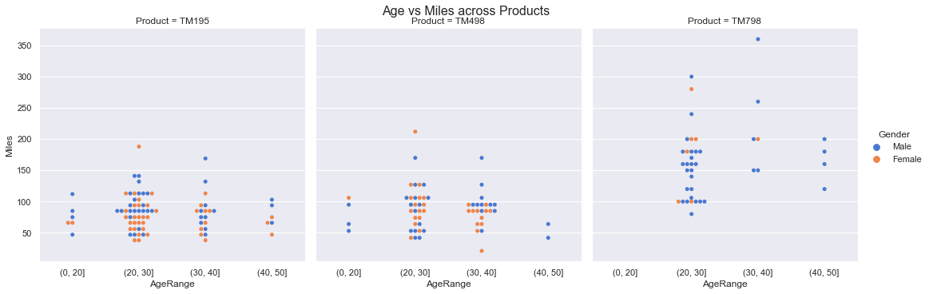
EDA - Multivariate Analysis - Age vs Miles across Products
Age does not affect the logging of miles for both the genders in the sample data

Slide 10
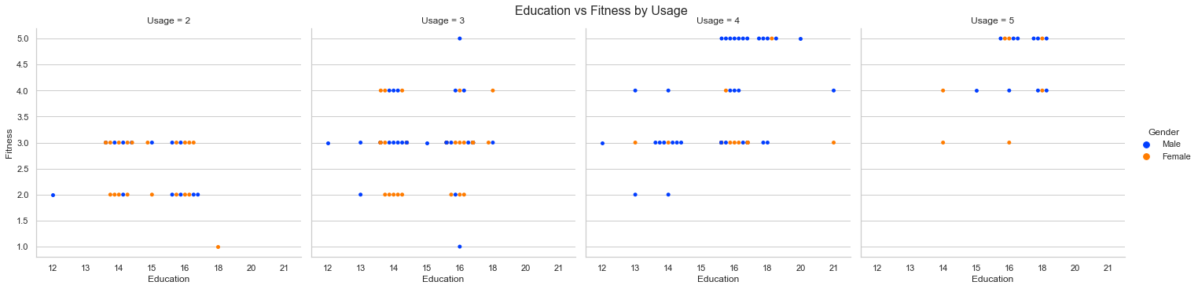
EDA-Multivariate Analysis- Education vs Fitness by Usage
Customers whose usage per week are more have more fitness and are highly educated

Slide 11
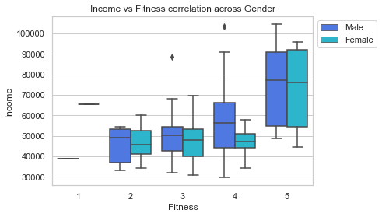
EDA-Bivariate Analysis - Income vs Fitness
As the Income increases the fitness among male increases gradually

Slide 12
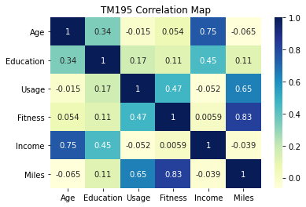
Bivariate Data Analysis - TM195 Heat Map Correlation
Observations:
Positive Correlation
As they get older their income increases.
The more fit people run more miles.
The more usage the more miles.
Negative correlation is almost negligible as it is close to zero.
Also there is no significant difference observed when plotted between the male and Female customers individually

Slide 13
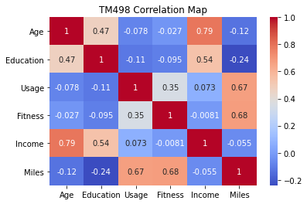
Bivariate Data Analysis - TM498 Heat Map Correlation
Observations:
As they get older, their income also increases
The more fit people run more miles
The more usage the more miles

Slide 14
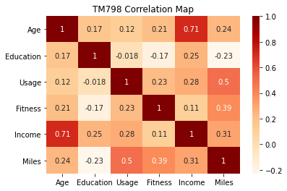
Bivariate Data Analysis - TM798 Heat Map Correlation
Observations:
Positive Correlation:
As they get older, their income also increases.
The more fit people run more miles.
The more usage the more miles.
Negative Correlation is almost negligible.
Female population is very low(count 7) to do any further analysis

Slide 15
Customer Profiling - TM195
Variables | TM195
 | Male | Female
Sample Data count | 40 | 40
Age | Men within the Age range 20-35 are the major customers | Women within the Age range 20-35 are the major customers
Education | Education level of customer range between 12 - 18 | Education level of female customers range between 14 - 18
Marital Status (Single:Partnered) | Among men this distribution is almost even in the ratio 1:1 | In female the ratio of Single vs partnered is 1:2. Partnered women is more in this category
Usage | Men have slightly higher usage than women with 3.2 as their average | Women uses it at an average of 2.9 times a week
Fitness | Fitness level is rated around 3 for both categories
Income | Average income is around 46K for both the categories
Miles | Men have a average value of 89 indicating more miles logging than female | Women have an average miles of 76 i indicating lower usage than men

Slide 16
Customer Profiling - TM498
Variables | TM498
 | Male | Female
Sample data count | 31 | 29
Age | Most customers are in the age range 20 -35 for both the categories
Education | Education level of the customers lie between 12-16 | Education level of customers lie between 13-18
Marital Status | Partnered customers are one and half times more than the single category
Usage | The usage count average is almost equal at 3 for Men | The usage count average is almost equal at 3.1 for women
Fitness | Men and women using this product are equally fit with an average of 2.9
Income | Both Genders are in the Average Income group of 48 - 49K
Miles | Men and women for this product log equal miles at an average of 87 miles per week

Slide 17
Customer Profiling - TM798
Since the Female Sample data is too low we will look into the Customer data holistically without gender grouping
Variables | TM798
Sample data count | 33(Male) 7(Female)
Age | Most Customers are in AgeRange 20-30 years
Education | Most Customers in this group has a Eduction level in the range 16 - 19
Marital Status | Partnered Customers are almost one and half times more than the Single category
Usage | Usage is most with an average of 4.7 per week for this Product among all three products
Fitness | Customers using this product also have high fitness level rated at 4.6 compared to other two products
Income | Customers average Income is 75k
Miles | Average miles logged is also high at 166 miles per week as compared to other products

Slide 18
Conclusions
Customers with Education level 16 are the maximum users of all the three products.
TM798 is popular among the highly educated and high income customer(mean =75k)
Customer using TM195 and TM498 has an average fitness of 3(mean value) versus the TM798 customer fitness of 5(highest).
TM195 and TM498 customers use the product at an average of 3 times a week and TM798 is being used by customers at an average of 5 times a week.
The maximum number of customers for each of the three products are in the agerange of 20 - 35 years of age.
Product TM195 has the highest number of customers among all the three products in the sample data.
Partnered customers are one and half times more than the single customer category.
For TM195 and TM498 gender do not impact the buying process. For TM798 the male customers are more in the given data Sample.
Male Customers log more miles than female customers for TM195 and TM498
TM798 has female customers logging more miles however the sample data is too less to certainly confirm on this conclusion.
There is a positive correlation for income vs fitness for male customers,as the income increases the fitness level also increases.

Slide 19
Recommendations
Target customers for all the three products lie in the age range of 20 - 35 years of Age.
Partnered customers outshine the single customers for all the three products.
TM195 is the highly used product among male and female customers.
TM798 is popular among high Income and highly fit people .
More educated(Education level >=16) people are fitness focussed than the less educated and can be targeted for the sales of the products.

Slide 20
Thank You!
Questions??

