Slide 1
IBM University Engagement Project Submission
“Exploring the Power of Agentic AI with IBM Granite”

Slide 2
Project Tile – Course Content Simplification Agent
Domain of Project – Education
Student Name | Recent Passport Photo | Email ID | Mobile number [WhatsApp]
Bhuvaneshwari B |  | bhuvibalaji05@gmail.com | 7418964642

Slide 3
Problem Statement -
Problem Statement : Course Content Simplification Agent
The Challenge
Educational materials often vary in complexity and may not be accessible to learners with different levels of prior knowledge. Students frequently struggle to understand key concepts due to technical jargon and advanced explanations in textbooks and lecture notes. There is a need for an AI-powered solution that can simplify and personalize academic content according to the learner's proficiency level.
Objectives
Analyze academic content and identify key concepts.
Simplify complex educational material while preserving meaning.
Adapt explanations for Beginner, Intermediate, and Expert learners.
Improve accessibility and understanding of course content.
Support personalized and inclusive learning experiences.
Leverage IBM Granite and IBM Cloud services for intelligent content transformation.

Slide 4
Technology Used
IBM Granite – Large Language Model (LLM) for content analysis and simplification.
IBM Watsonx.ai – AI platform for accessing and deploying Granite models.
IBM Cloud Lite Services – Cloud infrastructure for hosting and managing the application.

Slide 5
Proposed Solution -
Proposed Solution: Course Content Simplification Agent
The proposed solution is an AI-powered Course Content Simplification Agent that leverages IBM Granite models through Watsonx.ai to make complex academic content easier to understand. The system accepts educational materials such as lecture notes, textbook passages, and research articles as input. It analyzes the content, identifies key concepts, and simplifies the explanations according to the learner's proficiency level (Beginner, Intermediate, or Expert). By reducing technical jargon while preserving the original meaning, the solution provides personalized learning support, improves comprehension, and makes educational content more accessible to all learners.

Slide 6
Workflow
User uploads or pastes academic content and selects a learning level.
The web application sends the content to the Flask backend.
IBM Granite analyzes the content to understand concepts and context.
The system identifies complex terms and evaluates content difficulty.
The AI rewrites the content according to the selected proficiency level.
A simplified and personalized explanation is generated.
The processed content is returned to the web application.
The simplified output is displayed to the user for improved understanding.

Slide 7
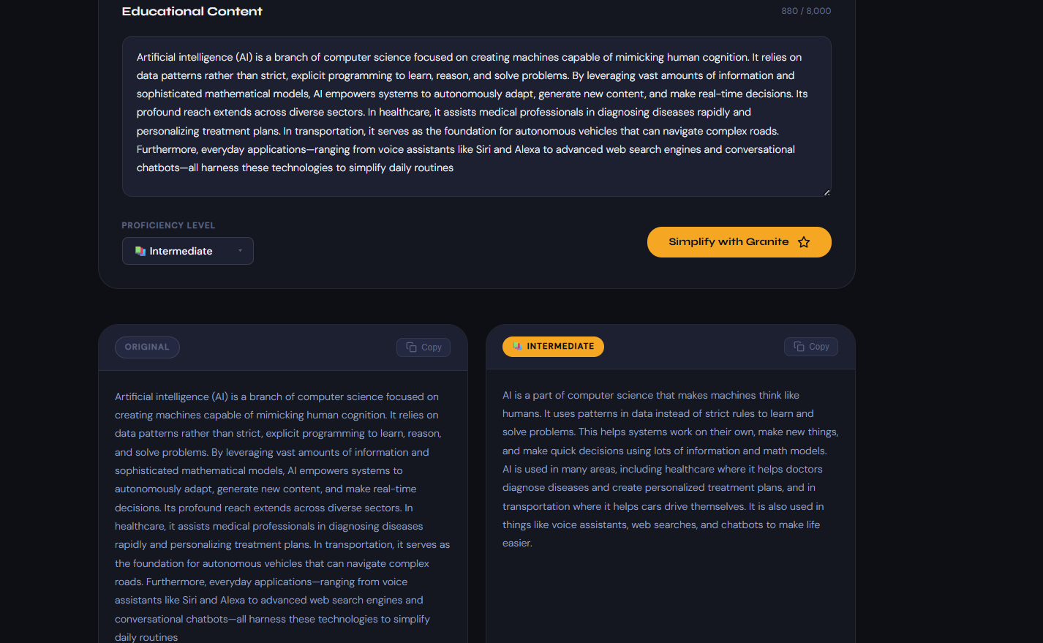
Course Content Simplification Agent

Slide 8
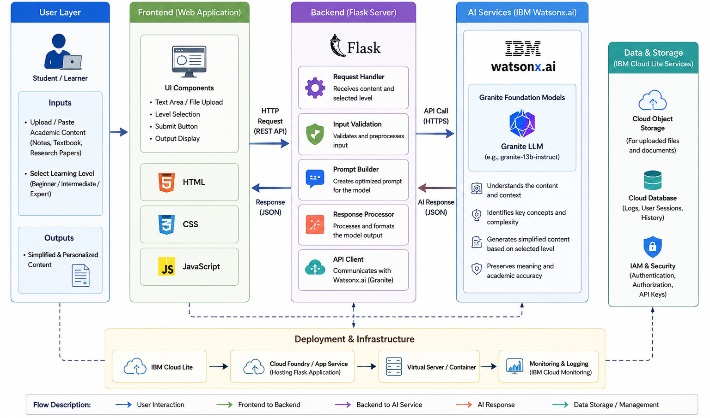
Architecture

Slide 9

Role of Agentic AI in the solution
Agentic AI acts as an intelligent assistant that autonomously analyzes, understands, and transforms academic content based on the learner's needs. Instead of simply generating text, it makes decisions about how the content should be simplified and personalized.
Understands User Intent by identifying the selected learning level (Beginner, Intermediate, or Expert).
Analyzes Academic Content to extract key concepts, context, and important information.
Assesses Complexity by recognizing technical jargon and difficult explanations.
Adapts Content Dynamically by choosing the appropriate level of simplification for each learner.
Generates Personalized Explanations while preserving the original meaning and academic accuracy.
Provides Learning Support by making content more accessible and easier to understand.
Improves User Experience through automated, real-time content transformation without manual intervention.

Slide 10
Technology Used
IBM Granite – Large Language Model (LLM) for content analysis and simplification.
IBM Watsonx.ai – AI platform for accessing and deploying Granite models.
IBM Cloud Lite Services – Cloud infrastructure for hosting and managing the application.
Python – Backend development and AI integration.
Flask – Lightweight web framework for building the application.
HTML, CSS, JavaScript – Frontend development and user interface design.
REST APIs – Communication between the frontend and AI services.

Slide 11
Novelty and Uniqueness
The proposed Course Content Simplification Agent introduces an innovative approach to personalized education by leveraging Agentic AI and IBM Granite Foundation Models to transform complex academic content into learner-friendly explanations. Unlike traditional summarization tools, the system intelligently analyzes content, identifies key concepts and technical jargon, assesses complexity, and adapts explanations according to the learner’s proficiency level (Beginner, Intermediate, or Expert).
Its uniqueness lies in its ability to generate personalized, context-aware explanations from the same source material while preserving academic accuracy and meaning. The solution supports various educational resources, including lecture notes, textbooks, and research papers, and delivers instant simplification without requiring manual intervention from instructors. By combining content understanding, complexity assessment, adaptive simplification, and personalized learning support within a single platform, the project enhances accessibility, improves comprehension, and promotes inclusive education for learners with diverse backgrounds.

Slide 12
Git Hub Link
https://github.com/Bhuvaneshwari0503/course-content-simplifier
·
·
·

Slide 13
Future Scope
1. Multilingual Content Simplification
Extend the system to support multiple languages such as Tamil, Hindi, Telugu, and other regional languages.
Allow students to receive simplified explanations in their preferred language.
Improve accessibility and make learning easier for a wider range of learners.
2. AI-Generated Quizzes and Learning Support
Automatically generate quizzes, practice questions, and summaries from the simplified content.
Help students test their understanding and improve knowledge retention.
Provide additional learning support for self-paced learning and exam preparation.
·
·
·

Slide 14


