Slide 1
Relational Database to NoSQL Conversion by Schema Migration and Mapping
International Journal of Computer Engineering In Research Trends
https://ijcert.org/ems/ijcert_papers/V3I909.pdf

Slide 2
Project Group: 46
Aparna Phundir - M23AID006
Bhuvaneswari J - M23AID053
Abhishek Kumar - M22AIE237

Slide 3
Purpose
To build a Schema-Migration and Mapping Framework using python to support automatic data migration from relational databases to NoSQL.
The Schema Migration class automates the migration of data from an SQLite database to Mongo DB, preserving relationships and dependencies between tables through foreign key analysis.
The Data mapping system is designed to facilitate the execution of SQL queries on a NoSQL database.

Slide 4
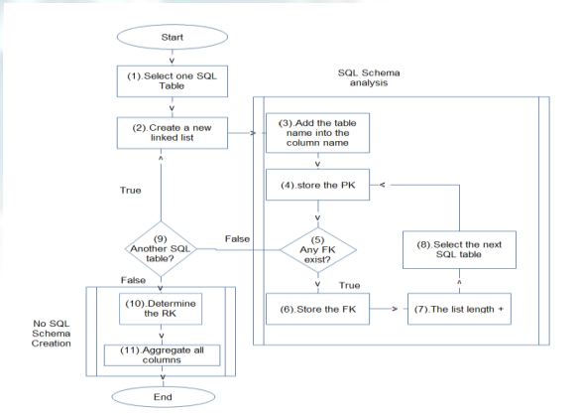
Schema Migration Framework

Slide 5
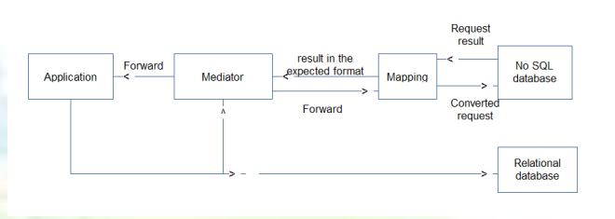
Data Mapping Framework

Slide 6
Prerequisites
Sqlite
MongoDB
Python 3.x
xml.etree.ElementTree
Sqlparse
Pymongo
re

Slide 7
Execution
Create DB in Sqlite with table structure and data.
Run mongo db using mongod command in command prompt.
Execute schema migration framework python code to migrate sqlite db data to mongo db.
Execute mapping framework python code to to facilitate the execution of SQL queries on a NoSQL database.
Execute sql2nosql_plot.py to validate performance of sqlite and mongodb transaction.

Slide 8
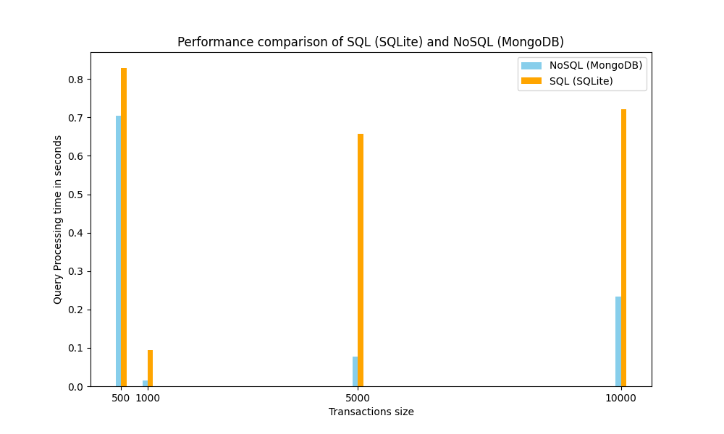

Slide 9
Thank you

