Slide 1

Version Control

Slide 2
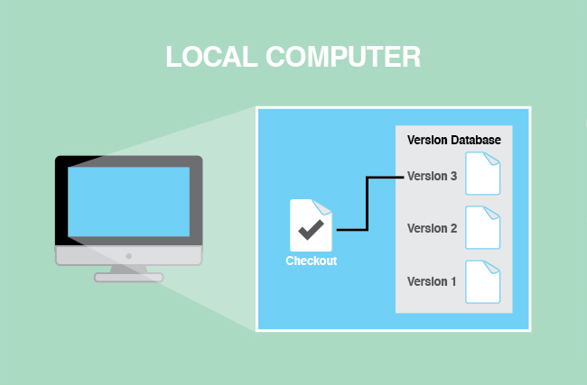
Why?

Slide 3
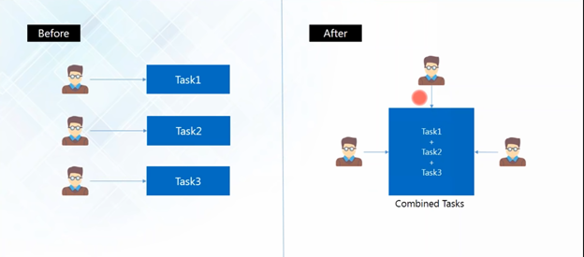
Why?

Slide 4
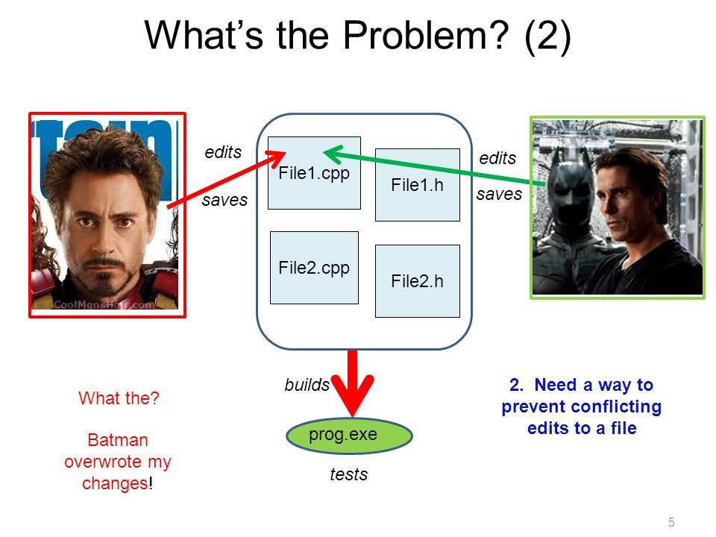

Slide 5
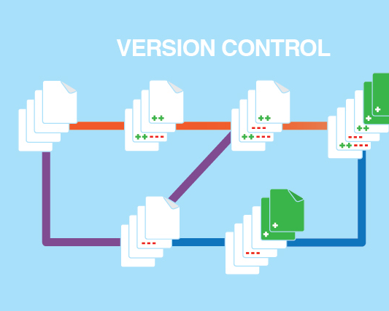
Getting Started
A version control system is a special application that stores and manages every revision of your files and code. Many developers and organizations use version control to collaborate on source code, manage releases, and roll back to previous versions when bugs are discovered.

Slide 6
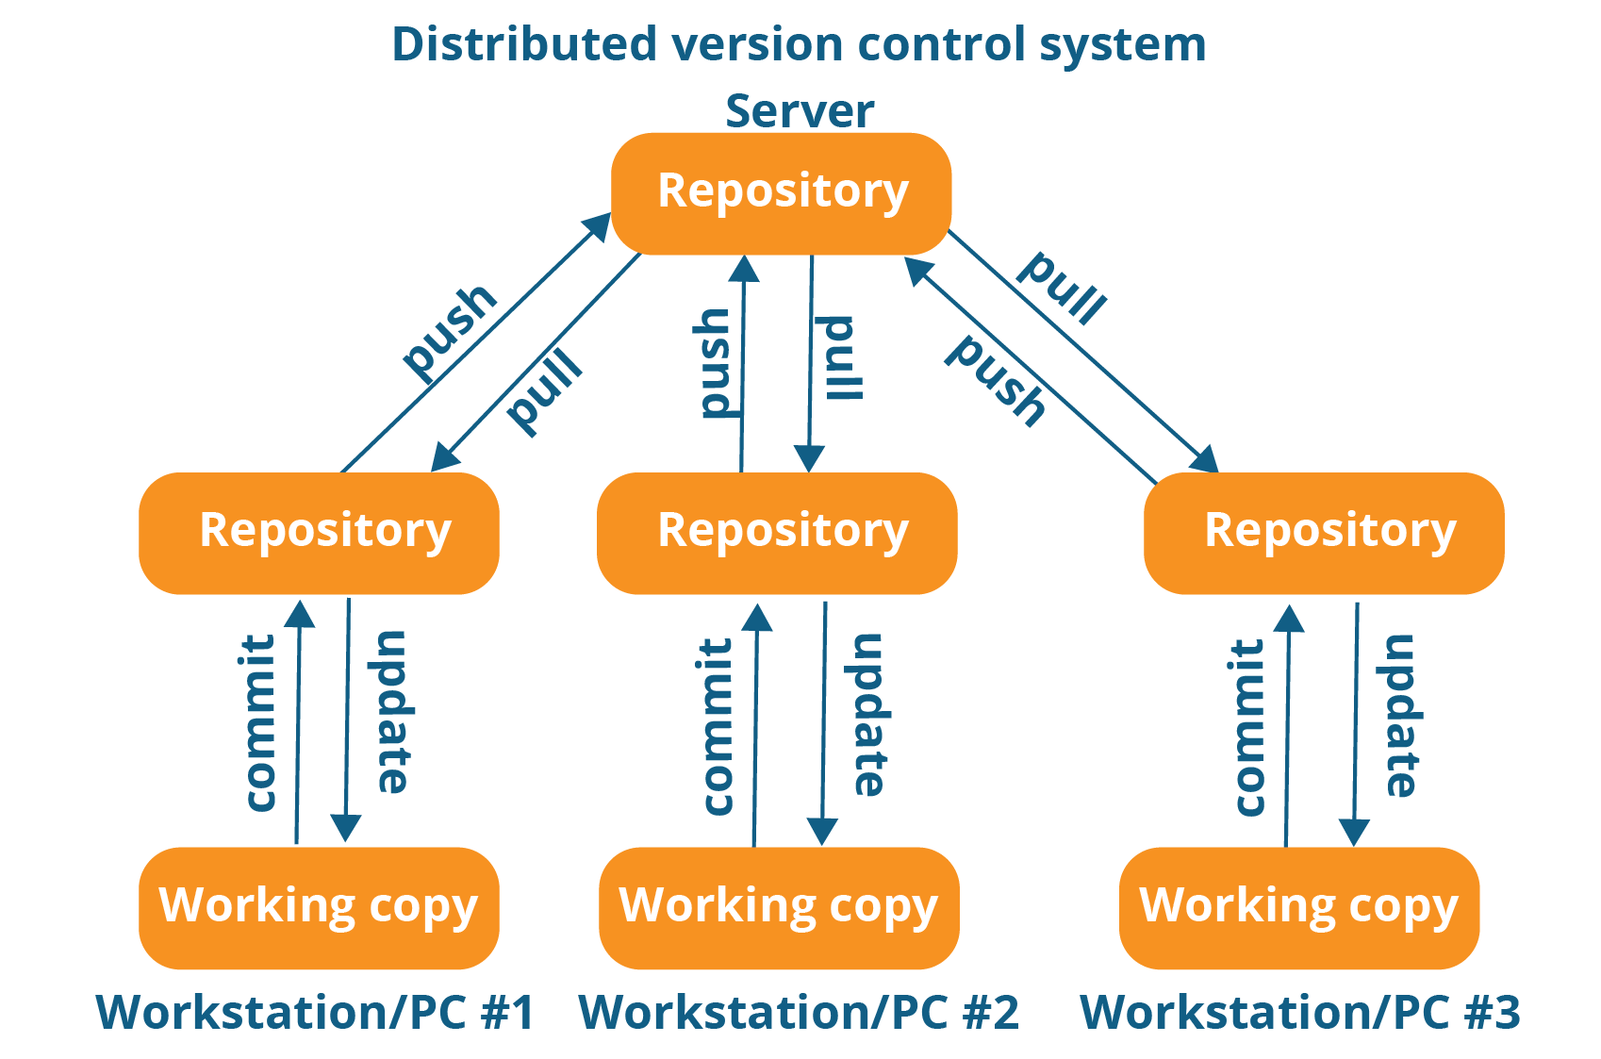
VCS

Slide 7
Benefits
Backup and Restore
Synchronization
Short-term undo
Long-term undo
Track Changes
Track Ownership
Sandboxing
Branching and
merging

Slide 8
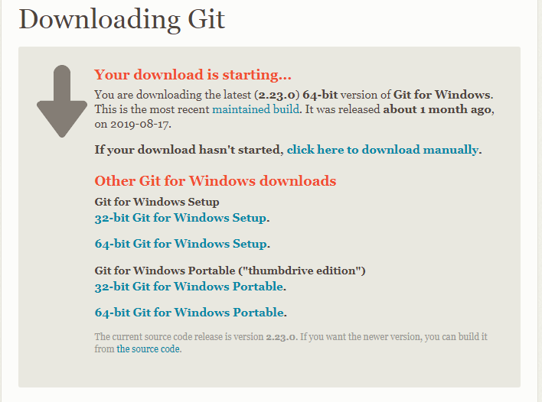
Installation & Setup
Git is a versioning system developed by Linus Torvalds, that is used by millions of users around the globe. Companies like GitHub offer code hosting services based on Git.
Run your own Git server
Git Client
https://git-scm.com/downloads

Slide 9
Basic Setup
Repository (repo): The database storing the files.
Server: The computer storing the repo.
Client: The computer connecting to the repo.
Working Set/Working Copy: Your local directory of files, where you make changes.
Trunk/Main: The primary location for code in the repo. Think of code as a family tree — the trunk is the main line.

Slide 10
Features
Add: Put a file into the repo for the first time, i.e. begin tracking it with Version Control.
Revision: What version a file is on (v1, v2, v3, etc.).
Head: The latest revision in the repo.
Check out: Download a file from the repo.
Check in: Upload a file to the repository (if it has changed). The file gets a new revision number, and people can “check out” the latest one.
Checkin Message: A short message describing what was changed.
Changelog/History: A list of changes made to a file since it was created.

Slide 11
Update/Sync: Synchronize your files with the latest from the repository. This lets you grab the latest revisions of all files.
Revert Throw away your local changes and reload the latest version from the repository
Branch: Create a separate copy of a file/folder for private use (bug fixing, testing, etc). Branch is both a verb (“branch the code”) and a noun (“Which branch is it in?”)

Slide 12
Diff/Change/Delta: Finding the differences between two files. Useful for seeing what changed between revisions.
Merge (or patch): Apply the changes from one file to another, to bring it up-to-date. For example, you can merge features from one branch into another.
Conflict: When pending changes to a file contradict each other (both changes cannot be applied).

Slide 13
Resolve: Fixing the changes that contradict each other and checking in the correct version.
Locking: Taking control of a file so nobody else can edit it until you unlock it. Some version control systems use this to avoid conflicts.
Breaking the lock: Forcibly unlocking a file so you can edit it. It may be needed if someone locks a file and goes on vacation (or “calls in sick” the day Halo 3 comes out).
Check out for edit: Checking out an “editable” version of a file. Some VCSes have editable files by default, others require an explicit command.

Slide 14
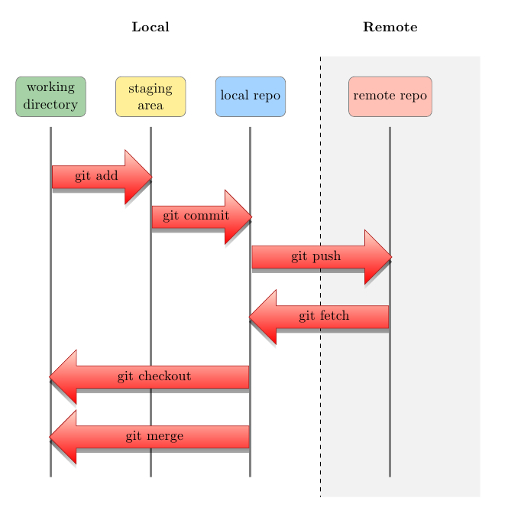

Slide 15
Git Commands
Initializing a Git Repository
2.
git init
Repository Status
git status
3.Adding files to Repository
git add file [file] [file..]

Slide 16
Git Commands
4.Committing Staged Files
5.
git commit -m ‘Initial Commit’
Pushing to repository
git push
6.Check status
git status

Slide 17
Uploading the content to github
git remote add origin remote url.git
git push origin master
Cloning the repository
git clone remote url.git

Slide 18
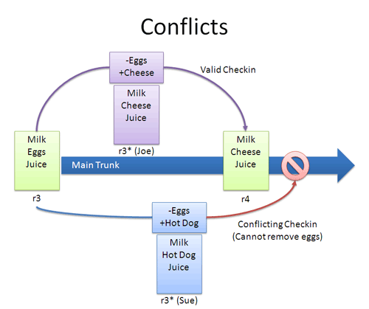

Slide 19
Checking the difference on conflict
git diff
Reverting the version
git revert HEAD
Create a branch
Git pull
git checkout -b [name_of_your_new_branch]
git push origin [name_of_your_new_branch]
View all branches
git branch -a

Slide 20
Add remote to your branch
git remote add [name_of_your_remote] [name_of_your_new_branch]
Push changes from your commit into your branch :
git push --set-upstream origin branch_name
Then Add commit and push
Git add .
git commit –m “message”
git push --set-upstream origin branch_name
View all branches
git branch -a

Slide 21
Update your branch when the original branch from official repository has been updated
git fetch [name_of_your_remote]
Then you need to apply to merge changes if your branch is
Git checkout master
git merge [name_of_your_branch]

Slide 22
Thanks

