Slide 1

Steganography: [HIDING DATA IN IMAGE]

Slide 2

STUDENT DETAILS
NAME : K .Bhuvan Sai
Email ID : bhuvansai_kolasani@srmap.edu.in
College : SRM University AP
Domain : EDUNET CYBERSECURITY
Duration : 04-06-2024 to -07-2024

Slide 3
Introduction:
The project is totally based on the securing the information or data.
Nowadays people basic fundamental is privacy.
Cybersecurity is important because it protects all categories of data from theft and damage.
This includes sensitive data, email information, personal texts, etc…
In this project, the data is secured in image by adding the embedded algorithm.

Slide 4
Steganography:
Steganography is the technique of hiding secret data within an ordinary, non-secret, file or message in order to avoid detection; the secret data is then extracted at its destination. The use of steganography can be combined with encryption as an extra step for hiding or protecting data.
Steganography is the practice of hiding a secret message inside of (or even on top of) something that is not secret. That something can be just about anything you want. These days, many examples of steganography involve embedding a secret piece of text inside of a picture.

Slide 5
Why we need:
CIA:
It provides a method to assure the confidentiality, integrity, authenticity, and accountability of electronic communications and data storage.
The CIA framework serves to outline the goals and objectives of the security program and helps organizations defend against threats such as data breaches/leaks, malware attacks, phishing, account/credentials compromise, web-based attacks, etc.

Slide 6
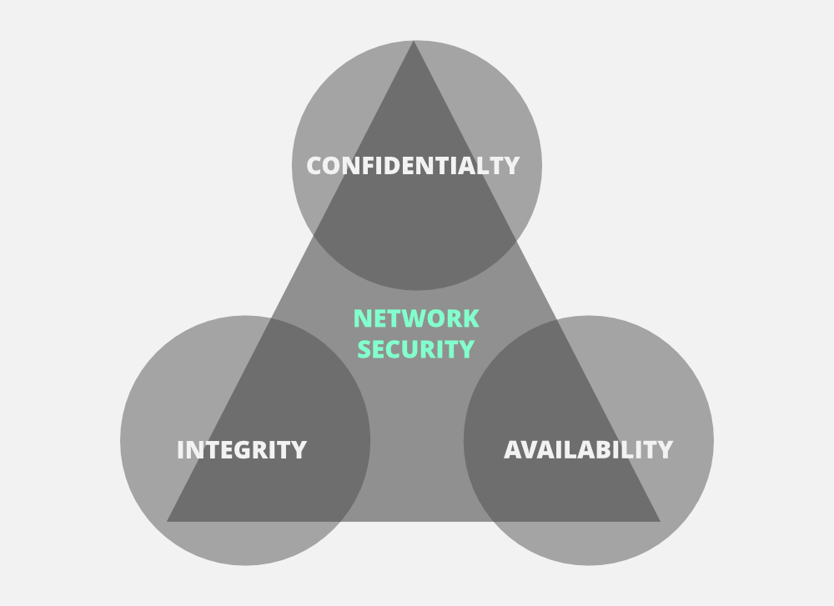
need of CIA:

Slide 7
Confidentiality:
Confidentiality is one of the core concepts of cybersecurity. Simply put, confidentiality ensures that secret information is protected from unauthorized disclosure. Protecting confidentiality is a responsibility shared between technologists and everyone else in the organization

Slide 8
Integrity:
Integrity means that data or information in your system is maintained so that it is not modified or deleted by unauthorized parties. This is an important element of data hygiene, reliability and accuracy.
The term 'integrity' means guarding against improper information modification or destruction, and includes ensuring information non-repudiation and authenticity.

Slide 9
Accountability:
The security goal that generates the requirement for actions of an entity to be traced uniquely to that entity. This supports non-repudiation, deterrence, fault isolation, intrusion detection and prevention, and after-action recovery and legal action.
Accountability is an assurance that an individual or an organization will be evaluated on their performance or behavior related to something for which they are responsible. The term is related to responsibility but seen more from the perspective of oversight.

Slide 10
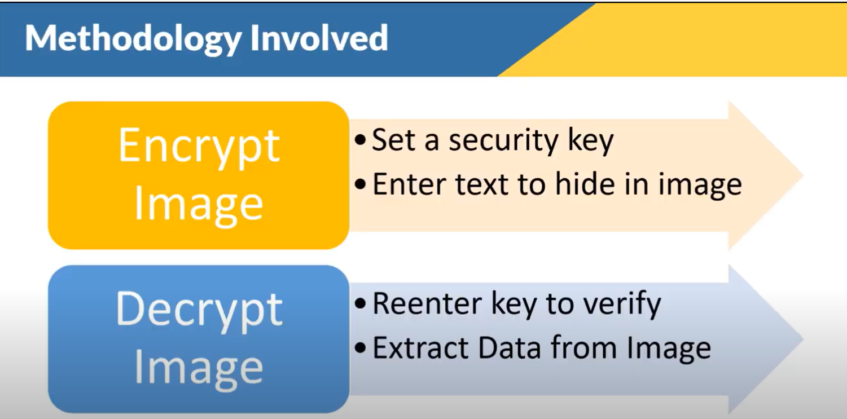
HOW IT WORKS

Slide 11
Where it is used:
The steganography is basically is used in hiding the data
Confidential communication and secret data storing.
Protection of data alteration.
Access control system for digital contents distribution.
Media Database systems.

Slide 12
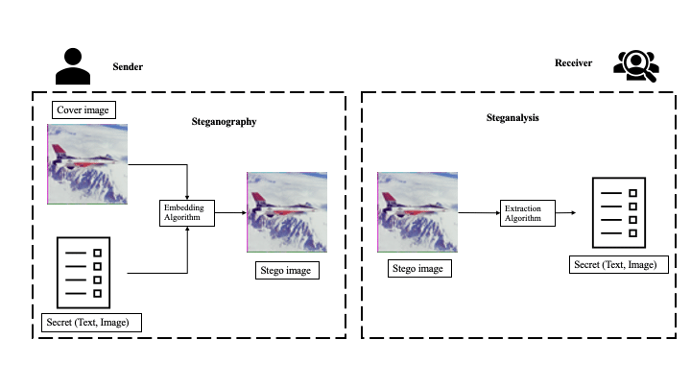
WORKING PRINCIPLE

Slide 13
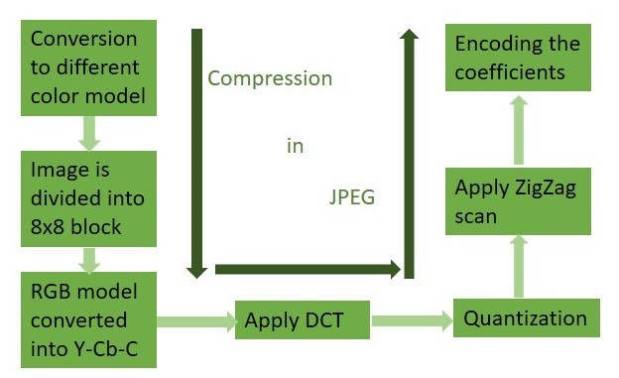
Picture format - Jpeg

Slide 14


Data sending through image

Slide 15
Conclusion:
In this project the data had been secured in the image.
The embedded algorithm has used to secure the information as an encryption.
The securing of the data is done, which is the main agenda of our project.
This is the one of best technique to hide or secure the information.

Slide 16
Git hub link
https://github.com/Bhuvansai030804/Steganography-

Slide 17

Thank you

