Slide 1
Unified Student Project Platform for Multiple Colleges
Project Title :- Unified student project platform for multiple colleges
Your Name :- [ Akash Singh , Bhuvan Tenguria , Bhupender Singh , Kavya Sharma ]
Uni. Roll No. :- [ 2115000102 , 2115000300 , 2115000302 , 2115000525 ]
Department Name :- CEA Department
Date :- 30/11/2023

Slide 2
Introduction
In today's educational landscape, collaboration and knowledge sharing are crucial components of student success. Our project, the Unified Student Project Platform, aims to create a centralized space where students from various colleges can collaborate, showcase their academic projects, and engage in meaningful knowledge exchange.
Traditional methods of project presentation and collaboration often limit students to within their own college or department. This isolation can hinder the sharing of diverse perspectives, ideas, and innovations. The Unified Student Project Platform addresses this limitation by providing a digital ecosystem where students from different colleges can connect, collaborate, and showcase their projects collectively.

Slide 3
Objectives
Cross-College Collaboration
Knowledge Exchange
Project Showcase
Enhanced Learning Experience
Networking Opportunities
User-Friendly Interface
Collaborative Tools
Community Building

Slide 4
Problem Statement
Innovation is the key to betterment of education and students in the Indian universities/colleges put a lot of efforts on the projects as a part of the academic requirements. If a common knowledge platform (with a facility for plagiarism) is created to bring all project works taken up at various levels by the students in Technical / Higher Educational Institutes and Universities throughout the country, then it will be a great source of knowledge and also will help the student community to take up unique/innovative project works.
An integrated platform should be developed where in all the universities/Colleges provide information about the projects done by the students. The information on this platform will help in the peer learning and this will also help in cross functional research between various universities/colleges. Objective: To develop an online integrated platform for projects taken up by the students of various universities/colleges .

Slide 5
Literature Review
Overview of Existing Collaborative Platforms
Common Features: Many existing collaborative platforms focus on project management, but they often operate within the confines of individual institutions, limiting cross-college collaboration.
Project Showcases: Several platforms emphasize project showcases but primarily within the context of a single college or department.
Limited Interactivity: Current platforms lack robust tools for real-time collaboration, hindering the dynamic exchange of ideas among students from different colleges.
Identified Gaps and Limitations
Isolationist Approach: Most platforms maintain an isolationist approach, where students are confined to collaborating within their own educational institution, missing out on the benefits of diverse perspectives.
Limited Networking Opportunities: Existing systems often lack dedicated features to foster networking opportunities beyond one's immediate academic circle.
Technological Barriers: Some platforms require extensive technical knowledge, presenting barriers to entry for students with varying technical backgrounds.

Slide 6
Methodology
Platform Architecture and Design:
Firebase Realtime Database: Employing Firebase Realtime Database to store project details, user information, and collaborative data.
Firebase Authentication: Leveraging Firebase Authentication for secure user authentication and authorization.
Firebase Hosting: Using Firebase Hosting to deploy the frontend and ensure quick, reliable access.
Technology Stack:
Frontend: Using a frontend framework like React.js integrated with Firebase SDK for web.
Backend: Employing Firebase Cloud Functions to handle server-side logic.
Real-Time Communication: Utilizing Firebase Realtime Database for real-time communication features.
Security: Leveraging Firebase Authentication and Firebase Security Rules for data security.
Networking Opportunities:
Firestore User Profiles: Storing user profiles in Firestore to allow users to create profiles, connect with peers, and build a professional network.
Firebase Cloud Functions: Integrating Cloud Functions for event triggers, facilitating seamless networking features.

Slide 7
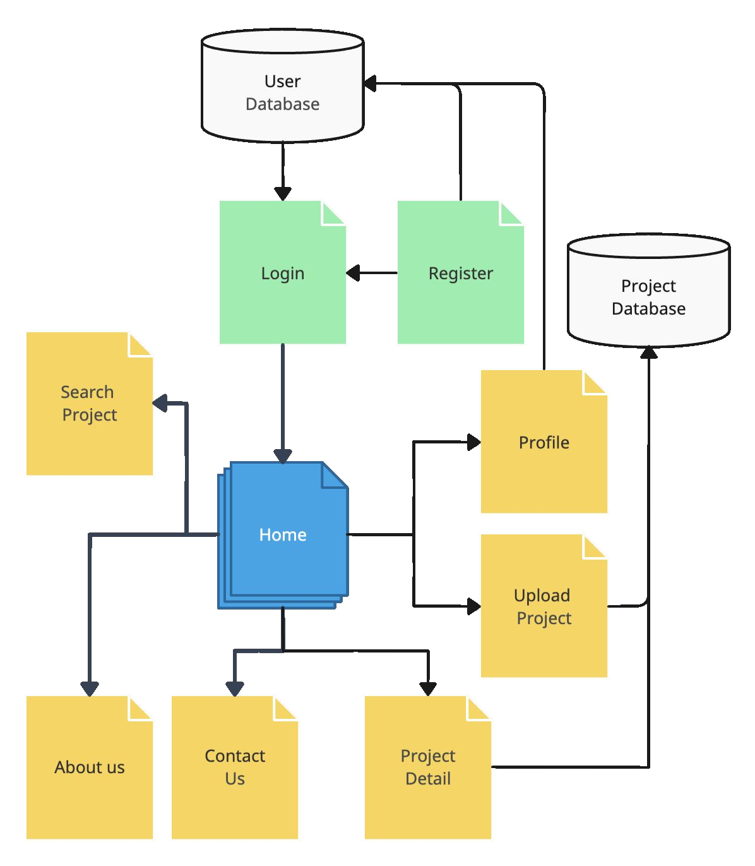
System Architecture

Slide 8
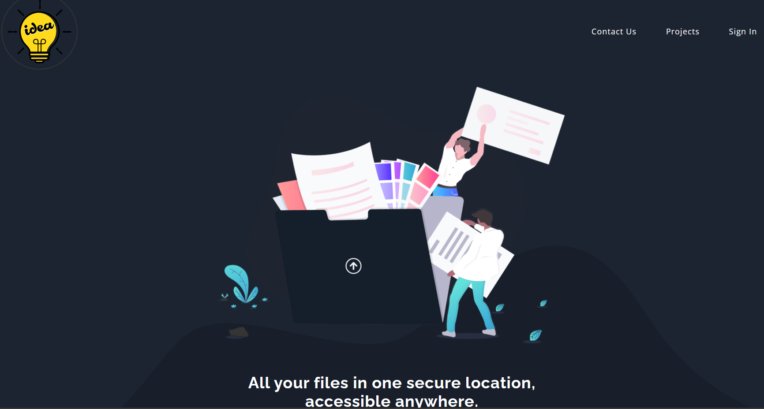
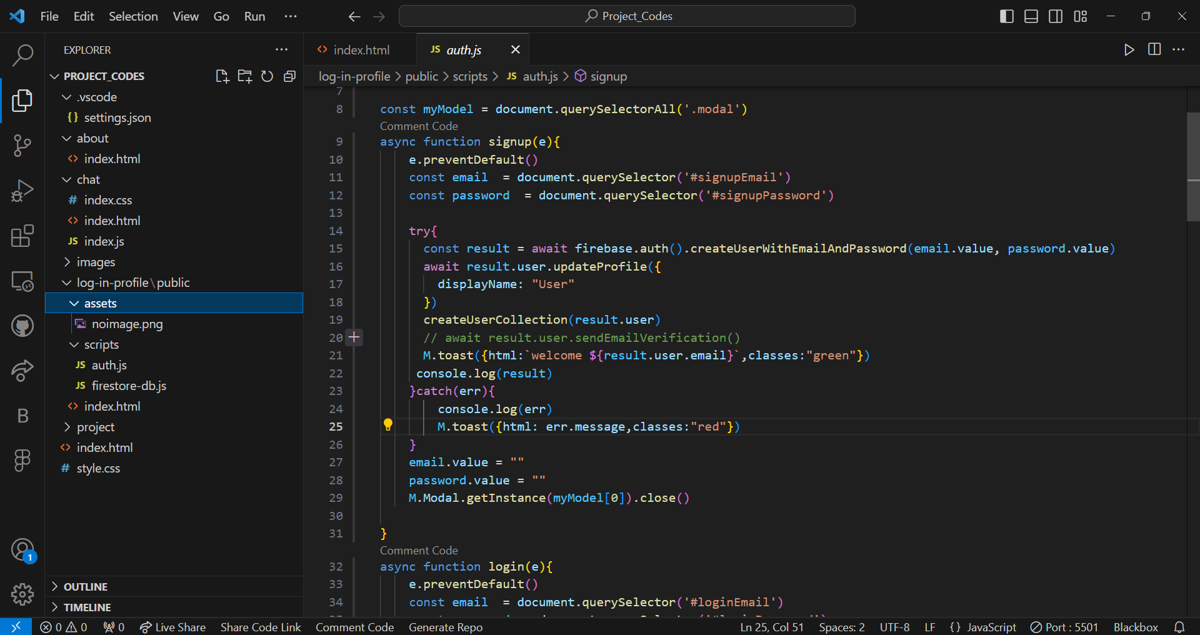
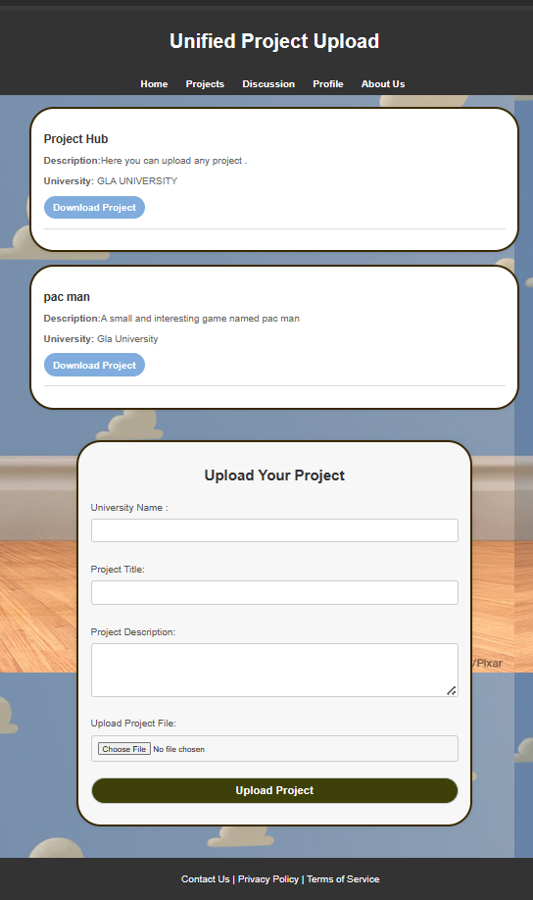
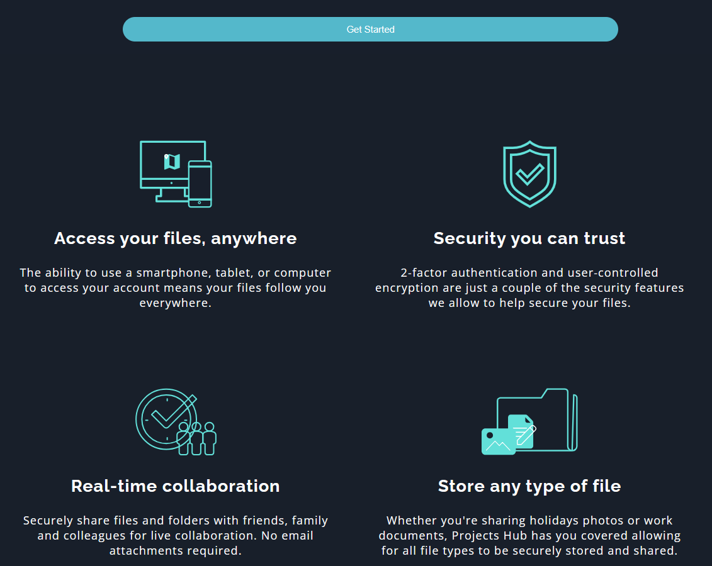
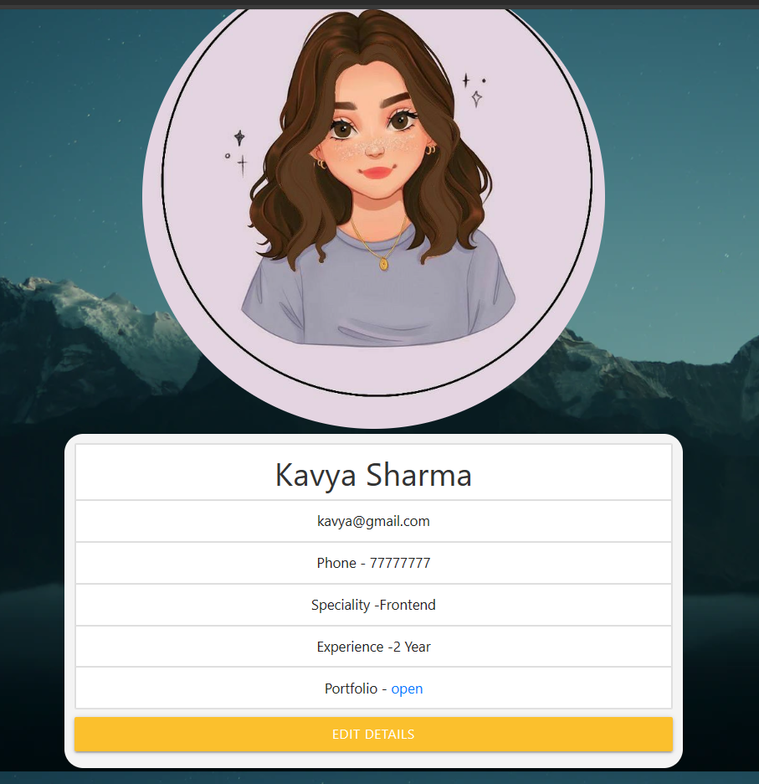
Implementation

Slide 9
Features
1. Cross-College Collaboration:
Description: The platform facilitates collaboration among students from different colleges.
Unique Functionality: Users can form interdisciplinary project teams, breaking down the traditional silos of collaboration within individual institutions.
2. Real-Time Collaboration Tools:
Description: Integrated chat, discussion forums, and document sharing for real-time collaboration.
Unique Functionality: Users can collaborate seamlessly on projects, providing instant feedback and engaging in discussions in real time.
3. Project Showcase:
Description: A dedicated space for students to showcase their academic projects.
Unique Functionality: The platform categorizes projects based on disciplines, themes, and colleges, allowing for easy exploration and recognition.
4. Knowledge Exchange Forums:
Description: Discussion forums where students can exchange ideas, insights, and best practices.
Unique Functionality: Forums promote interdisciplinary discussions, enabling students to learn from diverse perspectives and approaches.
5. User-Friendly Interface:
Description: An intuitive and easy-to-navigate user interface.
Unique Functionality: The design is user-centric, ensuring accessibility for students with varying technical proficiencies.

Slide 10
Results
Improved Collaboration
Networking Opportunities
Professional Development
User Satisfaction

Slide 11
Challenges Faced
Ensuring Data Security and Privacy:
Challenge: Handling sensitive student data while ensuring security and privacy.
Solution: Implement robust encryption protocols, adhere to industry-standard security practices, and comply with data protection regulations. Conduct regular security audits and penetration testing to identify and address vulnerabilities.
Technical Proficiency of Users:
Challenge: Students may have varying levels of technical proficiency, impacting their ability to navigate and utilize the platform.
Solution: Design an intuitive user interface with clear instructions and tooltips. Provide onboarding resources and tutorials. Conduct user testing to gather feedback and make iterative improvements to enhance usability.

Slide 12
Future Work
Feature Enhancements
Advanced Collaboration Tools
Community Building
Internationalization and Multilingual Support

Slide 13
Conclusion
In conclusion, the development of the Unified Student Project Platform for Multiple Colleges represents a significant stride towards fostering collaboration, breaking down geographical barriers, and enriching the academic experience for students. Throughout the project, we navigated various challenges and strategically implemented features to create a dynamic and inclusive platform.
The platform's key features, such as cross-college collaboration tools, real-time communication, project showcases, and networking opportunities, address the identified gaps in existing systems. By providing a space where students can collaborate seamlessly, showcase their projects, and engage in interdisciplinary discussions, the platform contributes to a more interconnected and vibrant academic community.

Slide 14
Acknowledgments
We extend our sincere appreciation to Mrs. Robin Khurana, our esteemed project mentor, whose unwavering encouragement, guidance, and assistance have been instrumental in the successful completion of this project. Additionally, we express our gratitude to our dedicated team members for their unwavering support, contributing significantly to the accurate and timely realization of the project objectives. This endeavor has not only augmented our technical proficiency but has also cultivated a heightened sense of maturity in thought and vision, qualities essential for professional growth. We are grateful for the invaluable insights gained from this experience under Mrs. Robin Khurana's mentorship and the collaborative efforts of our team members.

Slide 15
Q&A
What inspired the creation of this Unified Student Project Platform?
What technologies and programming languages are used in developing the platform?
How scalable is the platform, especially with an increasing number of users?
How can universities and colleges get involved with the project?

