Slide 1
Image Steganography
Submitted in the partial fulfillment for the award of the degree of
BACHELOR OF ENGINEERING
IN
BIG DATA AND ANALYTICS(IBM)
Submitted by:
Shivam Verma 19BCS3886
Bhuvnesh Gangwar 19BCS3887
Aryan Batra 19BCS3889
Akshat Gupta 19BCS3891
Under the Supervision of:
Ms. Aisha
Department of AIT-CSE
DISCOVER . LEARN . EMPOWER

Slide 2
Outline
Introduction to Project
Problem Formulation
Objectives of the work
Methodology used
Results and Outputs
Conclusion
Future Scope
References

Slide 3
Introduction to Project
Steganography is the art of hiding the fact that communication is taking place, by hiding information in other information. Many different carrier file formats can be used, but digital images are the most popular because of their frequency on the internet. For hiding secret information in images, there exists a large variety of steganography techniques some are more complex than others and all of them have respective strong and weak points. Different applications may require absolute invisibility of the secret information, while others require a large secret message to be hidden. This project report intends to give an overview of image steganography, its uses and techniques. It also attempts to identify the requirements of a good steganography algorithm and briefly reflects on which steganographic techniques are more suitable for applications.
If a person or persons views the object that the information is hidden inside of he or she will have no idea that there is any hidden information, therefore the person will not attempt to decrypt the information

Slide 4
HARDWARE REQUIREMENTS
Processor Type :- Intel Pentium IV or higher, (Preferably 1.0 Ghz or Greater)
512 MB RAM or above
2 GB Hard free drive space
Ethernet Connection (LAN) OR a wireless adapter (Wi-Fi)

Slide 5
SOFTWARE REQUIREMENTS
Visual Studio Code or Other IDE
Web Browser : Microsoft Internet Explorer, Mozilla , Google Chrome Etc.
Operating System: Window XP/ Windows 7/Windows 8 or higher
Python 3.7 or higher
.NET Framework 3.5
Python Libraries – Tkinter Etc.

Slide 6
Problem Statement
The former consists of linguistic or language forms of hidden writing. The later, such as invisible ink, try of hide messages physically. One disadvantage of linguistic steganography is that users must equip themselves to have a good knowledge of linguistry. In recent years, everything is trending toward digitization. And with the development of the internet technology, digital media can be transmitted conveniently over the network. Therefore, messages can be secretly carried by digital media by using the steganography techniques, and then be transmitted through the internet rapidly
Steganography is the art of hiding the fact that communication is taking place, by hiding information in other information. Many different carrier file formats can be used, but digital images are the most popular because of their frequency on the internet. For hiding secret information in images, there exists a large variety of steganography techniques some are more complex than others and all of them have respective strong and weak points.
So we prepare this application, to make the information hiding more simple and user friendly.

Slide 7
Objectives
The goal of steganography is covert communication. So, a fundamental requirement of this steganography system is that the hider message carried by stego-media should not be sensible to human beings.
The other goad of steganography is to avoid drawing suspicion to the existence of a hidden message. This approach of information hiding technique has recently became important in a number of application area
This project has following objectives:
To product security tool based on steganography techniques.
To explore techniques of hiding data using encryption module of this project
To extract techniques of getting secret data using decryption module.
Steganography sometimes is used when encryption is not permitted. Or, more commonly, steganography is used to supplement encryption. An encrypted file may still hide information using steganography, so even if the encrypted file is deciphered, the hidden message is not seen

Slide 8
Methodology Used
User needs to run the application. The user has two tab options – encrypt and decrypt. If user select encrypt, application give the screen to select image file, information file and option to save the image file. If user select decrypt, application gives the screen to select only image file and ask path where user want to save the secrete file.
This project has two methods – Encrypt and Decrypt.
In encryption the secrete information is hiding in with any type of image file.
Decryption is getting the secrete information from image file.

Slide 9
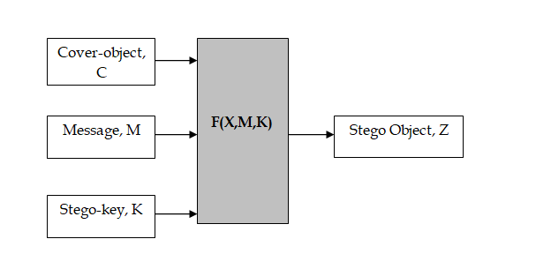
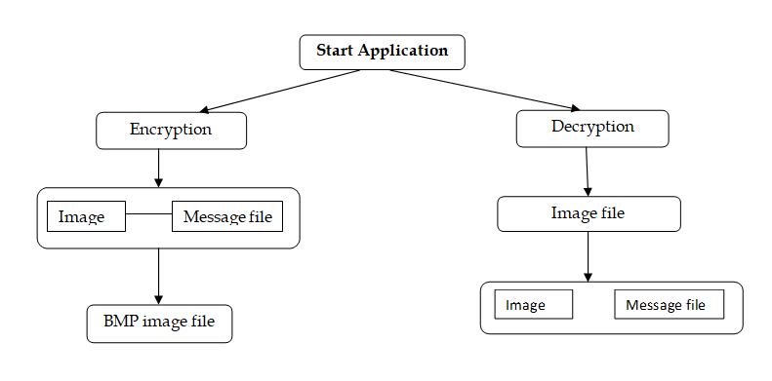
Basically, the model for steganography is shown on following figure:

Slide 10
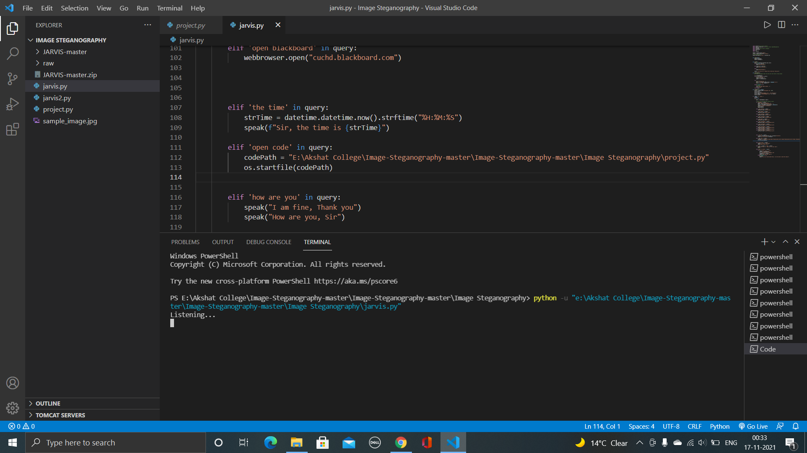
Results and Outputs

Slide 11
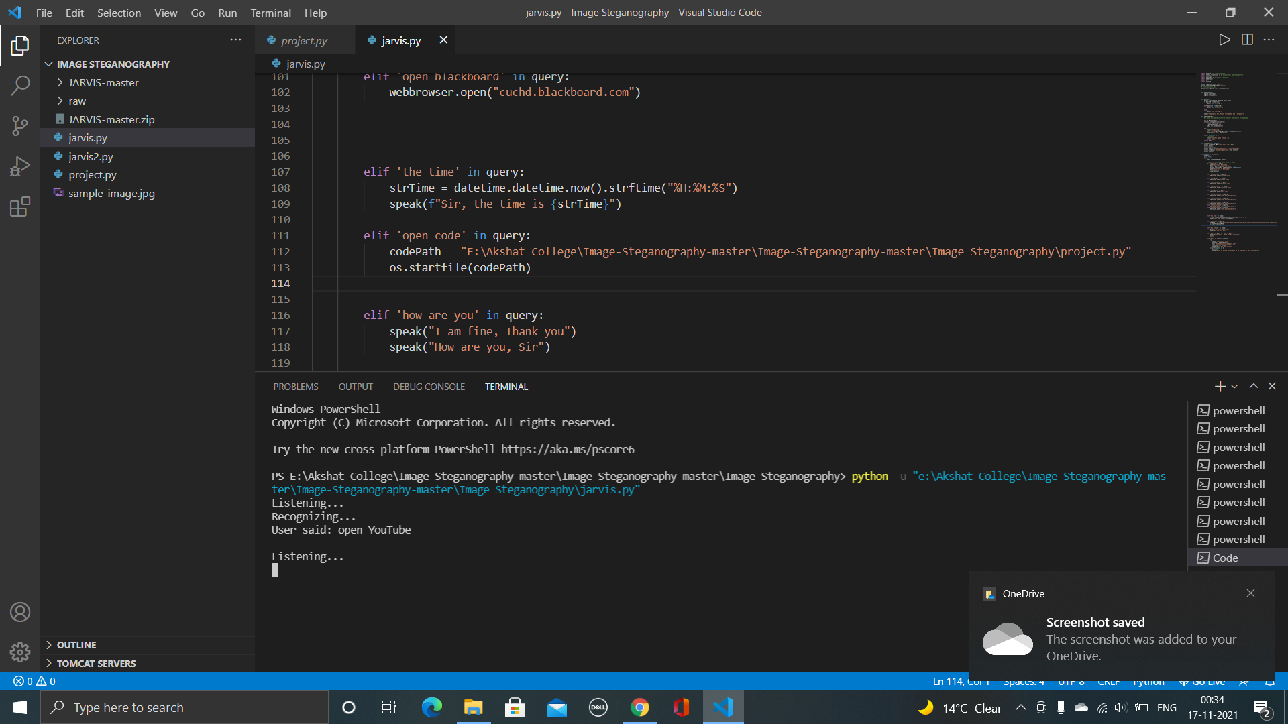
Results and Outputs

Slide 12
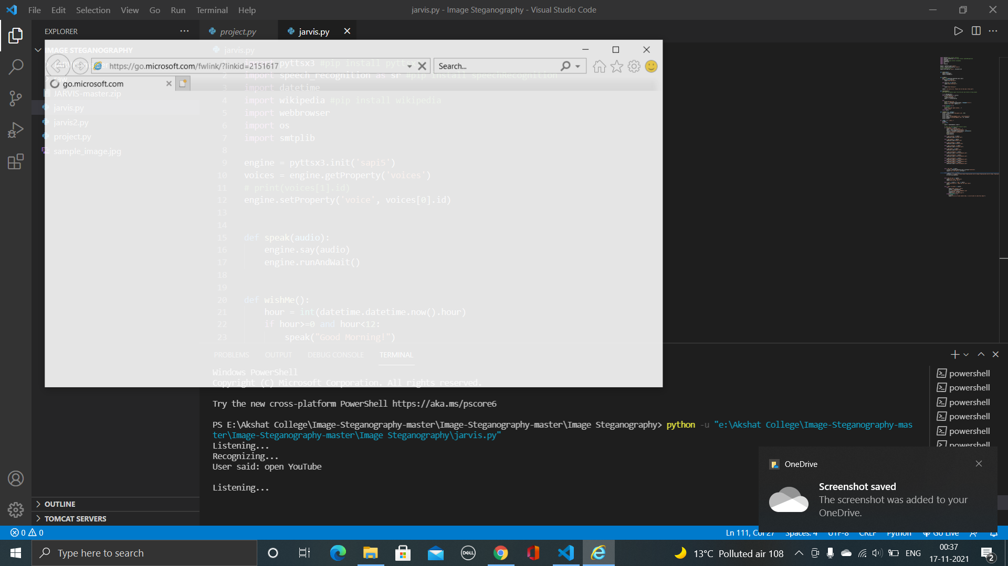
Results and Outputs

Slide 13
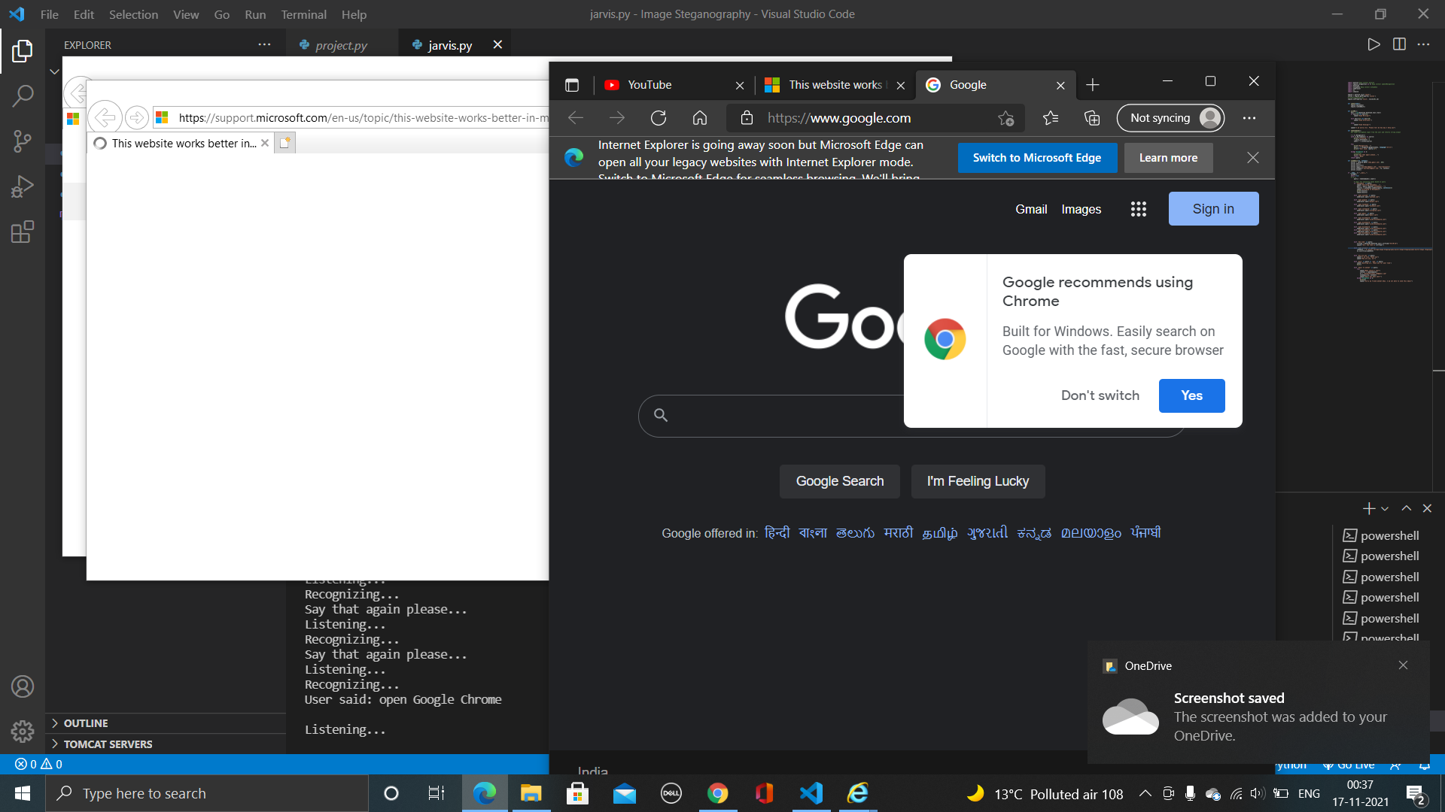
Results and Outputs

Slide 14
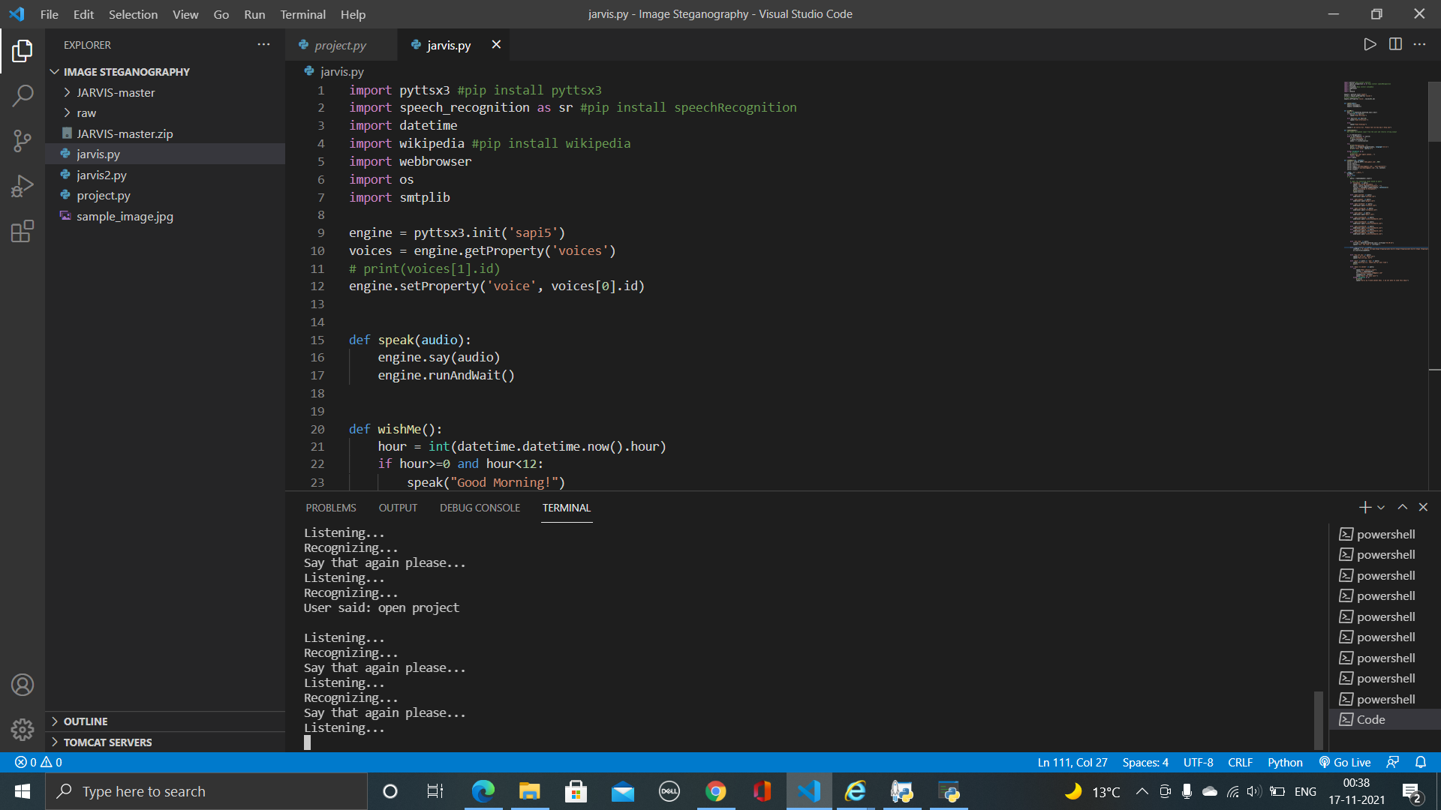
Results and Outputs

Slide 15
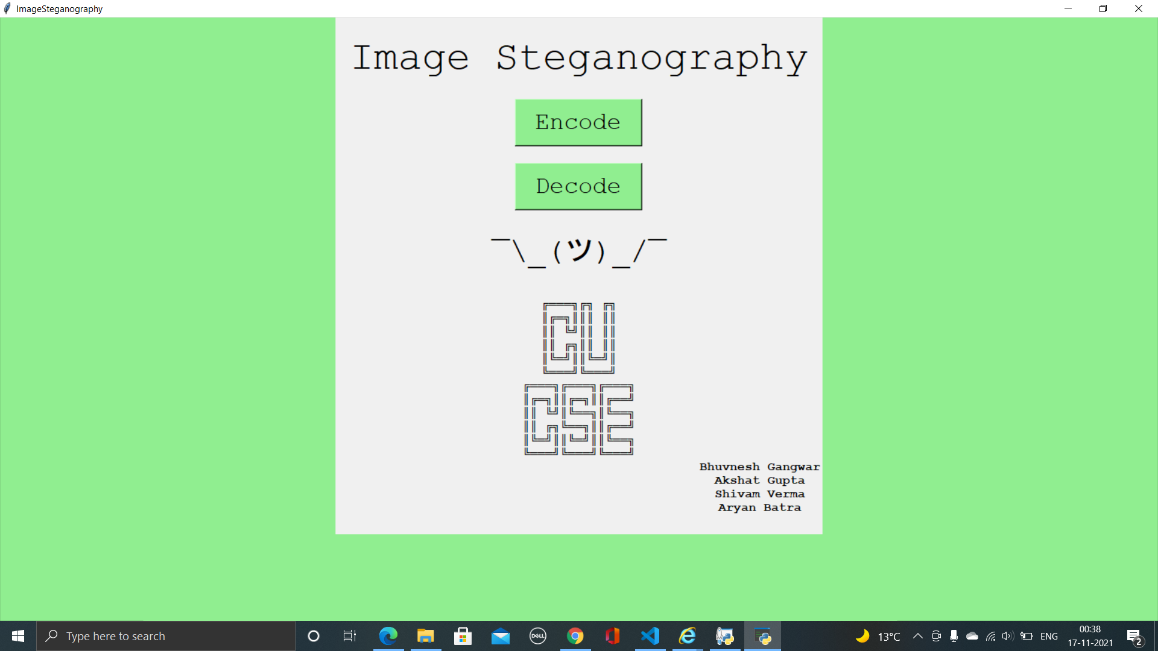
Results and Outputs

Slide 16
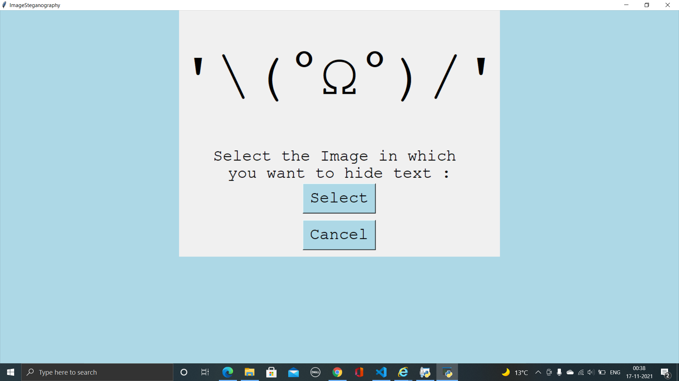
Results and Outputs

Slide 17
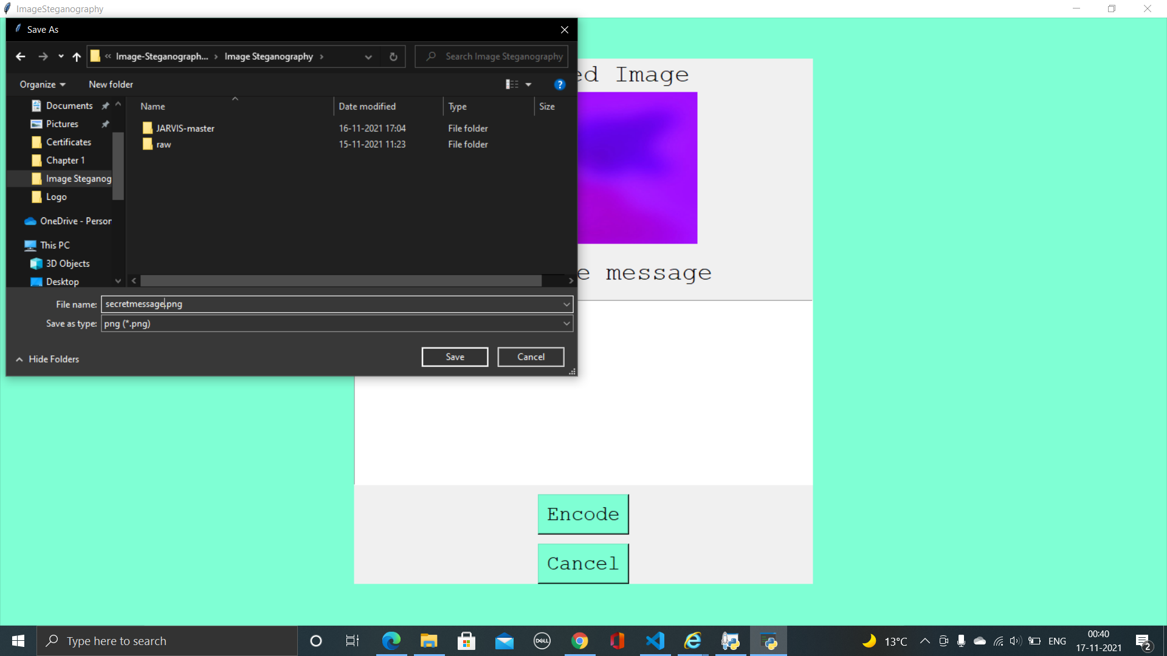
Results and Outputs

Slide 18
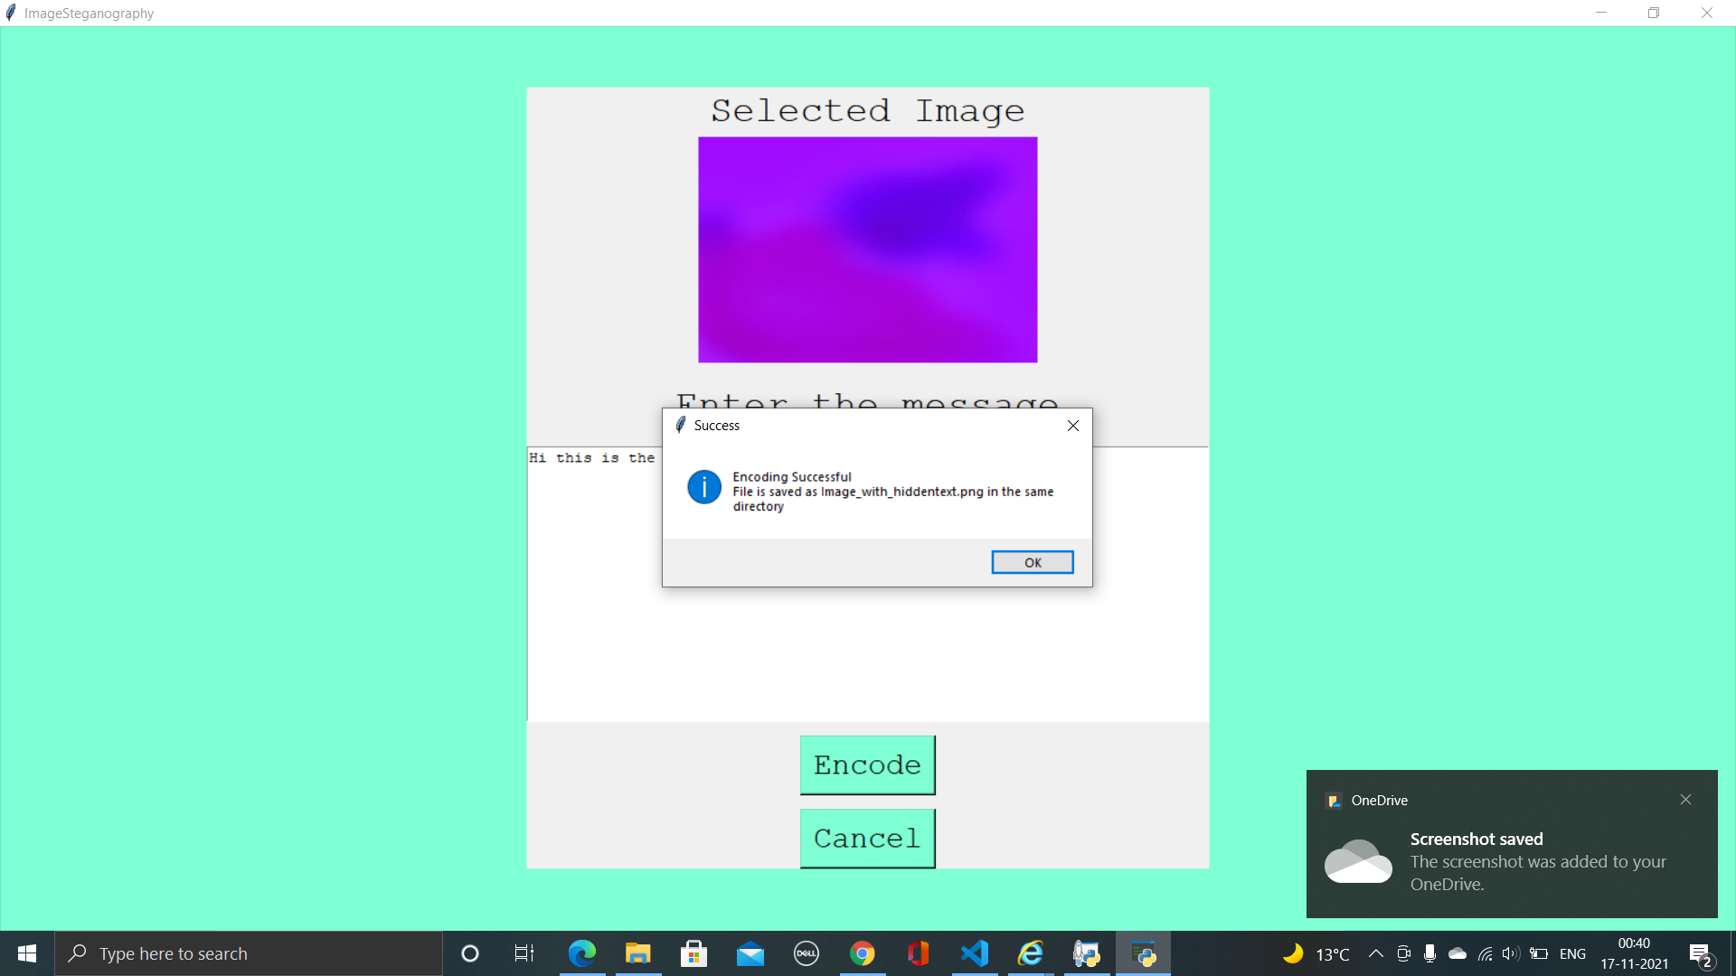
Results and Outputs

Slide 19
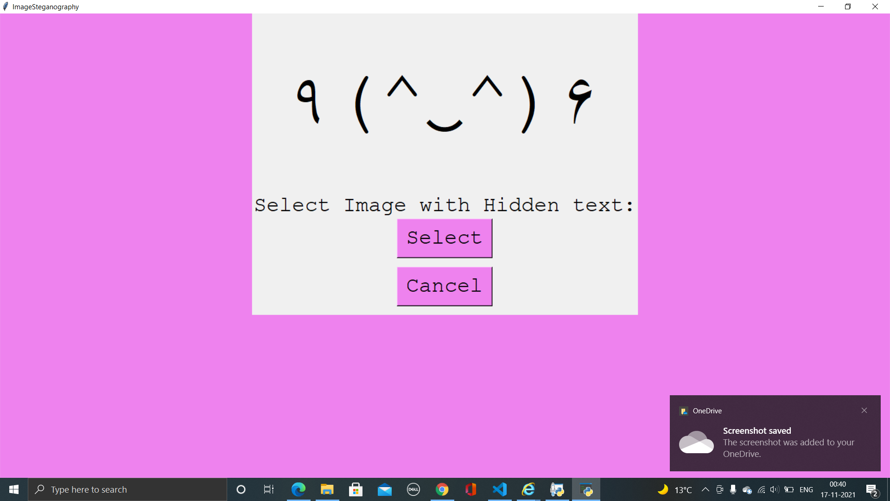
Results and Outputs

Slide 20
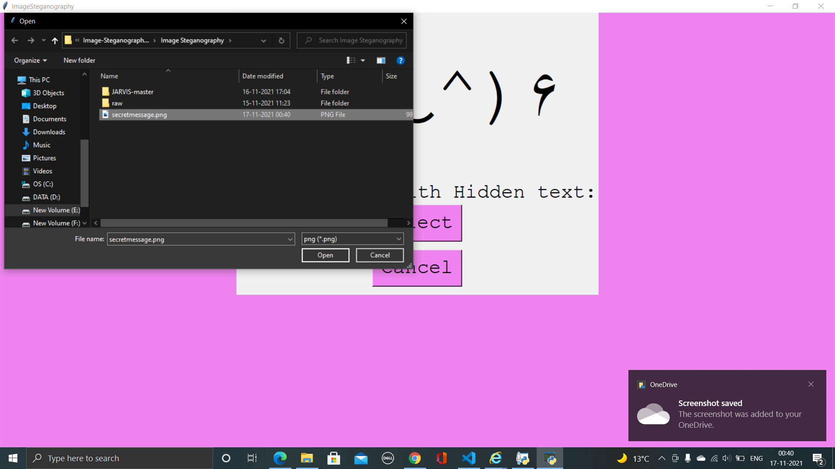
Results and Outputs

Slide 21
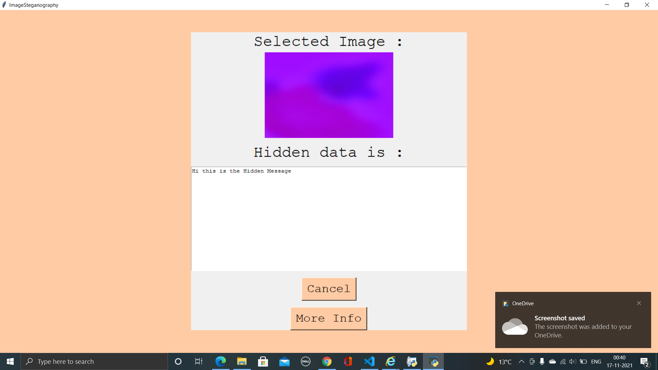
Results and Outputs

Slide 22
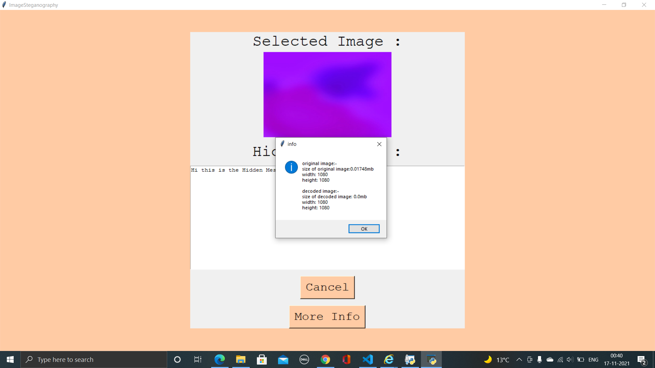
Results and Outputs

Slide 23
Conclusion
Steganography is a really interesting subject and outside of the mainstream cryptography and system administration that most of us deal with day after day.
Steganography can be used for hidden communication. We have explored the limits of steganography theory and practice. We printed out the enhancement of the image steganography system using LSB approach to provide a means of secure communication. A stego-key has been applied to the system during embedment of the message into the cover image.
This steganography application software provided for the purpose to how to use any type of image formats to hiding any type of files inside their. The master work of this application is in supporting any type of pictures without need to convert to bitmap, and lower limitation on file size to hide, because of using maximum memory space in pictures to hide the file. Since ancient times, man has found a desire in the ability to communicate covertly. The recent explosion of research in watermarking to protect intellectual property is evidence that steganography is not just limited to military or espionage applications. Steganography, like cryptography, will play an increasing role in the future of secure communication in the “digital world”.

Slide 24
Future Scope
This project is developed for hiding information in any image file. The scope of the project is implementation of steganography tools for hiding information includes any type of information file and image files and the path where the user wants to save Image and extruded file.
The scope of the project is to limit unauthorized access and provide better security during message transmission. To meet the requirements, I use the simple and basic approach of Steganography.
In this project, the proposed approach finds the suitable algorithm for embedding the data in an image using steganography which provides the better security pattern for sending messages through a network.

Slide 25
References
Websites
Following websites are referring to create this project reports.
http://www.google.com
http://www.programmer2programmer.net
http://www.codeproject.com
http://www.asp.net
http://www.asp123.com
http://www.wikipedia.org

