Slide 1




E-HEALTH DEVISED SMART INHALER
TEAM
BHAVYA S
BHUVANESHWARI M
GURU PRASAD V
SRI VAISHNAVI A
THILAKAVARSHINI T

Slide 2

INTRODUCTION
As the prevalence of asthma is increasing, and with no known cure, there needs to be further research into how the disease can be managed and controlled more effectively. The current world faces a new pandemic condition by wearing the mask continuously we have the extremity of getting affected with asthma.
Model is an emerging technology that can revolutionize the health industry. The proposed system “Smart Asthma Inhaler” monitors the patient’s health conditions, tracks the location and the time the inhalers are used so as to provide suitable medication to the patients once the reports are analysed by the physicians involved.
E-Health Devised Propeller Health Care Technology
IoT-Based Health Monitoring Model
Self Monitoring Compatibility Of Inhaler Actuations
Cost Efficient Clinical Significance

Slide 3

DEVELOPMENT
ATTRIBUTES | EXISTING MODEL FEATURES | DEVELOPED TECHSTACK MODEL
Size and Reliability | NEBULISER CHRONOLOG – Bulky Interpreter Device and High Cost | Compact ,Consistent and Cost Efficient Model
Aerosol Actuation | SMARTMIST – Automated Actuation - Poor Clinical Significance . | Proposal Of Electronic Proposal - High Clinical Significance
Data Acquisition | SMART INHALER TRACKER - Immature Computing Technology - Data Via USB Port | Cloud Assisted Framework
Dose Counter Functionality | CareTrx – Visual Dose Monitoring - Poor Medication Adherence | Consistent Metered Dosage - Accurate Medication Delivery and Adherence

Slide 4
DEVELOPMENT
Prototype Idea Presentment
Consistent Metered Dose Counter
Reliable Aerosol Actuation
Count Sensor
Air Vent

Slide 5


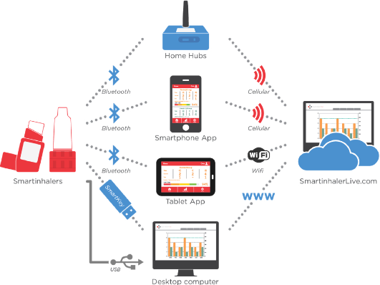
DEVELOPMENT
Application Development
Dose Counter Display Monitor
Air Vent Flow Rate Monitor
Notification Proposal
Air Quality Index

Slide 6

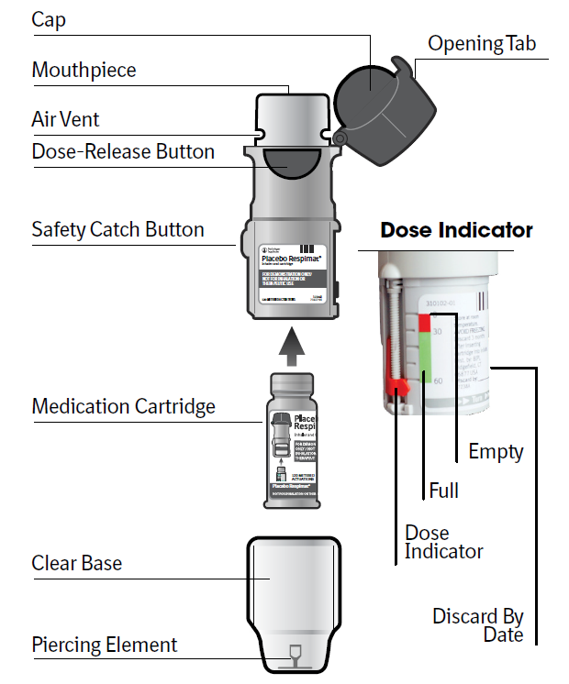
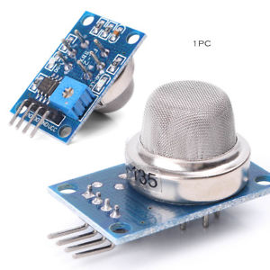
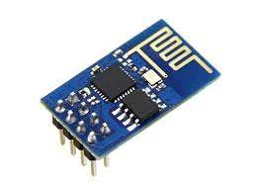
WORKING
TWO USER INTERFACE : a)Patients b)Smart phone – Cloud
Wi-Fi Module:
Reminder for Medication
Monitor and Corrects Users Inhalation Technique
Tracks Complete Medication History
Prevents and Alerts Dose Overused
Air Vent:
Checks AQI
Air Quality Analysis
Filter the Air
Alert in High Pollution Area
Dose Counter:
Counts the Medicated Dose
Alerts for Missed Dose
Reminder for Next Dose

Slide 7


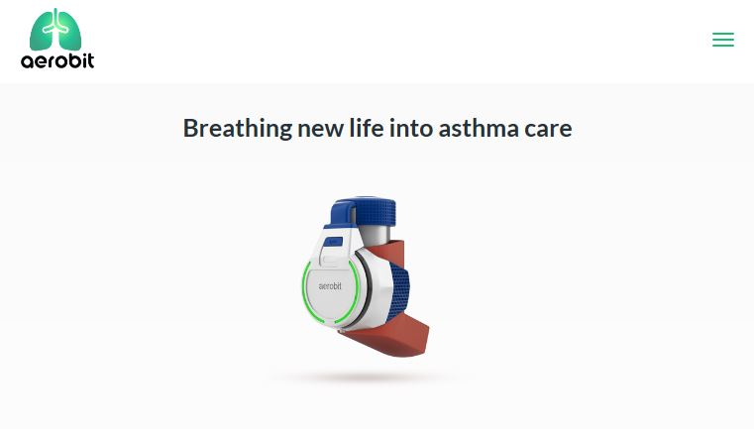

FUTURE SCOPE
Compact Design
Wearable
Reliable
FDA
Cost Efficient
Data Transfer – Smart Watch

Slide 8

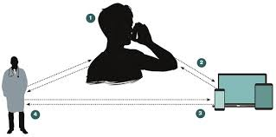
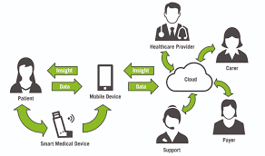
MARKET VIABILITY
SELF COMPATIBLE
IDEAL DESIGN
IDEAL CUSTOMERS
DEVISED
WORK FEATURES
AIR QUALITY INDEXING
ENHANCES MARKET FEASIBILITY
COVID
PANDEMIC
CONTINUOUS
MASK EXPOSURE
INCREASING
BREATHING RELATED HEALTH ISSUES

Slide 9


MAKING OUT AN AATMANIRBHAR INDIA
Increases Smart Inhalers Market Size
Reduction In Import Charges
Efficient Internal Manufacturing
Enhanced Economy
Effective Handling Of COVID 19 Pandemic
Empowering Telemedicine Technology

Slide 10

MEMBERS OF PHOENIX CLIQUE
THANK YOU

