Slide 1
TECHXCELERATE
Problem Statement - Create an AI system that analyzes real-time traffic data to control signals and optimize traffic flow in cities.
Problem Statement Title - AI Traffic Flow Optimizer
PS Category- ARTIFICIAL INTELLIGENCE
Team Name – V.I.B.E
COLLEGE – R.M.D ENGINEERING COLLEGE

Slide 2
HACKFORGE
RMD
Idea / Solution : 1️⃣ Develop an AI-driven system to analyze real-time traffic data. 2️⃣ Optimize traffic signal control to reduce congestion. 3️⃣ Utilize hybrid AI models (CNN + LSTM + Transformer) for accuracy. 4️⃣ Process video feeds and sensor data for traffic analysis. 5️⃣ Improve urban mobility, emergency response, and fuel efficiency.
Problem Resolution :
Enables vehicles to navigate more efficiently through traffic.
Accurate traffic predictions aid emergency responders in reaching destinations faster.
Unique Value Propositions (UVP) :
3D simulation to optimize and predict traffic flow dynamics.
Automatic risk assessment for congestion and accident-prone areas.
Real-time adaptive traffic signal control for smoother flow and reduced delays.

Slide 3
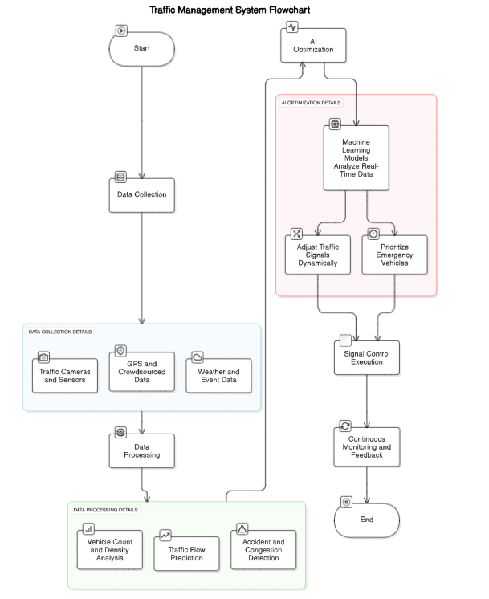
TECHNICAL APPROACH
RMD
Programming Languages: JavaScript for app logic, components, data fetching, and user interactions.
Integration with OpenStreetMap (OSM) – Utilize real-time map data for accurate traffic analysis, route optimization, and adaptive signal control.
Node.js: Handles API requests, processes traffic data, and connects to AI traffic optimization models.
AI Model Integration: TensorFlow.js or PyTorch for real-time traffic prediction and adaptive signal control.
Version Control: Git for tracking code changes and organizing app development.

Slide 4
FEASIBILITY AND VIABILITY
RMD
Analysis of the feasibility of the idea :
Technical Feasibility: AI-driven traffic optimization using ML, real-time data, and geospatial tech .
Market Feasibility: Target users include city traffic authorities, smart city planners, and emergency services.
Operational Feasibility: Supports real-time/offline optimization with secure data handling.
Financial Feasibility: Uses open-source tools (TensorFlow, Node.js) to minimize costs.
Resource Feasibility: Leverages free libraries (TensorFlow, OpenTraffic, OSm) for traffic data processing.
Potential challenges and risks :
🡪 Accuracy of real-time traffic data processing 🡪 Integration with offline maps and real-time traffic feeds 🡪 Variability in traffic patterns and unexpected road conditions 🡪 Performance optimization for large-scale
Strategies for overcoming :
🡪 Use ML for accurate traffic prediction and optimization.
🡪 Enable offline map downloads for seamless navigation.
🡪 Implement validation checks and fallback mechanisms.
🡪 Optimize performance with efficient algorithms.
🡪 Provide clear documentation and tutorials.

Slide 5
IMPACT AND BENEFITS
🔹
RMD
IMPACTS:
Reduced Traffic Congestion – Optimized signal timings decrease wait times and improve road efficiency.
Lower Fuel Consumption & Emissions – Smoother traffic flow reduces idling, cutting CO₂ emissions.
Faster Emergency Response – AI can prioritize emergency vehicles at intersections.
Improved Public Safety – Reduces accidents caused by traffic bottlenecks and sudden stops.
Enhanced Urban Mobility – Better traffic management leads to a smoother transportation system.
Data-Driven City Planning – Insights from real-time traffic analysis help in future infrastructure improvements.
BENEFITS:
Decreased Carbon Emissions – Reduced vehicle stoppage leads to lower CO₂ emissions.
Faster Emergency Response – AI prioritizes ambulances and fire trucks at intersections.
Real-Time Traffic Monitoring – Continuous analysis helps in proactive traffic management

Slide 6
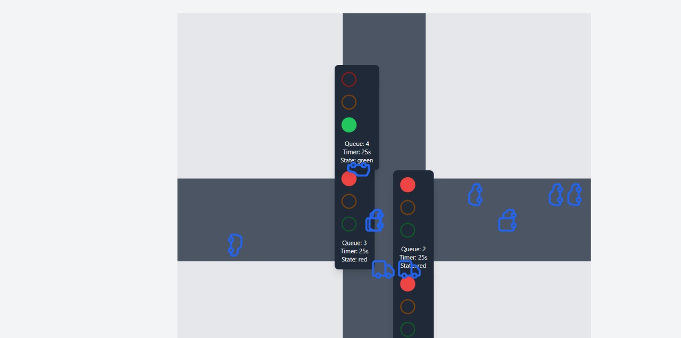
IMPACT AND BENEFITS
RMD
2D VIRTUAL SIMULATION

Slide 7
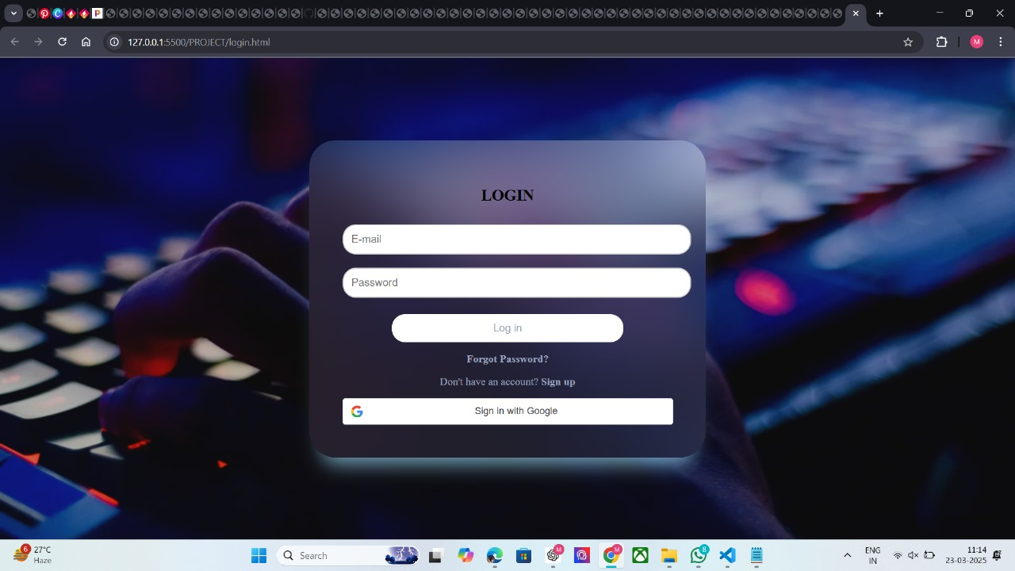

Slide 8
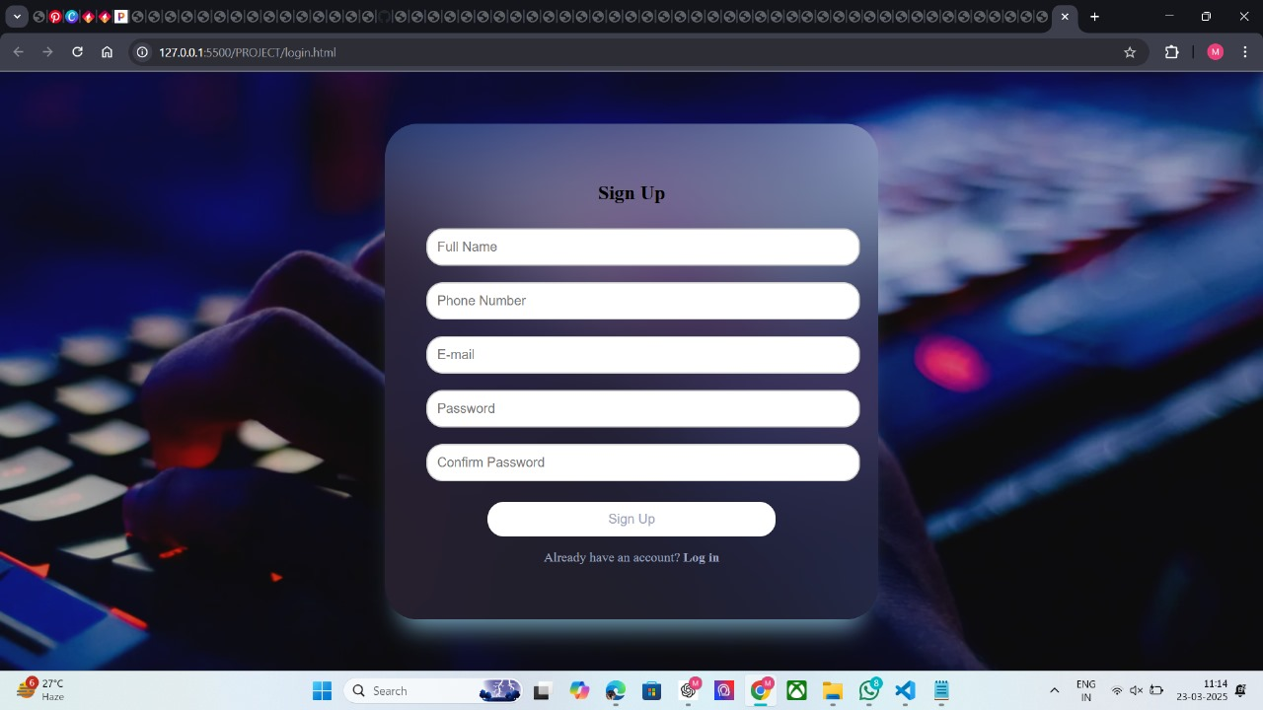

Slide 9
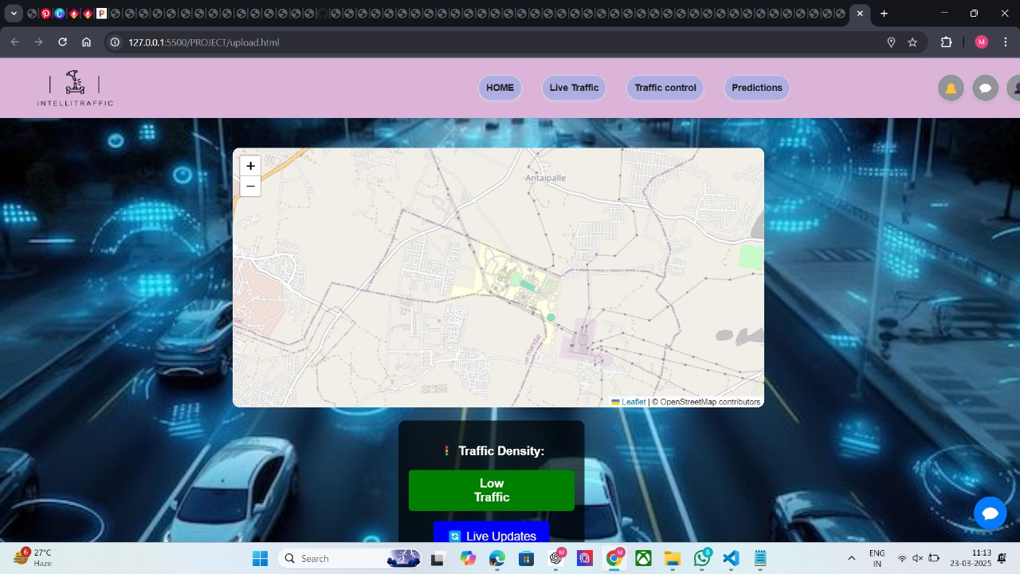

Slide 10
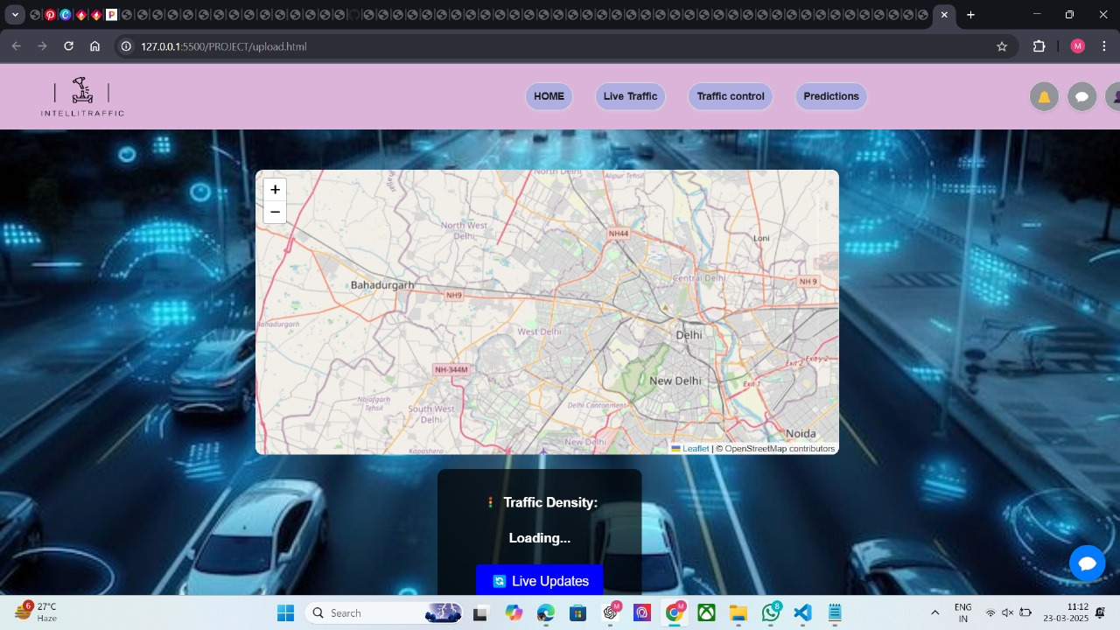

Slide 11
