Slide 1
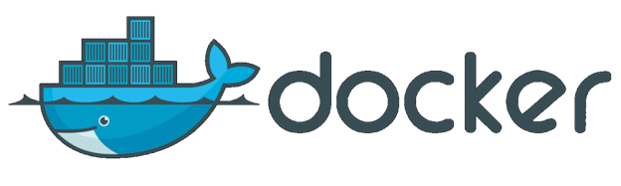

Slide 2
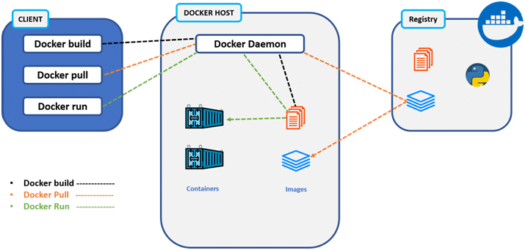
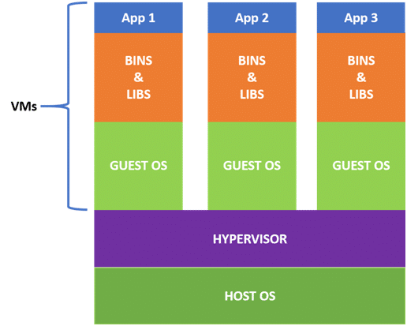
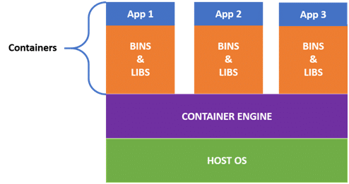
Definition: Docker is a platform which is used to containerize our software, using which we can easily build our application, package the dependencies and run them on different customer systems.
Docker allows developers to create templates called images using which we can create lightweight virtual machines called containers.
Docker Architecture
Docker Client
Primary way for user to interact with docker.
It uses command line utility to communicate with docker daemon
It can communicate with more than one docker daemon.
Docker Host/Daemon
It is consisting of docker objects and docker daemon.
Docker Objects:
Docker image is a type of docker template that can be used for creating docker containers.
Docker containers is a type of virtual machine that is created from the dicker image. It is the running instance of docker image.
Docker Daemon:
Docker daemon helps in listening the request coming from docker client, helps in managing the images, containers and volumes, building an images based on user input, and then saving it in registry.
A docker daemon can communicate with other daemons to manage docker service.
Host Virtualization
Docker/Containers
1. Virtualizes hardware resources.
2. Requires the complete OS installation.
3. A kernel is installed for every OS.
4. Heavy weight
5. Limited performance
6. Fully isolated.
1. Virtualizes only OS resources.
2. Install the containers on Host OS..
3. Uses the kernel of underlying OS.
4. Light weight
5. Native performance
6. Process level isolation.
Docker Registry
Docker registry is a repository for docker images. We can use a local or private or public repository like docker hub.
https://intellipaat.com/blog/tutorial/devops-tutorial/docker-tutorial/

