Slide 1

Login/sign-up page
Created by: Bhuvneesh sayal

Slide 2
Table of contents
Introduction
Tech Stack Used
Upcoming version

Slide 3
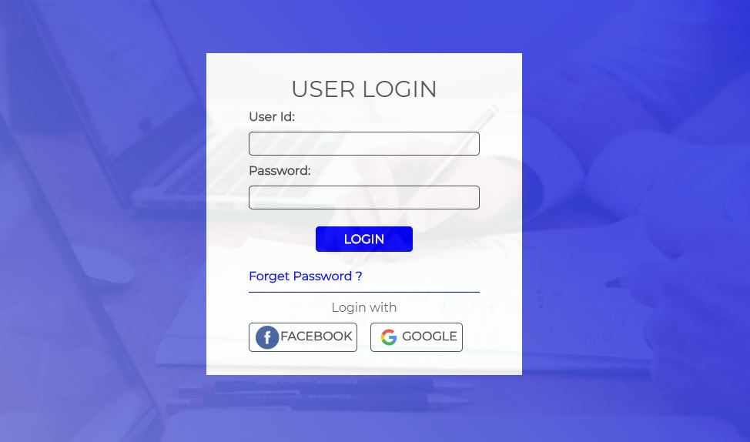
Introduction
My project is based on a Login/sign-up process
It allows you to create new username and password.
If you forgot your username or password it will be easily recovered.

Slide 4


Tech stack used
C++ Programming Language
VScode

Slide 5
Upcoming Version
It will include to set a strong password.
To recover your password with hint questions created by the user.

Slide 6

Thank You

