Slide 1
IBM University Engagement Project Submission
“Exploring the Power of Agentic AI with IBM Granite and IBM Bob”

Slide 2
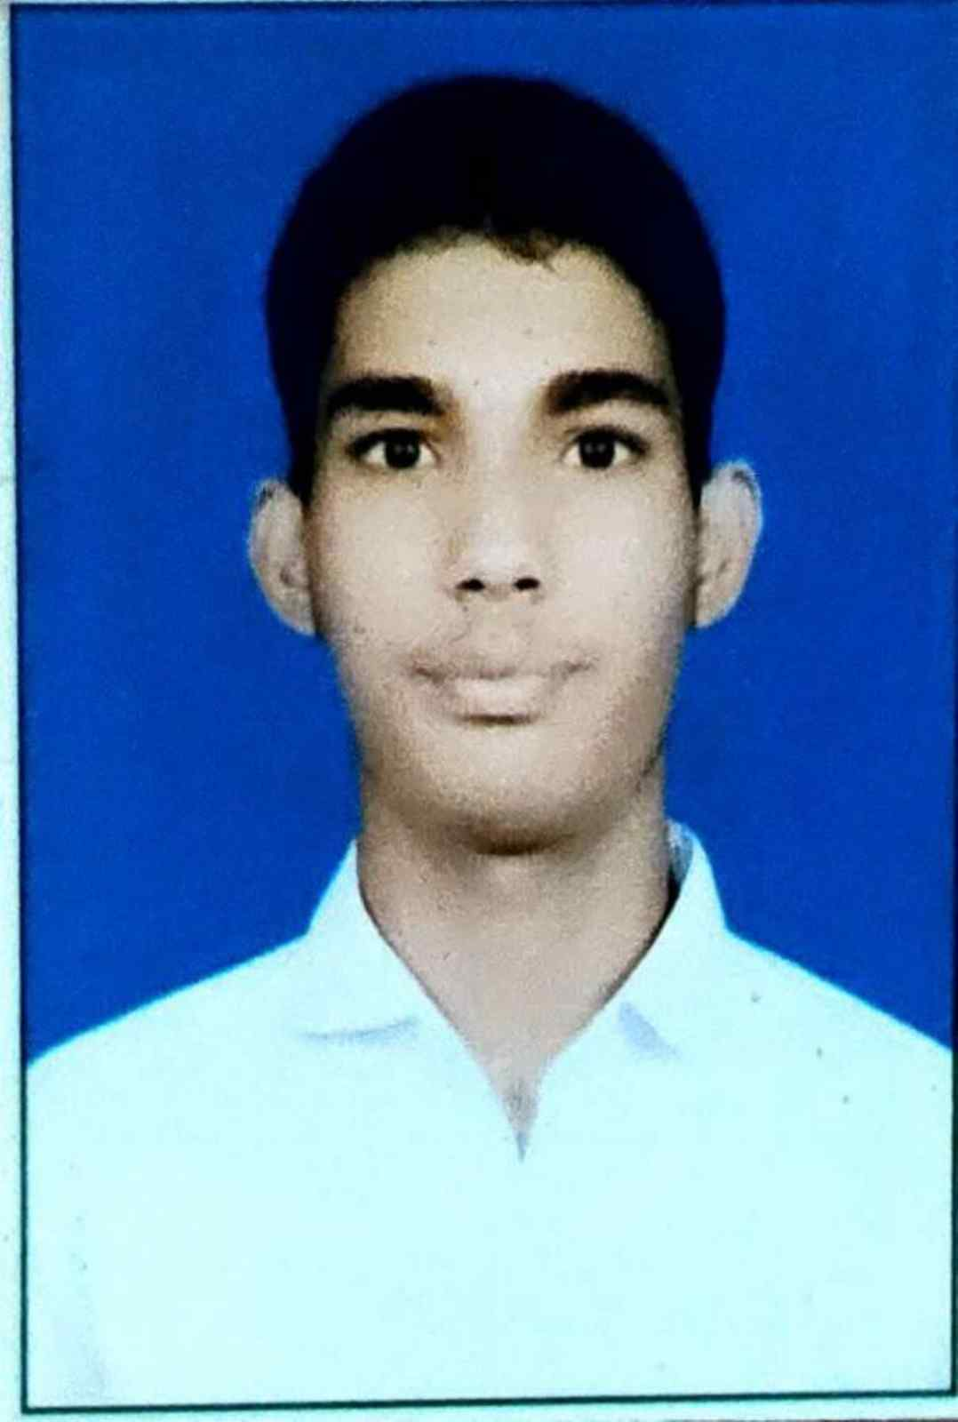
Project Title – Smart Farming AI Agent
Domain of Project – Agriculture
Student Name | Recent Passport Photo | Email ID | Mobile number [WhatsApp]
Bhuvnesh Kumar Jangid |  | bhavaskumar07@gmail.com | 7410808368

Slide 3
Problem Statement -
Problem Statement No. 14: AI Agent for Smart Farming Advice
The Challenge
Farmers often struggle with low crop yield, unpredictable weather, pest infestations, and limited access to timely expert advice. Traditional advisory services are fragmented, slow, and not personalized to the farmer's land, crop, or climate. With climate change, data-driven smart farming is needed to give farmers actionable insights.
The Objective
Build an AI-powered Smart Farming Agent that gives personalized, real-time, and sustainable agricultural advice. The solution should:
Agricultural Knowledge Retrieval (RAG) – best practices, crop guidelines, and government advisories.
Weather & Soil Insights – real-time forecasts, soil data, and irrigation needs for farm planning.
Pest & Disease Detection – farmers upload crop images for early identification and instant recommendations.
Personalized Advisory Agent – seeds, fertilizers, irrigation schedules, and harvest timelines for the farmer's profile.
Market & Cost Optimization – forecast demand, suggest market prices, and recommend cost-efficient practices.
Multi-Agent Collaboration – Crop Advisory, Weather & Irrigation, Pest/Disease Detection, and Market Insights agents.

Slide 4
Proposed Solution -
Proposed Solution: Smart Farming AI Agent
A multi-agent AI system built with IBM Bob, IBM watsonx.ai, and IBM Granite that gives farmers personalized, real-time advice in Hindi and English through a simple dashboard. An Orchestrator Agent understands each question, routes it to the right specialist agents, and merges their outputs into one clear answer.
A Retrieval-Augmented Generation (RAG) pipeline stores crop guides and government advisories in a ChromaDB vector database. Relevant passages are retrieved first and Granite summarizes them with source citations, so answers stay grounded in real data.
The system consists of five agents:
Crop Advisory Agent – RAG over crop guides; answers questions with citations.
Weather & Irrigation Agent – turns the Open-Meteo forecast into irrigation and farm-planning tips.
Pest Detection Agent – analyses an uploaded leaf photo, identifies the problem, and suggests treatment (organic options first).
Market Insights Agent – mandi price trends and selling-time suggestions.
Personalised Advisory Agent – a full season plan from location, land size, soil, crop, and season.
The Streamlit dashboard shows the farm profile, 7-day weather, irrigation advice, mandi price charts, and a chat box with image upload and voice input. Chemical advice carries safety disclaimers, and low-confidence answers point to the local KVK and Kisan Call Centre.

Slide 5
Technology Used
IBM Bob – AI development partner used to generate and refine the agents, backend, and dashboard code
IBM Granite models – via watsonx.ai, for reasoning, summarization, and multilingual (Hindi / English) advice
IBM watsonx.ai – hosted Granite inference (model ID configured in .env)
IBM Cloud – Docker and Code Engine deployment to run the agent in a reliable, scalable environment
RAG + ChromaDB – crop guides embedded (sentence-transformers) and stored in a vector database; real data is fetched first, then answers are generated
FastAPI + Streamlit – Python backend with orchestrator and agents, plus a farmer-friendly dashboard
Data sources and models – Open-Meteo weather API, mandi price data, ResNet-18 trained on PlantVillage (PyTorch) for leaf disease detection
deep-translator + SpeechRecognition – Hindi / English translation and voice input

Slide 6
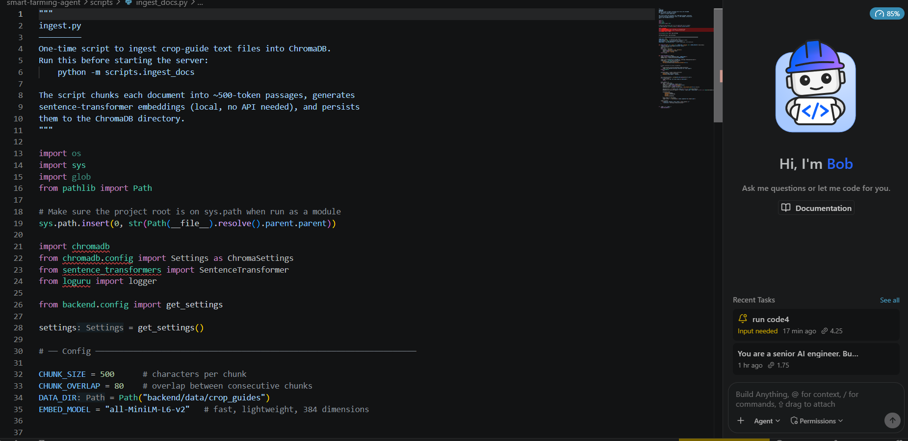
Required Files created using IBM bob -
backend/main.py
backend/agents/
backend/tools/granite_client.py
frontend/app.py
scripts/ingest_docs.py
requirements.txt
.env.example
deployment/ (Docker)

Slide 7
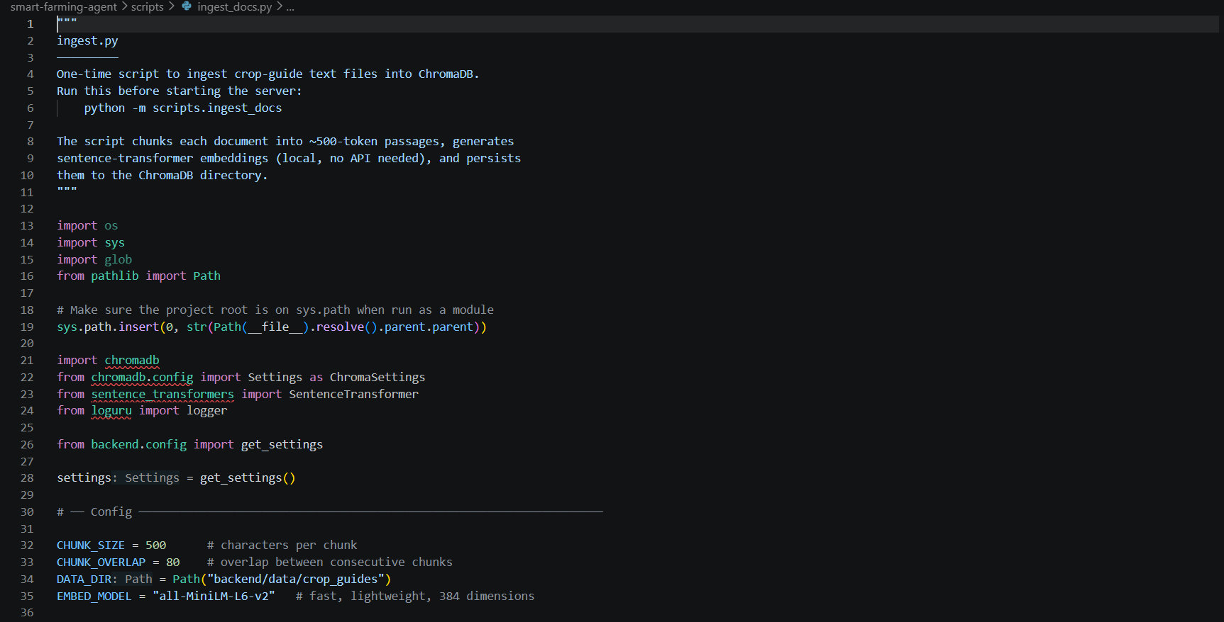
IBM Bob Screenshots:

Slide 8
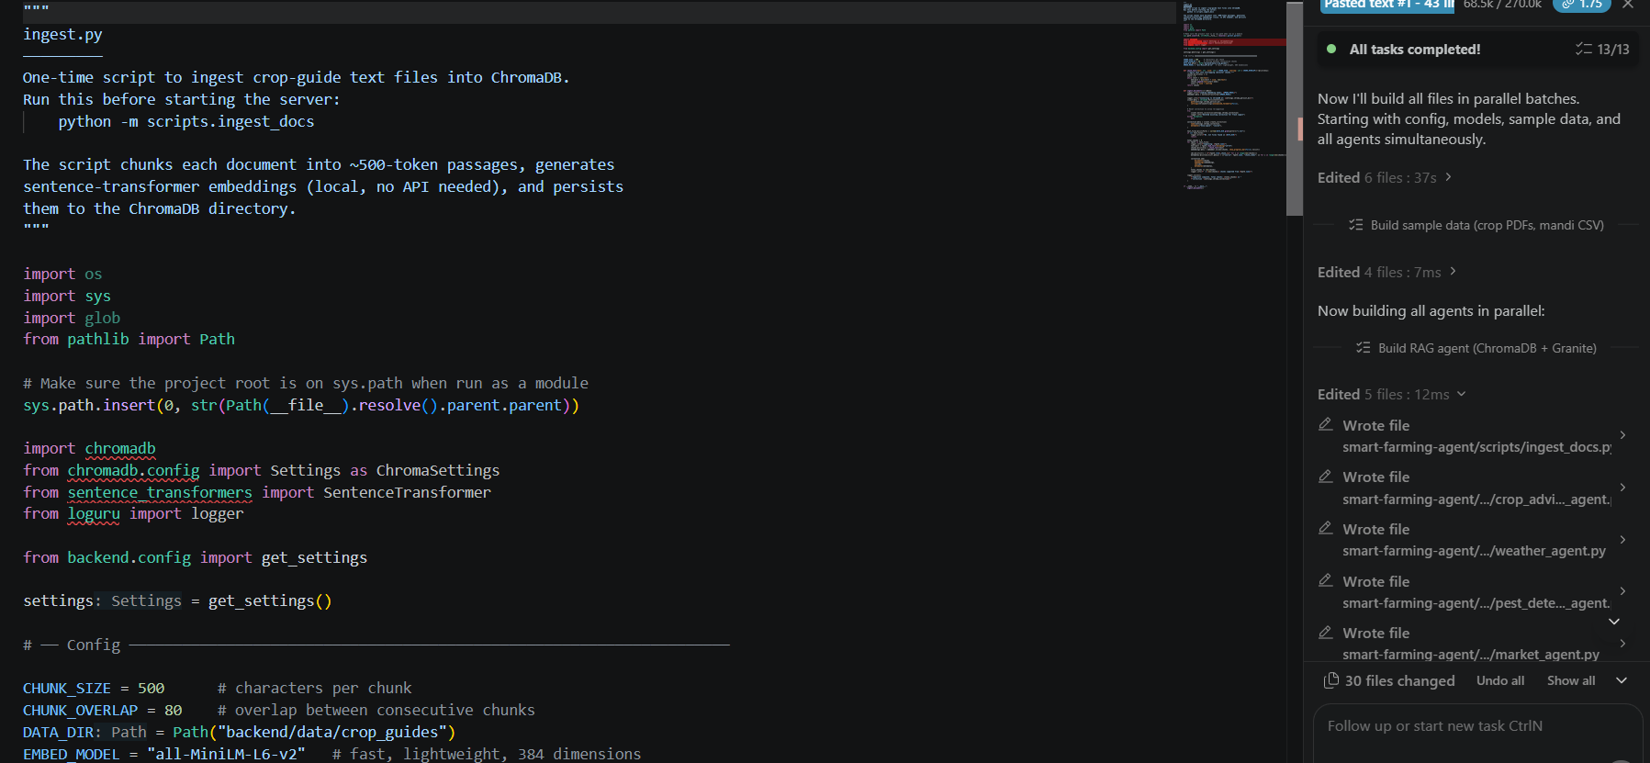

Slide 9
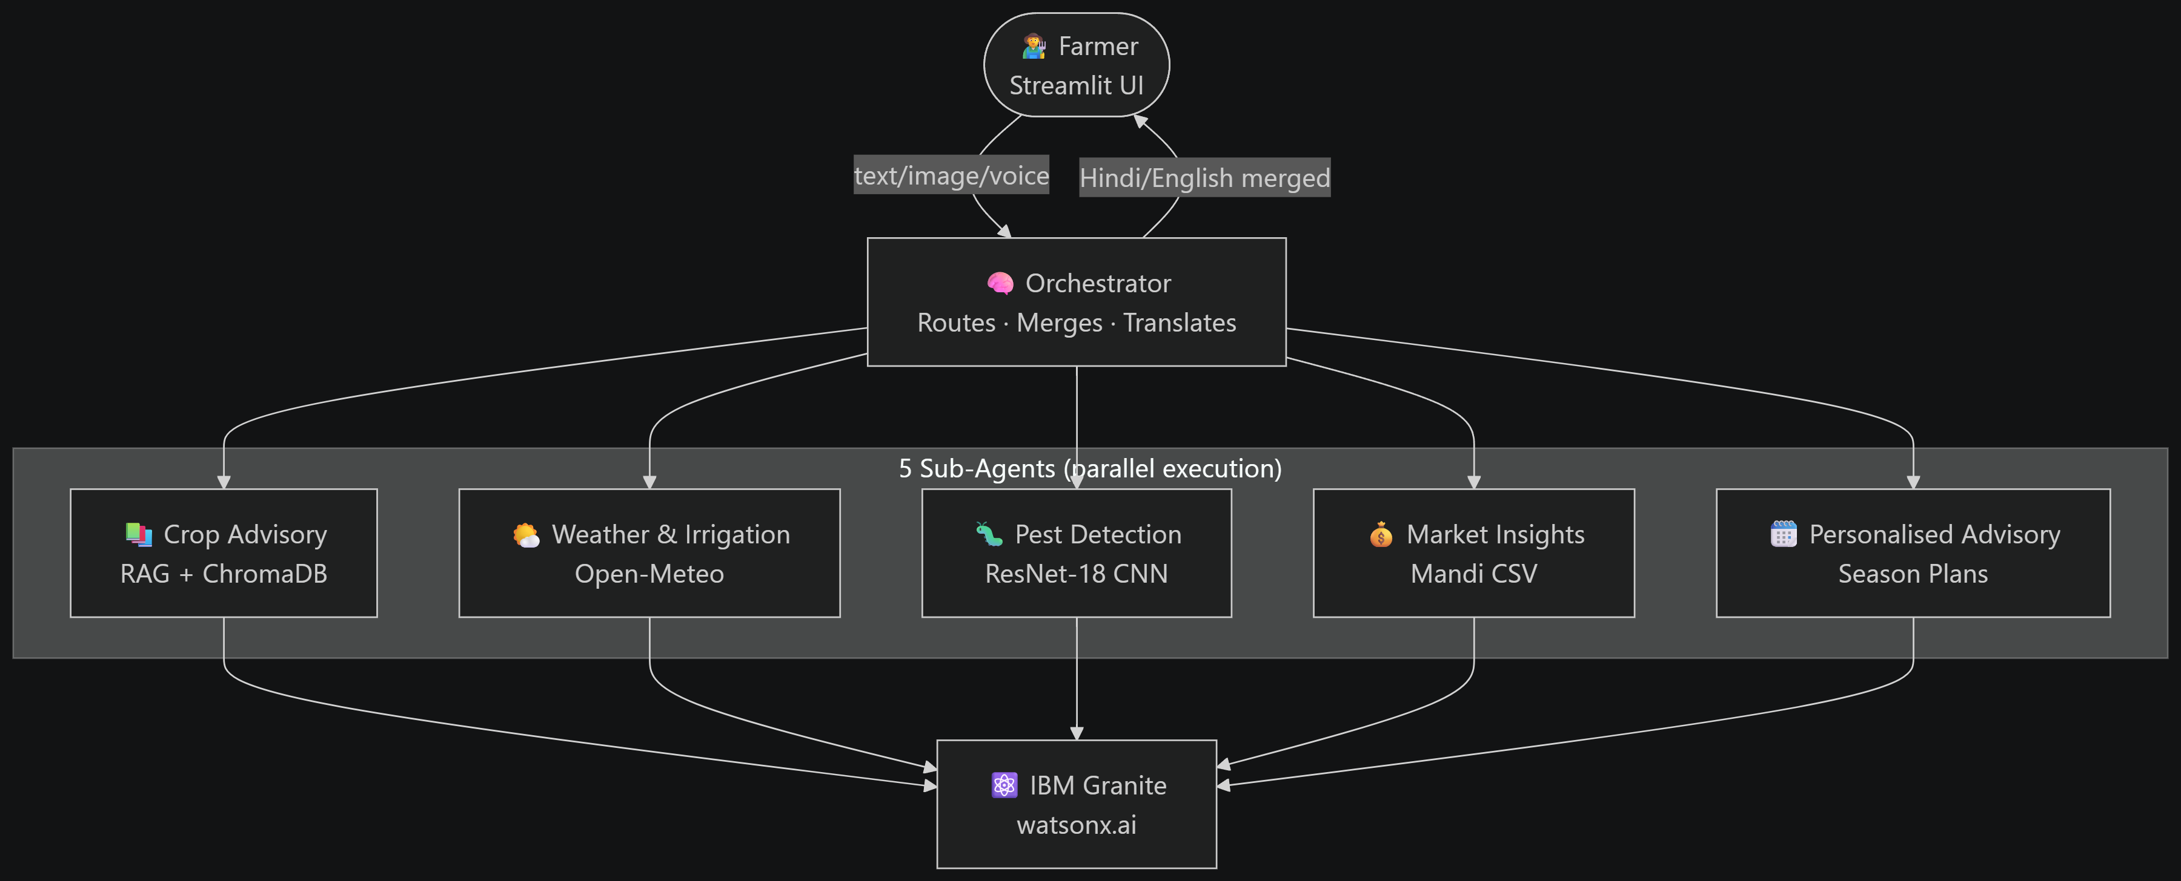
Architecture blueprint for IBM bob:

Slide 10

Role of Agentic AI in the solution
Role of Agentic AI in the Smart Farming Agent
Agentic AI turns the system from a simple chatbot into an autonomous farm assistant. An Orchestrator Agent reads the farmer's question and profile, decides which specialist agents are needed, and combines their answers.
Each agent has one job: Crop Advisory retrieves knowledge (RAG), Weather & Irrigation reads forecasts, Pest Detection diagnoses leaf photos, Market Insights tracks prices, and Advisory builds the season plan.
Context awareness: agents use the farmer's location, soil, crop, land size, and season, so advice is personal, not generic. Live weather and price data keep recommendations current, and answers are given in Hindi or English.
Overall, Agentic AI makes the system proactive and goal-driven, like a digital agronomist available to every farmer.

Slide 11
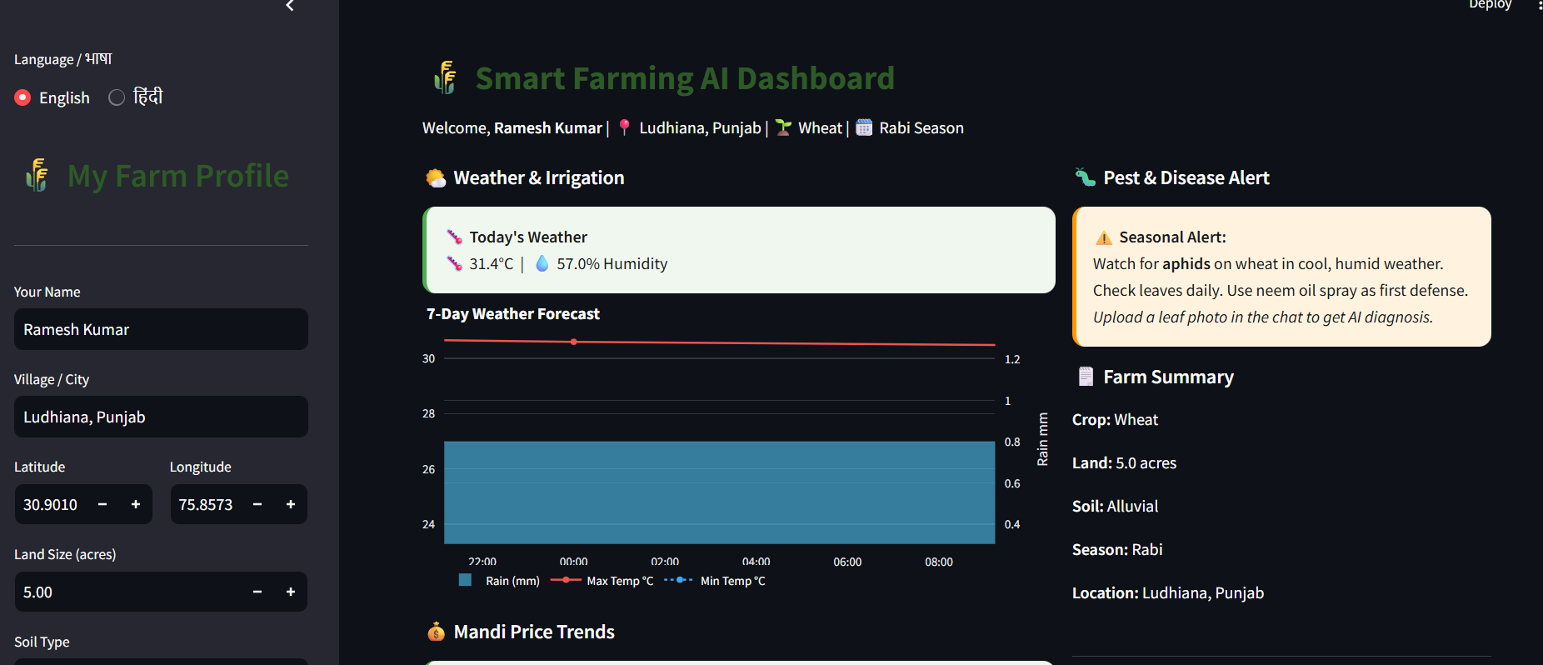
Project Output Screenshot
Please put IBM Bob output screenshots with 2-3 prompts.
You can take 2-3 more slides for each screenshot
·
·
·

Slide 12
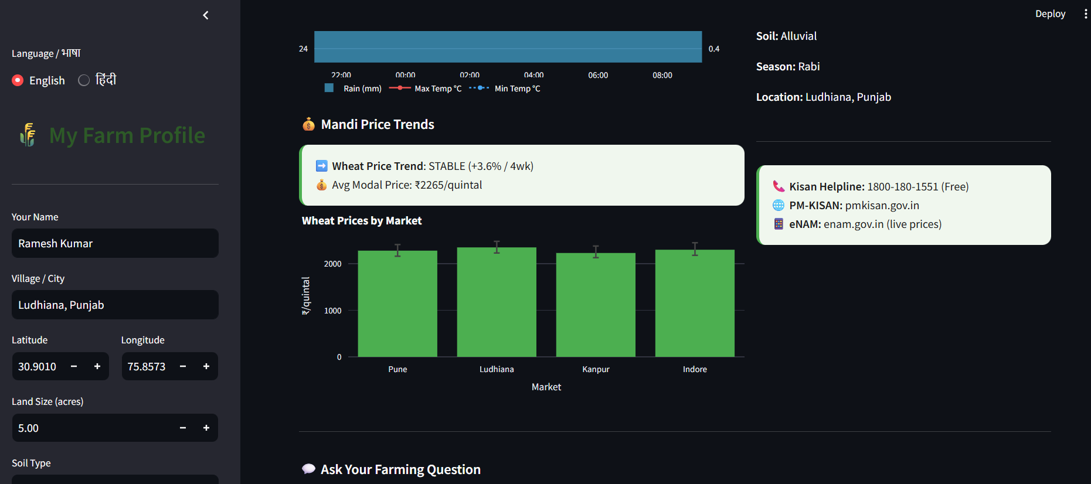
Project Output Screenshot
Please put IBM Bob output screenshots with 2-3 prompts.
You can take 2-3 more slides for each screenshot
·
·
·

Slide 13
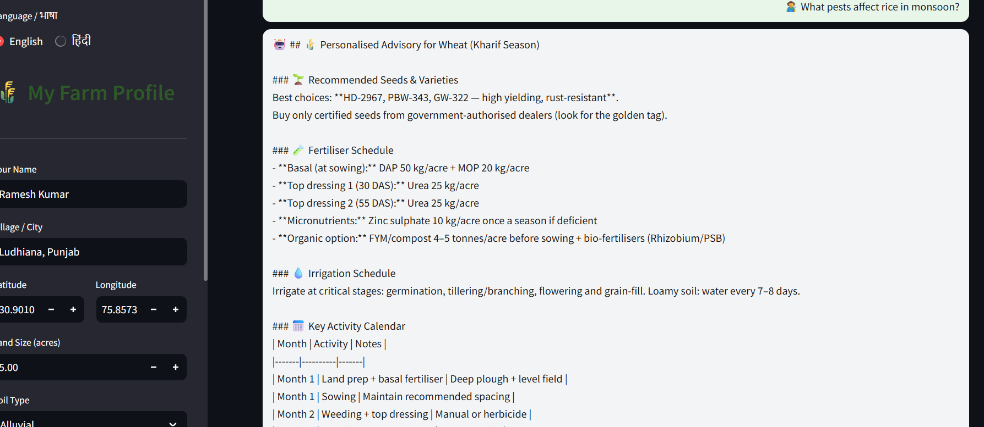
Project Output Screenshot
Please put IBM Bob output screenshots with 2-3 prompts.
You can take 2-3 more slides for each screenshot
·
·
·

Slide 14
Novelty and Uniqueness
The Smart Farming AI Agent combines multi-agent collaboration, RAG, and multimodal input to give farmers advice that is personal, current, and trustworthy.
Multi-Agent Intelligence – specialist agents for crop, weather, pest, and market, coordinated by an orchestrator.
RAG-Based Accuracy – answers grounded in crop guides and government advisories, with source citations.
Multimodal Input – farmers can type, speak, or upload a leaf photo for diagnosis.
Hindi & English Support – built for farmers who prefer their own language.
Hyper-Personalization – advice based on location, soil, crop, land size, and season.
Safety First – organic options first, disclaimers on chemical advice, and a fallback to the local KVK / Kisan Call Centre (1800-180-1551).
Enterprise-Ready – IBM Granite on watsonx.ai with IBM Cloud deployment.
This makes it a smart, adaptive digital agronomist, not just a static advisory tool.

Slide 15
Git Hub Link
GitHub Repository
https://github.com/Bhuvnesh2007/ai-farming
The repository contains:
All agent files: backend/ (orchestrator and agents), frontend/app.py, scripts/, deployment/
Problem statement (PDF)
Project presentation (.pptx)
README with architecture, setup steps, and demo script
requirements.txt and .env.example (no secret keys)

Slide 16
Future Scope
1. IoT Sensors & Satellite Data –
Connect soil-moisture sensors, drones, and satellite imagery for field-level irrigation and crop-health alerts, so advice reacts to real conditions on each farm.
2. Live Market & Scheme Integration –
Use live AgMarkNet / eNAM price feeds and match farmers automatically to PM-KISAN and other government schemes.
3. More Regional Languages & Offline Access –
Add Punjabi, Marathi, Tamil, and more, with an Android / WhatsApp interface and a low-bandwidth mode for villages with weak connectivity.

Slide 17
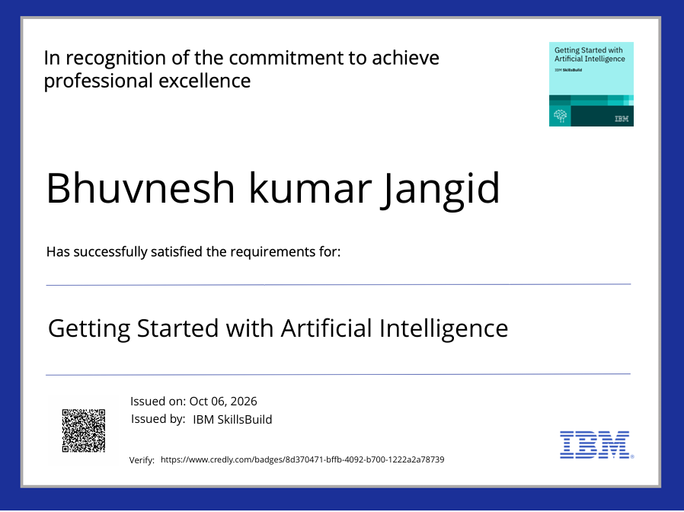
Certificates Earned:
Please add your credly certificate

Slide 18
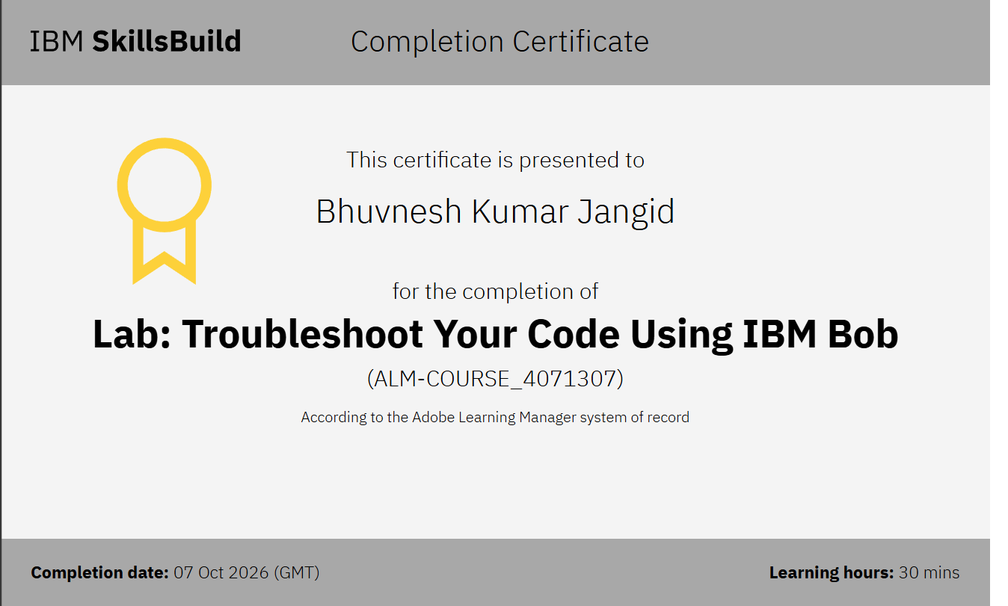
Certificates Earned:​
Add your IBM BOB Certificate

Slide 19


