Slide 1

Tribhuvan University Siddhanath Science Campus, Kanchanpur
Final year project work
on
Human Resource Management System
Presented by:
Bhuwan Buda
2078-08-04

Slide 2
Content
Introduction
Problem Statement
Objectives
Methodology
Requirement Analysis
Feasibility Analysis
Design
Working Tools and Technologies
Implementation
Testing
Conclusions
Limitations

Slide 3
Introduction
This system is useful for both user and employee.
User can provide its details and apply for the vacancy.
Employee can create the vacancy and hire user as per his/her requirement.
This system is fully responsive and supported in all devices.

Slide 4
Problem Statement
Build to overcome the problem of searching for job over the internet.
User and employee cannot find appropriate job or person for the job.
Manage time of both user and employee.

Slide 5
Objectives
To provide an easy to use GUI interface for both user and employee.
To allow users to provide their personal and academic details.
To allow employees create their vacancy as per their requirement.
To allow users to apply in the desired vacancy and employee to hire the appropriate user.

Slide 6
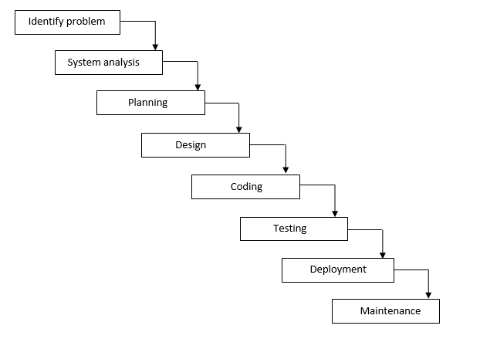
Methodology
It is used to reach the objectives of the project.
Includes all the steps and phases of software development process.
We have used waterfall model to develop our entire system.

Slide 7
Requirement Analysis
Functional Requirements
Provide and edit personal as well as academic details.
Create the vacancy.
Apply in the desired vacancy.
Hire the appropriate candidate.
Non-Functional Requirements
Modifiability
Usability
Reliability
Security
Portability

Slide 8
Feasibility Analysis
Technical Feasibility
Hardware Requirement
Software Requirement
Economic Feasibility
It helps to manage the cost and budget used for building the system.
Operational Feasibility
Someone with basic website knowledge can operate

Slide 9
Design
Our project design is divided into three parts:
UI Design
Goal is to make the user’s interaction with the system.
Database Design
Describes what data are stored and how data and tables are interrelated.
System Design
Defines overall design, modules, interfaces and data to satisfy specified requirements.

Slide 10
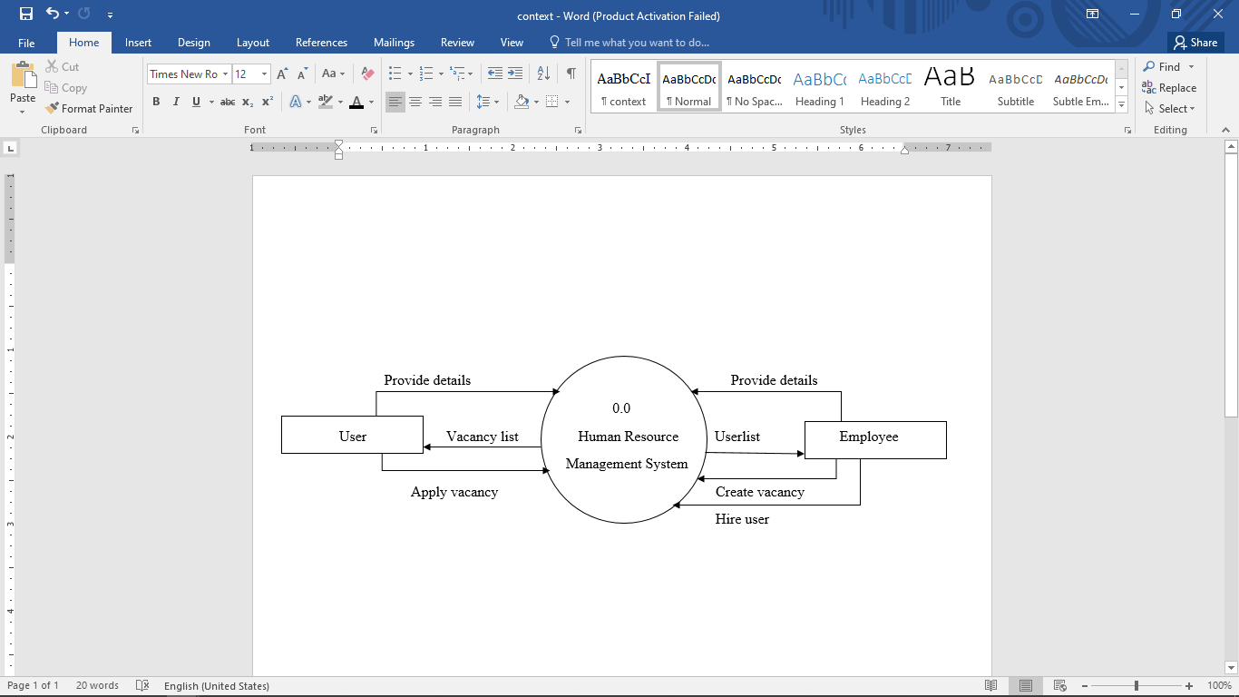
Design (Continued…)
Context diagram of the project that provides broad view about project.

Slide 11
Working Tools and Technology
Languages:
HTML, CSS and Python
Framework:
Bootstrap and Django
Tools:
PyCharm and Chrome Browser

Slide 12
Implementation
Implementation is less creative than the design.
Following activities are done for project implementation:
Employee:
Employee login in system and creates vacancy.
Provide all vacancy details.
Hire the appropriate candidate.
User:
User login in system and provides personal and academic details.
Apply for the vacancy.
Dashboard:
Manage all the details.

Slide 13
Testing
Unit Testing
Integration Testing
Module Testing
System Testing
Acceptance Testing

Slide 14
Conclusions
Involves providing details.
Employee can create the vacancy.
User can apply for the vacancy.
Easy-to-use fully responsive GUI.

Slide 15
Limitations
May add more functions of making communication.
Can add the undo function for applying vacancy and hiring user.
Transferring the projects or documents function can be added.

Slide 16
Thank You

