Slide 1

Predicting Used Car Prices Using Machine Learning: A Comparative Regression Analysis
The Coversheet
Student Name (unless anonymised) | Bhuwan Bahadur Ale Rustom Ale Magar
Student Number (as shown on student ID card): | 250223495 250212282
Word Count / Pages / Duration / Other Limits: | 15 mins
Assessment component number (1,2 or 3) | 2
Assessment type | Presentation
Attempt Number: | 1
Date of Submission: | 18 /12/2025

Slide 2
I have read and understood the Academic Misconduct statement. | Tick to confirm x
I have read and understood the Generative Artificial Intelligence use statement. | Tick to confirm x
I am satisfied that I have met the Learning Outcomes of this assignment (please check the Assignment Brief if you are unsure) | ​​​ Met x
Self-Assessment – If there are particular aspects of your assignment on which you would like feedback, please indicate below. Optional for students
Suggested prompt questions- How have you developed or progressed your learning in this work? What do you feel is the strongest part of this submission? What feedback would you give yourself? What part(s) of this assignment are you still unsure about?

Slide 3

Table of Content
Introduction
Dataset Description
Data Cleaning
Exploratory Data Analysis (EDA)
Feature Engineering
Preprocessing Strategy
Model Selection & Training
Model Evaluation Metrics
Cross-Validation Performance Analysis
Feature Selection using Recursive Elimination (RFE)
Hyperparameter Tuning
Visual Analysis of Model Predictions
Domain Application & Business Impacts
Ethical Considerations & Model Limitations
Conclusion

Slide 4
Introduction
Predicting used car selling prices using machine learning.
Based on historical vehicle and market data.
Focus on improving accuracy
Supports informed decision-making for buyers and sellers
Primary objective: To build a predictive model that accurately estimates the selling price of used cars based on their attributes and usage history.

Slide 5

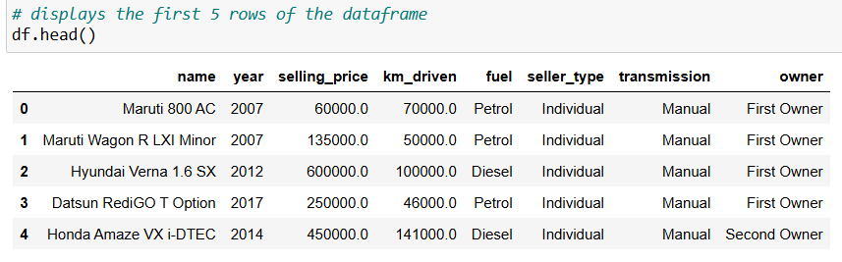
Dataset Description
After loading the dataset successfully, an initial inspection confirmed that it contains 4,340 records and 8 attributes.
The dataset includes both numerical(3) and categorical attributes(5).
The target variable for this study is selling price, which represents the resale price of a car and is the primary outcome the model aims to predict.

Slide 6
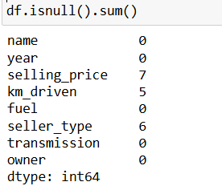
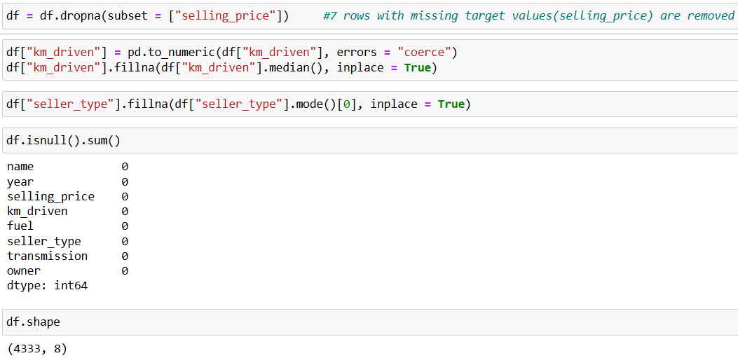
Data Cleaning
In the figure alongside, we can see total number of missing values for the given attributes. Among them, there are 7 missing target variables.
After handling the missing values, we now have 4333 rows, as we have removed 7 rows that contained missing target variables.

Slide 7
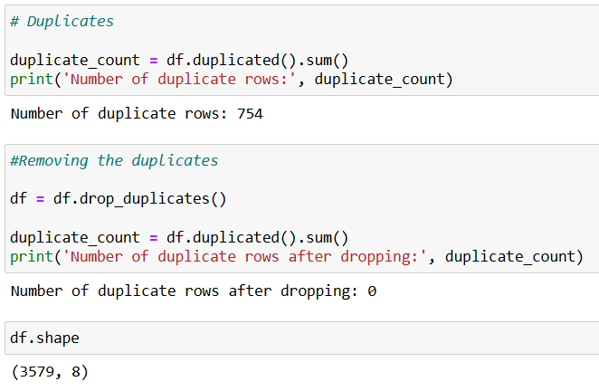
Data Cleaning
A total of 754 duplicate rows were identified in the dataset.
After duplicate removal, the dataset was reduced to 3,579 unique records, providing a cleaner and more reliable foundation for further analysis.

Slide 8
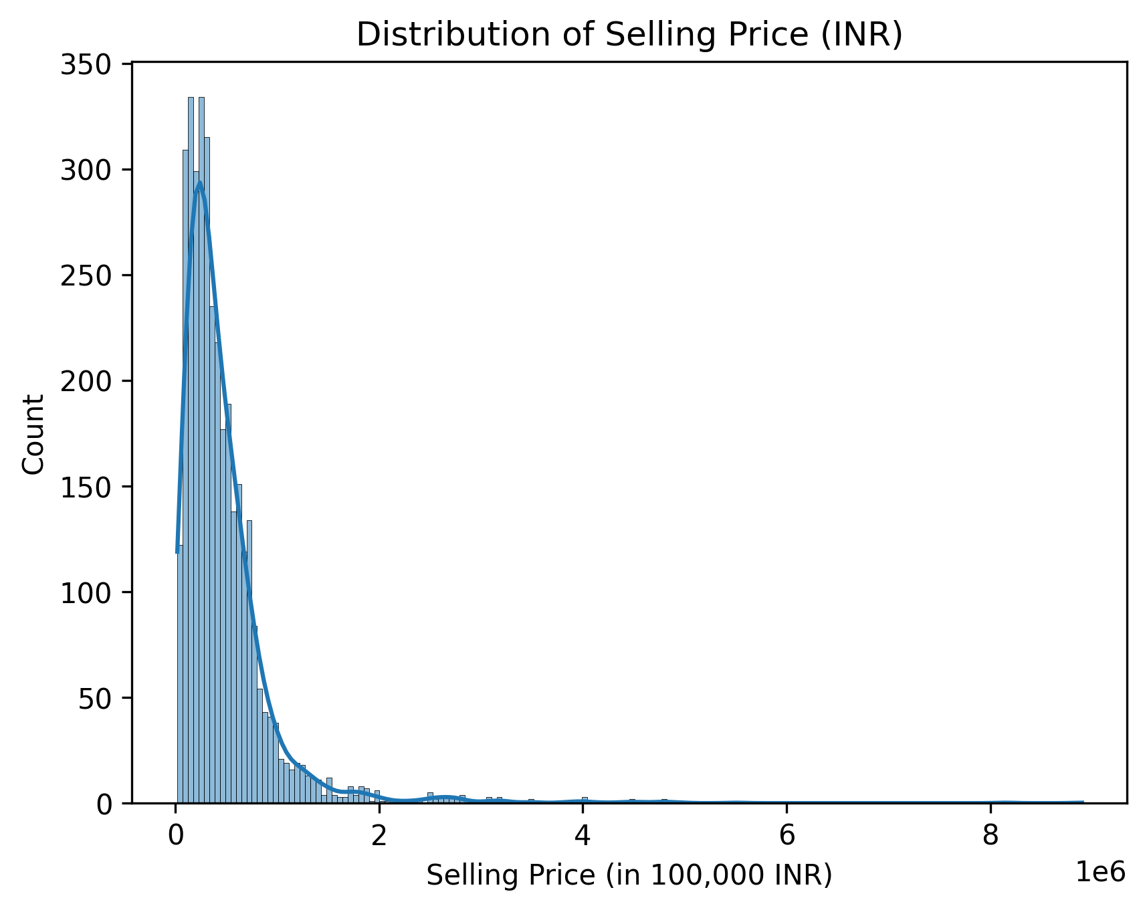
Exploratory Data Analysis (EDA)
The distribution reflects real-world market trends: affordable used cars are common, while premium vehicles are rare.
Extreme values indicate potential outliers, which can heavily influence regression models if not addressed properly.

Slide 9
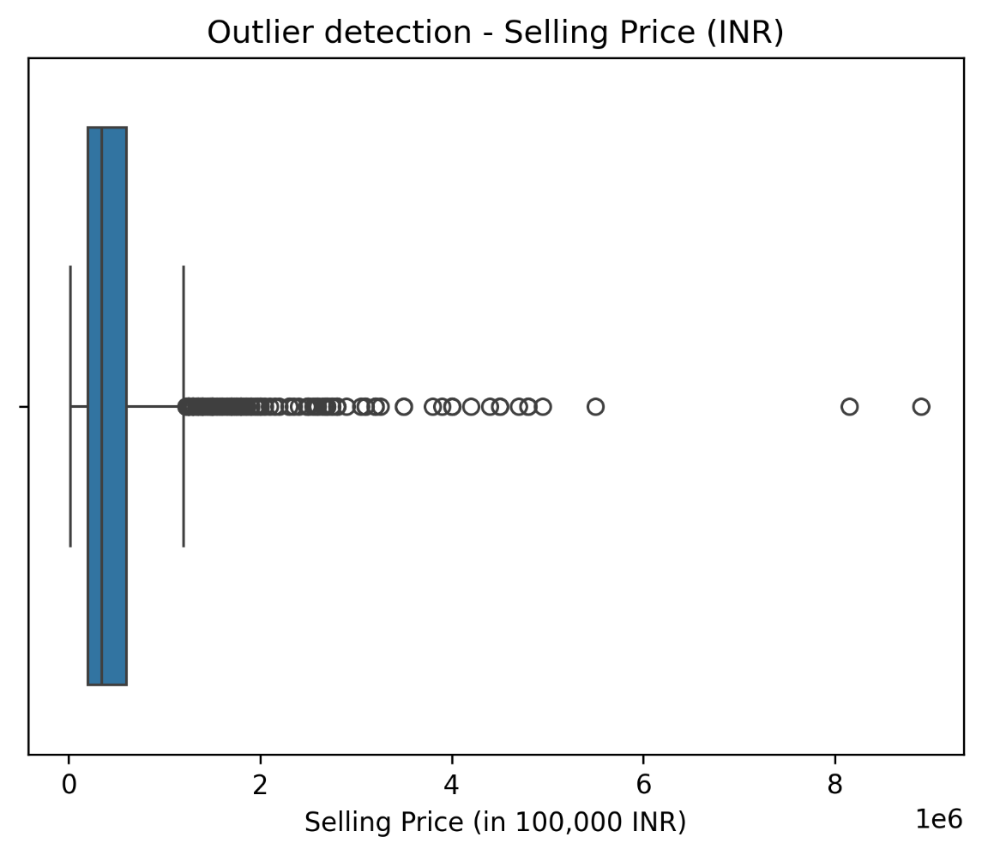
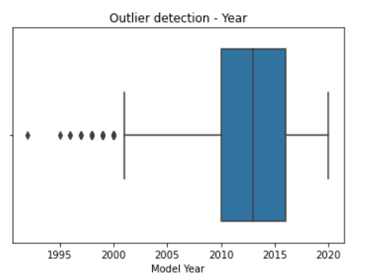
Exploratory Data Analysis (EDA)
From the first box plot, we can see that most used cars fetched the price of under 100,000 INR with some cars fetching higher price.
Whereas the cars that were made between 2010 to 2017 were a good catch for the buyers.

Slide 10
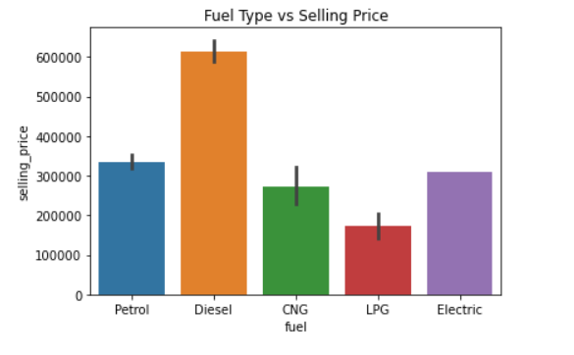
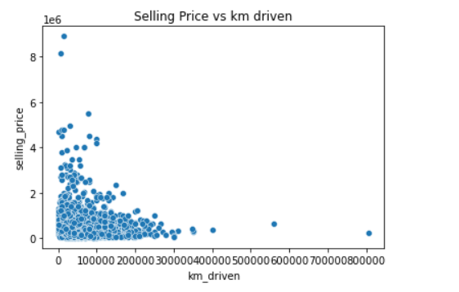
Exploratory Data Analysis (EDA)
Despite cars having less km, they are not getting the high price. It is due to other external factors such as car brand, conditions, etc.
It can be observed that the cars using diesel have the higher selling price, whereas LPG having the least.

Slide 11
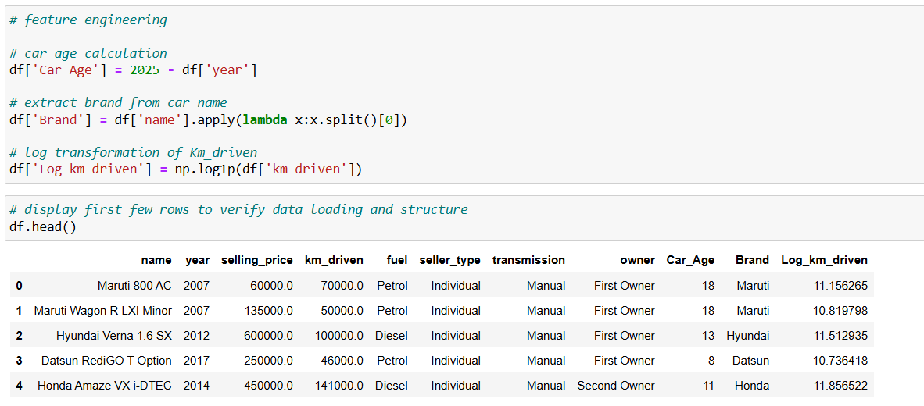
Feature engineering
Here, by using car manufacture year, we have calculated the car's age.
Also, we have taken the natural log of km driven to reduce skewness and stabilise variance.

Slide 12
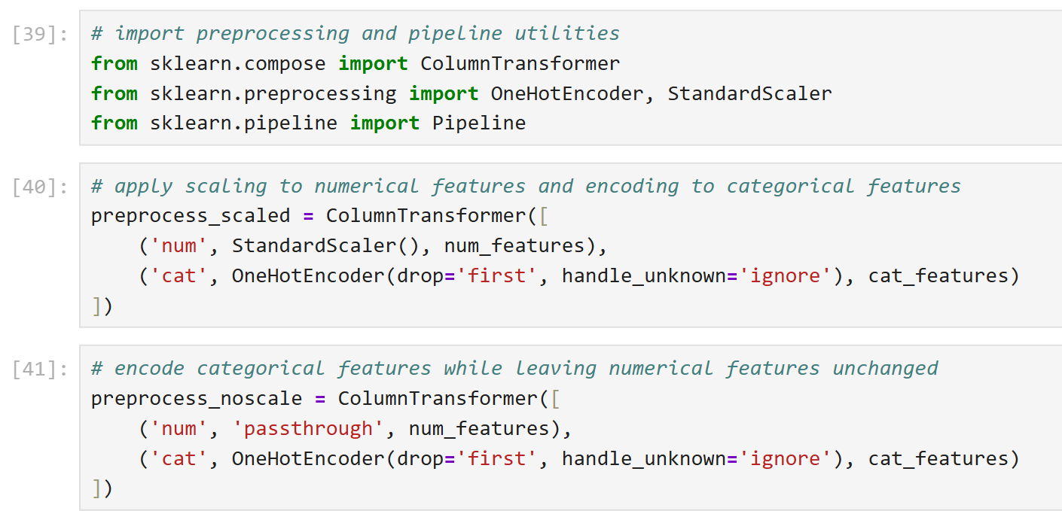
Preprocessing Strategy
Encoding of categorical variables
Scaling of Numerical Features
Train-Test Split Strategy
Prevention of Data Leakage

Slide 13
Model Selection
Multiple Linear Regression was chosen as a baseline model due to its simplicity and interpretability.
Random Forest Regressor was selected for its ability to model non-linear relationships and handle feature interactions without requiring feature scaling.
Support Vector Regression was included to assess the performance of kernel-based methods on the dataset.
All models were implemented using Scikit-Learn pipeline

Slide 14
Model Training
The dataset was split into training and testing sets using an 80:20 ratio with a fixed random state to ensure reproducibility.
Two preprocessing pipelines were constructed:
1. Scaled pipeline:
Applied standardization to numerical features and one-hot encoding to categorical features.
This pipeline was used for Linear Regression and SVR, as these models are sensitive to feature scale.
2. Non-scaled pipeline:
Applied one-hot encoding to categorical features while passing numerical features unchanged.
This pipeline was used for the Random Forest Regressor, as tree-based models do not require feature scaling.

Slide 15
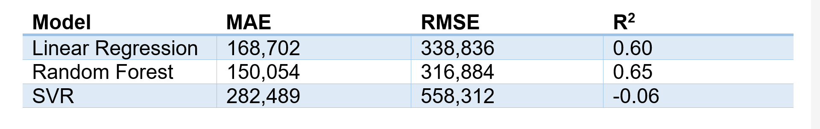
Model Evaluation Metrics
Model performance was evaluated using three standard regression metrics
Mean Absolute Error (MAE): measures the average magnitude of prediction errors.
Root Mean Squared Error (RMSE): penalizes larger prediction errors more heavily.
Coefficient of Determination (R²): indicates how much variance in the target variable is explained by the model.

Slide 16
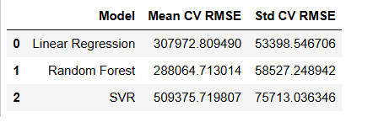
Cross-Validation Performance Analysis
Using RMSE as the evaluation metric, five-fold cross-validation was conducted to access model stability and generalization performance.
Overall, cross-validation results reinforced the selection of the Random Forest Regressor as the most reliable and accurate model for predicting used car selling prices.

Slide 17
Feature Selection using Recursive Feature Elimination (RFE)
Feature | Selected | Ranking
Fuel: Electric | Yes | 1
Brand: Jeep | Yes | 1
Brand: BMW | Yes | 1
Brand: Isuzu | Yes | 1
Brand: Jaguar | Yes | 1
Brand: Audi | Yes | 1
Brand: MG | Yes | 1
Brand: Land | Yes | 1
Brand: Volvo | Yes | 1
Brand: Mercedes Benz | Yes | 1
RFE using Linear Regression was applied on the training data to identify the most influential predictors of vehicle selling price, revealing that brand-related variables and fuel type (notably electric vehicles) dominate price influence, while seller type and transmission contribute relatively little.

Slide 18
Hyperparameter Tuning
GridSearchCV with five-fold cross-validation was used to tune the Random Forest pipeline by minimising RMSE.
The tuned model improved generalisation and was selected for final evaluation.

Slide 19
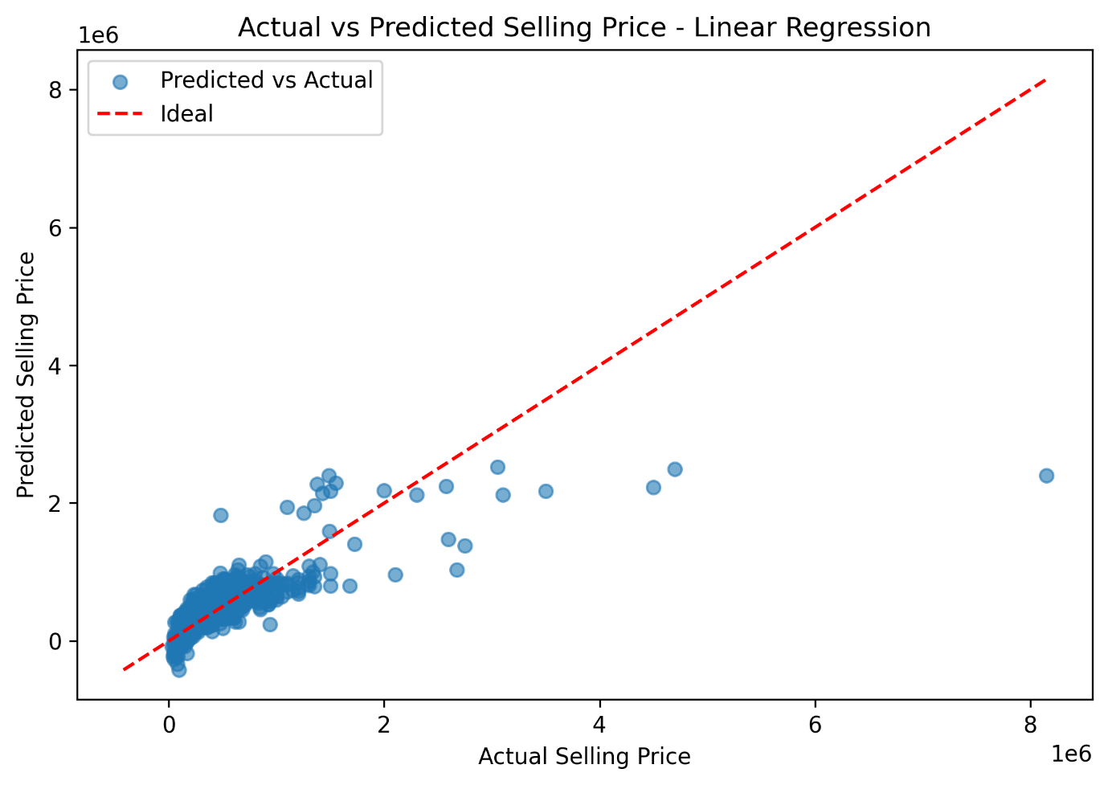
Visual Analysis of Model Predictions
Actual vs predicted plots assess how closely model predictions align with true prices.
Linear regression underestimates higher-priced vehicles, showing limited non-linear modelling capability.

Slide 20
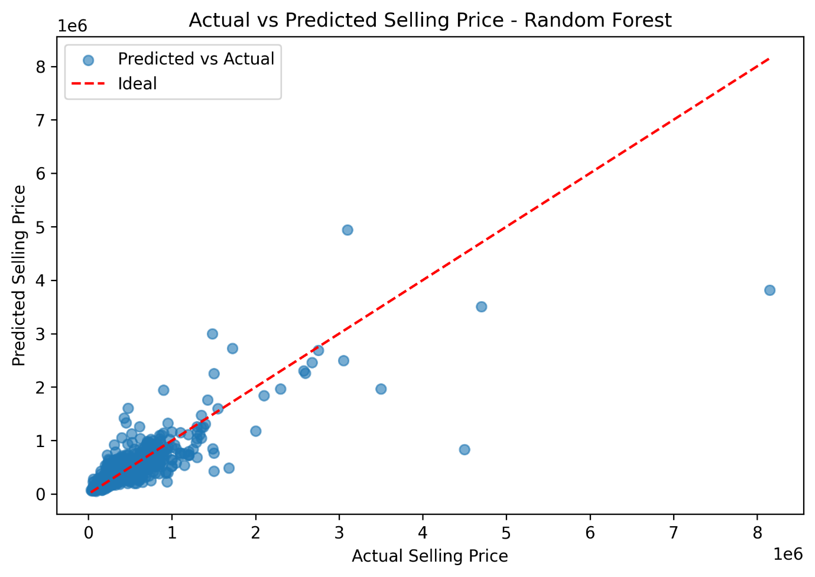
Visual Analysis of Model Predictions
Random Forest shows strong alignment with actual prices across ranges, indicating high accuracy and robust generalisation.

Slide 21
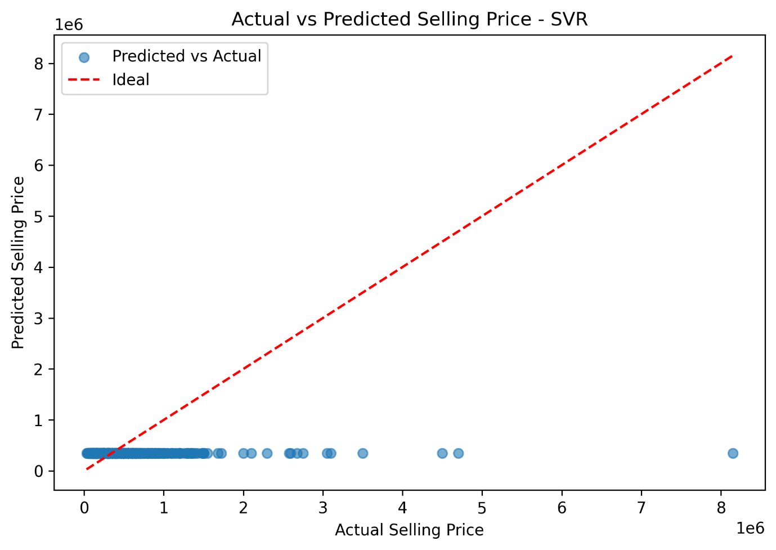
Visual Analysis of Model Predictions
SVR compresses predictions and underestimates higher-priced vehicles, indicating weak learning of the target distribution.

Slide 22
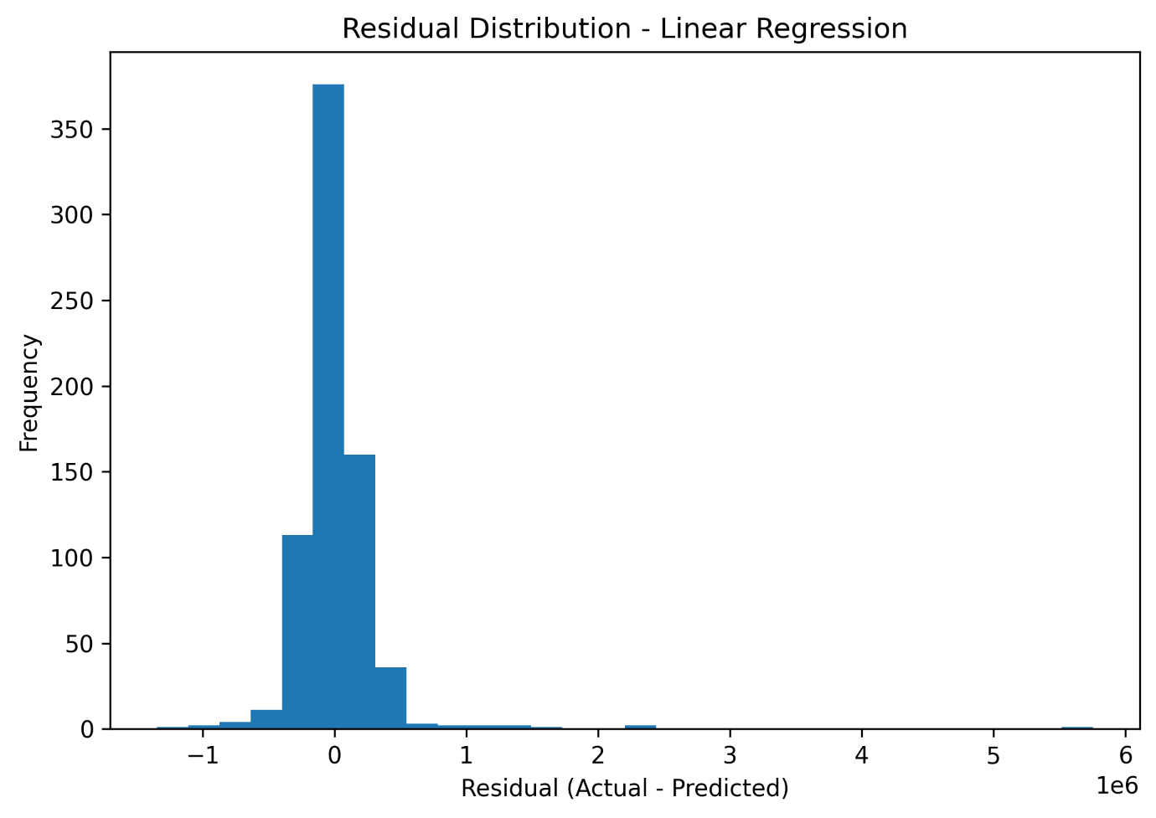
Visual Analysis of Model Predictions
Residual plots were used to assess model bias and error symmetry.
Linear Regression shows right-skewed residuals, indicating systematic underestimation of higher-priced vehicles

Slide 23
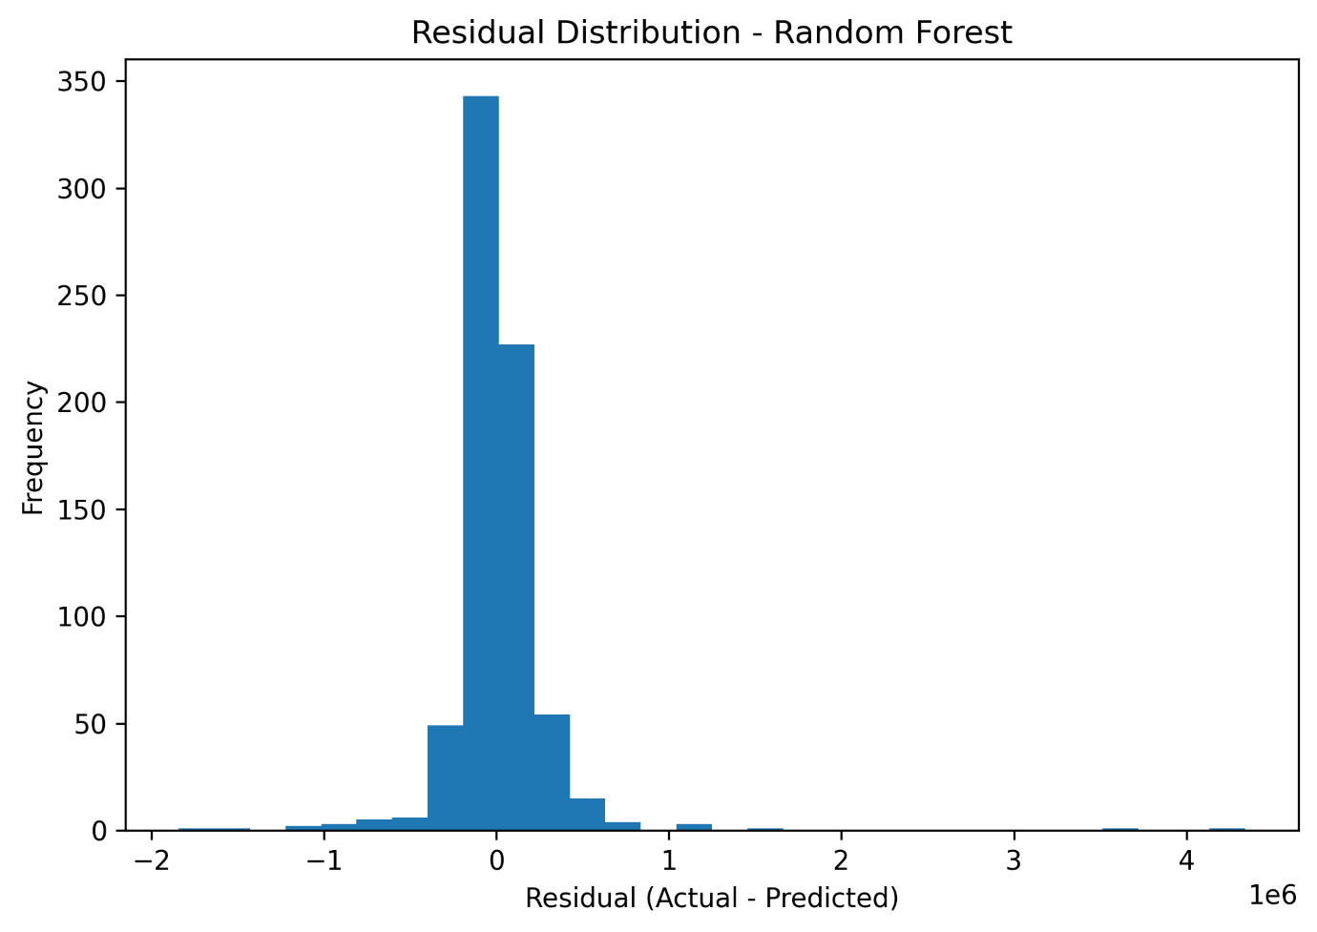
Visual Analysis of Model Predictions
Random Forest shows balanced, near-zero residuals with low spread, indicating robust and consistent predictions.

Slide 24
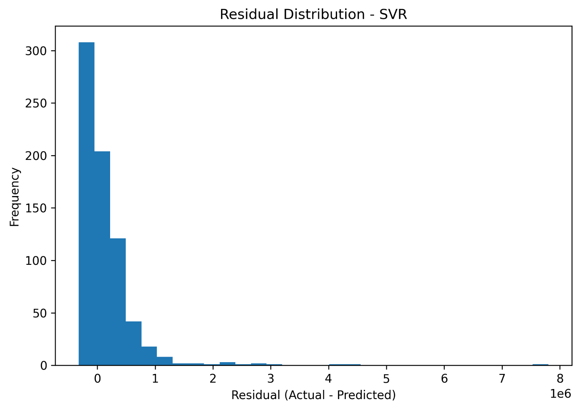
Visual Analysis of Model Predictions
SVR residuals are heavily skewed, indicating persistent underprediction and weak generalisation.

Slide 25
Domain Application & Business Impacts
Domain Implications
Supports consistent, data-driven vehicle pricing and faster negotiations across marketplaces and dealerships.
Enables anomaly detection (e.g., overpriced listings) and handles real-world non-linear pricing patterns.
Business & Research Implications
Improves transparency, trust, and operational efficiency through automated, consistent valuations.
Supports strategic decisions and future research while highlighting the need for responsible, unbiased model use.

Slide 26
Ethical Considerations & Model Limitations
Ensure privacy, consent, and regulatory compliance when linking pricing models to user or transaction data.
Address bias from underrepresented brands or categories to avoid unfair pricing outcomes.
Incorrect predictions can cause financial loss and reduced trust; outputs should support, not replace, human decisions.
Maintain transparency, uncertainty reporting, and regular retraining to adapt to changing market conditions.

Slide 27
Conclusion
Machine learning techniques were successfully applied to predict used car selling prices
Exploratory data analysis and preprocessing identified key factors influencing resale value.
Multiple regression models were developed and evaluated using k-fold cross-validation.
Random Forest Regressor achieved the best performance and generalisation.
Feature selection and hyperparameter tuning improved interpretability and accuracy.
Ensemble-based models effectively captured non-linear pricing relationships.

