Slide 1
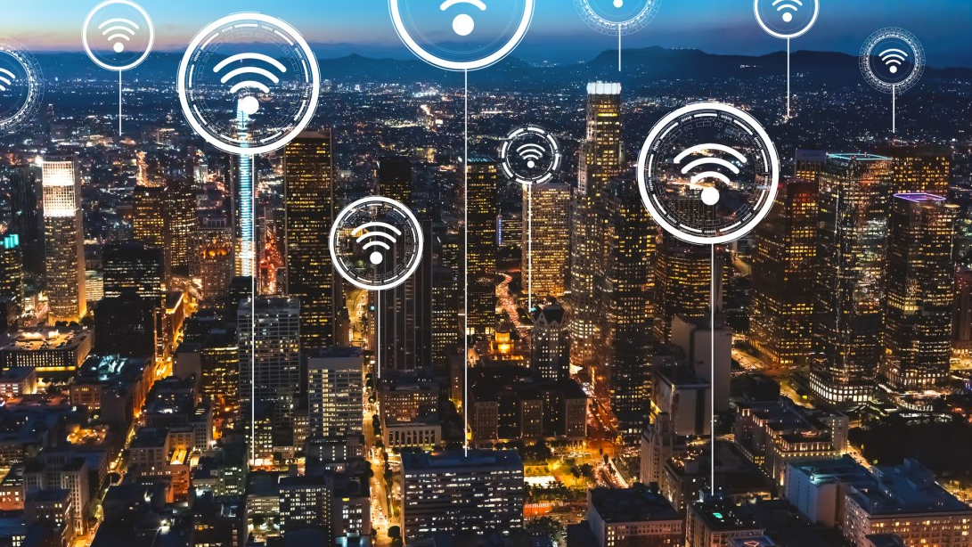
Broadband accessibility in the US
ByungHwa Lee

Slide 2
What is broadband?
allows for high-quality and quick access to information, teleconferencing, data transmission, and more, that can be used in a variety of capacities, from healthcare to education to technological development.
coaxial cable
fiber optic cable
radio waves

Slide 3
The problem
Internet users rate in the US is constantly increasing, yet many small cities and counties still suffer from lack of access and slow speed.
Global inconsistencies in internet availability
Unexpected fluctuations in use
The ever-rising demand for bandwidth

Slide 4
Goal
Determine which county needs for more broadband connections by comparing –
Internet usage
Broadband penetration
urbanization
Solution – provide more internet accessibility in rural areas and encourage economical / technological development

Slide 5
Risk & Assumptions
uneven distribution of internet services
Due to increasing internet users, demand for HD stream and faster information retrieval will become crucial in the future. Better to install broadbands now to meet the demand
Different urbanization rate between counties
Compare median income levels

Slide 6
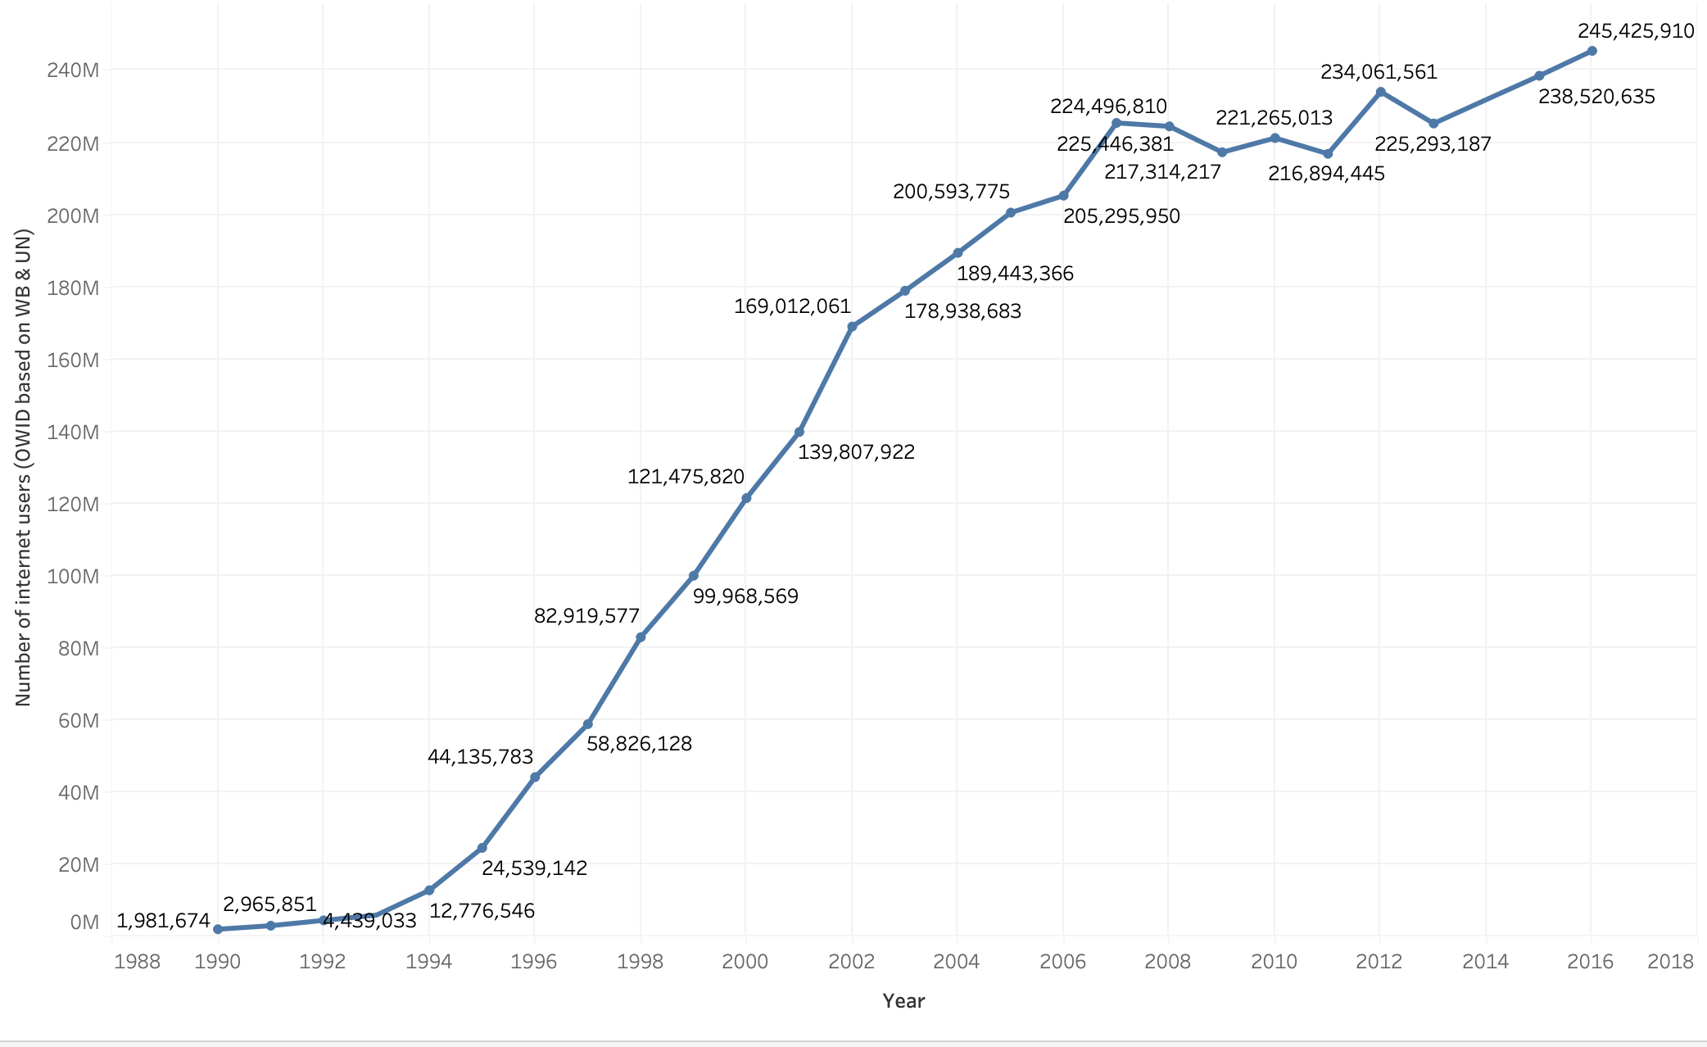
Current Internet Users in the US

Slide 7
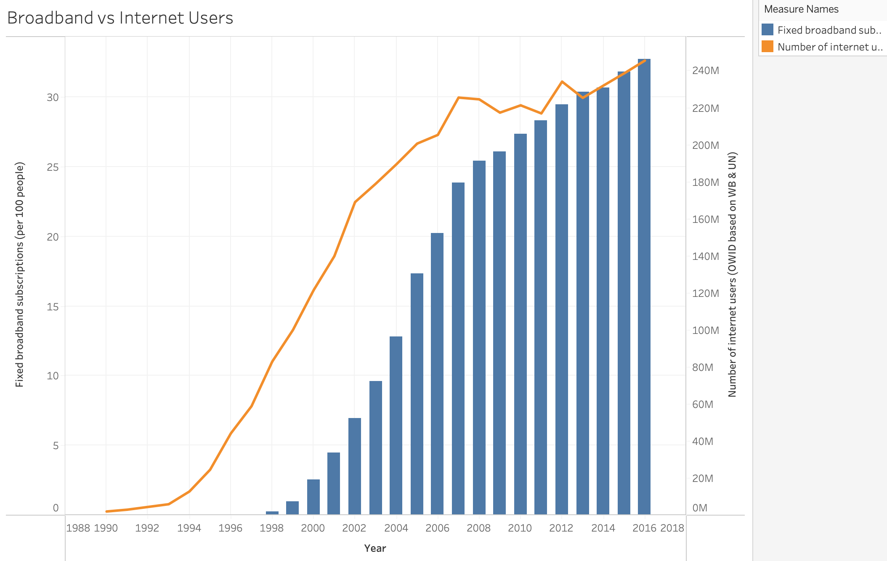
Broadband subscription

Slide 8

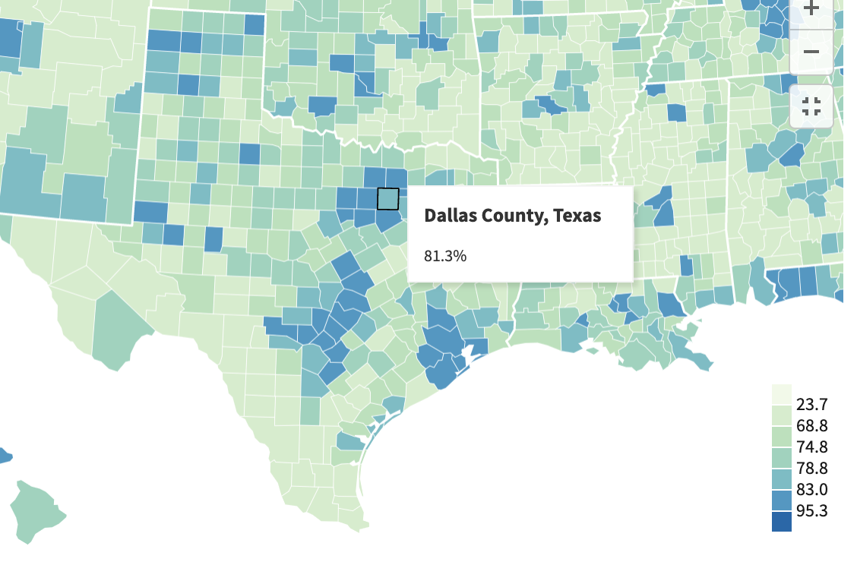
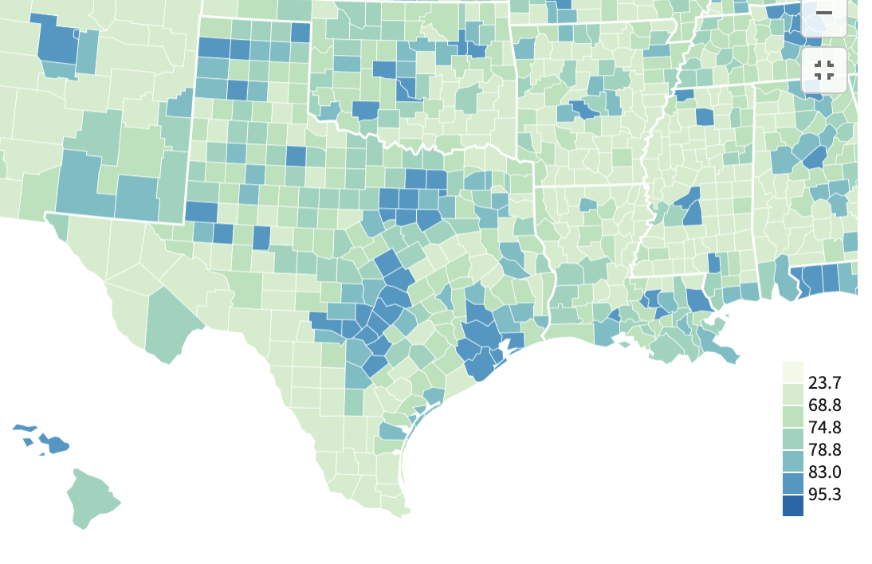
Broadband availability in Texas

Slide 9
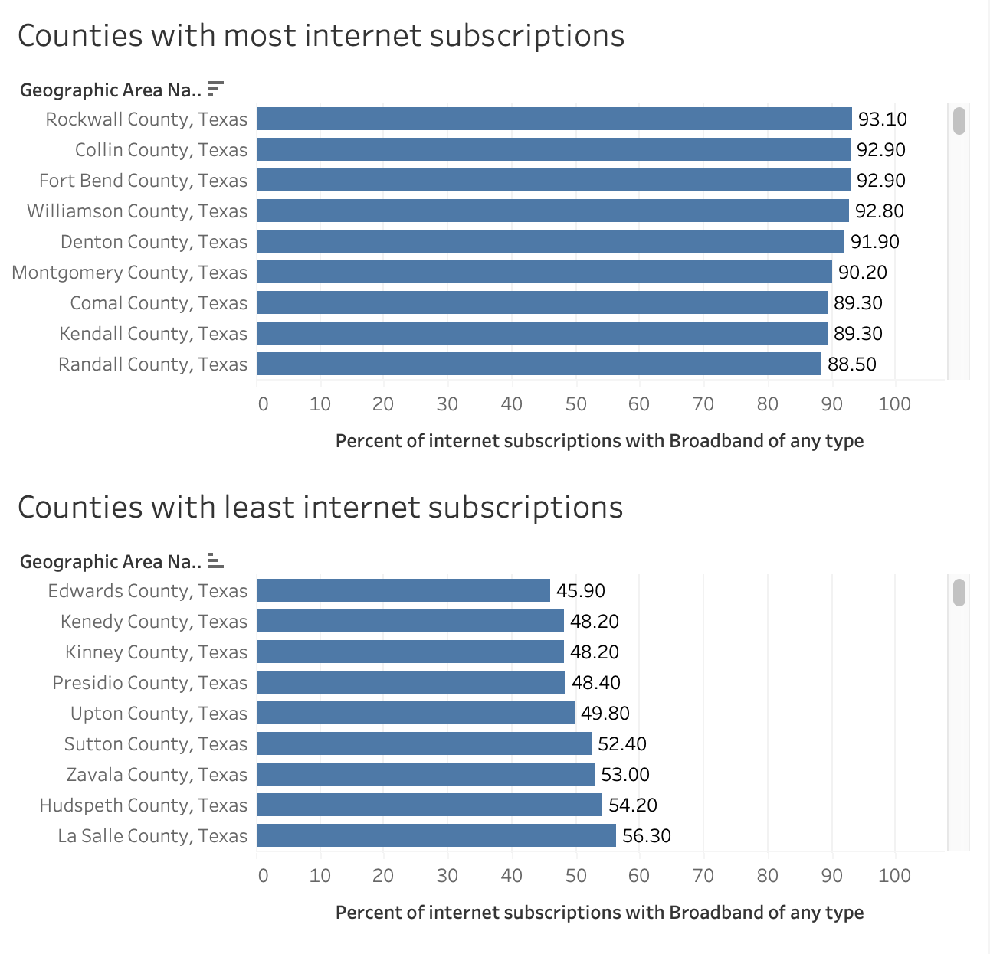
Vs counties

Slide 10
Takeaways
Difference between city and rural counties
Internet should be accessible to anyone and anywhere
Opportunities to capture new market shares in rural counties
Based on the trend, growing internet users will demand more broadbands, which can lead to technological and economical development

Slide 11
Future work
Demographics
Make a model using different median income rate
More income -> likely to afford broadband
Density of population
More people will need more internet speed

Slide 12

Thank you

