Slide 1

Diagnosing diabetes
ByungHwa Lee
October 29th, 2021

Slide 2
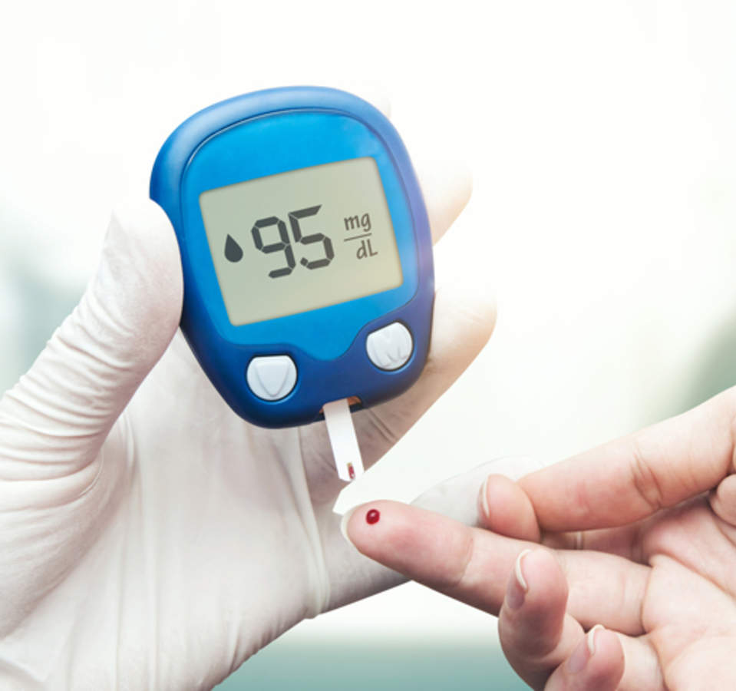
Problem
Evaluate a classification algorithm that diagnoses diabetes based on medical diagnostic measurements and determine which features are most influential in predicting the diagnosis.

Slide 3
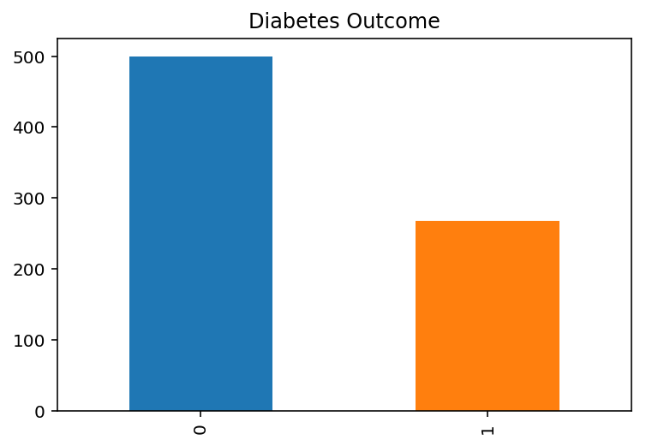
Dataset
Top 8 features include:
· Pregnancies: Number of times pregnant · Glucose: Plasma glucose concentration a 2 hours in an oral glucose tolerance test · BloodPressure: Diastolic blood pressure (mm Hg) · SkinThickness: Triceps skin fold thickness (mm) · Insulin: 2-Hour serum insulin (mu U/ml) · BMI: Body mass index (weight in kg/(height in m)²) · DiabetesPedigreeFunction: Diabetes pedigree function · Age: Age (years)

Slide 4

Goal
Maximize Recall (sensitivity) – correctly identified positive results

Slide 5
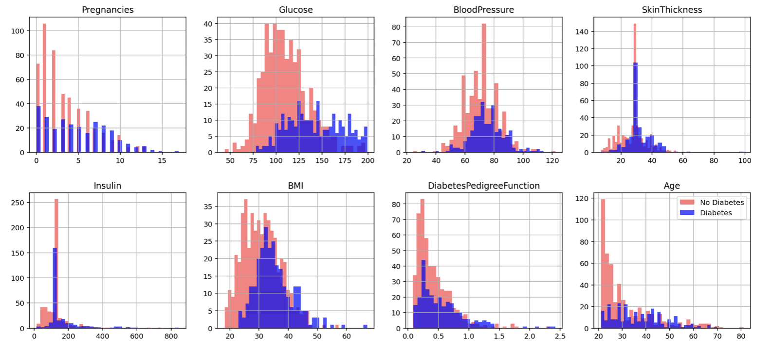
Insights

Slide 6
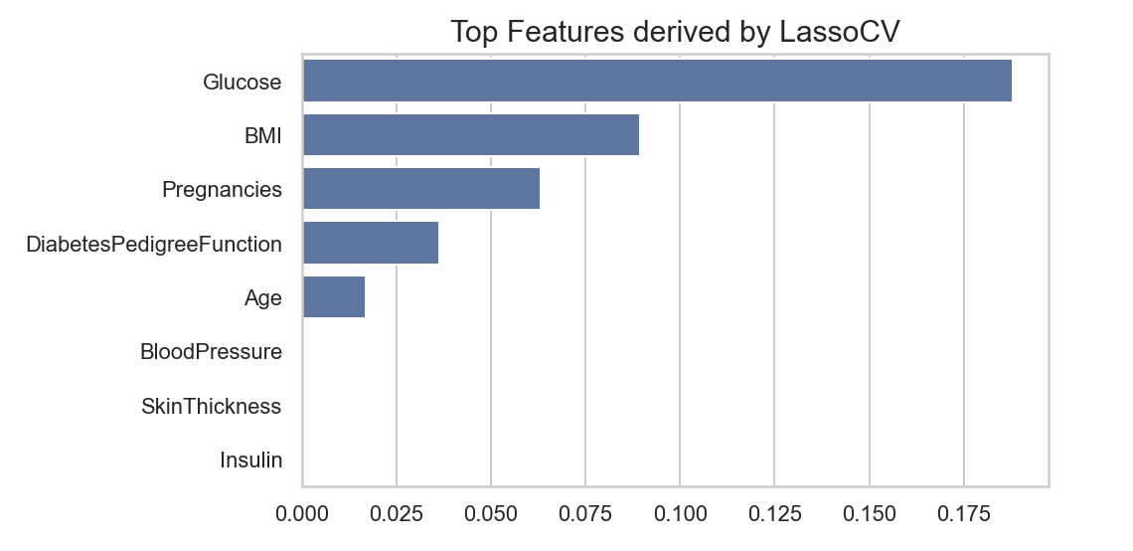
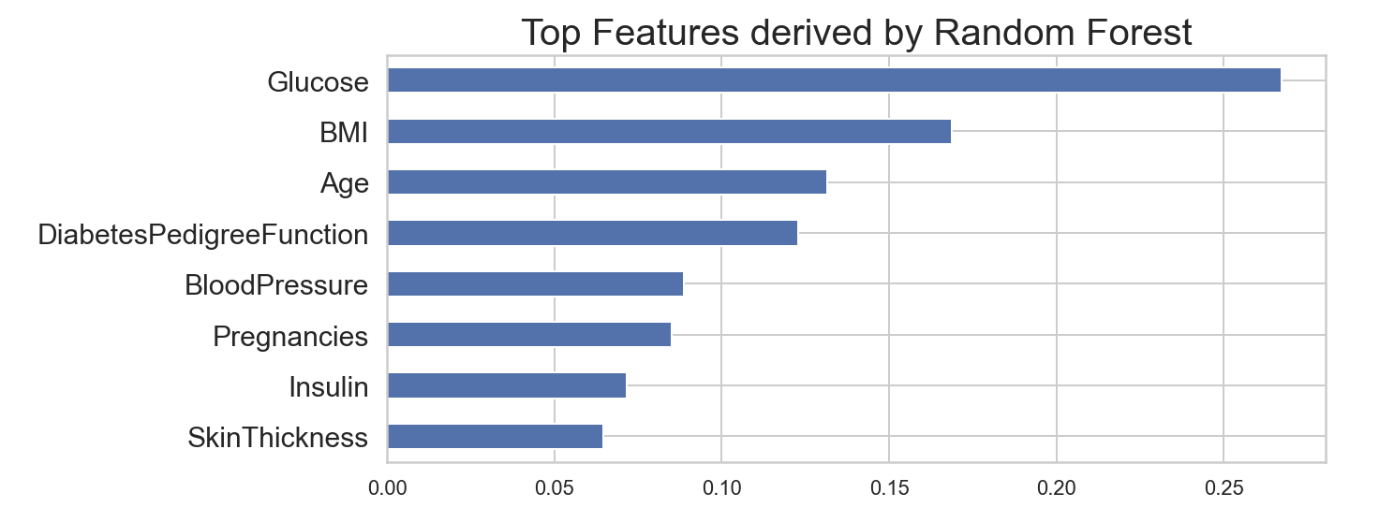
Feature Importance

Slide 7
Procedure
Compare model performance using cross-validation to determine which algorithm offers the best predictions
1
Use the performance metric to evaludate
2
Accuracy Score, Precision Score, Recall Score, F1 Score, Area Under ROC Curve, Log Loss
Use Grid Search to optimize model parameters for best recall and accuracy
3
Random Forest Classifier
Gaussian Naïve Bayes
K – Nearest Neighbors
Logistic Regression

Slide 8
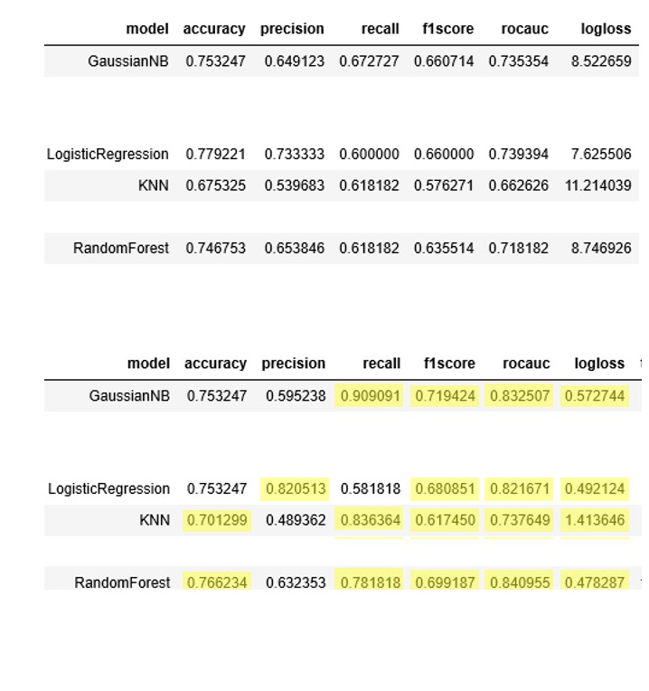
Model Comparison

Slide 9
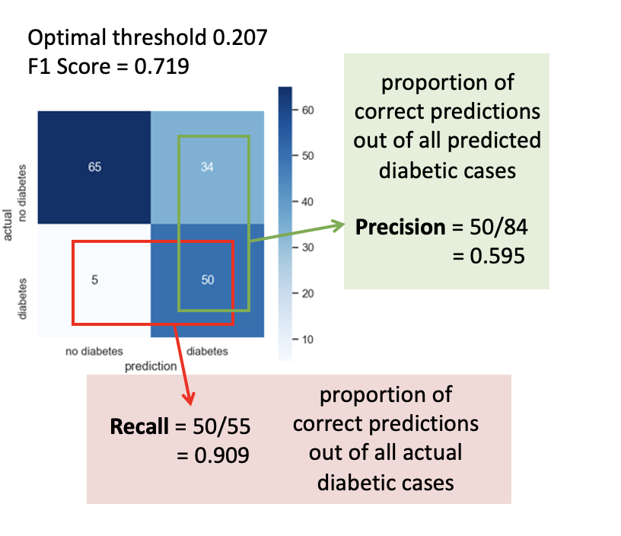
Results

Slide 10
Conclusion
Gaussian Naïve Bayes model proved to be the best algorithm to diagnose diabetes
Out of all diabetic patients, about 90% of them will be classified correctly using medical diagnostic measurements
Features that most contribute to diagnosis of diabetes are:
Glucose
BMI

Slide 11

Thank you!

