Slide 1


MTA Turnstile
ByungHwa Lee
Sept. 17, 2021

Slide 2
Introduction
WTWY is holding annual gala and wants to optimize their street team to gather signatures as much as possible to increase the participation of women in technology and build awareness and influence as a result
Objective is to use the given data – MTA turnstile - to locate where to place the street teams to maximize participation, and our goal is to find out which stations are the busiest and which day of the week has the most traffic

Slide 3
Methodology
Use 3 months (Jun – Aug, 2021) of data available on the MTA database
Python visualization modules; i.e., matplotlib, seaborn
Exploratory data analysis in Pandas
SQLALCHEMY to import data to Python
Removed outliers, duplicates (AUD), sorted by the volume of traffic

Slide 4
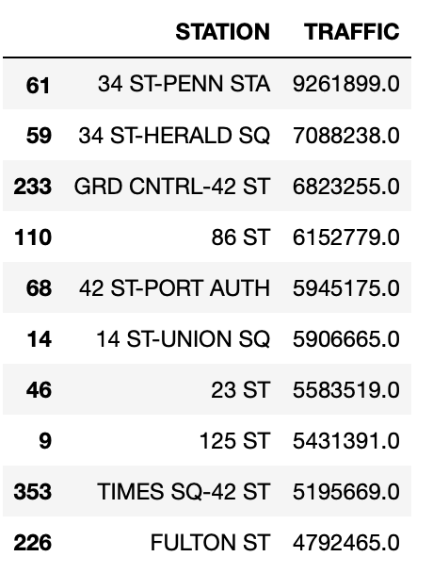
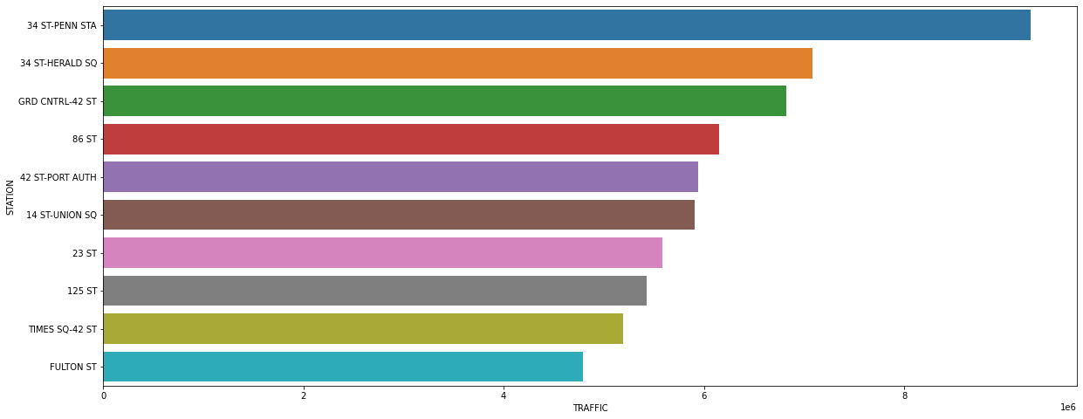
Results
Based on our data, we were able to rank top 10 stations
Found out which station has the most foot traffic based on the total of daily entries and exits

Slide 5

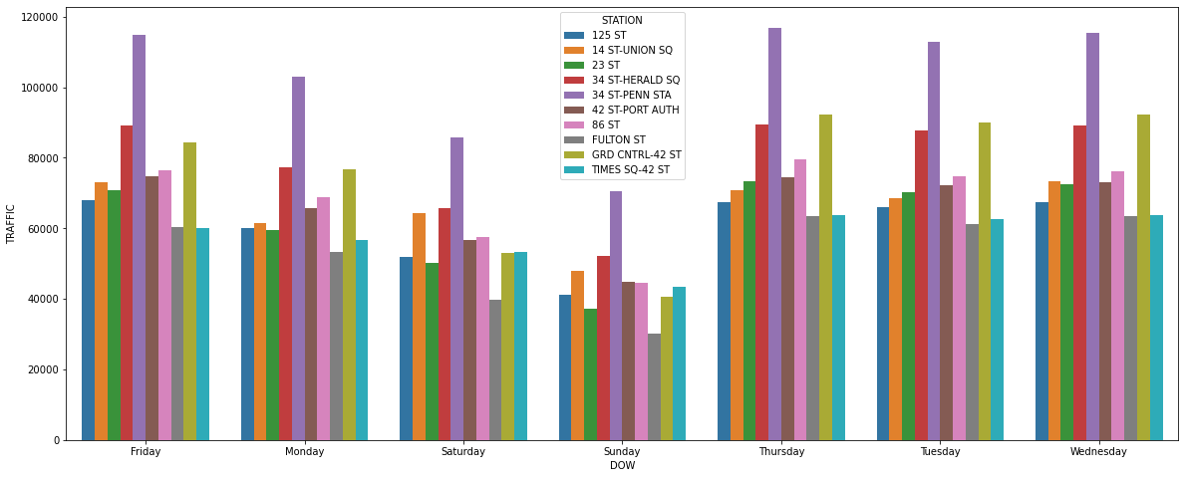

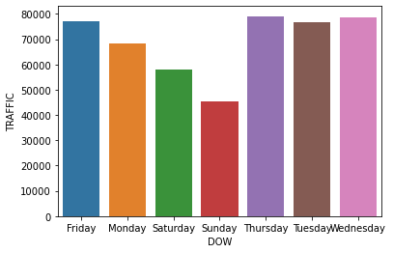
Results
Found out which day of the week has the most foot traffic based on the total volume of entries and exits
Finally, a deeper insight into which station has the most traffic based on different day of the week.

Slide 6
Conclusions
There seems to be a direct correlation between total traffic and day of the week.
Except for 34 ST-PENN STA, the street teams should be placed during Wednesday or Thursday near Grand Central -42ST and 34 ST-HERALD SQ, and 86ST to gather most signatures.
Weekends should be avoided as there is a significant drop in traffic across all stations

Slide 7
Future Work
Factors that might have affected:
Weather – i.e., rain and snow
Geographical location – method of transportation, affluent, neighborhood
College, school – students, campus
Demographic

