Slide 1

What features make a film successful?
Predicting total worldwide gross using linear regression
Byunghwa Lee

Slide 2

Summary
1. Retrieve Data
2. Make a Model
3. Make Predictions
4. Conclusions & Future Analysis

Slide 3

Data Data Collected
Box Office Mojo – Top 1,000+ movies (1960 – 2021)
IMDB.com

Slide 4
What makes a film successful?
Runtime
Budget
Domestic Opening
Season
Rating
Total # of Theaters
Genre

Slide 5
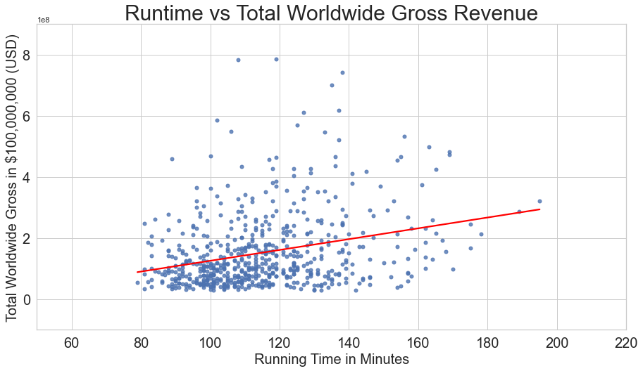
Runtime vs Total Worldwide Gross Revenue

Slide 6
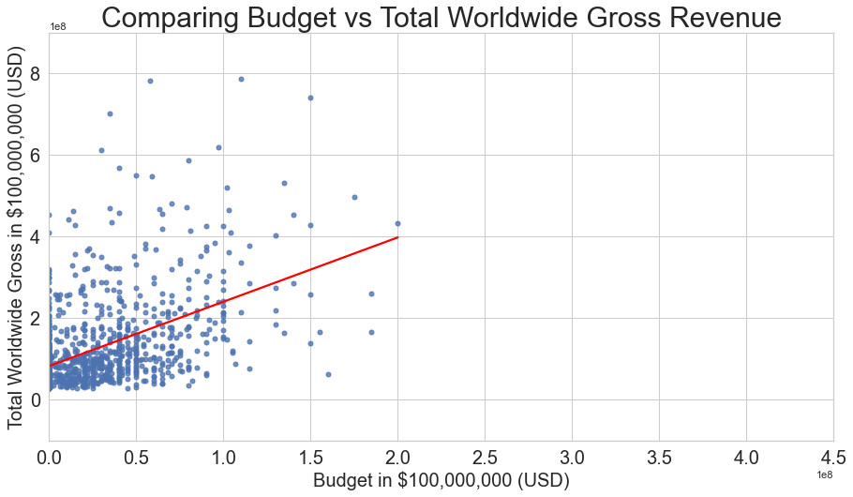
Budget vs Total Worldwide Gross Revenue

Slide 7
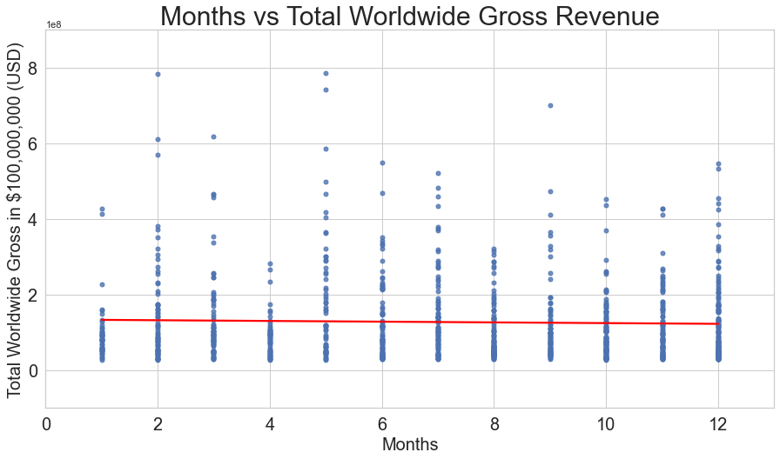
Months vs Total Worldwide Gross Revenue

Slide 8
Key Features
1. Budget – More budget generally brings more revenue
2. Month – Summer vs Winter movie season
3. Running time – Better storyline: Exposition -> Climax -> Resolution
4. Rating had less impact compared to other features

Slide 9
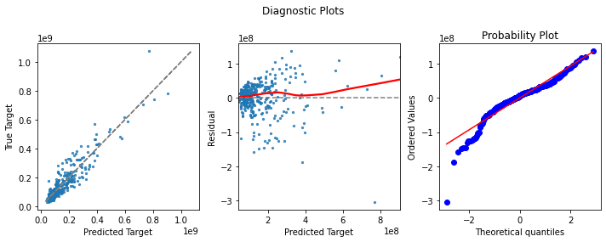
Predictions

Slide 10
Future Analysis
Explore
Explore other characteristics such as sponsor, production company, or distributor
Expand
Expand model to include actors and directors
Find
Find different ways to measure success such as Oscar nomination or view rates
Make
Make analysis of specific region of continents – Asia, Europe, Middle East, Africa

Slide 11

Thank you!

