Slide 1
Employment in Luxembourg

Slide 2
Dataset
Current Source: Eurostat https://statistiques.public.lu/en.html
Original Source: Data collected from the labor market
Type: Monthly (1995.01-2023.08)
Date Resident borderers Non-resident borderers National wage-earners 1 1995-01-01 8513.629 53011.24 149885.4 2 1995-02-01 8581.829 53403.45 150288.6 3 1995-03-01 8643.488 54013.79 150700.8 4 1995-04-01 8698.606 54550.09 150609.9 5 1995-05-01 8747.183 55239.47 151076.1 6 1995-06-01 8789.219 55824.79 152903.3 7 1995-07-01 8824.713 56373.09 153579.9 8 1995-08-01 8853.666 56548.19 152757.7 9 1995-09-01 8876.078 56766.31 156121.1 10 1995-10-01 8891.949 57103.50 155936.3 Domestic wage-earners National self-employment Domestic self-employment 1 194383.0 16793.75 17341.52 2 195110.3 16783.79 17338.56 3 196071.1 16793.58 17355.34 4 196461.4 16846.05 17424.80 5 197568.4 16866.50 17456.25 6 199938.8 16857.51 17456.25 7 201128.3 16844.90 17453.65 8 200452.2 16836.26 17442.01 9 204011.3 16839.99 17452.73 10 204147.8 16869.77 17492.51 National employment Domestic employment Number of unemployed 1 166679.1 211724.5 4868.758 2 167072.4 212448.8 4808.390 3 167494.3 213426.4 4703.404 4 167456.0 213886.2 4365.697 5 167942.6 215024.7 4168.847 6 169760.8 217395.1 4090.106 7 170424.9 218582.0 4022.740 8 169594.0 217894.2 4071.734 9 172961.1 221464.1 4498.680 10 172806.1 221640.3 4664.034 Active population 1 171547.9 2 171880.8 3 172197.7 4 171821.7 5 172111.5 6 173850.9 7 174447.6 8 173665.7 9 177459.8 10 177470.1

Slide 3
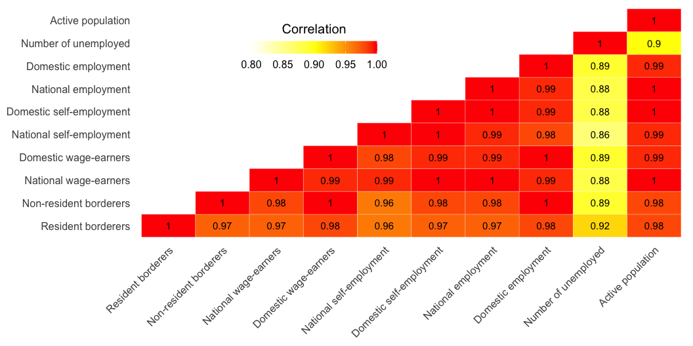
Heatmap

Slide 4
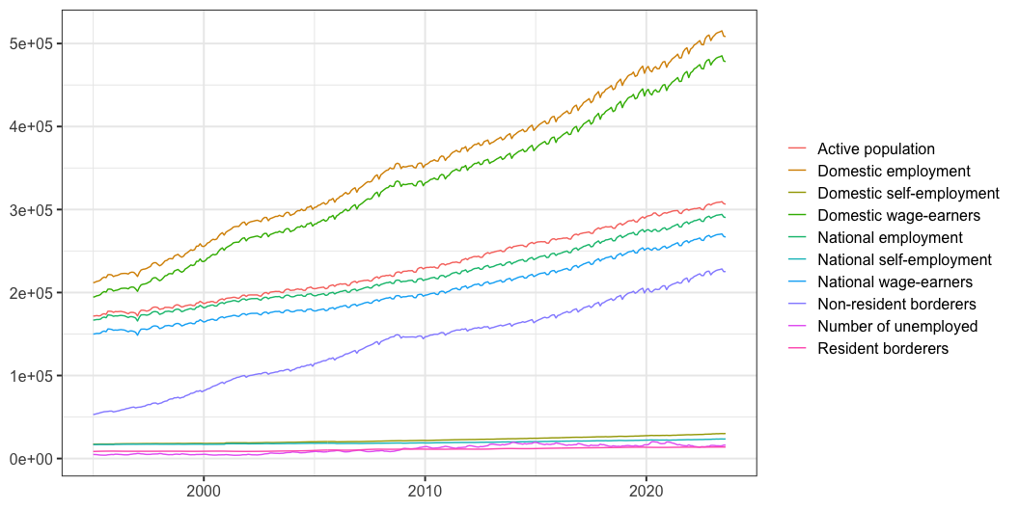
Line Graph
Line Graph for all data
Category Date Value 1 Active population 1995-01-01 171547.9 2 Active population 1995-02-01 171880.8 3 Active population 1995-03-01 172197.7 4 Active population 1995-04-01 171821.7 5 Active population 1995-05-01 172111.5 6 Active population 1995-06-01 173850.9 7 Active population 1995-07-01 174447.6 8 Active population 1995-08-01 173665.7 9 Active population 1995-09-01 177459.8 10 Active population 1995-10-01 177470.1

Slide 5
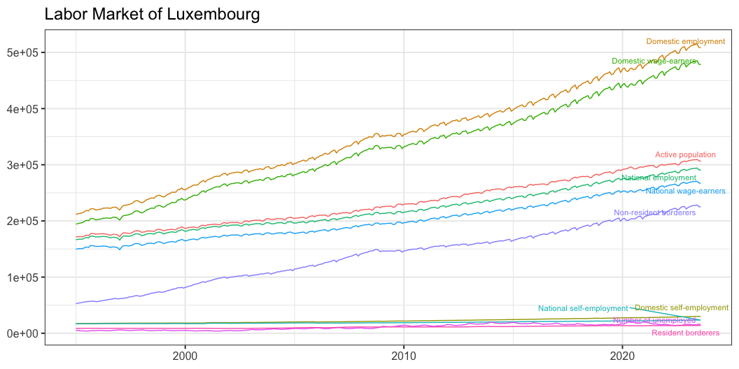

Slide 6
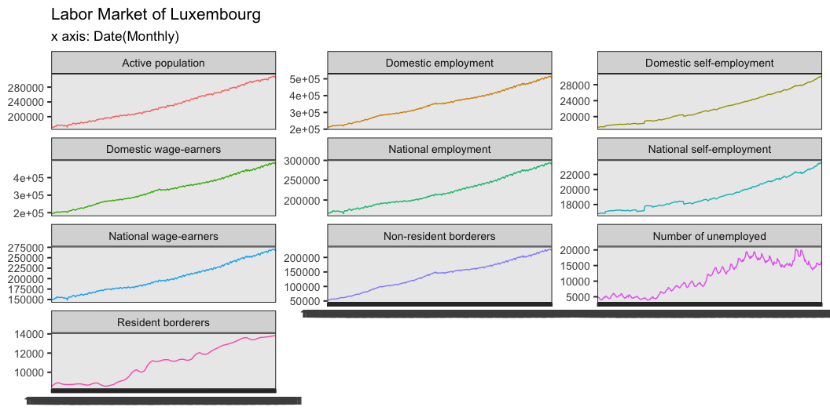
Small Multiples

Slide 7
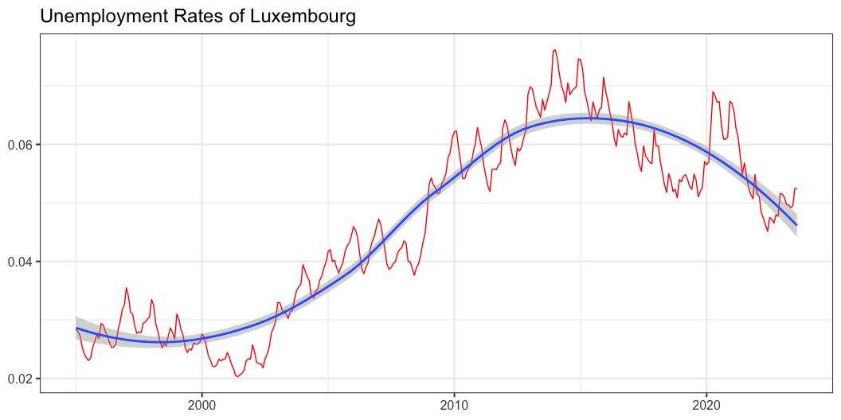
Unemployment Rates
But mainly, we are interested in Unemployment Rates. Unemployment rates = Number of unemployment / Active population

Slide 8
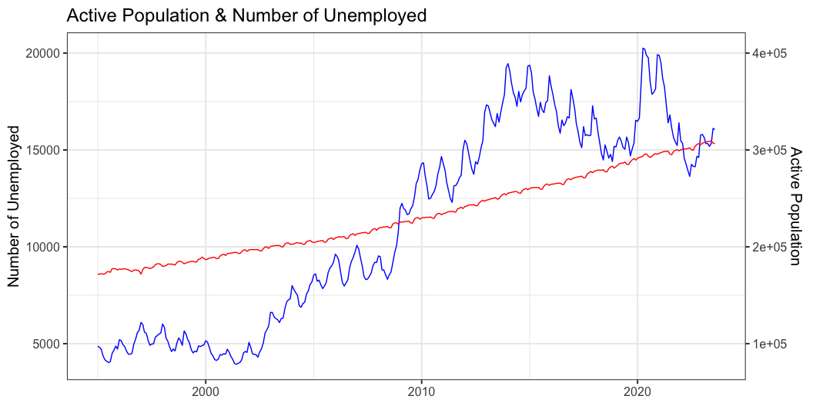

Slide 9
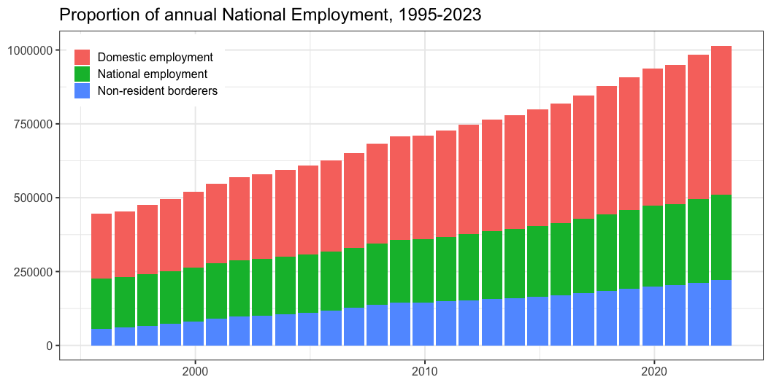
Bar Plot
National Employment & Domestic Employment
Annual data is represented by the data captured at the end of December of each year.

Slide 10
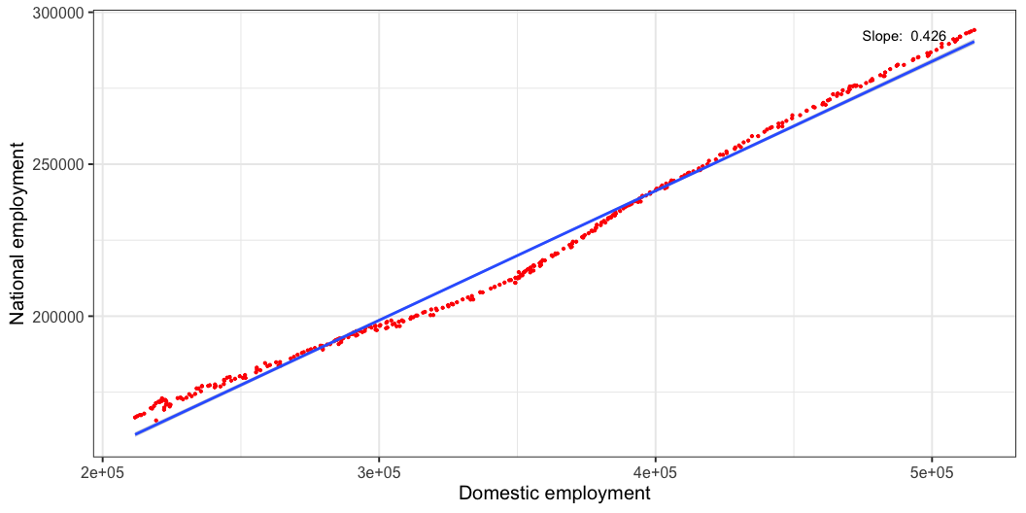
Scatter Plot
Now we plot the relationship between Domestic employment and National employment.

Slide 11
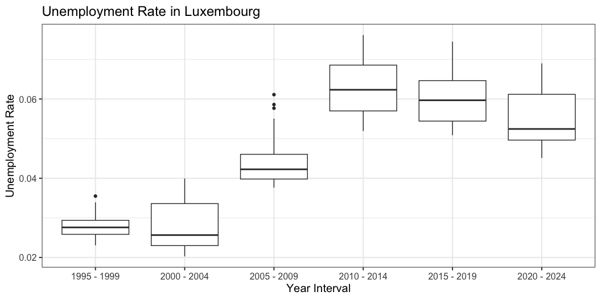
Distribution

Slide 12
This takes out the seasonal effects.

