Slide 1
Summary of Articles
Bixuan LIU

Slide 2
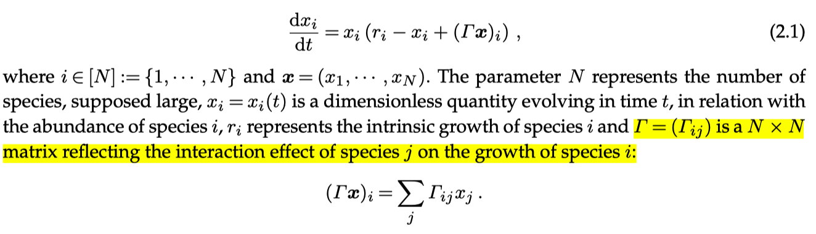
RSPA-2024
Lotka-Volterra (LV) model

Slide 3
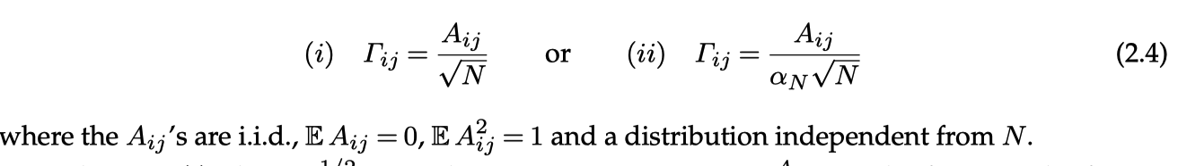
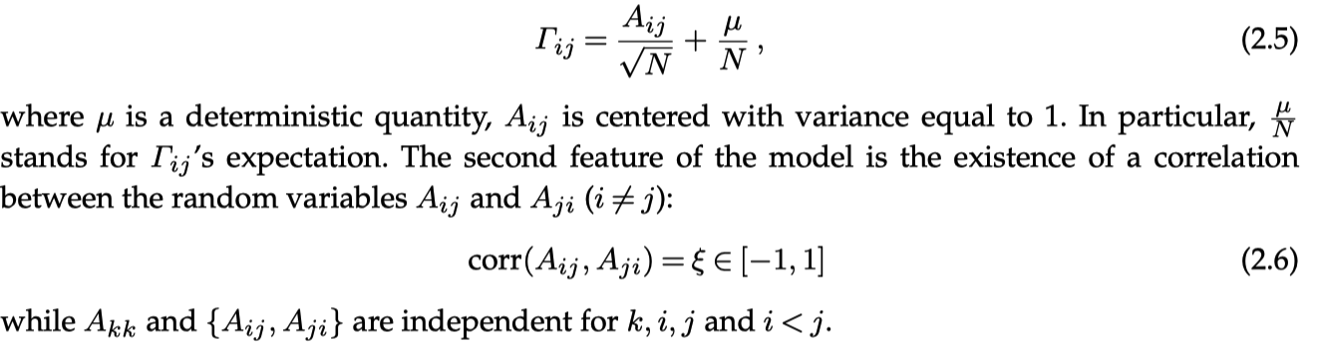
Two random interaction models
Independent and Identically Distributed entries
The elliptic model

Slide 4
Drton_Hollering_Wu
Structural Equation Models (SEMs) | Directed Graphs
Recursive | Acyclic | Possible to infer graph from data.
Non-recursive | Cyclic | Main results: Subclasses of graphs are generically identifiable
Main approach: compare matroids derived from the parameterizations of the models

Slide 5
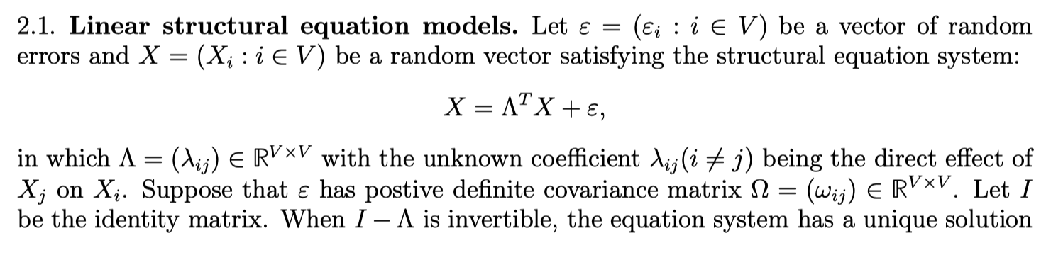
Linear structural equation models
The linear Structural Equation Model can be represented as a directed graph G = (V, E).

Slide 6
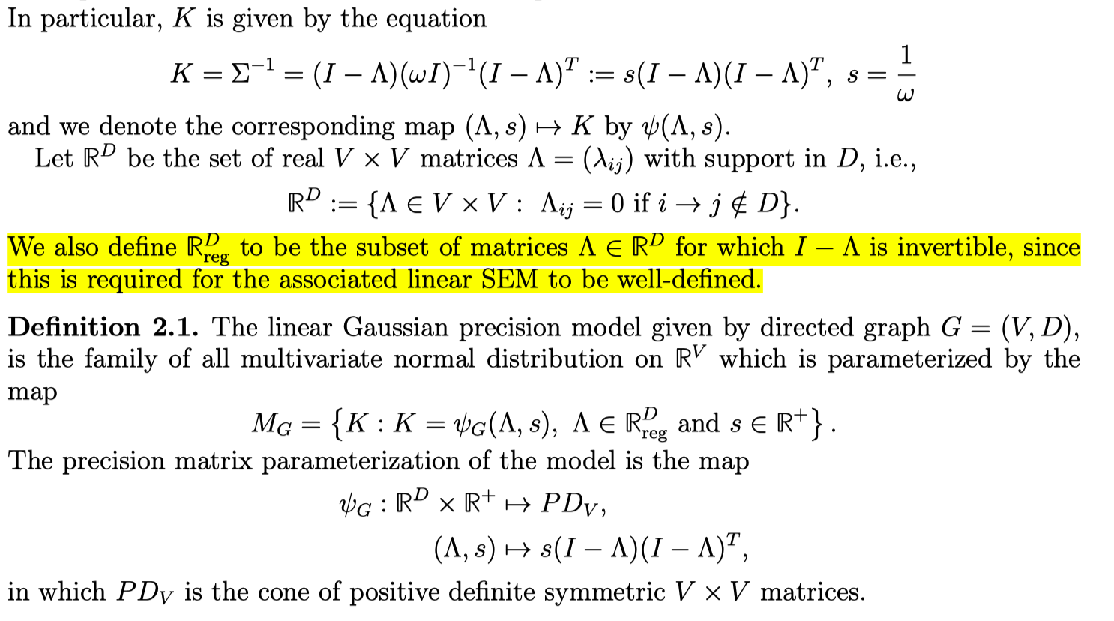
Parametrization

Slide 7
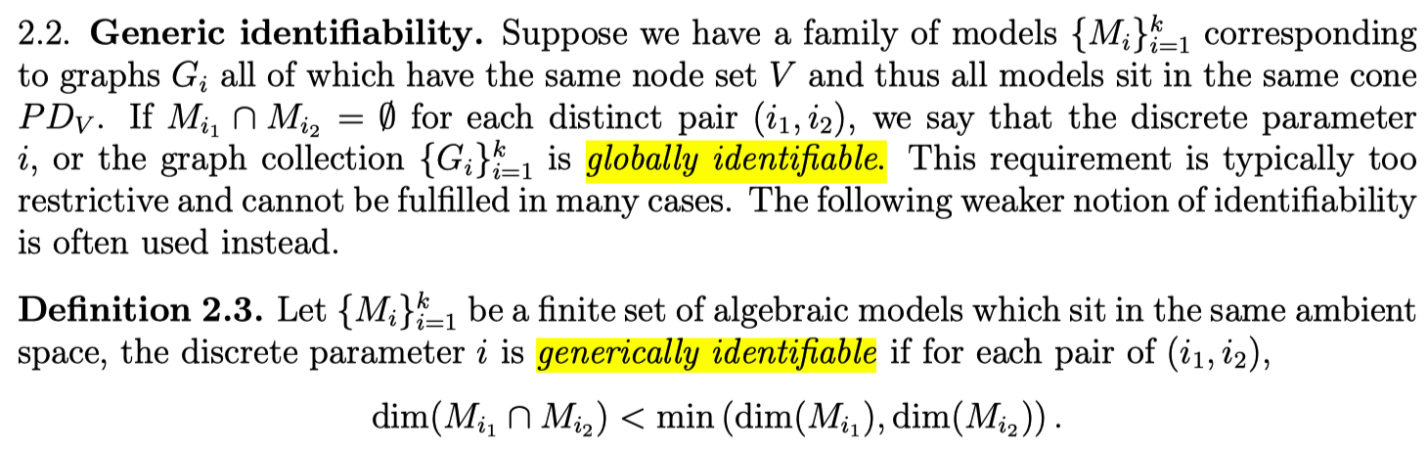
Identifiability

Slide 8
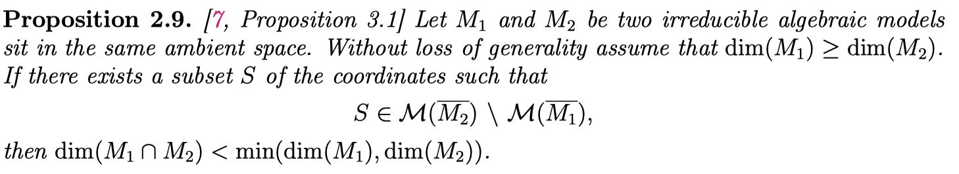
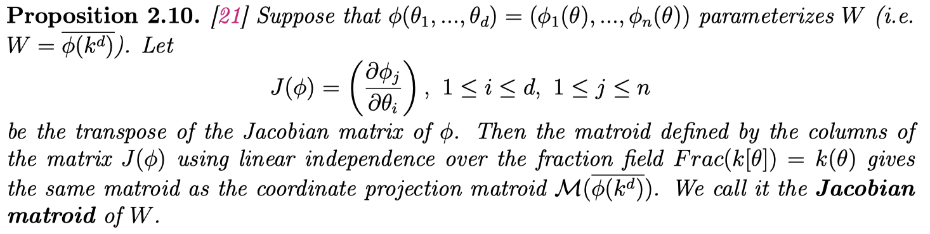
Main Approach
This allows to check generical identifiability by checking the Jacobian matroid.

Slide 9
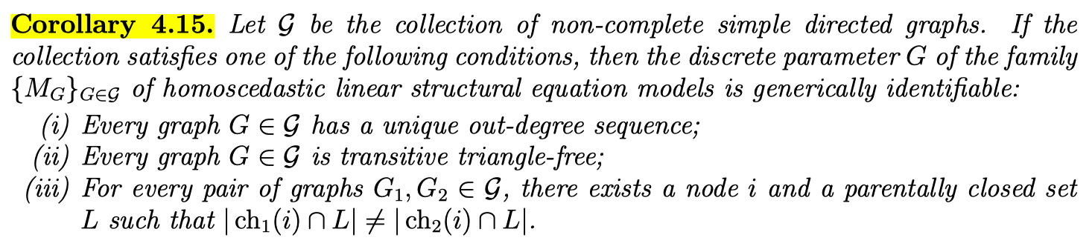
Main Results

Slide 10
Young-et-al

