Slide 1
Exploring Spam Classification Models Through Comprehensive Visual Analysis
Logistic Regression
Random
Forest
Gaussian
Discriminant
Analysis
Support
Vector
Machines
AMA2233 Data Analytics & Visualization
Huang Jingxian 23096649d
Wang Xinrui 23099603d
Yang Jingwen 23100669d

Slide 2
Project Structure

Slide 3
Project Structure
Conclusion
Evaluation
& Limitation
Ⅵ
Model Performance &
Comparative Analysis
Ⅴ
Methodology
Ⅳ
Data Collection
& Description
Ⅲ
Ⅱ
Introduction
Ⅰ

Slide 4
Ⅰ. Introduction
Ⅱ. Data Collection & Description
2.1 Data Collection
2.2 Raw Data Visualization
Ⅲ . Methodology
3.1 Data Preprocessing
3.2 Model Training & Evaluation
3.2.1 Literature Review for Models
3.2.2 Experimental Procedure
Ⅳ. Model Performance & Comparative Analysis
4.1 Model Results & Visualization
4.2 Decision Boundaries & Insights
Ⅴ. Evaluation & Limitation
Ⅵ. Conclusion

Slide 5
Ⅰ. Introduction

Slide 6
Ⅰ. Introduction
Background of Spam Detection
Machine Learning Models for Spam Detection
- focus on small enterprise
- computational cost/complexity
logistic regression
gaussian discriminant analysis
support vector machine
random forest

Slide 7
Ⅱ. Data Collection
& Description
2.1 Data Collection
2.2 Raw Data Visualization

Slide 8
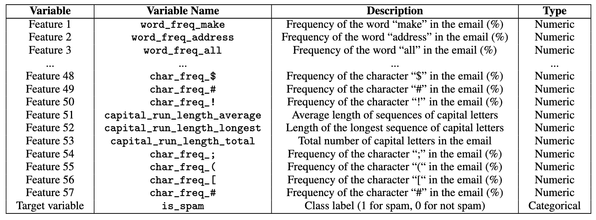
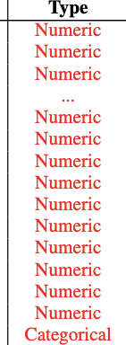
2.1 Data Collection
- Dataset: Spambase dataset from UCI Machine Learning Repository.
- Data Size: 4,601 email messages labeled as spam (1) or non-spam (0).
- Features: Total of 57 features extracted from email content.
Categories:
- Word-related features: Frequencies of specific words like "make," "address," "all.
- Character-related features: Frequencies of characters like $, #, !.
- Capitalization-related features: Metrics such as average length, longest sequence, and total number of capitalized letters.

Slide 9
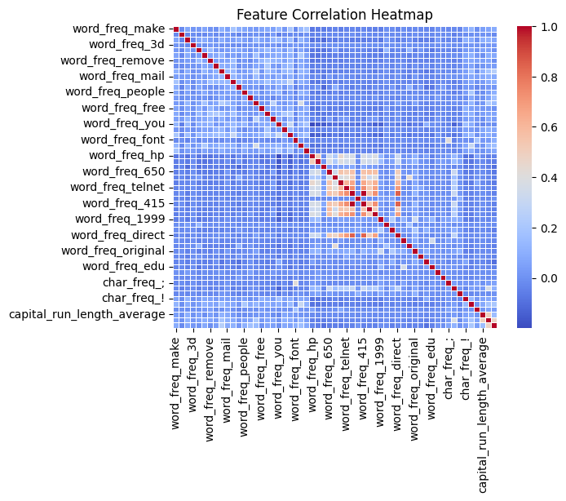
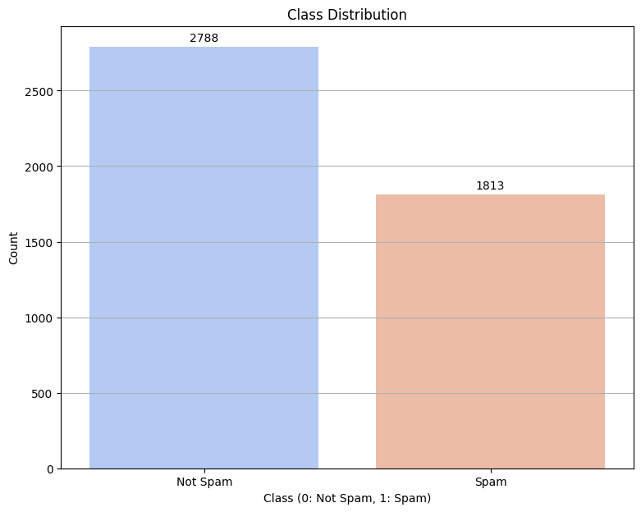
2.2 Raw Data Visualization
After Scaling/Normalization…
- Class Distribution Plot (bar chart)
- Feature Correlation Plot (heatmap)

Slide 10
Ⅲ. Methodology
3.1 Data Preprocessing
3.1.1 Feature Selection (LASSO)
3.1.2 Processed Data Visualization with Dimensional Reduction (PCA)
3.2 Model Training & Evaluation
3.2.1 Literature Review of Models
3.2.2 Experimental Procedure

Slide 11
3.1 Data Preprocessing
3.1.1 Feature Selection (LASSO)
Lasso Regression (L1 regularization)
- Identifies most relevant features.
- Prevents overfitting by simplifying the model.
With Cross-Validation
- Ensure reliable feature selection
Results: Retained 55 out of 57 features.
when k=5

Slide 12
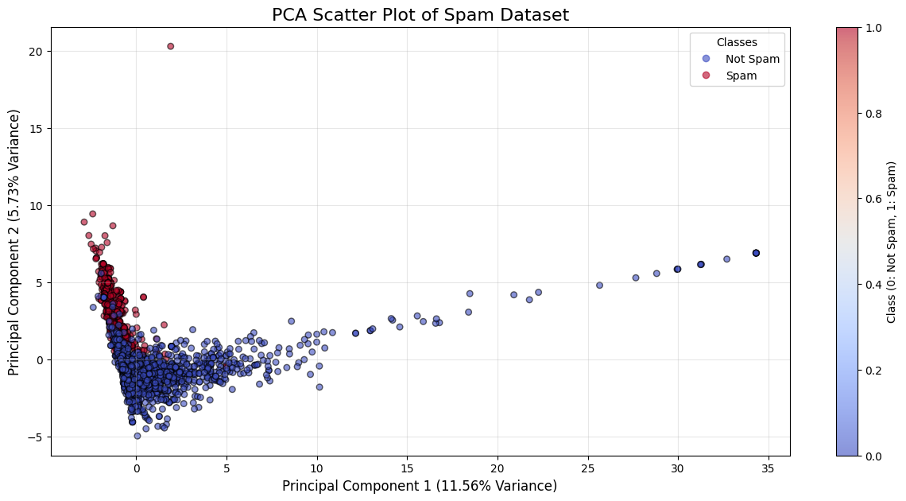
3.1 Data Preprocessing
3.1.2 Processed Data Visualization with Dimensional Reduction (PCA)
Principal Component Analysis (PCA) with 2 principal components
- Provides insights into feature relationships and aids classification optimization
Captures maximum variance.
- Reduced dataset complexity while preserving essential characteristics
Enables effective 2D visualization.
- Enhanced interpretability and performance of spam detection algorithms

Slide 13
3.2 Model Training & Evaluation
3.2.1 Literature Review for Models
Machine Learning in Spam Detection: Supervised/Unsupervised…
Reason for Model Selection:
- Proven effectiveness and suitability for spam classification.
- Address challenges like feature distributions, high-dimensionality, interpretability, and robustness.
Logistic Regression
Random
Forest
Gaussian
Discriminant
Analysis
Excluded Models:
- Deep Learning: Requires extensive labeled data and computational resources.
- Naive Bayes: Too simple; lacks complexity for nuanced spam detection.
Support
Vector
Machines

Slide 14
3.2 Model Training & Evaluation
3.2.1 Literature Review for Models
Use: Uses the sigmoid function to model the relationship between variables with probabilistic outputs.
Pros: Offers interpretability and efficiency.
Cons: Linear boundaries; Feature dependency; Feature engineering.
Logistic Regression
Use: Assumes features follow a multivariate Gaussian distribution to model probabilities and classify data.
Pros: Handles normally distributed features well; provides insights into feature relationships.
Cons: Non-Gaussian features; sensitive to the feature assumption.
Gaussian
Discriminant
Analysis
Support
Vector
Machines
Use: Identifies an optimal hyperplane for classification and can handle high-dimensional data effectively.
Pros: High accuracy; High-dimensional spaces; kernels flexibility.
Cons: hyperparameters and kernels tuning; computationally intensive.
Use: Ensemble learning method combining multiple decision trees for robust classification.
Pros: Robust against noise; reduces overfitting; evaluates feature importance effectively.
Cons: Computationally intensive; optimization required.
Random
Forest

Slide 15
3.2 Model Training & Evaluation
3.2.2 Experimental Procedure
Dataset Splitting
Splitting ratio: 90/10, 80/20, 70/30
Models: Logistic Regression, Gaussian Discriminant Analysis, Random Forest, Support Vector Machine.
With/without Cross Validation
Model Training & Testing
Performance Metrics Evaluation
Accuracy
Log Loss(Cross-Entropy Loss)
Confusion Matrix Analysis
Used for the best-performing model
Bar Plots: Show accuracy and log loss for each model, with and without cross-validation, across test sizes
Confusion Matrices & Analysis
Decision Boundaries & Analysis
Visualization & Analysis

Slide 16
Ⅳ. Model Performance
& Comparative Analysis
4.1 Model Results & Visualization
4.2 Decision Boundaries & Insights

Slide 17
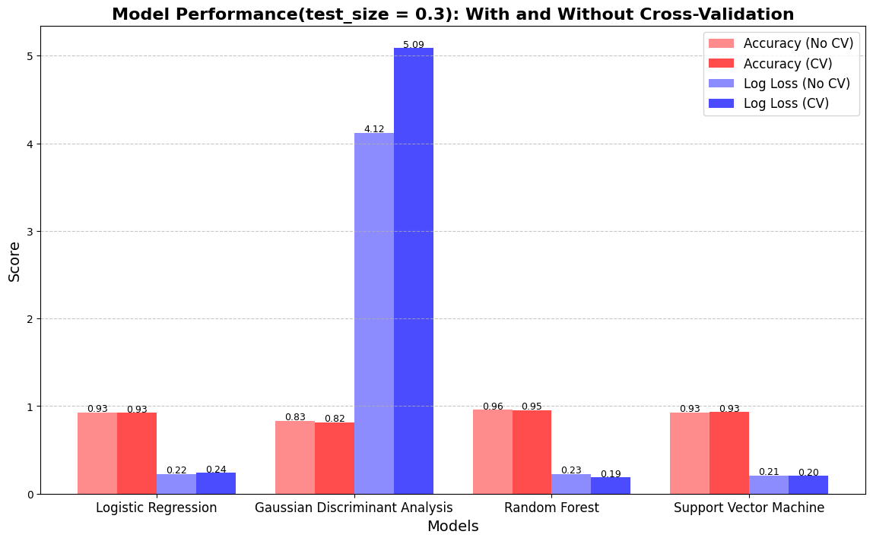
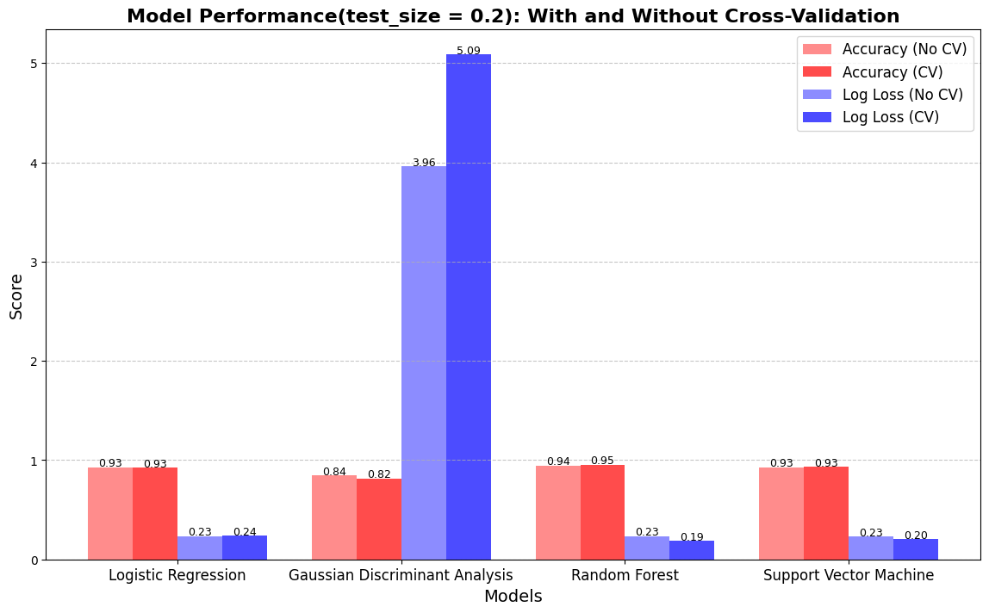
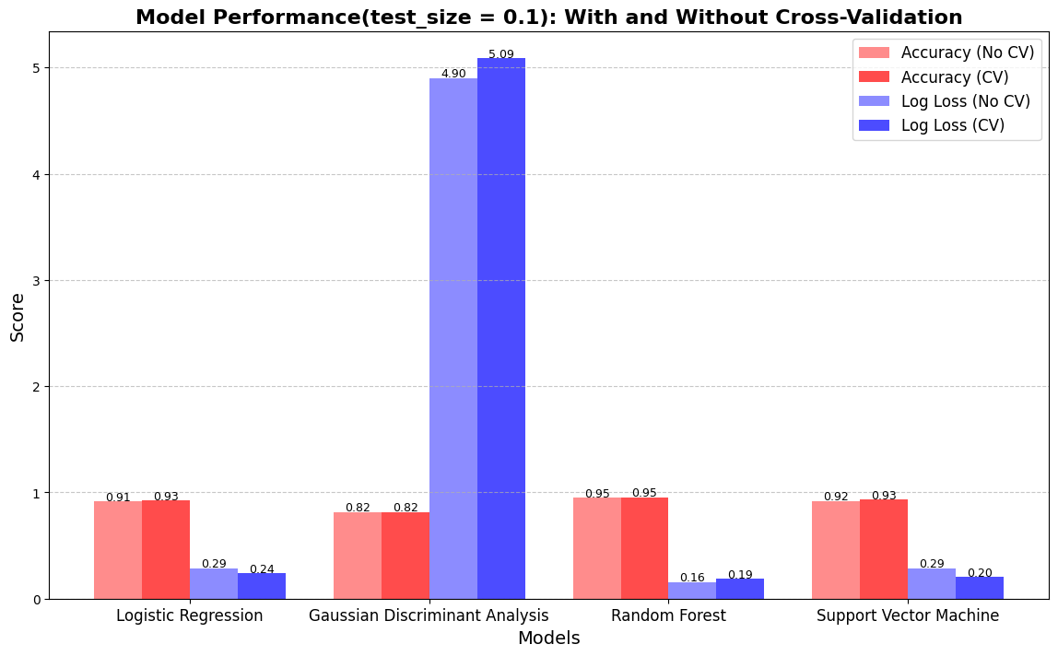
4.1 Model Results & Visualization

Slide 18
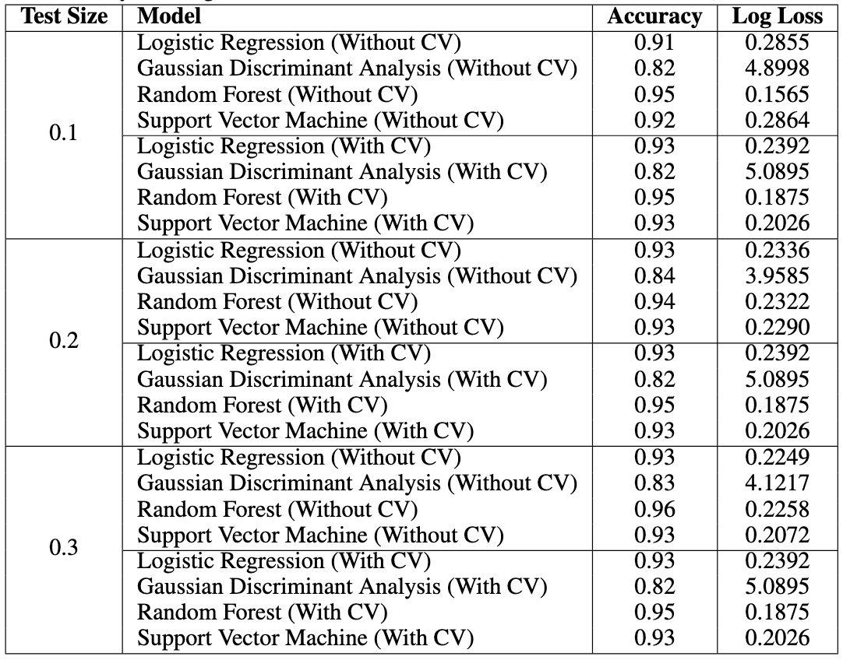
4.1 Model Results & Visualization

Slide 19
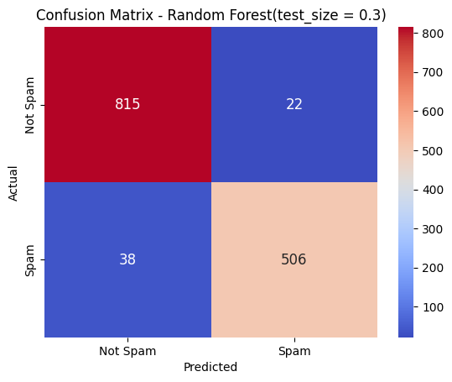

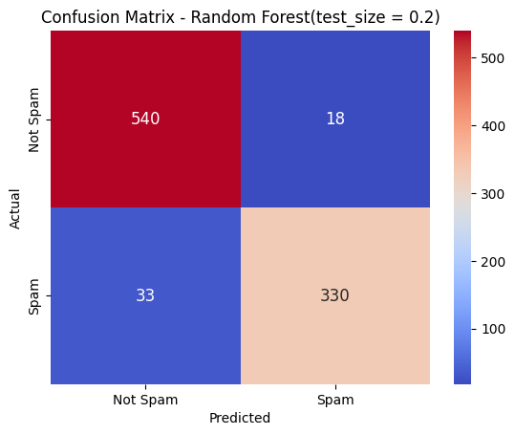
4.1 Model Results & Visualization

Slide 20
4.1 Model Results & Visualization
Overview Model Performance & Comparative Analysis
Random Forest (Best Model)
Highest Accuracy and Lowest Log Loss.
Stable performance across all test sizes.
Linear Regression & SVM
Highest Accuracy and Lowest Log Loss.
Stable performance across all test sizes.
GDA
Higher log loss, indicating limitations.

Slide 21
4.1 Model Results & Visualization
Cross-Validation Impact
Improved Performance in log loss for most models.
GDA showed increased log loss with CV, indicating poor model fit.
Effect of Test Size
Slight variations in accuracy and log loss across all models.
Random Forest showed great stability in performance even with larger test sizes (0.2 and 0.3).
Confusion Model Insights for Best Model
Strong balance between True Positives and True Negatives.
Minimal misclassification errors.

Slide 22
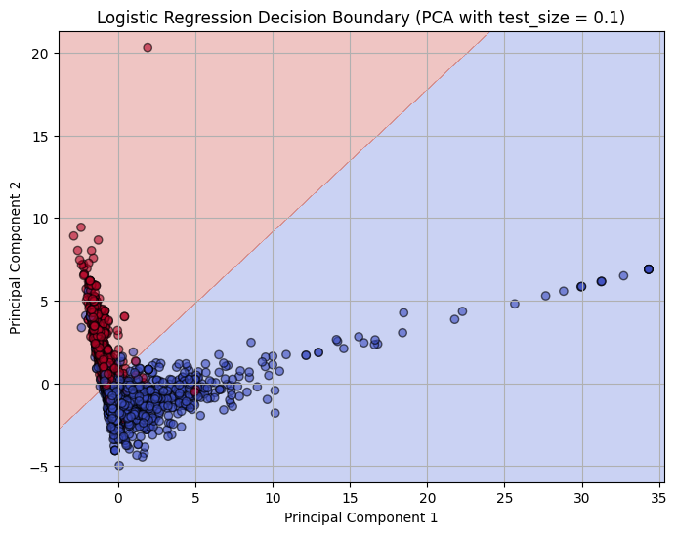
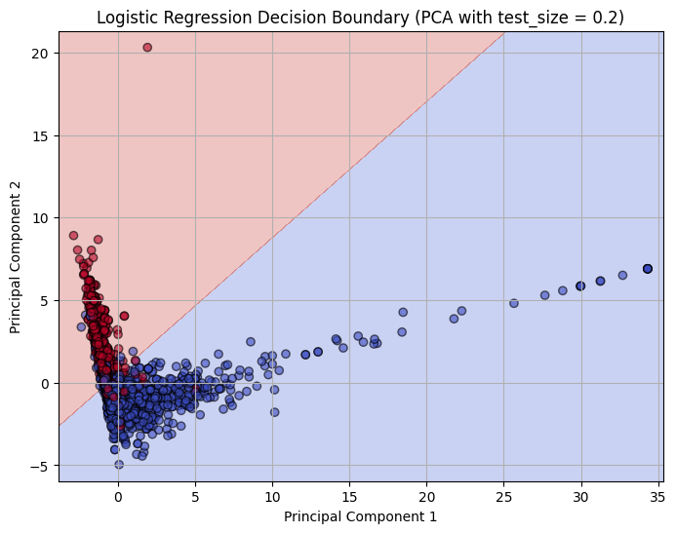
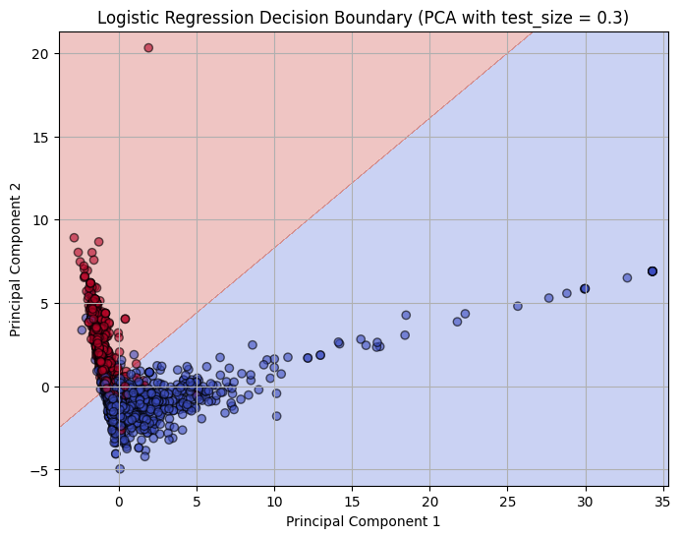
4.2 Decision Boundaries & Insights
Logistic Regression
Decision boundary improves in generalization as test size increases.
At 10%, boundary is rigid and prone to overfitting; at 30%, it becomes smoother and more balanced.

Slide 23
4.3 Performance & Result

Slide 24
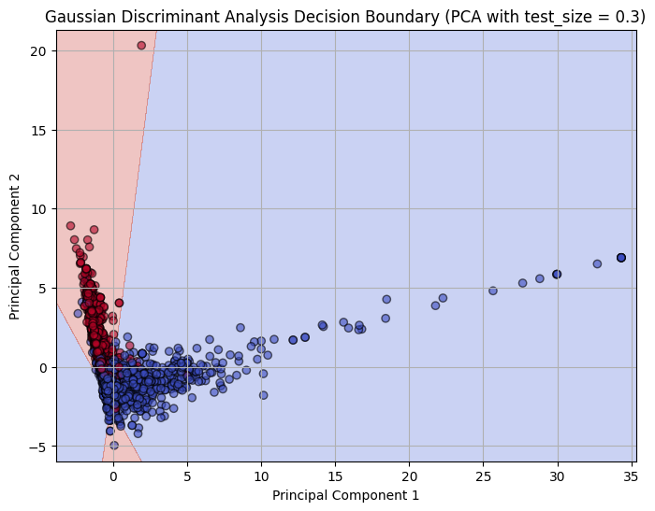
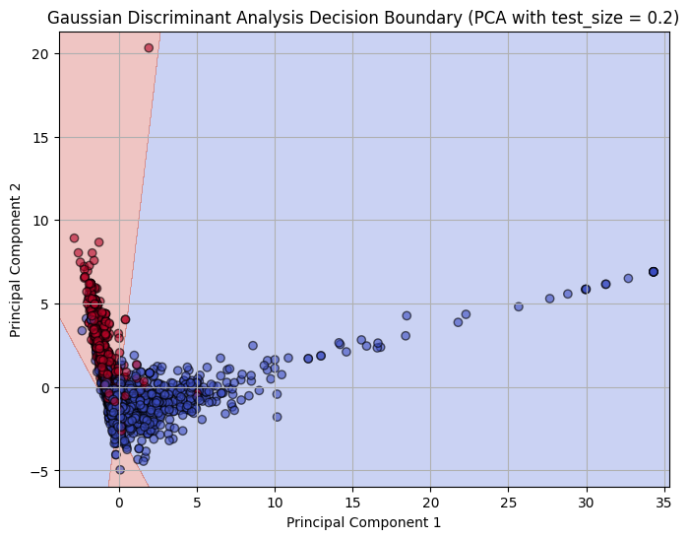

4.3 Performance & Result
Gaussian Discriminant Analysis
Performs consistently well with clear, smooth boundaries even at smaller test sizes.
Increasing test size further enhances robustness and reduces overfitting risk.

Slide 25
4.3 Performance & Result

Slide 26
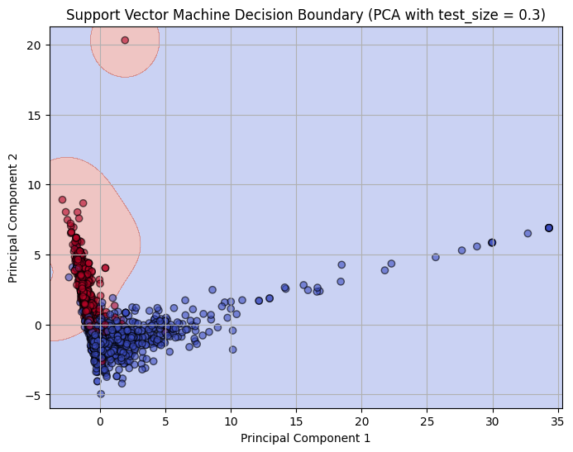
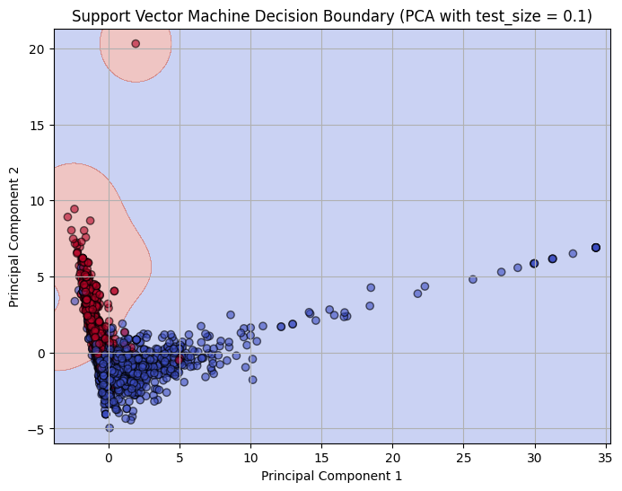

4.3 Performance & Result
Support Vector Machine
Narrow margins at smaller test sizes indicate overfitting.
Wider margins at larger test sizes improve generalization and reduce sensitivity to noise.

Slide 27
4.3 Performance & Result

Slide 28
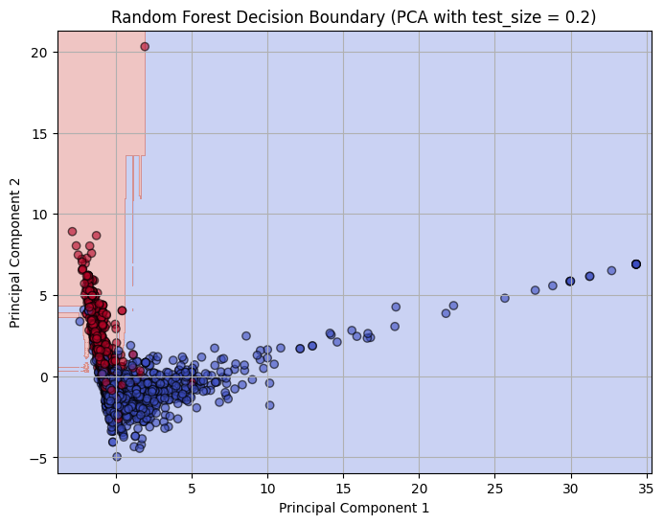
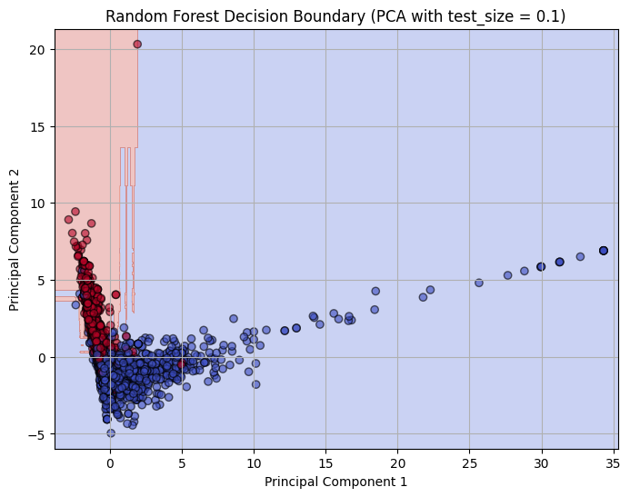

4.3 Performance & Result
Random Forest
Creates complex boundaries at smaller test sizes, showing signs of overfitting.
Larger test sizes lead to smoother, more stable boundaries, enhancing performance.

Slide 29
4.3 Performance & Result
0.1
test size
0.2
0.3
LR
GDA
SVM
RF

Slide 30
Ⅴ. Evaluation
& Limitation

Slide 31
Ⅴ. Evaluation & Limitation
Dataset Limitations
small size restrict generalizability
from late 1990
PCA Usage & Limitation
only for visualization
information loss
Model Optimization & Evaluation Methods
lack practical factors
Visualization Improvements
2D -> high-dimensional nuances

Slide 32
Ⅵ. Conclusion

Slide 33
Ⅵ. Conclusion
General Model Performance Evaluation
small size restrict generalizability.
from late 1990.
Model Selection Features
Random Forest: outperformed others in terms of accuracy and low log loss across all test sizes.
SVM and Logistic Regression: showed stable performance.
GDA: Gaussian distribution assumption not applicable to complex or high-dimensional datasets.
Real-World Application
Large Datasets: may prefer RF/SVM.
Small Datasets: may prefer LR.

Slide 34
Thank You

