Slide 1

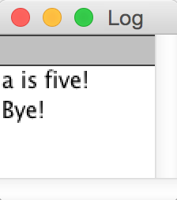
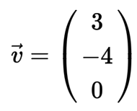
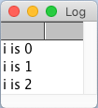
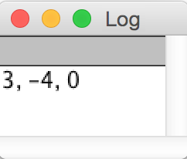
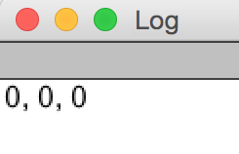
Macro language elements
String manipulation commands
output = replace(input, pattern, subst); replace any occurrence of pattern in input by subst
outputArray = split(input, separator); cut a string into a list of strings (array) according to the separator position(s)
length = lengthOf(string); returns number of characters of the string (see below for “lengthOf(array)”)
result = startsWith(input, pattern); returns true, if input starts with given pattern
result = endsWith(input, pattern); returns true, if input end with pattern
// comments for code documentation
numericVariable = 5;
stringVariable = "text value";
builtInCommand();
Operator | Description | Example all yield a = 9
= | Assignment | a = 9;
+ | Addition | a = 3 + 6;
- | Subtraction | a = 11 - 2;
* | Multiplication | a = 2 * 4.5;
/ | Division | a = 27 / 3;
++ | Increment by 1 | a = 8; a++;
-- | Decrement by 1 | a = 10; a--;
+= | Addition assignment | a = 3; a += 6;
-= | Subtraction assignment | a = 11; a -= 2;
*= | Multiplication assignment | a = 2; a *= 4.5;
/= | Division assignment | a = 27; a /= 3;
Conditions and logical operators
Operator | Description | Example for a = 2; b = 3;
<, <= | smaller than, smaller or equal to | c = (a < b); // c is 1 (“true”)
>, >= | greater than, greater or equal to | c = (a > b); // c is 0 (“false”)
== | equal to | c = (a==b); // c is 0 (“false”)
!= | not equal to¹ | c = (a != 1); // c is 1 (“true”)
a | b | “AND”: a && b (corresp. to a*b) | “OR”: a || b (~corresp. to a+b) | “NOT”: !a (corresp. to 1-a)
0 | 0 | 0 | 0 | 1
1 | 0 | 0 | 1 | 0
0 | 1 | 0 | 1
1 | 1 | 1 | 1
true || true && false → 1 + 1 * 0 = 1 (true || true) && false → (1 + 1) * 0 = 0
Math command | Description | Example all yield a = 9
pow(x, y) | x to the power of y | a = pow(3, 2);
sqrt(x) | square root of x | a = sqrt(81);
abs(x) | absolute value of x | a = abs(-9);
round(x) | rounding of x | a = round(9.4);
floor(x) | rounding down of x | a = floor(9.8);
Boolean variables:
1 means true
0 means false
Custom functions
Conditional programming (if statement)
// define a custom function
function customFunction (param) {
return param * 2;
}
a = customFunction(3); // call the function
a = 5;
if (a == 5) {
print("a is five!");
} else {
print("a is not five!");
}
print("Bye!");
Vectors / arrays
// create arrays
v = newArray(3, -4, 0);
// arrays can also hold strings
animals = newArray("Dog","Cat","Mouse");
// access individual array elements
v[0] = 3;
// NOTE: the first element has index 0!
// output arrays
Array.print(v);
// create an empty array of given size
v = newArray(3);
Array.print(v);
// combine arrays
mixed = Array.concat(v, animals);
// determine size of an array
numberOfElements = lengthOf(v);
Iterative programming (for loop)
1
2
3
1
for(i = 0; i < 3; i++ ) {
print("i is " + i);
}
1
start with this
before each loop: check & only continue if this is true
after each loop: do this
2
3
Iterative programming (while loop)
while (condition) {
// do sth at each loop iteration
// until condition is false
}
2021-05-12
Notes:
syntax highlighting colors (of Fiji for ImageJ macro, hex color values):
function: AD8000
numeric value: 6400C8
"if", "while", etc.: 0000FF
strings: DC009C
#@: 949500
operators (=, +, etc.) : 804040
brackets: FF0000
comments: 008000 (+italic)

Slide 2
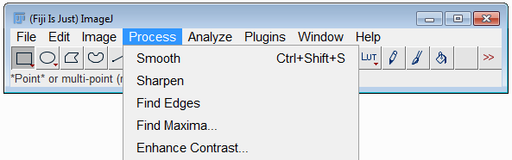
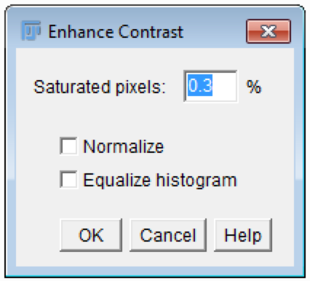
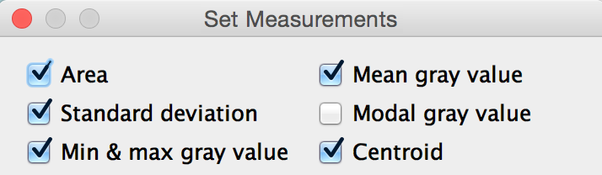
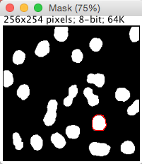
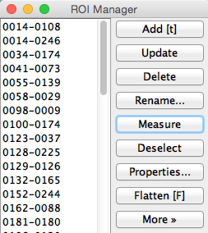
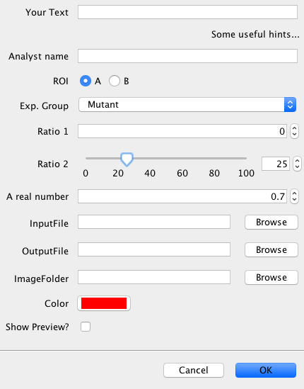
Switch between image windows
titleOfCurrentImage = getTitle();
selectWindow(titleOfAnyImage);
Calling any ImageJ/FIJI menu
run("Enhance Contrast...", "saturated=0.3 normalize")
Navigation in image stacks
Stack.getDimensions(width, height, channels, slices, frames);
Stack.setSlice(slice);
Stack.setChannel(channel);
Stack.setFrame(frame);
Stack.setDisplayMode("color"); Stack.setDisplayMode("composite"); Stack.setDisplayMode("grayscale");
ROI manager
roiManager("add"); roiManager("split"); roiManager("delete"); roiManager("reset");
roiManager("measure"); roiManager("count");
roiManager("open", filename); roiManager("save", filename); roiManager("save selected", filename);
roiManager("select", index); roiManager("select", newArray(index1, index2, ...)); roiManager("deselect");
roiManager("show all"); roiManager("show all with labels"); roiManager("show none");
roiManager("and"); roiManager("combine");
Basic image statistics
getStatistics(area, mean, min, max, standard_deviation);
Handle image files and folders
open(folder + "/" + imageFilename);
close();
fileList = getFileList(folder);
numFiles = lengthOf(fileList);
for (i=0;i<lengthOf(fileList);i++){ file = fileList[i]; open(folder + "/" + file); // actual image processing... close(); }
Result tables
run("Set Measurements...", "area mean standard min centroid"); corresp. to this:
run("Analyze Particles...", "add clear display");
roiManager("Measure");
rowCount = nResults();
value = getResult("column title", rowNumber);
setResult("column title", rowNumber, newValue);
saveAs("Results","myResults.xls");
run("Clear results");
Reading image calibration
getPixelSize(unit, pWidth, pHeight);
getVoxelSize(vWidth, vHeight, vDepth, unit);
Ask for user action
waitForUser("headline", "prompt");
Generate user interfaces with #@Parameter
Syntax: #@ <data type>(<options>) <variable name>
#@ String(label="Your Text") userText #@ String(value="Some useful hints...", visibility="MESSAGE") hints #@ String(label="Analyst name", description="Your name") analystName #@ String(choices={"A", "B"}, style="radioButtonHorizontal") ROI #@ String(label="Exp. Group", choices={"Mutant", "Control"}, style="list") expGroup #@ Integer(label="Ratio 1") r1 #@ Integer(label="Ratio 2", value=25, min=0, max=100, style="slider") r2 #@ Double(value=0.7, min=0, max=1, label="A real number") realNumber #@ File(style="open") inputFile #@ File(style="save") outputFile #@ File(style="directory") imageFolder #@ ColorRGB(value="red") color #@ Boolean(label="Show Preview?") preview
Best practices in developing software
Divide and rule Split complex issues into smaller, accessible issues If a function solves several issues, split it in separate functions.
Don’t repeat yourself (DRY) Don’t copy code if similar things are done twice, because you may copy programming errors. Program a loop or custom function instead. Maintenance is easier then.
Keep it short and simple (KISS) develop code so that others can read, understand and maintain it.
Variable and function names name functions after what they do, (verb + object). e.g.: analyzeImage() name variables after what they contain, e.g.: ("A" versus "area") assign parameter values at the beginning of the script, so you do not have to search for them once you want to change them
Useful links
ImageJ macro reference | https://imagej.nih.gov/ij/developer/macro/macros.html https://imagej.nih.gov/ij/developer/macro/functions.html
Analyzing fluorescence microscopy images | https://petebankhead.gitbooks.io/imagej-intro/content/
Forum | https://image.sc/
Macro code auto formatter | http://jsbeautifier.org/
2021-05-12
Notes:
syntax highlighting colors (of Fiji for ImageJ macro, hex color values):
function: AD8000
numeric value: 6400C8
"if", "while", etc.: 0000FF
strings: DC009C
#@: 949500
operators (=, +, etc.) : 804040
brackets: FF0000
comments: 008000 (+italic)

