Slide 1
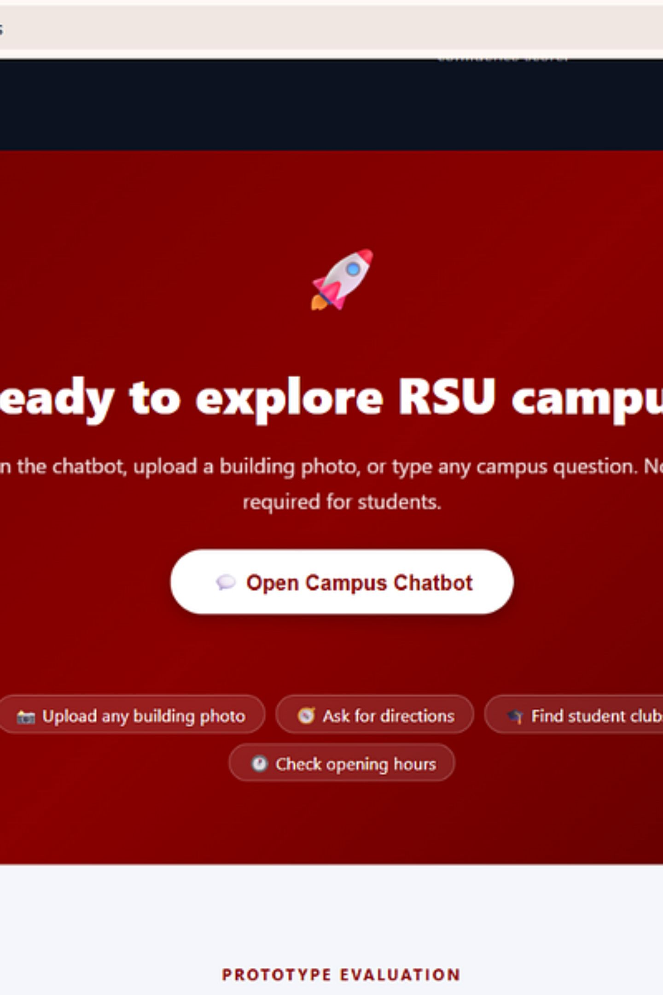

ICT105 · FUNDAMENTAL TECHNOLOGY ENTREPRENEURSHIP
RSU Campus Buddy
Smart Campus Chatbot with AI Image Recognition
Rangsit University · A capstone venture project reimagining how students and visitors navigate campus through the power of artificial intelligence.
Khin Zu Zu Oo
Min Khant Zaw
Product Lead & Technical Lead
Documentation Lead & Validation Lead
Phyo Min Khant
UX/UI Lead

Slide 2


THE PROBLEM
Campus Navigation Problems
Every semester, thousands of students arrive at Rangsit University unsure of where to go. Fragmented information and outdated resources create a frustrating experience that wastes time and reduces engagement.
Unidentifiable Buildings
Time Lost Asking Directions
New students cannot recognize or locate campus buildings without prior knowledge or guidance from others.
Students waste valuable time asking peers or searching scattered online sources for basic location information.
Scattered Information
Hard to Find Facilities
Campus data — facilities, clubs, office hours — is spread across multiple platforms with no unified access point.
Locating specific offices, student clubs, and service centers remains difficult without a smart, visual guide.
Target Users: New Students · Current Students · Campus Visitors · University Staff

Slide 3
CUSTOMER DISCOVERY
Evidence from Customer Discovery
Our team conducted structured interviews and prototype testing to validate the problem and refine our solution. The findings confirmed strong demand for an AI-powered, photo-based campus navigation tool.
User Testing Summary
5 Prototype Testers
High Task Success Rate
Positive AI Feedback
Key Suggestion
Representative users from the target audience completed guided tasks.
AI recognition and directory features received the strongest praise.
Testers recommended training more building images to improve accuracy.
Most testers completed core tasks without assistance or errors.
Research Findings
Students struggle to identify campus buildings on their own, even after weeks on campus.
Most rely on friends or Facebook groups rather than official university resources.
Users strongly prefer uploading a photo over typing or browsing manually for information.

Slide 4
OUR SOLUTION
RSU Campus Buddy - Our Solution
"Know your campus. Just snap a photo."
RSU Campus Buddy uses AI Image Recognition to instantly identify any campus building from a user-uploaded photo. Within seconds, the system delivers comprehensive, structured information — eliminating the need for manual searches or asking strangers for directions.
Building Name
Facilities
Student Clubs
Opening Hours
Floor Information
Directions
Rooms, labs, and amenities listed
Guided navigation to the location
Instantly recognized from your photo
Clubs and organizations in the building
Up-to-date operational schedules
Per-floor breakdown of spaces

Slide 5
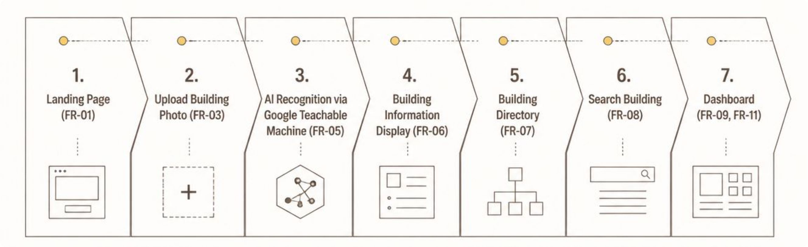


PROTOTYPE DEMO
Prototype Demonstration Flow
The RSU Campus Buddy prototype follows a clear, intuitive user journey from landing on the app to accessing detailed building information. Each step maps to a specific functional requirement, ensuring a complete and testable experience.
Functional Requirements Covered: FR-01 · FR-03 · FR-05 · FR-06 · FR-07 · FR-08 · FR-09 · FR-11

Slide 6
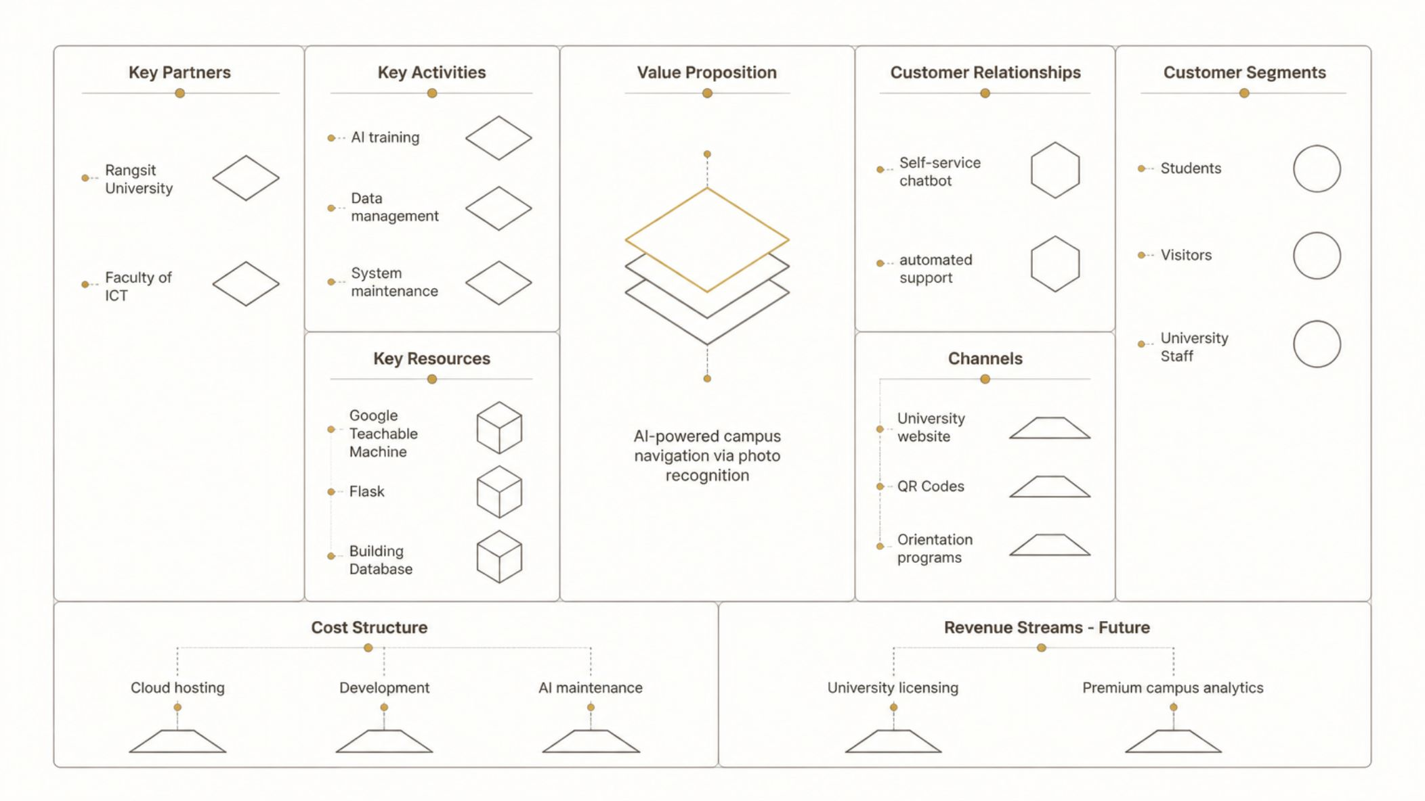


BUSINESS MODEL
Business Model Canvas
RSU Campus Buddy is designed as a scalable university service with a clear path from pilot deployment to institutional licensing. The model prioritizes user value first, with monetization emerging through university partnerships.

Slide 7
PRODUCT METRICS
Startup Metrics & User Testing
Our initial prototype testing delivered strong validation across all key performance indicators. The results demonstrate both technical feasibility and user satisfaction — a critical signal for early-stage product-market fit.
19
5
100%
5★
Buildings Mapped
Demo Testers
Task Completion
User Satisfaction
Campus buildings trained in the AI recognition model
Users who completed the full prototype flow
Most testers completed core tasks successfully
Positive feedback on AI recognition and directory
What Users Said
Key Takeaway
"Much faster than searching manually"
"The AI recognition felt magical"
"Easy to use even for first-timers"
Users consistently reported that RSU Campus Buddy was faster and more intuitive than traditional methods of finding campus information. The photo-based approach resonated strongly across all tester profiles.

Slide 8
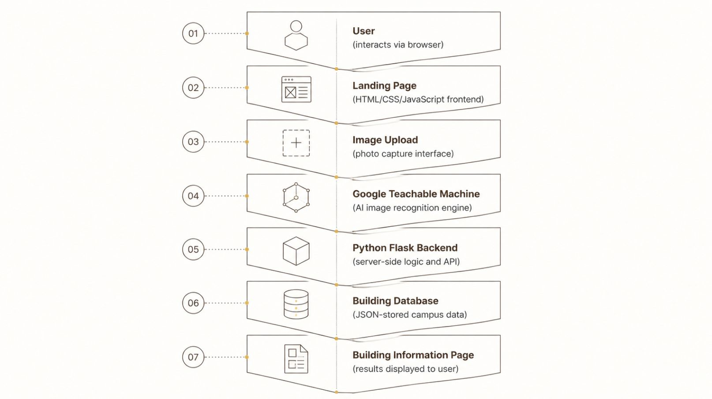
TECHNOLOGY
System Architecture
RSU Campus Buddy is built on a lightweight, modern technology stack designed for rapid prototyping and easy deployment. The architecture centers on Google Teachable Machine for AI recognition, with a Python Flask backend orchestrating data flow between the user interface and the building database.
Frontend
HTML5 & CSS3
JavaScript (interactive UI)
Responsive design for all devices
Backend & AI
Python Flask (web server)
Google Teachable Machine (image classifier)
JSON Database (building records)

Slide 9

ROADMAP
Future Development
RSU Campus Buddy is a living product. Based on user feedback and technical learnings from our prototype, we have defined a clear roadmap to evolve the platform from a capstone project into a full-scale university navigation solution.
1
2
3
4
Phase 1 -AI Accuracy
Phase 2 -Mobile & Maps
Phase 3 - Indoor Navigation
Phase 4 - Live Data
Train more building images, improve recognition accuracy, and expand coverage to all major campus structures.
Integrate with the official university database for real-time updates on hours, events, and facility status.
Launch a mobile app version with Google Maps integration for real-time, GPS-assisted outdoor navigation.
Add indoor floor-by-floor wayfinding for large buildings, helping users locate specific rooms and offices.

Slide 10

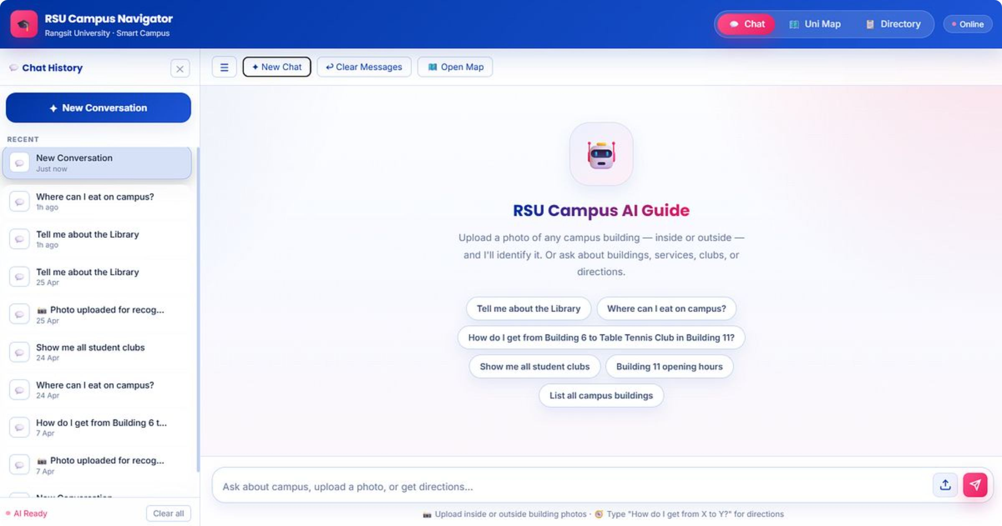
THANK YOU
RSU Campus Buddy
"Know your campus. Just snap a photo."
RSU Campus Buddy transforms campus navigation using AI Image Recognition, making it easier for students, visitors, and staff to explore Rangsit University. What began as a capstone project has the potential to become a lasting institutional tool — one photo at a time.
🎓 Rangsit University
🤝 Our Team
ICT105 · Fundamental Technology Entrepreneurship
Khin Zu Zu Oo · Min Khant Zaw · Phyo Min Khant
❓ Questions & Answers
We welcome your feedback and questions

