Slide 1
Apollo LogiSolutions
ALS CRM Tool
Nov, 2018

Slide 2
ALS CRM In-House Solution
ALS CRM Solution In-House developed web based solution on Microsoft Technology Stack
Customer , Opportunity & Lead Management, Meetings and Conveyance Claims.
Competitor Intelligence and Communication Management
Opportunity Qualification – Approval based
Proposal Ratification by Stake Holders – Legal, HR, IT, Finance , Operations, Sales
Captures all 7 stages of CRM.
Multi Tenant – Caters to different workflows for specific verticals
Access control rights and Admin panel for Sales Team.
CRM Dashboard – Web Based.
Live for all verticals ALS SCS, ALS FFD, Infra, Liquid Logistics
ALS CRM Solution Business Case
Current user count - 25 across verticals.
Cost Saving per month - INR 50K.
On Premise Data repository – No Data storage charges.
Complete visibility of Sales Performance to the management.
Historical CRM data available for Analytics.

Slide 3
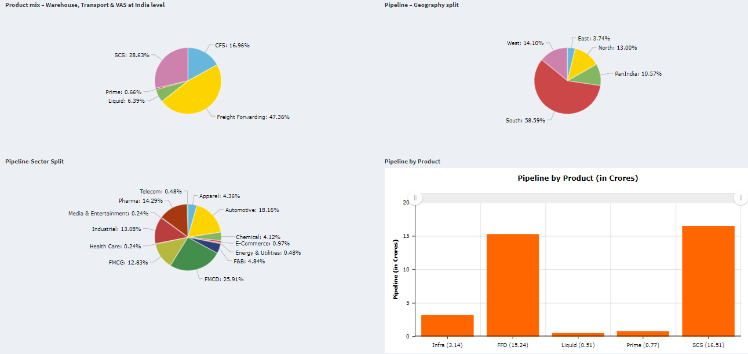
ALS CRM Dashboard

Slide 4
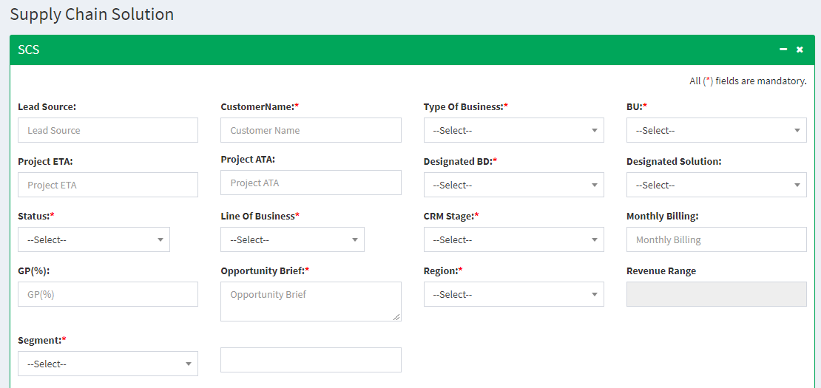
CRM – Lead Creation

Slide 5
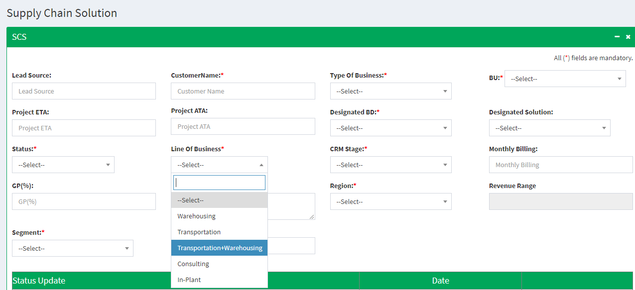
CRM- Line of Business Options

Slide 6
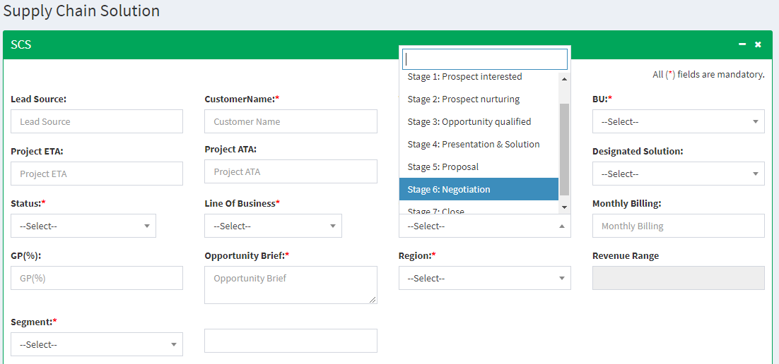
CRM – Stages

Slide 7
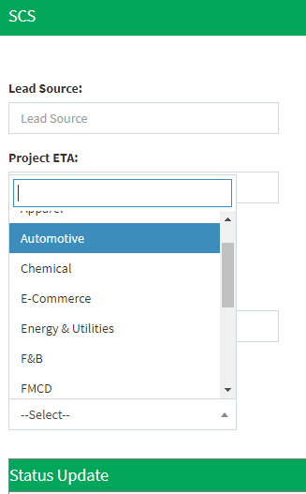
CRM- Segments
Segments:
Apparel
Automotive
Chemical
E-commerce
Energy & Utilities
F&B
FMCD
FMCG
Healthcare
Industrial
Media & Entertainment
Pharma
Telecom
Others

