Slide 1



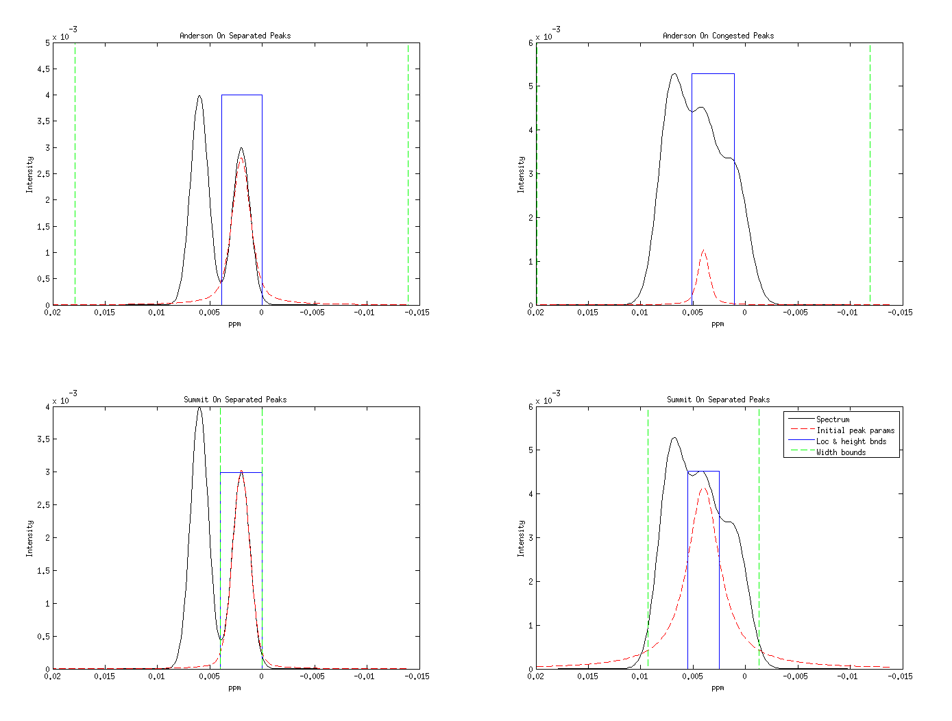
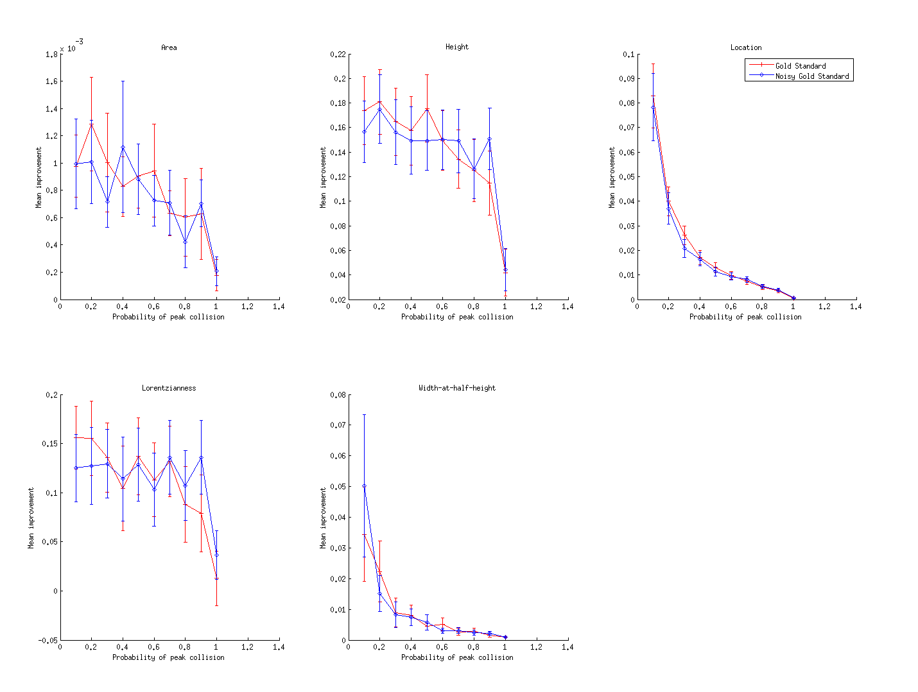
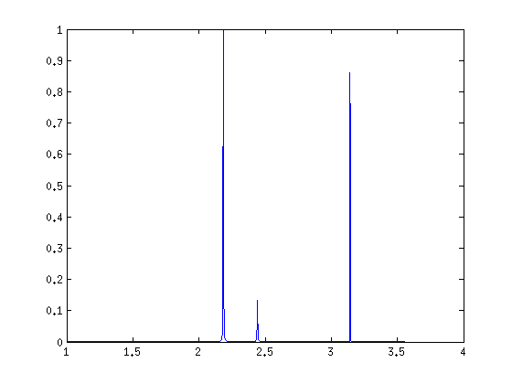
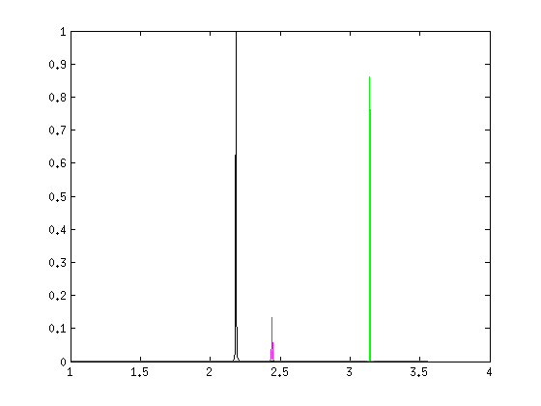
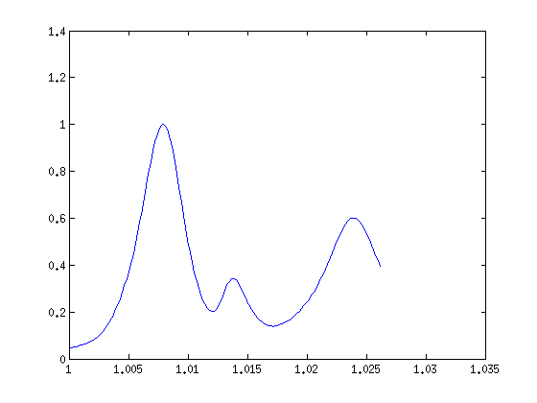
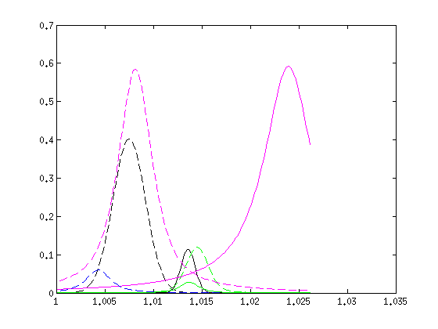
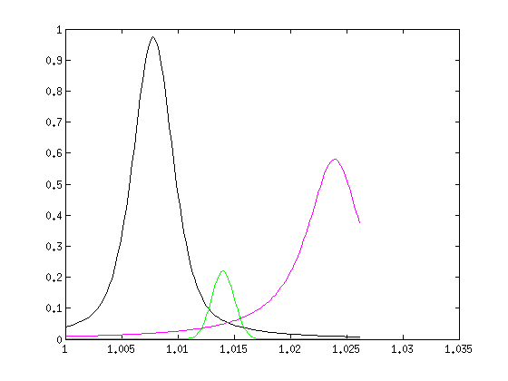

Improving automatic peak parameter determination in crowded NMR spectra by using summit-focused parameter initialization
Eric Moyer & Michael Raymer Bioinformatics Research Group, Kno.e.sis Center, Wright State University, Dayton, OH USA
1. Overview
4. Our Improvement
6. Resutls
We improve an algorithm that extracts peak shapes from simulated congested spectra. Congested spectra are commonly encountered in analysis of biological samples.
Contributions:
Improved optimization initialization with tighter bounds and better starting points to avoid local minima.
Significantly better extraction of all fundamental and derived peak-shape parameters
Summit contains most information
2. The Problem
Extract parameters for the Lorentzian functions that make up each peak
Humans naturally try to fit the peaks by looking at the top of each visible peak in turn and mentally subtracting it. We don't try to deal with all the interactions at once nor do we focus on the tails very much at all.
This is a good strategy because the signal for each peak is strongest near its summit. These points maximize SNR (signal-to-noise ratio) with respect to random noise and also distortions caused by nearby peaks.
For each peak take a small number of samples around the initial maximum.
Fit only the model for that peak and only to those samples around the maximum
After fitting a peak, subtract is contribution from the spectrum fitted by later peaks.
Fit the peaks in order of increasing height - otherwise the tails from the larger peaks can overwhelm smaller peaks. Repeat previous steps 2x to stabilize results.
Set search bounds: Location: midpoint between this peak and its neighbor Height: 0 and the maximum within the location bounds Width: 0 and 75%-ile of estimated widths + 3 * inter-quartile range. Lorentzianness: between 0 and 1 (same as Anderson)
The charts above indicate likely improvement in all parameters including the important derived parameter: area.
To verify our results, we used T-tests with a Holm-Bonferroni multiple test correction to bring the family-wise error to 0.05 (95% significance).
Two sets of tests were done - one for improvement, the other for worsening. Because of worsening and improvement are mutually exclusive, there is an implicit dependence so each set got its own test correction.
All 100 combinations of peak property, picking method and interval width except one had significant improvement with our initialization. The exception was Lorentzianness for the gold standard and the most congested interval.
No combination had a significant worsening.
Difficult when spectra are congested. Which is the correct extraction?
Or
5. Experiment
Simulated spectra let us generate more spectra and gives us known peak parameters so we can calculate the errors of the extracted parameters.
Location parameters uniformuly distributed over the interval.
Non-location peak parameters derived from MetAssimulo's standards database
7 peaks per spectrum (the maximum with acceptable calculation times)
10 spectral widths give different levels of congestion. 10%, 20% … 100% chance of peak merging better than 99.98% chance that +/- 0.4%
Peak pickers Gold standard – correct peak locations input Noisy Gold standard – gold standard + noise simulating human expert
1200 spectra generated and 4 sets of params extracted for each: one for each combination of picker and initialization method
7. Future Work
Add fully automatic peak-picking. It has more complicated behavior(and likely improves less than the methods we've presented so far) . It requires additional data to fully evaluate.
Assumptions underlying significance tests need to be verified. They meet the standard rules of thumb for Normal approximation, but it is good practice to check and use nonparametric statistics if necessary.
3. Solution
In 2012 Anderson et. al. presented an approach that models the spectrum as a sum of Gauss-Lorentz peaks and uses nonlinear optimization to find solutions that are close to the original spectrum in the least-squares sense. He uses a peak-picking routine to generate an initial estimate of peak modes. Then he generates an initial value and search bounds from those modes before finally doing the optimization.
Acknowledgement: This work is sponsored by an award from the Henry M Jackson Foundation

