Slide 1
Quantification
Paul Anderson
Last updated: 11/4/2009

Slide 2
A word from your computer scientist
The quantification program is still under development. That has both advantages and disadvantages. The disadvantages is that the documentation always lags behind the program, and that you may encounter bugs. The advantage is that you can influence the development of the project. Think of a bug or annoying task as an opportunity to suggest improvements. One feature that I hope to add soon is the ability to lookup metabolites using the Human Metabolome Project. I also want to encourage anyone reading this document to edit it or even add new documentation.

Slide 3
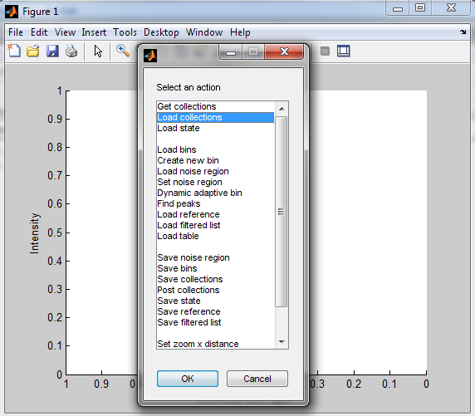
Loading data
Data is loaded and stored in the program as collections (i.e., just like the website). There are two different methods for loading data into the quantification MATLAB program.
Right now there is no way to unload a collection from the program (you just have to start over again).
Go into the “quantifications” folder and type “main” to bring up this window:
Be a little patient if loading a number of spectra
Directly from the website using a collection’s ID
From a tab-delimited zip/txt file

Slide 4
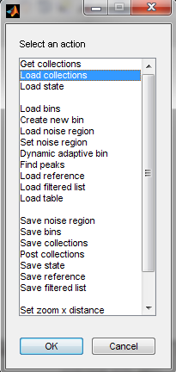
Bin boundaries
After loading data into the program, you must define bin boundaries prior to quantification. This is the case even if the objective is deconvolution. There are three options to creating bin boundaries:
Dynamic adaptive binning
Manually
Combination of dynamic adaptive binning and manually
If you already know a subset of peaks that you are interested in quantifying (i.e., a targeted approach), then the manual option is your best option.
If you are analyzing an entire spectrum (i.e., global approach), then the combination is your best option.
Manually create a new bin
Run the dynamic adaptive binning algorithm
After you have created a set of bin boundaries, it is important to save this information
for future analysis. You can then load these bin boundaries by selecting ‘Load bins’ from this menu.

Slide 5
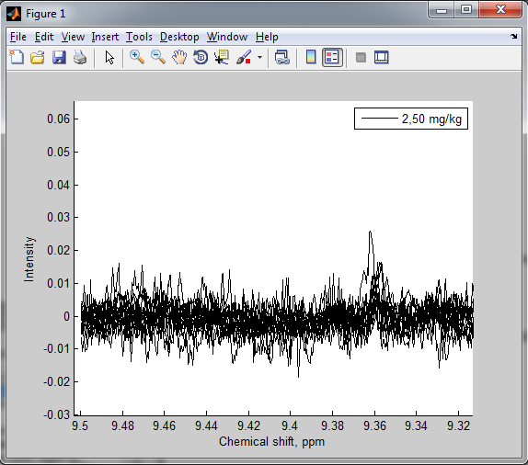
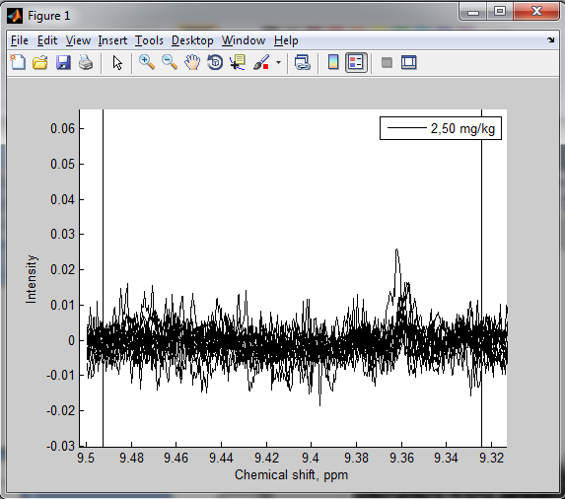
Preconditions
To use the quantification algorithm, some preconditions must be met:
Noise region must be set
Reference spectrum must be set (only necessary if using deconvolution) [COVERED ON NEXT SLIDE]
Procedure
Zoom into a region of the spectrum that contains only noise
Create and adjust the noise cursors
Set/save/load menu options

Slide 6
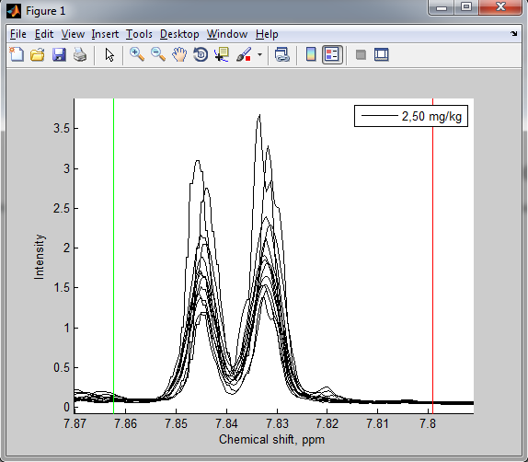
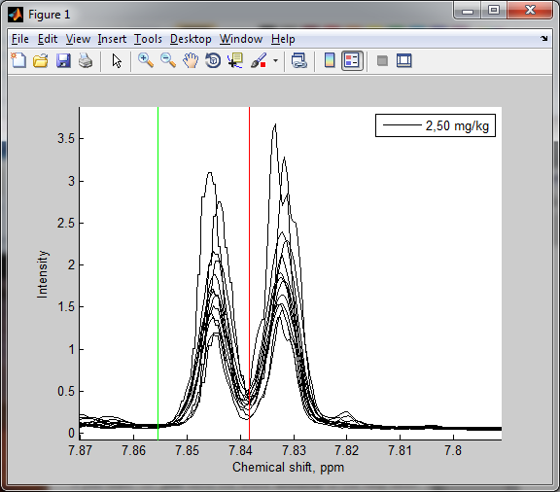
Manually creating bin boundaries
Zoom into the area that you want to bin, then select ‘Create new bin’ from the menu. The new bin will then be created, where the start and end of the bin are shown in green and red colors, respectively.
Now adjust the bin boundaries as you desire.

Slide 7
Keyboard shortcuts
When you are creating and viewing bins you might find several keyboard shortcuts useful.
Move (shift) your view by using the arrow keys.
Zoom on the x-axis by using page-up/page-down keys
Zoom on the y-axis by using the home/end keys
To reset the display (i.e., zoom completed out), hit the ‘r’ key.
It is also important to note that none of the commands will work if you have one of the MATLAB tools selected (e.g., the
magnifying glass).

Slide 8
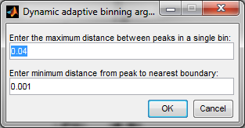
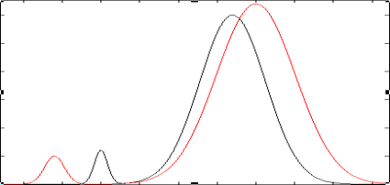
Dynamic adaptive binning
The dynamic adaptive binning algorithm is designed to automatically intelligently bin spectra. A manuscript describing it is in preparation for submission. It has two user-friendly parameters that are important to understand:
The minimum distance from a peak to the nearest boundary determines what level of congestion is allowed when determining bin boundaries. A larger number leads to fewer bins, but it also increases the likelihood that bins will contain more than one peak from each spectrum.
The maximum distance between peaks in a single bin determines the maximum width of a bin. In the example to the right, the first two peaks are binning separately because the distance between them is greater than this threshold.
Take home message: These parameters are set based on your preferences. Don’t forget that you can adjust the bin boundaries manually at a later time.

Slide 9
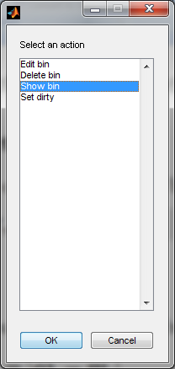
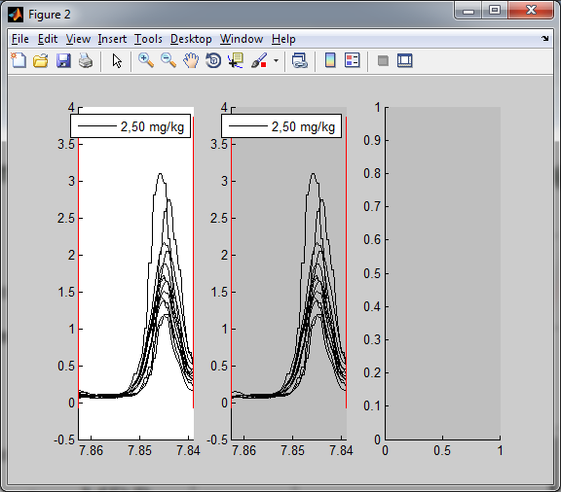
Selecting the type of quantification for each bin
The program allows you to specify a different type of quantification for each bin. The three choices are (1) bin summation, (2) smart binning, and (3) deconvolution. The default type for each bin is summation. To change this for a specific bin, right click on the bin boundary and click ‘Show bin’. Edit bin allows you to edit bins that have been loaded from an external file. ‘Set dirty’ forces the bin values to be recomputed for this bin. You “shouldn’t” have to use this option.
Summation
Smart
Deconvolution
You can select a different type of binning, by clicking on that screen.

Slide 10
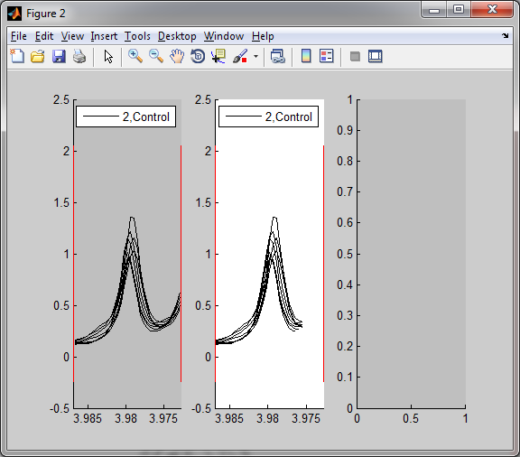
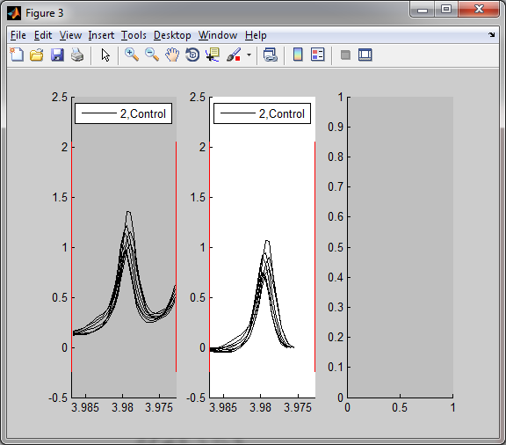
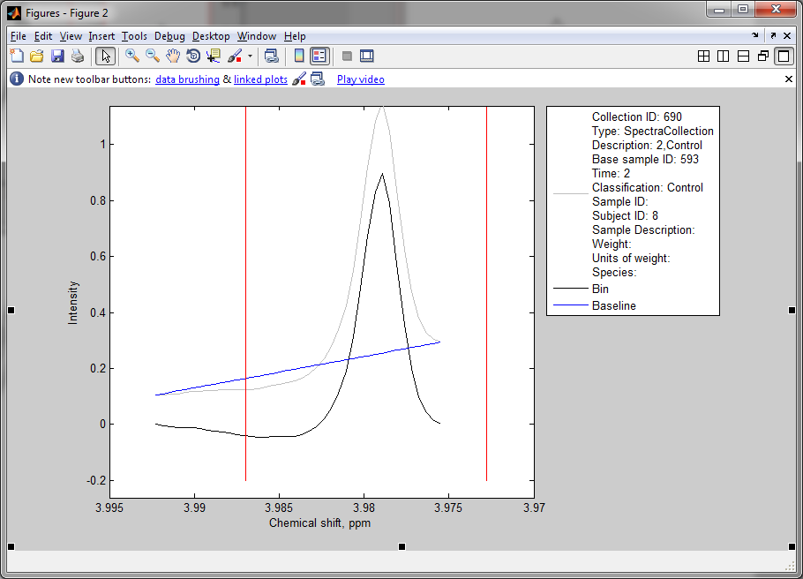
Smart binning
Smart binning tweaks the summation binning. Improved summation binning. I’m hoping to run some analysis on some synthetic data to show the advantageous and any potential problems with these tweaks.
The first tweak that is always applied when using smart binning is adjusting the bin boundaries for each spectrum independently. These are adjusted to the location of the first and last minimum inside the bin boundaries. The goal is exclude adjacent peaks from the bin value. Here is an example.
In addition to providing specialized boundaries for each spectrum, the smart binning algorithm also provides simple baseline adjustment. There are two options that are allowed by right-clicking on the smart binning window: (1) Fit endpoints and (2) Fit minimum (i.e., horizontal baseline). Here is the result of fitting endpoints. Notice how the slight incline in the bin is now removed. You can examine each spectrum individually by clicking on it.

Slide 11
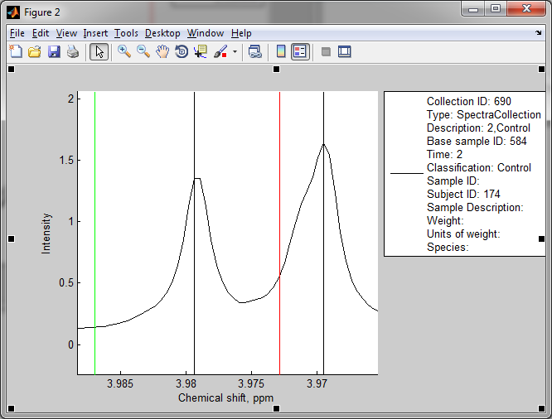
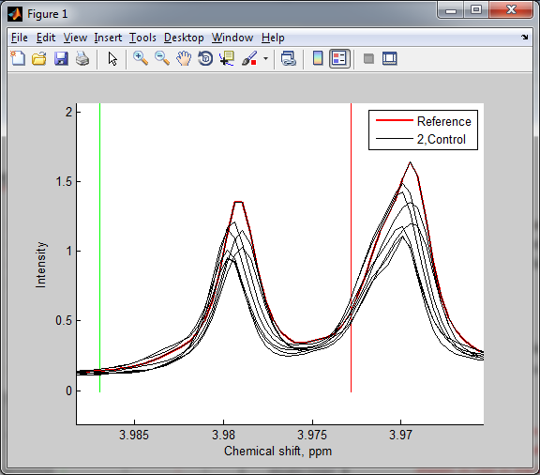
Deconvolution
Deconvolution is a much more involved procedure than binning. However, to activate it is very simple. Just click on the third window and after showing a bin. The deconvolution is automatically computed if there reference has been set. The reference is essential to the deconvolution. It is used for alignment and matching, and it should the same reference should be used throughout the experiment. A reference consists of two parts:
Spectrum (x,y data)
Peak locations
To define a reference, just right click on any spectrum in the main window. This will popup a new window displaying just this spectrum. This graph will show the spectrum along with all the peak locations displayed with black lines.
To set this spectrum as a reference just right click on the plot of the reference peak and select ‘Set as reference’. The reference will then be shown in red in the main window.

Slide 12
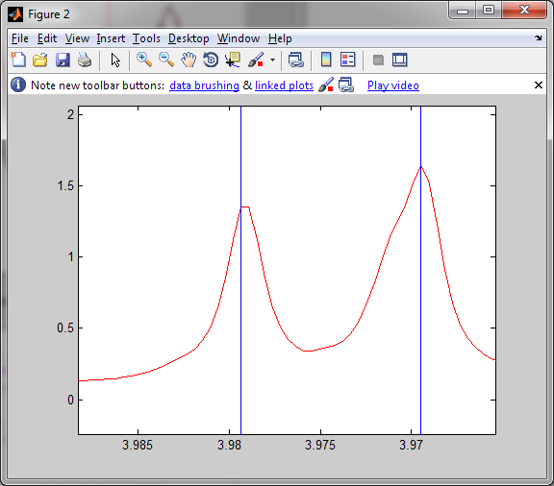
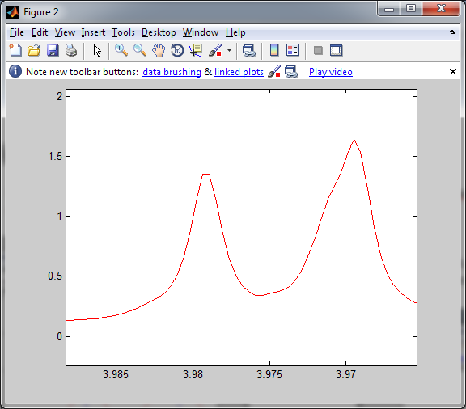
Adjusting the reference
It may be necessary to customize the reference as you explore your deconvolution. To customize the reference select ‘Show reference’ from the main menu.
From here you can delete and add peaks to the reference by right-clicking on a peak or clicking on the plot, respectively.

Slide 13
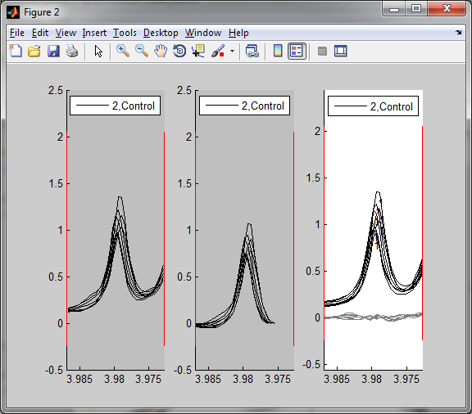
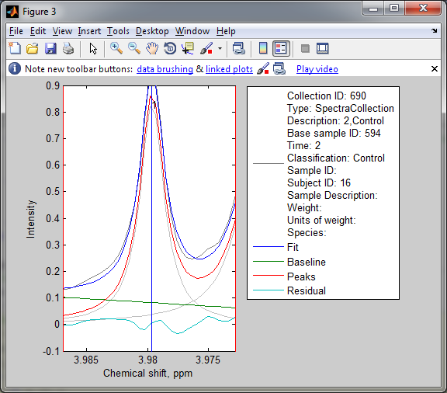
Examining the deconvolution
It is very important to examine the deconvolution for problems. Here is a checklist of things you should check before accepting the deconvolution. Check these by clicking on the denconvolution window, which will open up a figure that you can edit. Scroll trough each spectrum using “j” and “k” keys.
Check to see if all of the fits converged. This is easily spotted in the main MATLAB window or by watching for dashed lines in the plot.
Check the residual to see if it is acceptable. The residual is shown in gray on the plot. The other lines in the window show the model that was created for each spectrum.
Make sure the peaks in the bin are matched correctly. An incorrect match can be fixed by adding/removing peaks from either the reference or the individual spectrum. To check this you want to zoom in on each of the peaks and match sure the numbers are correct.
As a final check it is a good idea to click on each of the lines in the plot to get a clearer picture of the model.
If you are satisfied with the fit, click on the spectrum to get the “select an action” box and select “save collections”. This will prompt you to save in a directory of your choice. This is the integral data, and is a text file

