Slide 1
CEUR-WS Analyzer
TBDM Project
02.07.2024
Simon, Aron & Pierluigi

Slide 2
Content
Project description / objectives
Methodology and technology being used
Technical implementation
Achieved results
Possible future improvements

Slide 3
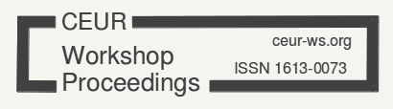

Project description / objectives
Objectives
Extract data from CEUR website
Store it in a NoSQL Database
Visualization with analytical tools
Implement LLM for Q&A
Author
Title
Year
Lack of Search functionality
Notes:
This project is part of the "Technology for Big Data Management" course. It aimed to develop a method to analyze the website of CEUR-WS website. This site hosts volumes of scientific papers that are available for download in zip format. The homepage displays papers like a library, showcasing metadata such as author, volume, and title, and allowing papers to be downloaded as PDFs. However, the website lacks a search functionality to filter content by topic, title, or other metadata. Our objective was to solve this problem by extracting data from the website, storing it in a database, and analyzing it with an analytical tool like Tableau. Additionally, we aimed to provide an interactive way to explore the website's content, including the PDFs, through a Large Language Model (LLM) that could respond to natural language queries about the content.

Slide 4
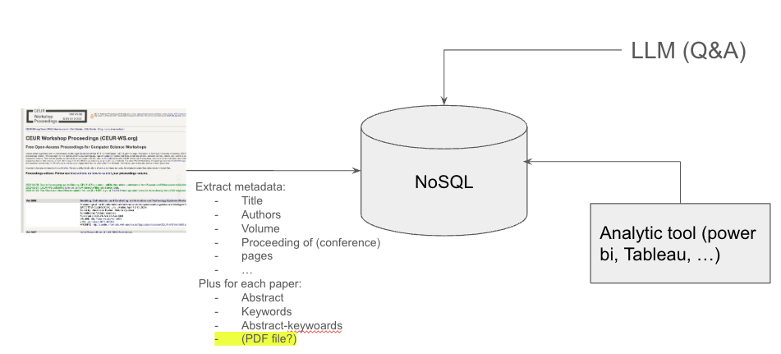
Proposed Structured

Slide 5
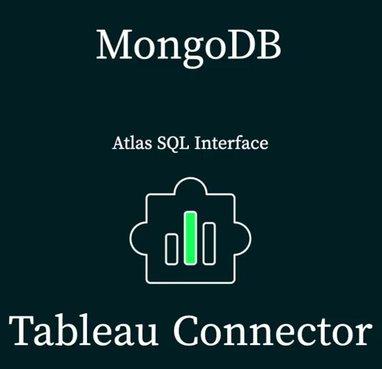
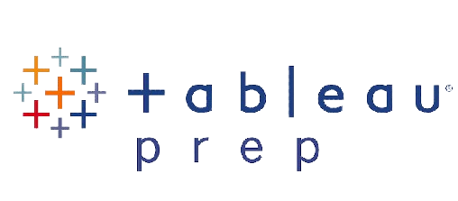

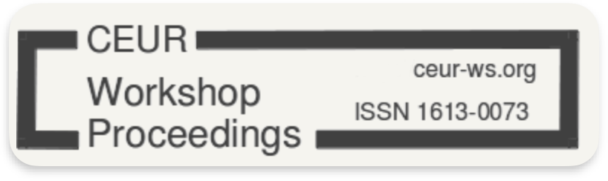






Methodology and Technology being used
Connector
Transformation
Visualization
Database
UI
Extraction
Vector Query
Q&A
Notes:
To address the initial stated objectives, we followed the proposed structure by our professor, Dr. Massimo De Donato Callisto. The solution involved importing the metadata from the CEUR website to a NoSQL database and analyzing the data with a Analytic Tool and an LLM. For data import, we used a web scraper to navigate the website and open each PDF to extract information. We utilized MongoDB for our NoSQL database. The analytical part was conducted using Tableau and Tableau Prep Builder, both connected to the MongoDB database through a Tableau-MongoDB connector. The LLM component was implemented using MongoDB's vector search capabilities and Google's Gemini LLM.

Slide 6
Technical Implementation
Data Extraction
Web Scraper
Beautiful Soup
Multithreading
New paper detection
Data Storage
Mongo DB
Collections
Volume
Papers
Vector Records
Data Transformation
Tableau Prep Builder
MongoDB Tableau Connector: MongoDB Atlas by MongoDB (JDBC driver & connector)
Data Transformation Schema
Data Analytics
VectorSearch/Gemini
Python App
VectorSearch
Pymongo
Gemini
Data Visualization
Tableau Desktop
MongoDB Tableau Connector: MongoDB Atlas by MongoDB (JDBC driver & connector)
Prebuild Tableau Dashboard
Python Script
Notes:
The system architecture consists of three main components: data extraction, data storage, and data analysis. A web scraper was developed to extract metadata and content from the CEUR website. The scraper navigates through the website, opens each PDF, and extracts the necessary information. After testing the web scraper, it now uses multithreading and parallelization of instances to speed up the process, as the initial run took too long due to the large amount of data. The scraper has also been adapted to check if a paper is new or old to the database, adding only new papers to the database in subsequent runs, significantly reducing processing time after the first run.
For data organization, we defined two main datasets: one for volumes and papers intended for Tableau analysis to minimize nested data (arrays), and another for PDF content utilized in the LLM component. Metadata formats were specified and extracted accordingly to ensure compatibility with both datasets.
Extracted data is stored in MongoDB, a NoSQL database that allows for flexible storage of semi-structured data.
For data analysis, Tableau is used for visualizing and analyzing the stored data. Nonetheless, the extracted data needed to be prepared due to the inflexibility of Tableau Desktop, which is more suited to SQL rather than NoSQL. Therefore, we used Tableau Prep to handle this part. Tableau Prep connects to the MongoDB database using a dedicated connector ("MongoDB Atlas by MongoDB" supported by a JDBC driver and connector), enabling direct usage of the data on our MongoDB collections. Tableau Prep allows for cleaning, reshaping, and organizing the data into a format compatible with Tableau Desktop. Once prepared, the transformed data can be add manually as a data source to Tableau Desktop to analyze the data. However, Tableau itself can also be directly connected to the MongoDB database using the same dedicated connector as for Tableau Prep Builder, enabling real-time data analysis and visualization. Nonetheless, these visualizations are limited due to Tableau's SQL limited funcitonalities.
To integrate the Large Language Model (LLM) into our project, we are utilizing the extracted PDF information obtained in the initial phase using our web scraper. In preparation for advanced search capabilities, we convert the extracted text into numerical vectors using MongoDB's VectorSearch, which includes techniques like word embeddings. These vectors, along with document metadata, are efficiently stored in MongoDB using Python's PyMongo library, enabling scalable data management.
With the data stored and indexed in MongoDB, our next step involves leveraging its capabilities to query and retrieve documents based on similarity metrics derived from the vectorized representations. This approach ensures that users can explore related papers or topics effectively.
To further enhance the project's analytical capabilities, we have employed Google's Gemini model. This advanced language model analyzes the retrieved documents, generating insightful summaries and facilitating a deeper understanding of their content. Gemini's capabilities extend to natural language processing tasks, enabling us to provide interactive and informative insights based on user queries.
Additionally, we developed a user-friendly LLM interface that can be embedded as an iframe within Tableau (with the website add-on in Tableau Desktop as can be seen in the pre-build Tableau dashboard) or used independently in a web browser.

Slide 7
Achieved results
CEUR website metadata and content stored in MongoDB
Interactive pre-build dashboards in Tableau for data filtering and exploration
Reusable manual data transformation schema in Tableau Prep Builder
LLM-based Querying
Usability Enhancement
Improves accessibility and searchability of CEUR research papers
Notes:
We successfully extracted metadata and content from the CEUR website and stored it in MongoDB. Interactive dashboards were created in Tableau, allowing users to filter and explore the data based on various metadata fields. A reusable manual data transformation schema was created in Tableau Prep to prepare the data for Tableau Desktop. We developed an LLM-based querying system that enables users to ask questions about the content in natural language and receive accurate responses. The implemented solution significantly improves the accessibility and usability of the CEUR website, allowing for easy searching and exploration of research papers.
By integrating these technologies and methodologies, our project not only addresses the initial challenge of enhancing search and exploration on the CEUR platform, but also the integration of a LLM-based quering functionality in a Tableau dashboard as well as delivers robust, data-driven insights and user experiences.

Slide 8
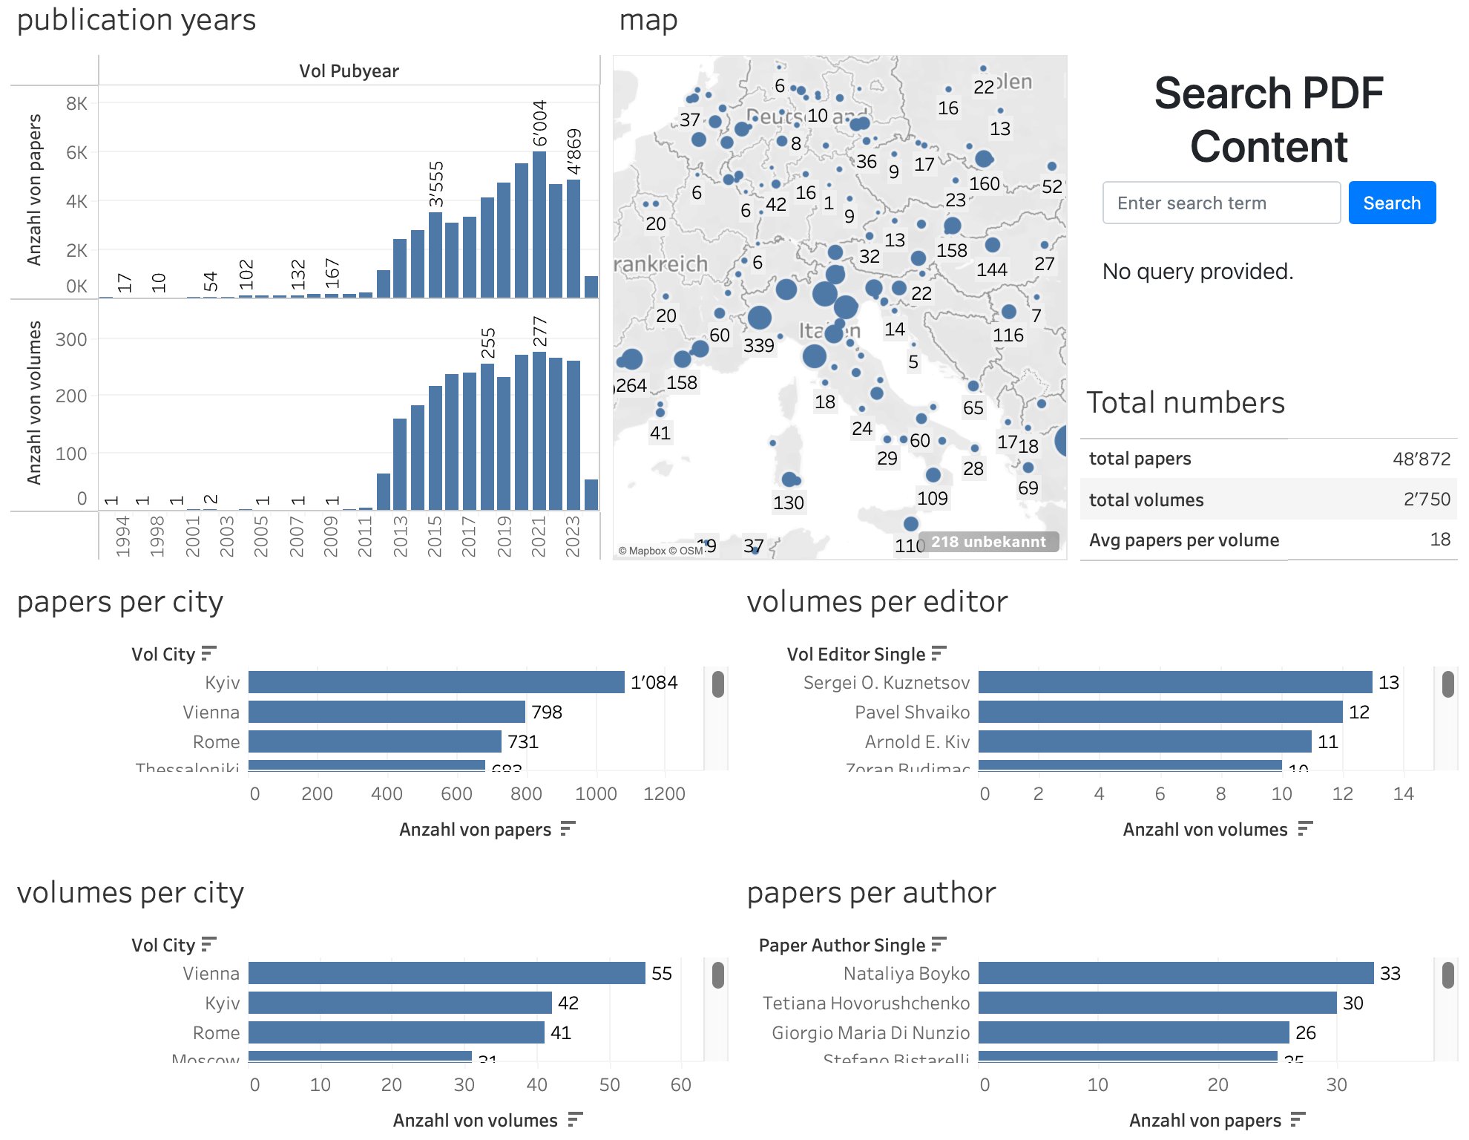
Pre-Build Tableau Dashboard

Slide 9
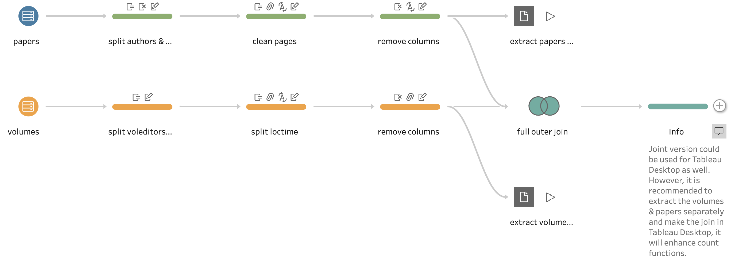
Tableau Prep Builder Schema

Slide 10
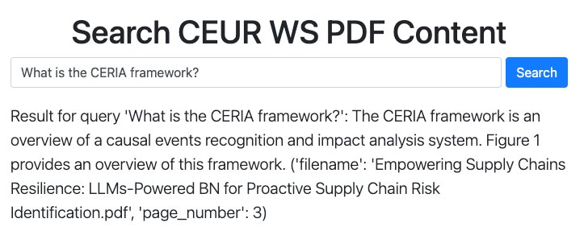
LLM Vector Search

Slide 11
Possible future improvements
Integrate LLM in Tableau with a sophisticated add-on (which can be used for searching and filtering functionalities)
Add automated data transformation pipeline (i.e. in Tableau Prep Builder schema)
Optimize web scraper
Refine system performance
Integrate data from more platforms
Explore advanced ML models
Notes:
For user usability, integrating the LLM functionality directly within Tableau for natural interpretation of results would enhance the overall user experience. Additionally, we developed a user-friendly LLM interface that can be embedded as an iframe within Tableau or used independently in a web browser. While this solution partially addresses the integration challenge, a more comprehensive integration with Tableau as an add-on would require a larger scope than initially planned for this project.
Future improvements could also focus on optimizing the web scraper for faster data extraction, enhancing system stability, and addressing any existing bugs. Integrating data from additional research platforms would further enrich the analysis capabilities. Moreover, exploring advanced analytical tools such as machine learning models could offer deeper insights into the data and enhance the overall functionality of the system.

