Slide 1
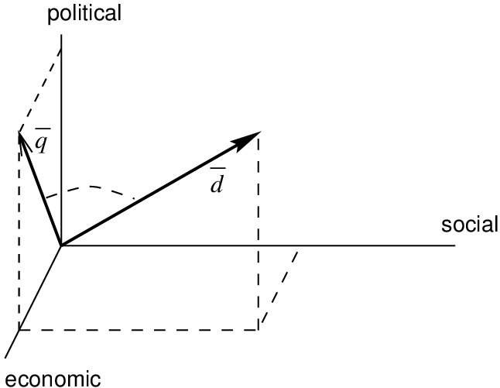
Similarity Between Documents
Cosine Similarity vs Soft Cosine Similarity
Bia Chaudhry
184055
NLP
Submitted to
Ma’am Seemab Latif

Slide 2

Project Outline
Document processing
TF-IDF
Similarity (Cosine & Soft Cosine)
Network Graph
Dendogram (Clusters)
Accuracy : Evaluation
Conclusion

Slide 3

Preparation of Documents
Extract the abstract of 3 COVID-19 papers
These papers are comparing Cardiac Disease with COVID-19
3 Wikipedia articles related to movie characters i.e. Harry Potter, Tom Cruise, and Spider Man
2 Sports related Wikipedia article pieces i.e. Cricket and Hockey.
Lemmatization of Documents to create Vocabulary

Slide 4
TF-IDF Score
Term means Word or the tokenized small thing
Document means Sentence or The large thing
TF = Term Frequency
IDF = Inverse Document Frequency
Mathematically:
TF = How Frequently the term occurs in the document = LOG (Count( Term in a document) + 1)
IDF = LOG( Total # of Doc / # of Doc with that Term in it)
TF-IDF = TF*IDF

Slide 5
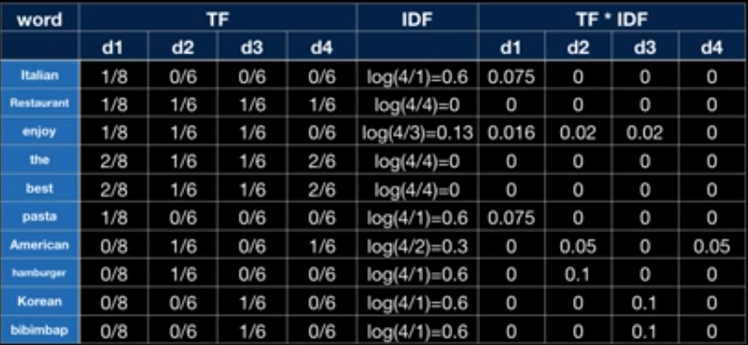
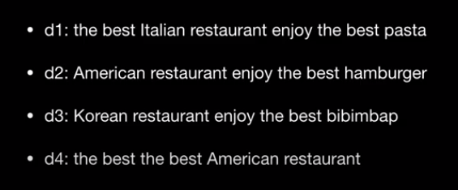

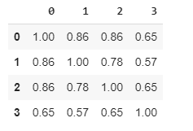


TF-IDF Explanation
Documents
*
Similarity Matrix
SQRT(( )²) * SQRT(( )²)

Slide 6
Limitations of TF-IDF Cosine Similarity
Semantics are ignored
Synonyms could be treated differently
Could be improved by
Soft Cosine Similarity

Slide 7
Soft Cosine Similarity
Considers the meaning (semantics) along with the syntax
For Example, ‘President’ vs ‘Prime minister’, ‘Food’ vs ‘Dish’, ‘Hi’ vs ‘Hello’ should be considered similar

Slide 8
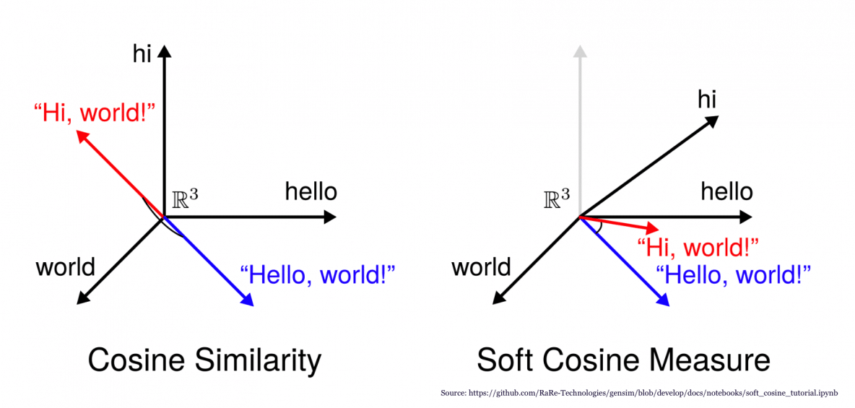
Cosine Similarity vs Soft Cosine Similarity

Slide 9
How it works
FastText word embeddings
Word vectors
Dictionary (a map of word to unique id)
Corpus containing documents
Similarity Matrix using FastText Embeddings
Soft Cosine Similarity by Comparing it with Similarity Matrix

Slide 10
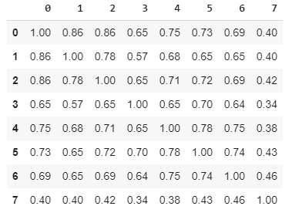
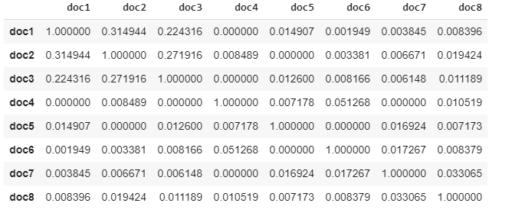
Similarities
Cosine Similarity
Soft Cosine Similarity

Slide 11
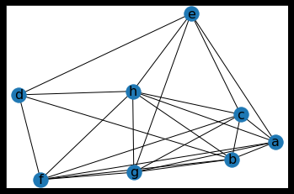
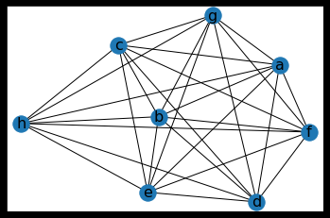
Network Graphs
Cosine Similarity
Soft Cosine Similarity

Slide 12
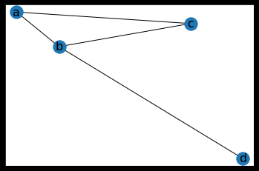
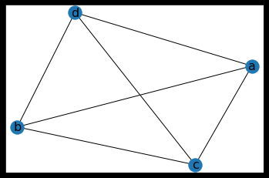
Network Graphs
Cosine Similarity
Soft Cosine Similarity

Slide 13


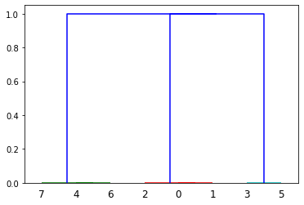
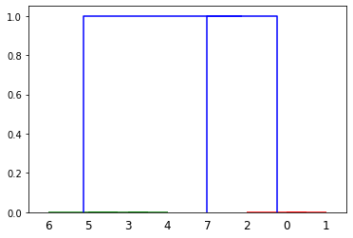
Dendogram (Clusters)
Cosine Similarity
Soft Cosine Similarity
Clusters
Dendogram
Clusters
Dendogram
Notes:
An agglomerative algorithm is a type of hierarchical clustering algorithm where each individual element to be clustered is in its own cluster. These clusters are merged iteratively until all the elements belong to one cluster. It assumes that a set of elements and the distances between them are given as input.

Slide 14
Evaluation: Accuracy Scores
Cosine Similarity
Soft Cosine Similarity
Actual: 1,1,1, 2, 2, 2, 0 , 0
Predicted: 1,1,1, 2,0,2, 0, 0
Accuracy = True values/Total Values * 100
= 7/8 * 100 = 87.5%
Actual: 2,2,2,0,0,0,1,1
Predicted: 2,2,2,0,0,0,0,1
Accuracy = 7/8 * 100 = 87.5%

Slide 15
Related Work : Looking Forward
Similarity scores could be used for clustering and ranking documents
Machine Translations could be improved using Similarity Scores
Readability of document could also be improved with Similarity measures

Slide 16
Conclusion
Similarity scores with embeddings could be used for semantic similarity between documents
For just term based similarity TF-IDF based cosine similarity is better

