Slide 2
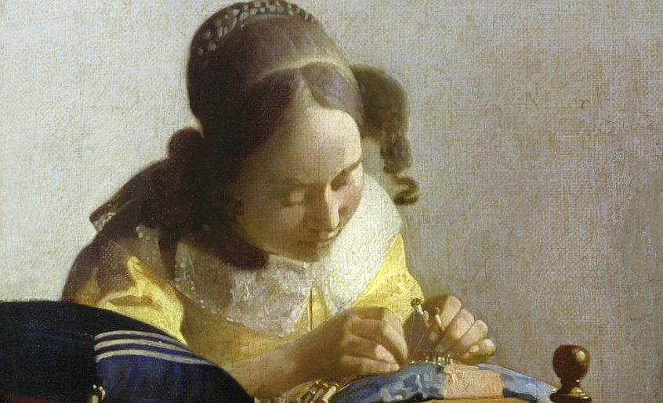

Slide 3

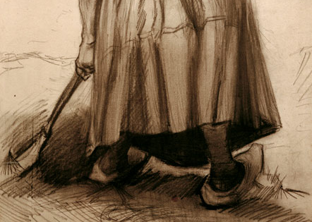
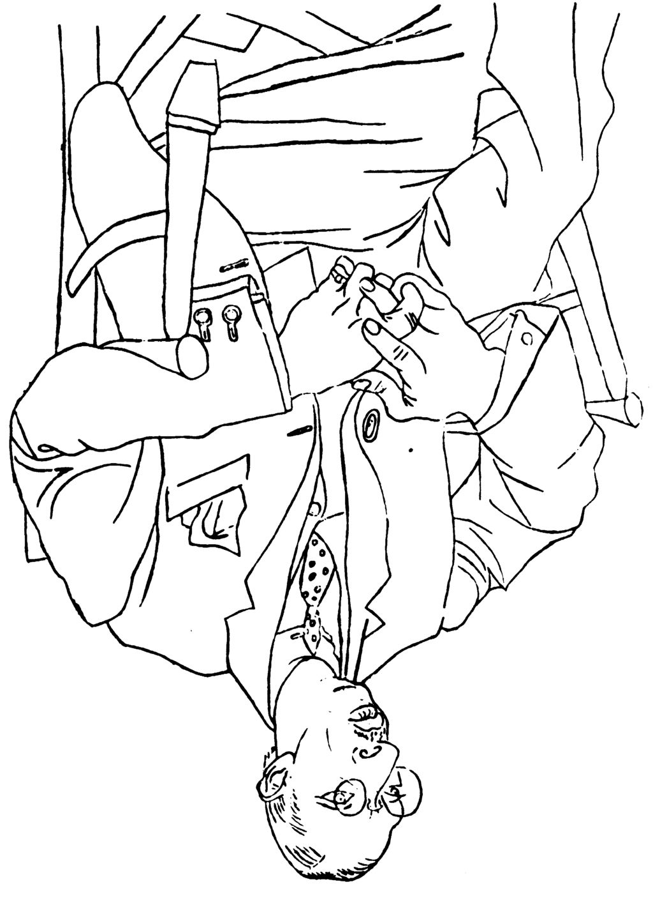
https://www.art-prints-on-demand.com/a/van-gogh-vincent/vvangoghpeasantwomandiggi.html
https://papodehomem.com.br/para-comecar-a-desenhar/

