Slide 1
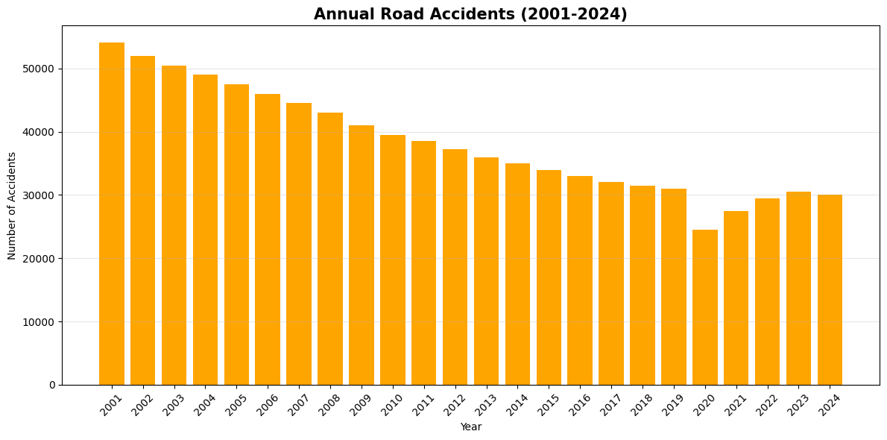
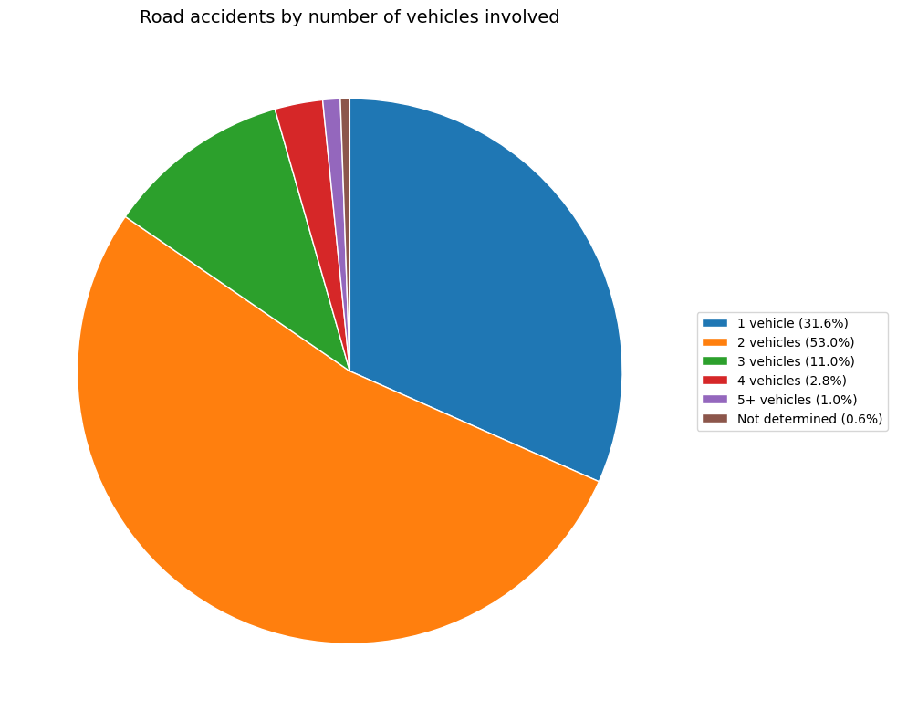
Road Safety in Milan
An analysis of road accidents with injuries, severity and territorial risk
Student name: Biagio Chiarandà
Student ID: 938221
Student e-mail address: b.chiaranda@campus.unimib.it
Milano Road Safety Dashboard • Data Visualization Project
Sources: Comune di Milano Open Data.

Slide 2
Research questions
How has road safety changed in Milan over time, and which indicators best describe this change?
Which recent changes emerge when comparing 2001 and 2024 in Milan city?
Do incidents, injured people and deaths move in the same direction, or do they tell different stories?
Which Milan municipalities show the highest road accident risk in 2024?
Which limitations should be considered when using police-recorded accident data?
Milano Road Safety • Data Visualization Project

Slide 3
About Data
Chosen datasets
Municipality of Milan Open Data: road accidents with injuries and injured people by month and number of vehicles involved (2001-2024).
Municipality of Milan Open Data: road accidents with injuries by month and municipality / former decentralization zone (2001-2024).
Municipality of Milan Open Data: resident population by citizenship and municipality (1999-2025), used for normalized indicators.
Quality and limitations
The data counts police-recorded road accidents with injuries. Accidents without deaths or injuries are excluded.
Deaths are counted when the injured person dies within 30 days from the accident.
Some territorial records can have missing municipality information.
Population normalization is useful, but residents do not measure daily traffic flows, commuting or tourism.
Milano Road Safety • Data Visualization Project

Slide 4
Methodology
Data collection: data sources were identified on the official Open Data portal of the Municipality of Milan. The datasets were available in machine-readable formats such as CSV/JSON and were downloaded from the portal.
Data processing: Python/pandas was used to download, clean and aggregate the datasets. The HTML dashboard performs client-side aggregation for interactive exploration.
Data cleaning: I checked column names, numeric formats, missing values, year/month consistency and municipality coding. Municipality numbers were matched with readable municipality names to improve interpretation.
Data transformation: monthly records were aggregated by year and month. Injured people were calculated as injured + deaths, while severity was calculated as injured people per incident.
Normalization: territorial analysis uses resident population to compute incidents per 10,000 residents when population data are available.
Analytical techniques: I used descriptive statistics, trend analysis, comparison between years, maximum-value detection and rates/ratios to identify the main patterns.
Visualization tools: Matplotlib was used to create static charts for the pitch; HTML/JavaScript/SVG was used for the interactive dashboard.
Reproducibility: all scripts, sources and dashboard are included in the final project folder, so the analysis can be replicated.
Milano Road Safety • Data Visualization Project

Slide 5
Insights from the Data
This project analyzes the evolution of road safety in Milan by combining accident volume, injured people and severity indicators. The analysis also considers the number of vehicles involved in each accident and the areas of the city where accidents are more concentrated.
The dashboard supports this analysis by allowing users to explore the data interactively through yearly trends, monthly patterns, vehicle-involvement categories and municipality-level rankings. Its goal is to provide a more complete view of road safety, showing not only whether accidents decreased over time, but also how severe they are, what types of accidents are more common, and which municipalities show higher road-safety risk.
Open the interactive dashboard
Milano Road Safety • Data Visualization Project

Slide 6
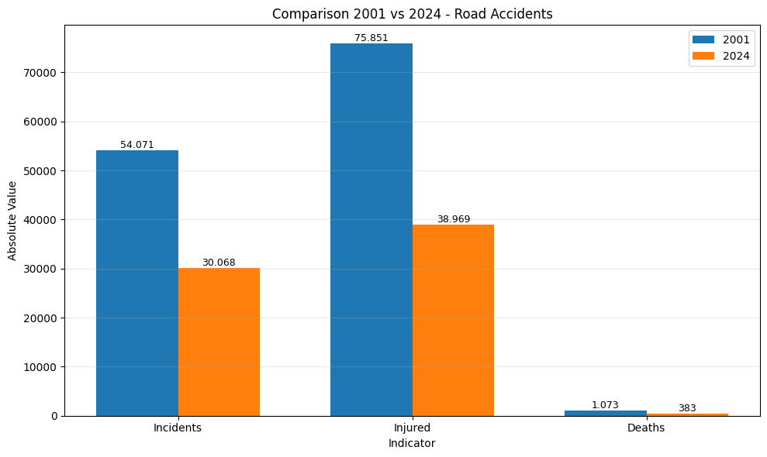
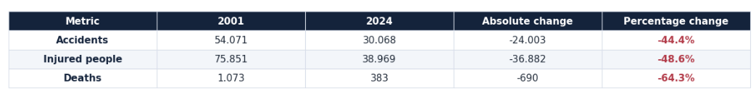
Which recent changes emerge when comparing 2001 and 2024 in Milan city?
changes emerge when comparing 2001 and 2024 in Milan city?
Between 2001 and 2024, road accidents decreased substantially.
Accidents fell by 44.4%, while injured people decreased by 48.6%.
The strongest improvement concerns fatal outcomes: deaths dropped by 64.3%.
This suggests that road safety improved not only in terms of accident frequency, but also in terms of accident severity.
Milano Road Safety • Data Visualization Project

Slide 7
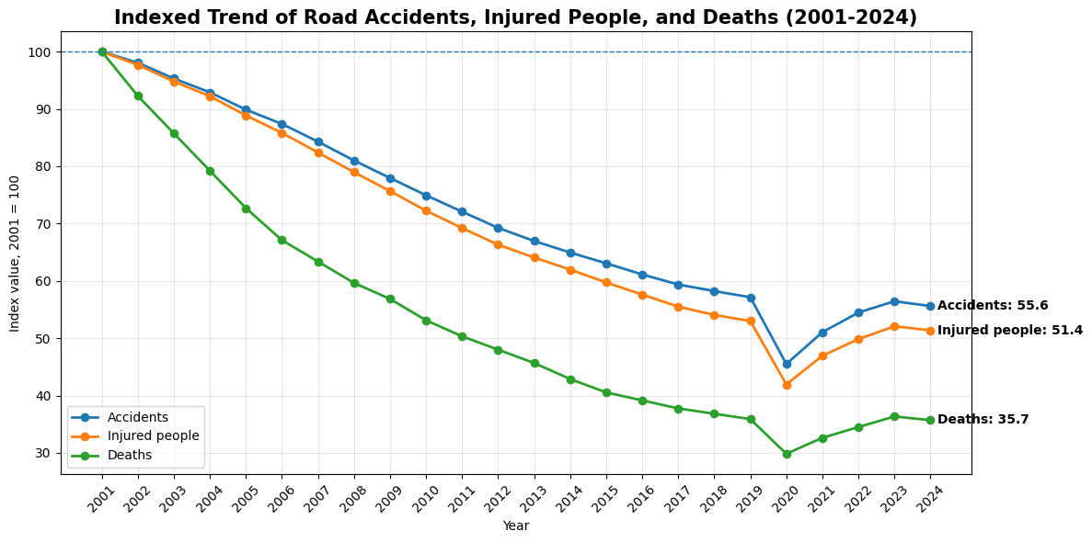
Do incidents, injured people and deaths move in the same direction, or do they tell different stories?
This chart shows that accidents, injured people and deaths follow the same general downward trend over time, but they do not decrease with the same intensity.
Accidents and injured people decline more gradually, while deaths fall much more sharply, suggesting that the strongest improvement concerns fatal outcomes.
A particularly sharp drop is visible around 2020, during the Covid-19 period: this should be interpreted carefully, because it was likely influenced by mobility restrictions and reduced traffic volumes rather than by a permanent structural improvement in road safety.
After 2020, the indicators partially rise again, showing that the issue remains relevant even after the long-term decline.
Milano Road Safety • Data Visualization Project

Slide 8
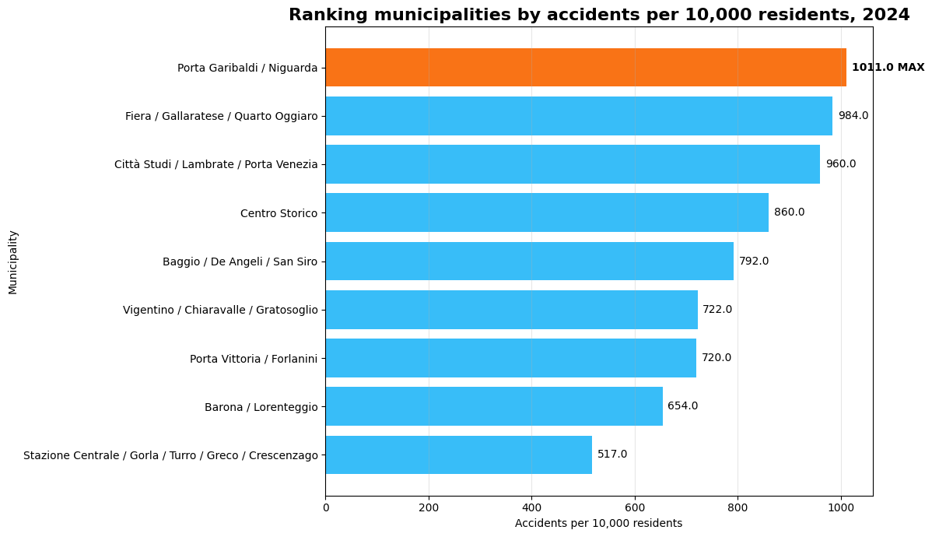
Which Milan municipalities show the highest road accident risk in 2024?
This chart shows the ranking of Milan municipalities by accidents per 10,000 residents in 2024.
The indicator is normalized, meaning that the number of accidents is divided by the resident population and then multiplied by 10,000. This makes municipalities more comparable, because areas with different population sizes can be evaluated on the same scale.
The highest normalized value is recorded by Municipio 9 - Porta Garibaldi / Niguarda, suggesting that this area has the highest accident burden relative to its resident population.
However, the result should be interpreted carefully, because resident population does not fully capture daily mobility flows, commuters, tourists or people who cross the area without living there.
Milano Road Safety • Data Visualization Project

Slide 9
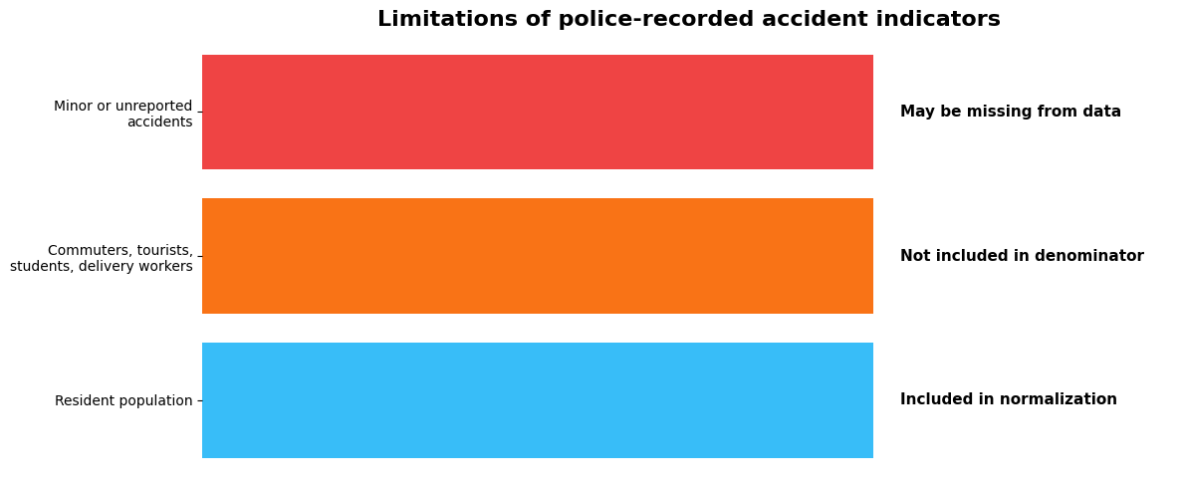
Which limitations should be considered when using police-recorded accident data?
This visual explains the main limitation of the normalized indicator. Accidents per 10,000 residents use resident population as the denominator, but resident population does not fully represent real road exposure. Commuters, tourists, students and delivery workers may use the road network every day without being counted as residents. Moreover, police-recorded data may exclude minor or unreported accidents. Therefore, the indicator is useful for comparison, but it should not be interpreted as a complete measure of road-safety risk.
Milano Road Safety • Data Visualization Project

Slide 10
LICENCE
Slides are shared with the following license:
Road Safety in Milan: analysis of road accidents with injuries, severity and territorial risk by Biagio Chiarandà is licensed under Creative Commons Attribution-ShareAlike 4.0 International https://creativecommons.org/licenses/by/4.0/
Data source:
- Municipality of Milan Open Data: road accidents with injuries, 2001-2024.
- Municipality of Milan Open Data: resident population by municipality, 1999-2025.
- Municipality of Milan Open Data: resident population by citizenship and municipality (1999-2025).
Interactive Dashboard
The dashboard was developed as a standalone HTML/CSS/JavaScript file and tested locally in the browser. It was then uploaded to GitHub and published online through GitHub Pages, so it can be accessed through a public link.
Open the interactive dashboard
Milano Road Safety • Data Visualization Project

