Slide 1
Web Patronus Chrome Extension + Cybersecurity Quiz Game

Slide 2
Agenda
The Problem
Web Patronus Solution
Technical Implementation
Setup
Vision

Slide 3
The Problem
73% of users clicked malicious links this year
220% increase in phishing attacks
Users lack cybersecurity knowledge
"People need protection AND education to stay safe online"
"People need protection AND education to stay safe online"

Slide 4
Web Patronus Solution
🛡️
Real-time Protection
Scans every link instantly
🎮️
Gamified Learning
Level up security knowledge
How it works:
1.Scan page links → 2. Show security warning → 3. Offer quiz question → 4. User levels up!

Slide 5
Technical Implementation
Multi-Layer Security Analysis:
Google Safe Browsing API - Real-time threat data
VirusTotal API - 70+ antivirus engines
Custom Heuristics - Pattern recognition

Slide 6
Setup
Open Chrome → Go to chrome://extensions/
Turn on "Developer mode" (top-right toggle)
Click "Load unpacked"
Select our /src folder
✅ Extension installed!
Test It:
Browse any website → automatic scanning
Click extension icon → view results dashboard
Take security quiz → earn XP and level up!

Slide 7
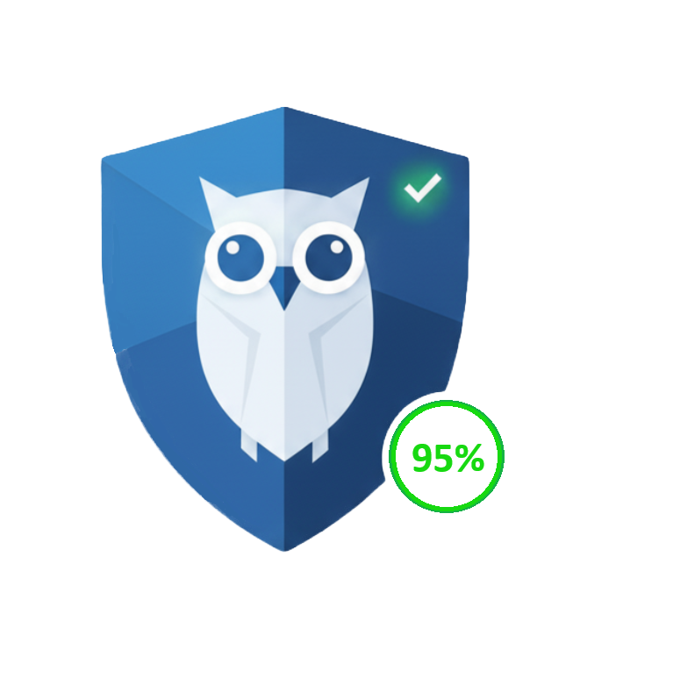
Vision
AI-Driven Threat Detection – Leverage machine learning to identify emerging threats.
Comprehensive Digital Safety Hub – Evolve from link scanning into a full suite that checks emails, cookies, trackers, and downloads for potential risks.
Gamified Cybersecurity Education – Turn online safety into a skill-building journey, rewarding users with levels, badges, and challenges as they learn.
Real-Time, Cross-Platform Protection – Extend Web Patronus beyond Chrome to other browsers and devices for seamless, consistent security.
Community Intelligence & Reporting – Empower users to flag suspicious links, share feedback, and strengthen a collective threat-awareness network.

Slide 8
Thank you
Web Patronus
🛡️ Secure • 📚 Educational • 🎮 Engaging Ready to protect the web, one click at a time!

