Slide 1
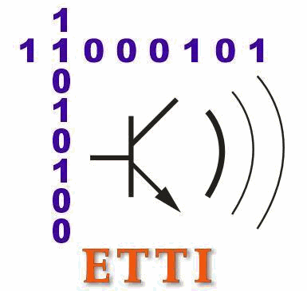

UNIVERSITY “POLITEHNICA” OF BUCHAREST
Faculty of Electronics, Telecommunications and Information Technology
Master Advanced Computing in Embedded Systems
Developing the drive system of a syringe infusion pump for drug
delivery and blood sampling
Student: Palade Bianca
Bucharest
January 2020

Slide 2


UNIVERSITY “POLITEHNICA” OF BUCHAREST
Faculty of Electronics, Telecommunications and Information Technology
Master Advanced Computing in Embedded Systems
Contents
v
Motivation
1
2
State-of-the-Art
3
Hardware Description
Software Description
Conclusions
Bucharest
January 2020

Slide 3
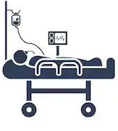



UNIVERSITY “POLITEHNICA” OF BUCHAREST
Faculty of Electronics, Telecommunications and Information Technology
Master Advanced Computing in Embedded Systems
1. Motivation
1
2
3
[1]A.Andrew Silva and et al., "Advanced Control System for Syringe and Infusion Pump Using IoT," International Journal of Innovative Research in Advanced Engineering , vol. VI, no. 3, pp. 221 - 224, 2019.

Slide 4
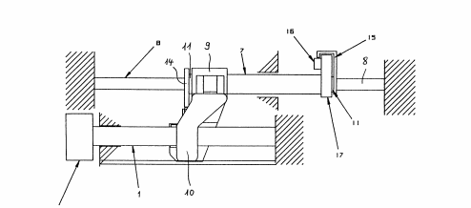
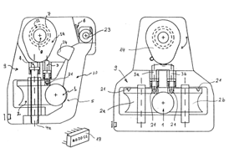
UNIVERSITY “POLITEHNICA” OF BUCHAREST
Faculty of Electronics, Telecommunications and Information Technology
Master Advanced Computing in Embedded Systems
2. State-of-the-Art
Figure II.1. – Kinematic diagram of a syringe pump [2]
Figure II.2. – Lateral view of syringe pump [2]
[2] J.M. Schwartz et al., "Syringe Pump". United States of America Patent 3,554,673, 12 January 1971.

Slide 5
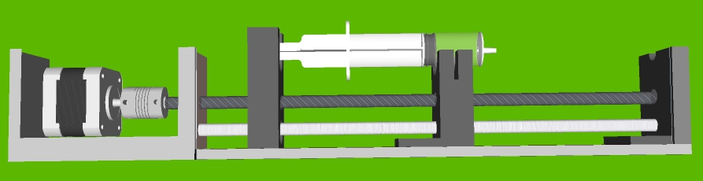
UNIVERSITY “POLITEHNICA” OF BUCHAREST
Faculty of Electronics, Telecommunications and Information Technology
Master Advanced Computing in Embedded Systems
3. Hardware Description
Figure III.1. – Mechanism
Bucharest
January 2020

Slide 6
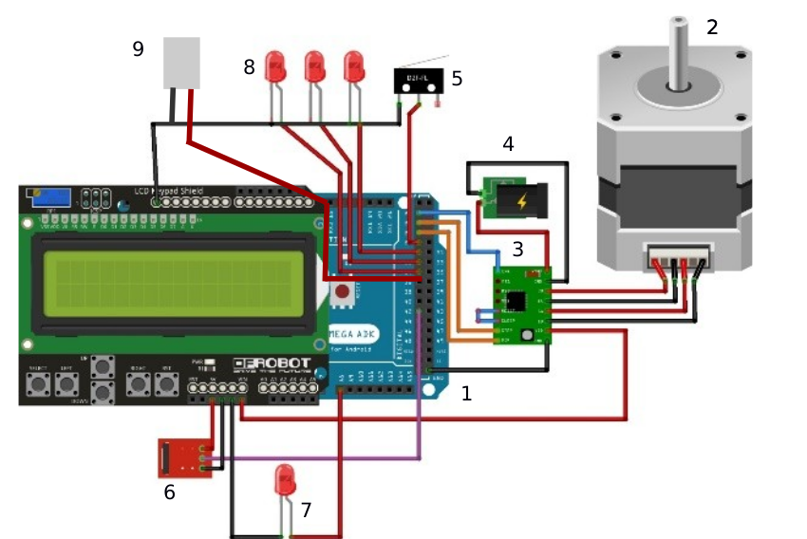
UNIVERSITY “POLITEHNICA” OF BUCHAREST
Faculty of Electronics, Telecommunications and Information Technology
Master Advanced Computing in Embedded Systems
3. Hardware Description
Figure III.2. Arduino Mega AT 2560(2) Bipolar stepper motor 42shdc4043z-22b, (3) Bipolar Driver Stepper Motor A4988, (4) Adapter 12V, 1A, (5) Limit Switch (6) IR Sensor, (7-8) LEDs, (9) Mini PTC Heating Element
Bucharest
January 2020

Slide 7
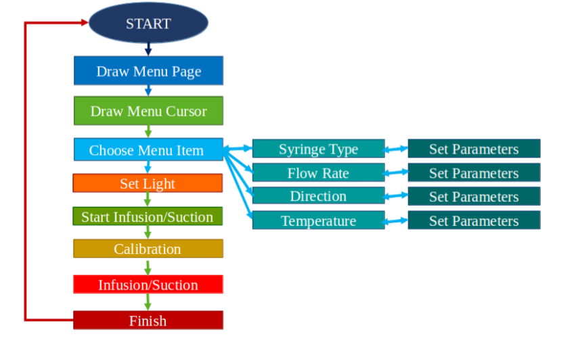
UNIVERSITY “POLITEHNICA” OF BUCHAREST
Faculty of Electronics, Telecommunications and Information Technology
Master Advanced Computing in Embedded Systems
4. Software Description
Bucharest
January 2020

Slide 8
UNIVERSITY “POLITEHNICA” OF BUCHAREST
Faculty of Electronics, Telecommunications and Information Technology
Master Advanced Computing in Embedded Systems
5. Conclusions
The developed system could be used as an infusion pump or suction pump. The device allows
the setting of the basic parameters of the syringe pump.
During the experiments, it was found that the function of the stepper motor produces too much
vibration in the infused or aspirated liquid so that the biological samples such as blood or lymph can
not be taken. The stepper motor cannot perform small enough steps so that the piston speed to be
approximately constant at very low speeds, therefore it is necessary to add a 1: 1000 gearbox. Also,
due to vibration, it could not be implemented an alert system for occlusion or bubbles detection.
Bucharest
January 2020

Slide 9
Universitatea „Politehnica” București
Facultatea de Electronica Telecomunicații și Tehnologia Informatiei
Master Advanced Computing in Embedded Systems
Thank you for your atention!
Bucharest
January 2020

