Slide 1
Building (a part of) Watson

Slide 2
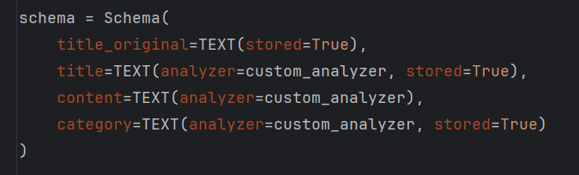


Indexing and retrieval
RegexTokenizer
LowercaseFilter
SynonymFilter
Lemmatizer
StopFilter with a Custom Stop Words Lis

Slide 3
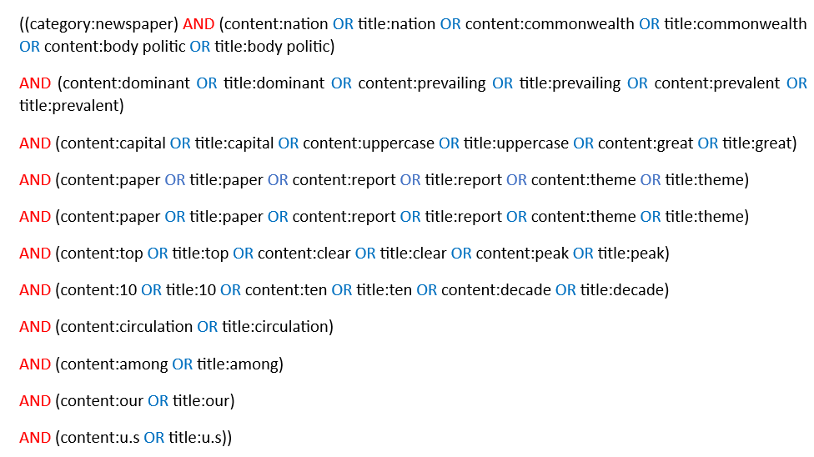
Building the search query

Slide 4
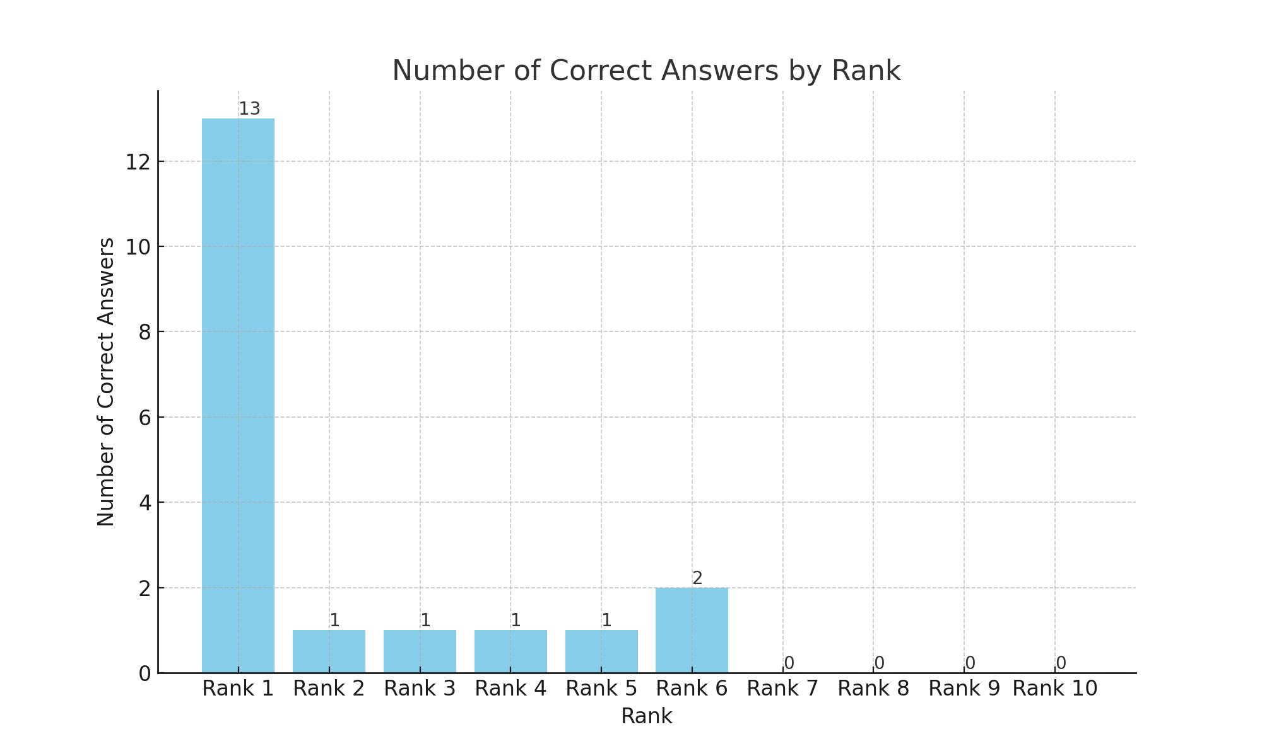
Measuring performance
Precision at 1 (P@1) = 0.13
Mean Reciprocal Rank = 0.146

Slide 5
Error Analysis
Performance Summary:
Correct Answers: 19
Success Factors for Correct Answers:
Direct Matching: Keywords/synonyms match directly with Wikipedia titles/content.
Distinctiveness of Keywords: Unique keywords reduce ambiguity in queries.
Observed Error Categories:
Broad or Ambiguous Queries: Categories/clues too wide-ranging or vague.
Specificity and Uniqueness: Lack of distinctive keywords leads to missed matches.
Inadequate Contextual Understanding: System fails with synonyms and semantic variations.

Slide 6

Improving retrieval
Overview of Improvement:
Integrated ChatGPT into our existing Information Retrieval (IR) system.
Objective: rerank and refine Wikipedia page titles for improved accuracy.
Implementation Details:
Input: structured file with questions and top 10 Wikipedia titles (from existing IR or generated afresh).
ChatGPT Integration:
Uses GPT-3.5-turbo via API.
Constructs prompts with questions and existing titles.
Extracts and reranks titles from ChatGPT's responses.
Performance Metrics:
Top 10 Answers Coverage: Increased to 45 correct answers.
Precision at 1 (P@1): Improved to 0.19.
Mean Reciprocal Rank (MRR): Rose to approximately 0.267.
Comparative Analysis:
Significantly higher Top 10 Coverage.
Increased P@1 indicating first results are more often correct.
Improved MRR suggesting correct answers appear higher in the list.

